Slide 1
daily count
The following slides are intended to support collaborative or group counting
Teachers should adapt to suit the needs of their learners, including further examples or different images
Teachers may wish to record a voice-over so that pupils can hear the sound of each number
1 | 2 | 3 | 4 | 5 | 6 | 7 | 8 | 9 | 10
1 | 2 | 3 | 4 | 5 | 6 | 7 | 8 | 9 | 10 | 11 | 12 | 13 | 14 | 15 | 16 | 17 | 18 | 19 | 20
0 5 10 15 20 25 30 35 40 45 50 55 60 65 70 75 80 85 90 95 100

Slide 2
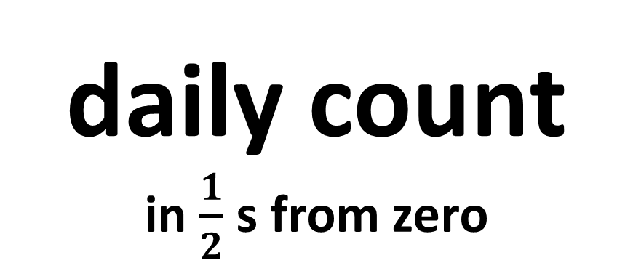
daily count
in $\frac{1}{2}$ s from zero
0 $\frac{1}{2}$ $\frac{2}{2}$ $\frac{3}{2}$ $\frac{4}{2}$ $\frac{5}{2}$ $\frac{6}{2}$

Slide 3
zero
0 $\frac{1}{2}$ $\frac{2}{2}$ $\frac{3}{2}$ $\frac{4}{2}$ $\frac{5}{2}$ $\frac{6}{2}$

Slide 4
one half
0 $\frac{1}{2}$ $\frac{2}{2}$ $\frac{3}{2}$ $\frac{4}{2}$ $\frac{5}{2}$ $\frac{6}{2}$

Slide 5
two halves
0
1
0 $\frac{1}{2}$ $\frac{2}{2}$ $\frac{3}{2}$ $\frac{4}{2}$ $\frac{5}{2}$ $\frac{6}{2}$

Slide 6
three halves
0
1
0 $\frac{1}{2}$ $\frac{2}{2}$ $\frac{3}{2}$ $\frac{4}{2}$ $\frac{5}{2}$ $\frac{6}{2}$

Slide 7
four halves
0
1
2
0 $\frac{1}{2}$ $\frac{2}{2}$ $\frac{3}{2}$ $\frac{4}{2}$ $\frac{5}{2}$ $\frac{6}{2}$

Slide 8
five halves
0
1
2
0 $\frac{1}{2}$ $\frac{2}{2}$ $\frac{3}{2}$ $\frac{4}{2}$ $\frac{5}{2}$ $\frac{6}{2}$

Slide 9
six halves
0
1
2
3
0 $\frac{1}{2}$ $\frac{2}{2}$ $\frac{3}{2}$ $\frac{4}{2}$ $\frac{5}{2}$ $\frac{6}{2}$

Slide 10
what is the next step of one half ?
0
1
2
3
0 $\frac{1}{2}$ $\frac{2}{2}$ $\frac{3}{2}$ $\frac{4}{2}$ $\frac{5}{2}$ $\frac{6}{2}$
Keep counting !

Slide 11
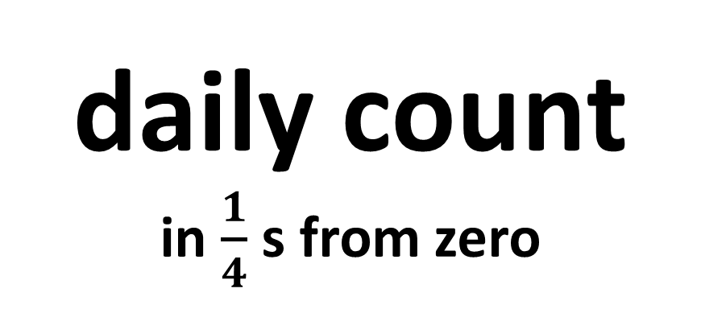
daily count
in $\frac{1}{4}$ s from zero
0 $\frac{1}{4}$ $\frac{2}{4}$ $\frac{3}{4}$ $\frac{4}{4}$ $\frac{5}{4}$ $\frac{6}{4}$ $\frac{7}{4}$ $\frac{8}{4}$ $\frac{9}{4}$ $\frac{10}{4}$ $\frac{11}{4}$ $\frac{12}{4}$

Slide 12
zero
0 $\frac{1}{4}$ $\frac{2}{4}$ $\frac{3}{4}$ $\frac{4}{4}$ $\frac{5}{4}$ $\frac{6}{4}$ $\frac{7}{4}$ $\frac{8}{4}$ $\frac{9}{4}$ $\frac{10}{4}$ $\frac{11}{4}$ $\frac{12}{4}$

Slide 13
one quarter
0 $\frac{1}{4}$ $\frac{2}{4}$ $\frac{3}{4}$ $\frac{4}{4}$ $\frac{5}{4}$ $\frac{6}{4}$ $\frac{7}{4}$ $\frac{8}{4}$ $\frac{9}{4}$ $\frac{10}{4}$ $\frac{11}{4}$ $\frac{12}{4}$

Slide 14
two quarters
0 $\frac{1}{4}$ $\frac{2}{4}$ $\frac{3}{4}$ $\frac{4}{4}$ $\frac{5}{4}$ $\frac{6}{4}$ $\frac{7}{4}$ $\frac{8}{4}$ $\frac{9}{4}$ $\frac{10}{4}$ $\frac{11}{4}$ $\frac{12}{4}$

Slide 15
three quarters
0 $\frac{1}{4}$ $\frac{2}{4}$ $\frac{3}{4}$ $\frac{4}{4}$ $\frac{5}{4}$ $\frac{6}{4}$ $\frac{7}{4}$ $\frac{8}{4}$ $\frac{9}{4}$ $\frac{10}{4}$ $\frac{11}{4}$ $\frac{12}{4}$

Slide 16
four quarters
0
1
0 $\frac{1}{4}$ $\frac{2}{4}$ $\frac{3}{4}$ $\frac{4}{4}$ $\frac{5}{4}$ $\frac{6}{4}$ $\frac{7}{4}$ $\frac{8}{4}$ $\frac{9}{4}$ $\frac{10}{4}$ $\frac{11}{4}$ $\frac{12}{4}$

Slide 17
five quarters
0
1
0 $\frac{1}{4}$ $\frac{2}{4}$ $\frac{3}{4}$ $\frac{4}{4}$ $\frac{5}{4}$ $\frac{6}{4}$ $\frac{7}{4}$ $\frac{8}{4}$ $\frac{9}{4}$ $\frac{10}{4}$ $\frac{11}{4}$ $\frac{12}{4}$

Slide 18
six quarters
0
1
0 $\frac{1}{4}$ $\frac{2}{4}$ $\frac{3}{4}$ $\frac{4}{4}$ $\frac{5}{4}$ $\frac{6}{4}$ $\frac{7}{4}$ $\frac{8}{4}$ $\frac{9}{4}$ $\frac{10}{4}$ $\frac{11}{4}$ $\frac{12}{4}$

Slide 19
seven quarters
0
1
0 $\frac{1}{4}$ $\frac{2}{4}$ $\frac{3}{4}$ $\frac{4}{4}$ $\frac{5}{4}$ $\frac{6}{4}$ $\frac{7}{4}$ $\frac{8}{4}$ $\frac{9}{4}$ $\frac{10}{4}$ $\frac{11}{4}$ $\frac{12}{4}$

Slide 20
eight quarters
0
1
2
0 $\frac{1}{4}$ $\frac{2}{4}$ $\frac{3}{4}$ $\frac{4}{4}$ $\frac{5}{4}$ $\frac{6}{4}$ $\frac{7}{4}$ $\frac{8}{4}$ $\frac{9}{4}$ $\frac{10}{4}$ $\frac{11}{4}$ $\frac{12}{4}$

Slide 21
nine quarters
0
1
2
0 $\frac{1}{4}$ $\frac{2}{4}$ $\frac{3}{4}$ $\frac{4}{4}$ $\frac{5}{4}$ $\frac{6}{4}$ $\frac{7}{4}$ $\frac{8}{4}$ $\frac{9}{4}$ $\frac{10}{4}$ $\frac{11}{4}$ $\frac{12}{4}$

Slide 22
ten quarters
0
1
2
0 $\frac{1}{4}$ $\frac{2}{4}$ $\frac{3}{4}$ $\frac{4}{4}$ $\frac{5}{4}$ $\frac{6}{4}$ $\frac{7}{4}$ $\frac{8}{4}$ $\frac{9}{4}$ $\frac{10}{4}$ $\frac{11}{4}$ $\frac{12}{4}$

Slide 23
eleven quarters
0
1
2
0 $\frac{1}{4}$ $\frac{2}{4}$ $\frac{3}{4}$ $\frac{4}{4}$ $\frac{5}{4}$ $\frac{6}{4}$ $\frac{7}{4}$ $\frac{8}{4}$ $\frac{9}{4}$ $\frac{10}{4}$ $\frac{11}{4}$ $\frac{12}{4}$

Slide 24
twelve quarters
0
1
2
3
0 $\frac{1}{4}$ $\frac{2}{4}$ $\frac{3}{4}$ $\frac{4}{4}$ $\frac{5}{4}$ $\frac{6}{4}$ $\frac{7}{4}$ $\frac{8}{4}$ $\frac{9}{4}$ $\frac{10}{4}$ $\frac{11}{4}$ $\frac{12}{4}$

Slide 25
What is the next step of one quarter ?
0
1
2
3
0 $\frac{1}{4}$ $\frac{2}{4}$ $\frac{3}{4}$ $\frac{4}{4}$ $\frac{5}{4}$ $\frac{6}{4}$ $\frac{7}{4}$ $\frac{8}{4}$ $\frac{9}{4}$ $\frac{10}{4}$ $\frac{11}{4}$ $\frac{12}{4}$
Keep counting !

