Slide 1
Year 8
HIAS Blended Learning Resource
Accuracy, powers and roots (unit 8.7)
Round numbers and measures to an appropriate degree of accuracy (decimal places and significant figures)
Use conventional notation for powers and roots
Introduce simple fractional powers, linking to roots and the laws of indices
HIAS maths Team
Spring 2021
Final version
© Hampshire County Council

Slide 2
HIAS Blended Learning Resource
These slides are intended to support teachers and students with a blended approach to learning, either in-class or online. The tasks are intended to form part of a learning journey and could be the basis of either one lesson or a short sequence of connected lessons.
Teachers should delete, change and add slides to suit the needs of their students. Extra slides with personalised prompts and appropriate examples based on previous teaching may be suitable. When changing the slide-deck, teachers should consider:
Their expectations for the use of representations such as bar models, number lines, arrays and geometric diagrams.
Which strategies and methods students should use and record when solving problems or identifying solutions. This could include a range of informal jottings and diagrams, the use of tables to record solutions systematically and formal or informal calculation methods.
Teachers may also wish to record a ‘voice over’ to talk students through the slides.

Slide 3
HIAS Blended Learning Resource
YEAR 8 : SPRING TERM OVERVIEW
Week | HIAS Unit | Topic
1 | Unit 8.6 | Geometry: Formulae for perimeters and areas
2 | Unit 8.7 | Accuracy, powers, and roots
3 | Unit 8.8 | Compound measures
4 | Unit 8.9 | Statistics: Graphs and charts
5 |  | Statistics: averages for numerical data
 | Half term
6 | Unit 8.10 | Number: Standard form (representing numbers)
 |  | Number: Standard form (simple calculations)
7 |  | Number: Standard form (simple calculations)
 |  | Number: Prime factorisations
8 |  | Number: Prime factorisations
9 | Unit 8.11 | Graphs: Linear and quadratic
10 |  | Graphs: Simultaneous equations

Slide 4
HIAS Blended Learning Resource
Show how you would evaluate each of the following and find the value.
For example:
3² = 3 x 3 = 9
a. 5³ b. 4⁴ c. 8² d. 6³
Notes:
5 x5x5=125
4x4x4x4=256
8x8=64
6x6x6=216

Slide 5
HIAS Blended Learning Resource
Put these values in order of size with the smallest first
5² 3² 3³ 2⁴
……… ……… ……… ………
smallest largest
Testbase question
Notes:
9, 16, 25, 27
3^{2,} 2^{4,} 5^{2,} 3³

Slide 6
HIAS Blended Learning Resource
Show how you would evaluate each of the following and find the value.
a. 6⁷ b. 4⁵ c. 2⁸ d. 9⁶
For 8⁶, record the keys, in order, that you would use to evaluate this expression on a calculator.
x^{n}
Notes:
1
6x6x6x6x6x6x6=279,936
4x4x4x4x4=1024
2x2x2x2x2x2x2x2=256
9x9x9x9x9x9=531,441
2. 8 x^{n} =

Slide 7
HIAS Blended Learning Resource
Show how you would evaluate each of the following and put your answer in index form
a. 6³ x 6² b. 2⁸ x 2³ c. 4⁵ ÷ 4² d. 9⁶ ÷ 9⁵
Simplify 8⁶ x 8³ x 8⁷ x 8¹
Notes:
1a. 6x6x6x6x6 = 6⁵
b. (2x2x2x2x2x2x2x2)x(2x2x2) = 2¹¹
c. (4x4x4x4x4) = 4³
(4x4)
d. 9x9x9x9x9x9 = 9¹
9x9x9x9x9
2. 8¹⁷

Slide 8
HIAS Blended Learning Resource
16 can be expressed as:
4² or 2⁴ or 16¹
Express 81 in as many different ways as you can using index form.
Notes:
81¹
9²
3⁴

Slide 9
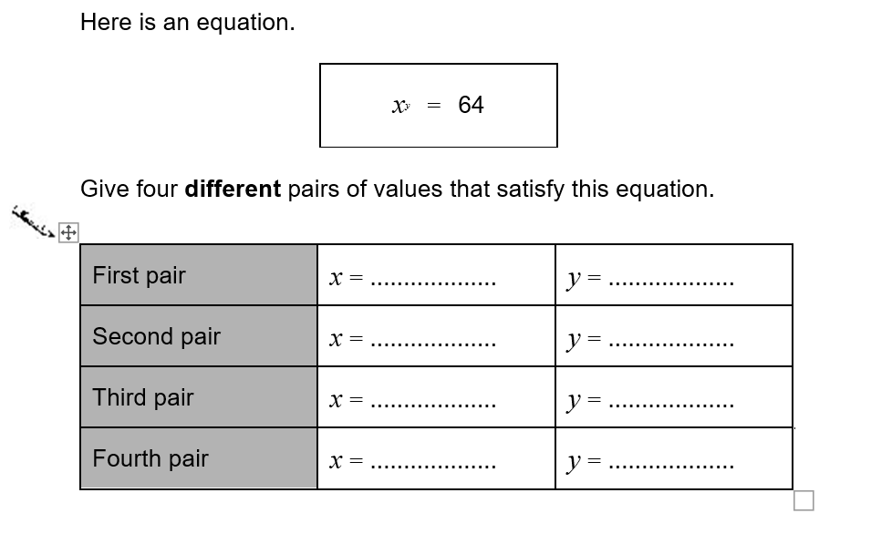
HIAS Blended Learning Resource
x^{y} = 64
Testbase question
Notes:
64¹
8²
4³
2⁶

Slide 10
HIAS Maths team
HIAS Blended Learning Resource
The HIAS maths team offer a wide range of high-quality services to support schools in improving outcomes for learners, including courses, bespoke consultancy and in-house training.
For further details, please contact any member of the secondary maths team:
Jo Lees: Jo.Lees@hants.gov.uk
Jenny Burn: Jenny.Burn@hants.gov.uk
Tessa Ingrey: Tessa.Ingrey@hants.gov.uk
For further details on the full range of services available please contact us using the following details:
Tel: 01962 874820 or email: hias.enquiries@hants.gov.uk
For further details on the full range of services available please contact us using the following details:
Tel: 01962 874820 or email: hias.enquiries@hants.gov.uk

