Slide 1
Year 7
HIAS Blended Learning Resource
Linear Functions (unit 7.10)
This unit is about coordinates in all four quadrants and linear functions
This set of problems is about the equation of a straight line
HIAS maths Team
Spring 2021
Final version
© Hampshire County Council

Slide 2
HIAS Blended Learning Resource
These slides are intended to support teachers and students with a blended approach to learning, either in-class or online. The tasks are intended to form part of a learning journey and could be the basis of either one lesson or a short sequence of connected lessons.
Teachers should delete, change and add slides to suit the needs of their students. Extra slides with personalised prompts and appropriate examples based on previous teaching may be suitable. When changing the slide-deck, teachers should consider:
Their expectations for the use of representations such as bar models, number lines, arrays and geometric diagrams.
Which strategies and methods students should use and record when solving problems or identifying solutions. This could include a range of informal jottings and diagrams, the use of tables to record solutions systematically and formal or informal calculation methods.
Teachers may also wish to record a ‘voice over’ to talk students through the slides.

Slide 3
HIAS Blended Learning Resource
YEAR 7: SPRING TERM OVERVIEW
Week | HIAS Unit | Topic
1 | Unit 7.6 | Four operations: Fractions (vulgar and decimal)
2 | Unit 7.7 | Probability: 0-1 scale
3 | Unit 7.8 | Geometry: Polygons
4 |  | Geometry: Area
5 |  | Geometry: Volume and 3-D shape
 | Half term
6 | Unit 7.9 | Percentages (of amounts)
7 |  | Percentages (FDP equivalence)
8 |  | Ratio and proportion: Notation and part: whole
9 | Unit 7.10 | Coordinates (four quadrants)
10 |  | Coordinates (linear functions )

Slide 4
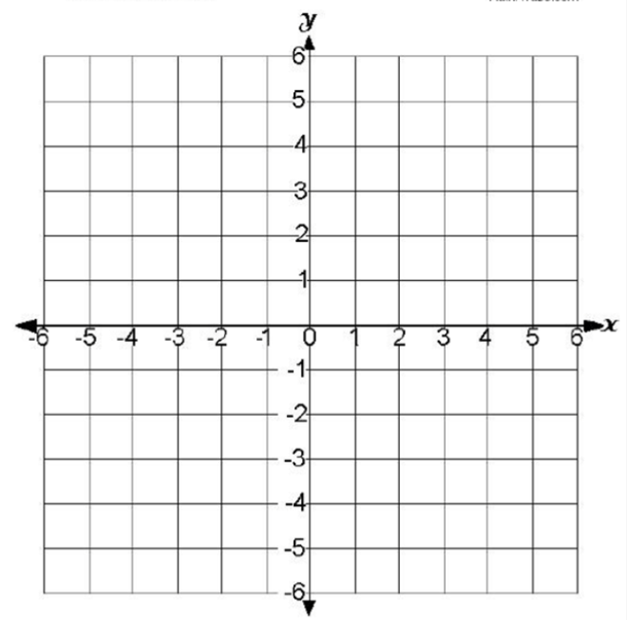
HIAS Blended Learning Resource
x = -1
x = ____
The four green lines enclose a square
The equations of two of the lines are:
x = -1
y = 3
What are the equations of the other two
green lines ?
y = 3
y = ____
Notes:
Solutions
x = 4 and y = 2

Slide 5
HIAS Blended Learning Resource
x = ___
x = ____
The four green lines enclose a rectangle
What are the equations of the four
green lines ?
y = ____
y = ____
Notes:
Solutions
x = -4 ; x = 5; y = 1 and y = -3

Slide 6
HIAS Blended Learning Resource
The four green lines enclose a rectangle
What are the equations of the four
green lines ?
Notes:
Solutions
x = 1; x = 3; y = 4 and y = -5

Slide 7
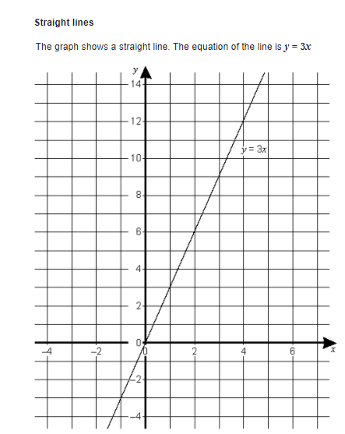
HIAS Blended Learning Resource
The equation of this line is y = 3x
Some points on this line are:
(1 , 3)
(4 ,12)
(-2 ,-6)
Does the point (25, 75) lie on the line y=3x?
Explain how you know
Adapted from ‘Test Base’
Notes:
Solutions
Yes, since 25 x 3 = 75
Every y-coordinate is three times the x-coordinate

Slide 8
HIAS Blended Learning Resource
y = 2x
The equation of this line is y = 2x
Write down three different points on this line.
Does the point (-5, 10) lie on the line y=2x?
Explain how you know
Does the point (-5 , -10) lie on the line y=2x?
Explain how you know
Notes:
Solutions
(0,0); (1, 2); (-3, -6)
(-5,10) is not on the line since the y-coordinate is not twice the x-coordinate (it is -2 times the x-coordinate)
(-5 ,-10) is on the line since the y-coordinate is twice the x-coordinate

Slide 9
HIAS Blended Learning Resource
Taken from ‘Test Base’
Notes:
Solutions
(50 , 146)
(18, 50)
(-10 , -34) is on the line since the y-coordinate is three times the x-coordinate subtract 4

Slide 10
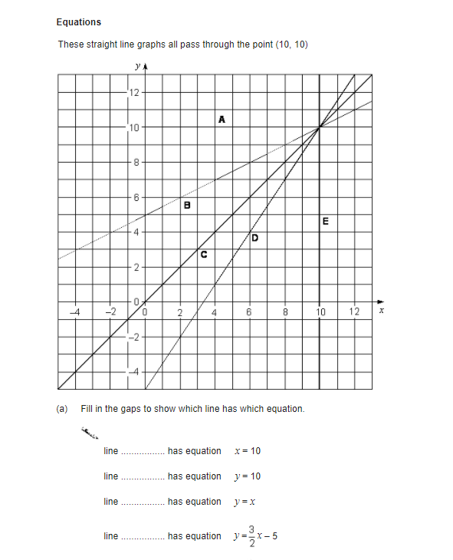
HIAS Blended Learning Resource
Which line has which equation?
Taken from ‘Test Base’
Notes:
Solutions
Line E is x = 10
Line A is y = 10
Line C is y = x
Line D is y = 3/2 x - 5

Slide 11
HIAS Blended Learning Resource
Taken from ‘Test Base’
Notes:
Solutions
Line through AB has equation x = 8
Line through FE has equation y = x + 7
Line through BC has equation y = x - 1

Slide 12
HIAS Maths team
HIAS Blended Learning Resource
The HIAS maths team offer a wide range of high-quality services to support schools in improving outcomes for learners, including courses, bespoke consultancy and in-house training.
For further details, please contact any member of the secondary maths team:
Jo Lees: Jo.Lees@hants.gov.uk
Jenny Burn: Jenny.Burn@hants.gov.uk
Tessa Ingrey: Tessa.Ingrey@hants.gov.uk
For further details on the full range of services available please contact us using the following details:
Tel: 01962 874820 or email: hias.enquiries@hants.gov.uk
For further details on the full range of services available please contact us using the following details:
Tel: 01962 874820 or email: hias.enquiries@hants.gov.uk

