Slide 1
Year 2
HIAS Blended Learning Resource
Multiplication and division
HIAS maths Team
Spring 2021
Final version
© Hampshire County Council

Slide 2
HIAS Blended Learning Resource
These slides are intended to support teachers and pupils with a blended approach to learning, either in-class or online. The tasks are intended to form part of a learning journey and could be the basis of either one lesson or a short sequence of connected lessons.
The 4-step Polya model for problem solving has been used to provide a structure to support reasoning. Teachers may need to use more or fewer steps to support the range of learners in their class.
Teachers should delete, change and add slides to suit the needs of their pupils. Extra slides with personalised prompts and appropriate examples based on previous teaching may be suitable. When changing the slide-deck, teachers should consider:
Their expectations for the use of representations such as bar models, number lines, arrays and diagrams.
Which strategies and methods pupils should use and record when solving problems or identifying solutions. This could include a range of informal jottings and diagrams, the use of tables to record solutions systematically and formal or informal calculation methods.
Teachers may also wish to record a ‘voice over’ to talk pupils through the slides.

Slide 3
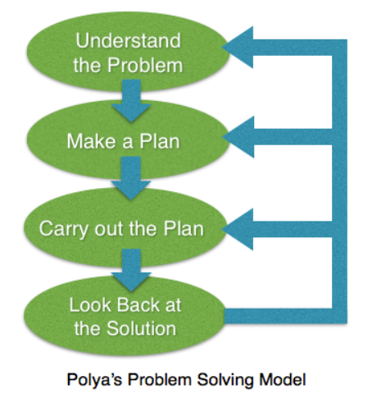
HIAS Blended Learning Resource
1945 George Polya published ‘How To Solve It’ 2nd ed., Princeton University Press, 1957, ISBN 0-691-08097-6.

Slide 4
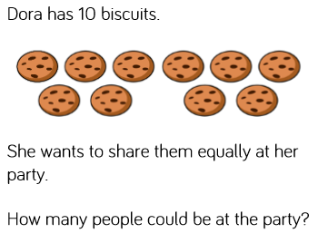
Maths focus: division (sharing)
HIAS Blended Learning Resource

Slide 5
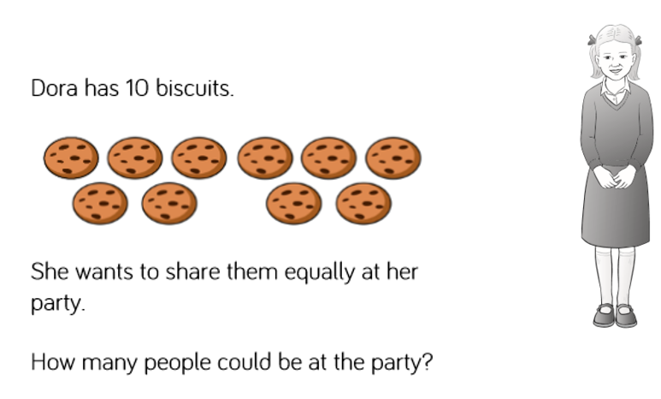
Understand the problem
HIAS Blended Learning Resource
Dora has 10 biscuits to share equally with her party guests.
We need to find out how many different ways we can share 10 biscuits equally.
Then we need to use that to find out how many people could have been at her party.

Slide 6
Make a Plan
HIAS Blended Learning Resource
Step 1: Find one way to share 10 biscuits equally. See if there are any other ways.
Step 2: Once we have found all of the ways, decide how many people could have been at her party. There will be more than one possible solution.

Slide 7
Carry out your plan: show your reasoning
HIAS Blended Learning Resource
Step 1:
10 biscuits could be put into 5 groups of 2
10 biscuits could be put into 2 groups of 5
10 biscuits could be put into 10 groups of 1
(They could also be put into 1 group of 10, but this would mean Dora had no guests at her party.)
Step 2: So there could have been 5 people at her party (Dora and 4 friends), 2 people (Dora and 1 friend), or 10 people (Dora and 9 friends)

Slide 8
10 divided into groups of 2 gives 5 groups
10 ÷ 2 = 5
10 divided into groups of 5 gives 2 groups
10 ÷ 5 = 2
10 divided into groups of 1 gives 10 groups
10 ÷ 1 = 10

Slide 9
Review your solution: does it seem reasonable? Which steps/ parts did you find easy and which harder?
HIAS Blended Learning Resource
How could you check?
Go through the steps you took and check for errors
Remember the question is about division – sharing 10 cookies equally in different ways.
Try to solve the calculation a different way and see if you get the same answer. Could you use a bar model to show how you have shared the biscuits?

Slide 10
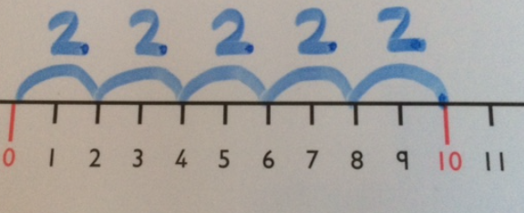
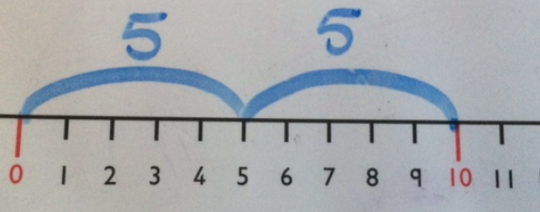
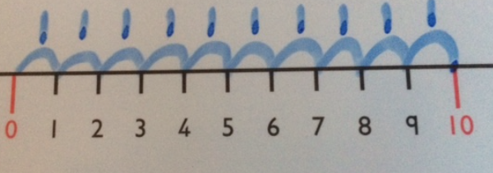
HIAS Blended Learning Resource
Checking with a number line:
10 ÷ 2 = 5
10 ÷ 5 = 2
10 ÷ 1 = 10

Slide 11
Now try this one
HIAS Blended Learning Resource
Understand the problem
Make a plan
Carry out your plan: show your reasoning
Review your solution: does it seem reasonable?
Think about your learning: which parts of the problem did you find easy and which parts did you find harder?
What if Dora had 12 biscuits to
share equally? How many
friends could she have had to
her party then?

Slide 12
HIAS Maths team
HIAS Blended Learning Resource
The HIAS maths team offer a wide range of high-quality services to support schools in improving outcomes for learners, including courses, bespoke consultancy and in-house training.
For further details referring to maths, please contact either of the team leads:
Jacqui Clifft : Jacqui.clifft@hants.gov.uk
Jo Lees: Jo.Lees@hants.gov.uk
For further details on the full range of services available please contact us using the following details:
Tel: 01962 874820 or email: hias.enquiries@hants.gov.uk
For further details on the full range of services available please contact us using the following details:
Tel: 01962 874820 or email: hias.enquiries@hants.gov.uk

