Slide 1
Year 2
HIAS Blended Learning Resource
Multiplication / Division
HIAS maths Team
Spring 2021
Final version
© Hampshire County Council

Slide 2
HIAS Blended Learning Resource
These slides are intended to support teachers and pupils with a blended approach to learning, either in-class or online. The tasks are intended to form part of a learning journey and could be the basis of either one lesson or a short sequence of connected lessons.
The 4-step Polya model for problem solving has been used to provide a structure to support reasoning. Teachers may need to use more or fewer steps to support the range of learners in their class.
Teachers should delete, change and add slides to suit the needs of their pupils. Extra slides with personalised prompts and appropriate examples based on previous teaching may be suitable. When changing the slide-deck, teachers should consider:
Their expectations for the use of representations such as bar models, number lines, arrays and diagrams.
Which strategies and methods pupils should use and record when solving problems or identifying solutions. This could include a range of informal jottings and diagrams, the use of tables to record solutions systematically and formal or informal calculation methods.
Teachers may also wish to record a ‘voice over’ to talk pupils through the slides.

Slide 3
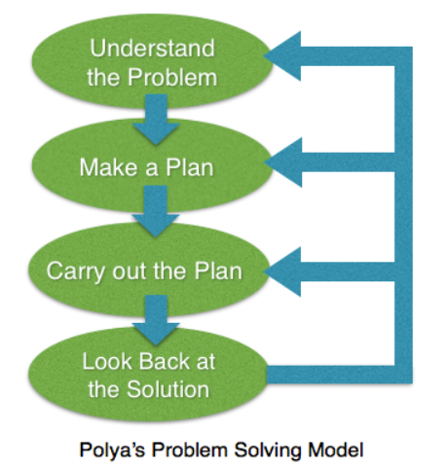
HIAS Blended Learning Resource
1945 George Polya published ‘How To Solve It’ 2nd ed., Princeton University Press, 1957, ISBN 0-691-08097-6.

Slide 4
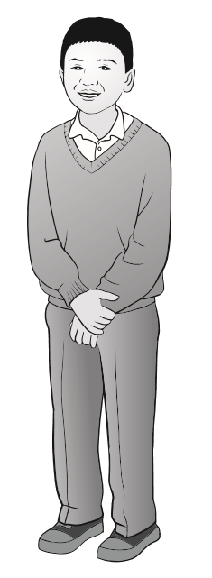
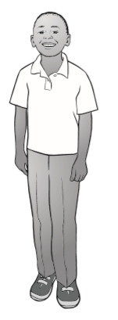
Solve problems involving multiplication and division
HIAS Blended Learning Resource

Slide 5
Understand the problem
HIAS Blended Learning Resource
This problem is a 2 step problem.
First we have to work out how many marbles would be in four boxes altogether if there are 5 in each box. This will tell us how many marbles Jonathan has.
Then, we need to work out how many marbles Richard has if he has 10 fewer than Jonathan.

Slide 6
Make a Plan
HIAS Blended Learning Resource
Step 1: First we need to find out how many marbles Jonathan has.
Step 2: Then, we need to find out how many marbles Richard has by taking ten away from the number Jonathan has.
Step 3: The answer to the question will be the number of marbles Richard has.

Slide 7
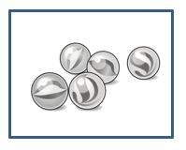
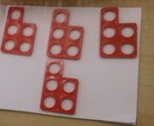
Representations to help solve the
problem
5
5
5
5
Step 1: 5 x 4 =
Step 2: – 10 =
Step 3: Richard had marbles.
Jonathan’s marbles
Richards marbles
-10 marbles

Slide 8
Carry out your plan: show your reasoning
HIAS Blended Learning Resource
Step 1: 5 x 4 = 20 (5 + 5 + 5 + 5)
Step 2: 20 – 10 = 10
Step 3: Richard had 10 marbles.

Slide 9
Review your solution: does it seem reasonable? Which steps/ parts did you find easy and which harder?
HIAS Blended Learning Resource
How could you check?
Go through the steps you took and check for errors
Remember the question is about multiplication (5 x 4) and subtraction (20 – 10)
Try to solve the calculation a different way and see if you get the same answer. Could you check using a number line?

Slide 10
HIAS Blended Learning Resource
Checking with a number line:
5 x 4 = 20
20 - 10 = 10

Slide 11
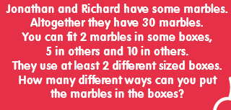
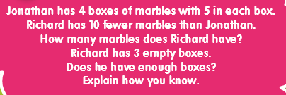
Now try these:
HIAS Blended Learning Resource
Understand the problem
Make a plan
Carry out your plan: show your reasoning
Review your solution: does it seem reasonable?
Think about your learning: which parts of the problem did you find easy and which parts did you find harder?

Slide 12
HIAS Maths team
HIAS Blended Learning Resource
The HIAS maths team offer a wide range of high-quality services to support schools in improving outcomes for learners, including courses, bespoke consultancy and in-house training.
For further details referring to maths, please contact either of the team leads:
Jacqui Clifft : Jacqui.clifft@hants.gov.uk
Jo Lees: Jo.Lees@hants.gov.uk
For further details on the full range of services available please contact us using the following details:
Tel: 01962 874820 or email: hias.enquiries@hants.gov.uk

