Slide 1
Recovery Curriculum Planning Mathematics
Post COVID-19 Lockdown
jacqui.clifft@hants.gov.uk

Slide 2
Recovery Curriculum Planning Summer Term
It is vital that all schools look to develop sequences of learning that:
revisit prior learning across all the domains
challenge and support pupils to remember key ideas and facts
challenge pupils to reason and solve problems
regain the levels of fluency and accuracy previously attained.

Slide 3
Remember the basics…
Reasoning and problem solving
Counting and place value
Four operations (mental and formal)
Key number facts
Key facts about measures

Slide 4
‘Home Learning’ resources Year 1- Year 6
Each year group:
Home learning schedule, including all domains, for whole summer term
Linked example ‘problem of the week’
Each ‘Problem of the week’:
Written with simple explanation of the task for pupil independence, parental support
Worked example for the solution
Variations of the task for further practise
Solutions
References to online resource if used
https://maths.hias.hants.gov.uk/course/index.php?categoryid=135

Slide 5
‘Transition Plans’ from summer 2
Transition Plans start from summer 2 through to the end of the following autumn term.
Year 1 to Year 6
Eg Year 1 summer term to end of the autumn term in Year 2
Link to Hampshire Primary scheme of learning Unit Plans
First 7 weeks secures end of one year eg end of Year 1 before beginning to work in the following year’s curriculum eg Year 2
Can be used with any other resource eg White Rose
Support for changes of teacher summer/ autumn term giving one plan to follow

Slide 6
Revised 2020 Planning Overview: Summer 2 to end of Autumn
‘Transition’ Plans
21 weeks
Autumn term ‘Catch Up’ plans
14 weeks
Notes:
Y3 and Y4 start with multiplication and division so that tables can be re started through CPA and then kept on the go during the half term…

Slide 7
Why Year 6?
They are in a unique position – all pupils will be moving to a new school and working within a new curriculum
For many pupils this imminent transition will be a source of anxiety
They will be acutely aware that they have not completed their Primary curriculum
We have an opportunity to work with Year 6 and develop a sense of growth and confidence in their ‘readiness’…
Notes:
Year 6 pupils have been identified for an early return as they are in a unique position – all pupils will be moving to a new school and working within a new curriculum. For many pupils this imminent transition will be a source of anxiety: they will be acutely aware that they have not completed their Primary curriculum. However, the good news is, the English curriculum is both cumulative and recursive. Every time we read and write we draw on the same set of skills. As fluency increases in the basic skills we introduce nuances and explore the impact of these. We have an opportunity to work with Year 6 and develop a sense of growth and confidence in their ‘readiness’. It is vital that all schools look to develop sequences of learning that revisit prior learning; challenging pupils to remember and apply key skills with the levels of fluency and accuracy previously attained. The HIAS English Team are developing sequences of learning to support schools in planning for this period.

Slide 8
Year 6 Four week plan
20 lesson learning schedule based on the Hampshire Mathematics Scheme of Learning
This document focusses on the core skills, knowledge and understanding that an ‘on-track’ learner would be expected to bring to the next stage of their learning
Teachers will need to adapt this schedule to the needs of their learners.
https://maths.hias.hants.gov.uk/

Slide 9
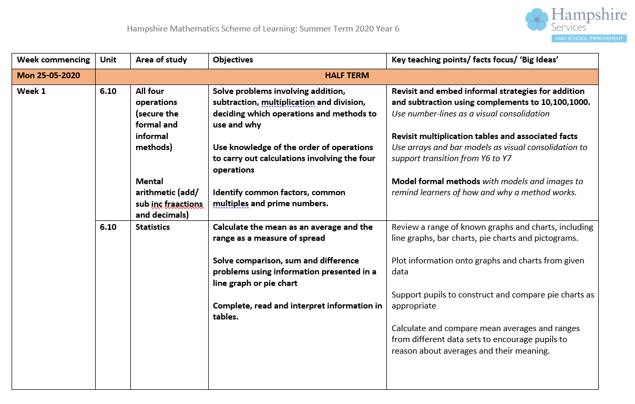
Week 1:
Four operations
(inc decimals)
Week 2:
Geometry
Week 3:
Fractions
(add/sub; multi/ divi, %)
(Week 4)
(Measurement)

Slide 10
Recovery Curriculum Planning Autumn Term ‘Catch up’ plans
revisit key learning from the previous year’s curriculum
check and close the most vital ‘gaps’ in knowledge, skills and understanding
focus on the more complex aspects of the previous year’s curriculum which is unlikely to have been covered or sufficiently understood. Possibly some domains not taught.
align the revision and catch up coverage with the new year’s curriculum so that it is sequential and progressive, and enables pupils to catch up fully in the academic year 2020-2021
For particularly low attaining year groups, could start with ‘Transition Plans’ which have a 7 week focus securing previous year group’s curriculum before beginning Autumn term ‘Catch Up Plan’. Both plans seamlessly link together giving a 21 week plan.

Slide 11
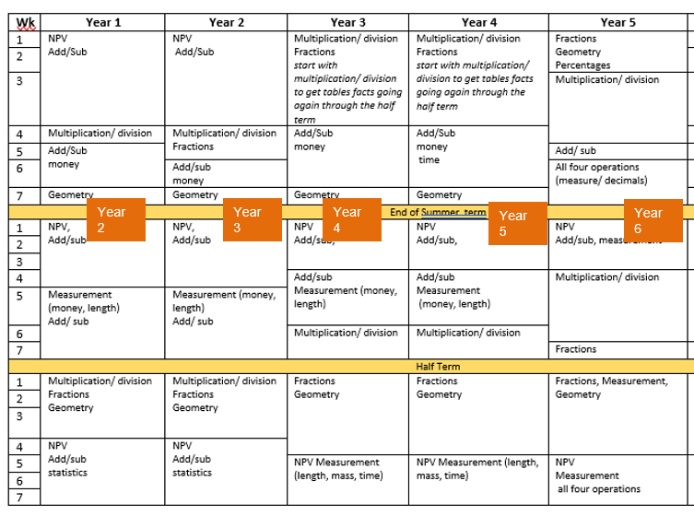
Revised 2020 Planning Overview: Summer 2 to end of Autumn
‘Transition’ Plans
7 weeks + 14 weeks
Autumn term ‘Catch Up’ plans
14 weeks
Notes:
Y3 and Y4 start with multiplication and division so that tables can be re started through CPA and then kept on the go during the half term…

Slide 12
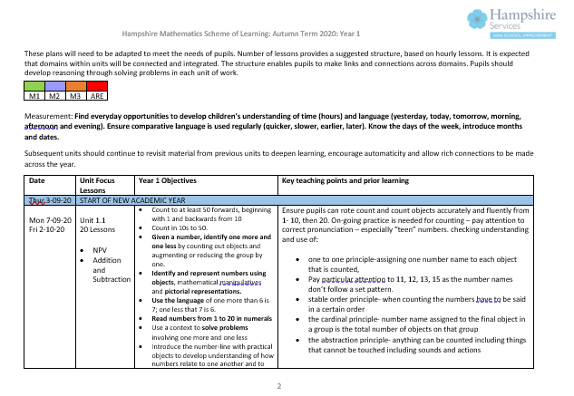
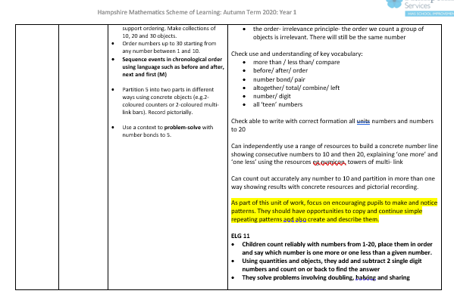
Autumn term ‘Catch Up Plan’ Year 1
Supports YR to Y1 journey with references to ELGs
Year 1 – Appendix
Transition from the Early Years Foundation Stage to the Key Stage One Curriculum guidance document
4 weeks: add/sub PV
3 weeks: measurement add/sub
3 weeks: multi/ div; fractions, geometry
4 weeks: NPV, add/sub
Links to Year 1 Unit Plans in Hampshire Primary Scheme of Learning

Slide 13
Catch up Plans from Autumn term Year 1 to Year 6

Slide 14
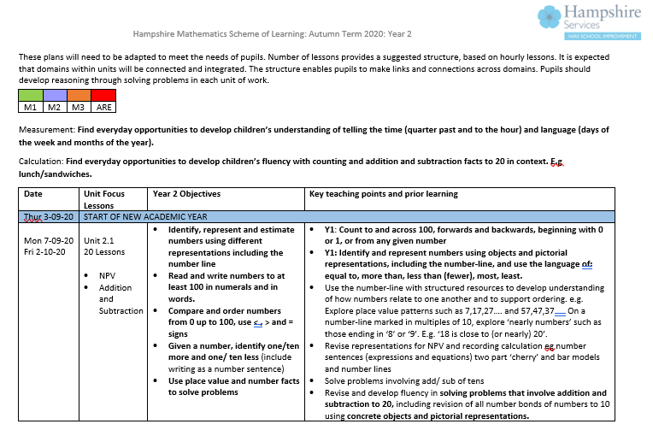
Date / suggested number of weeks for each block
Links to Unit Plan Learning Journeys in Moodle Plus, additional resources eg vocab cards
Year group objectives
Teaching tips for recovering learning, tracking back to previous curriculum

Slide 15
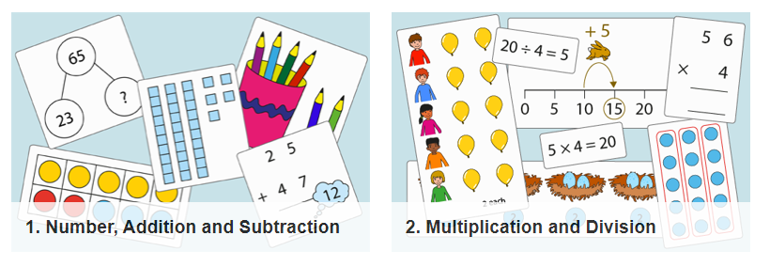
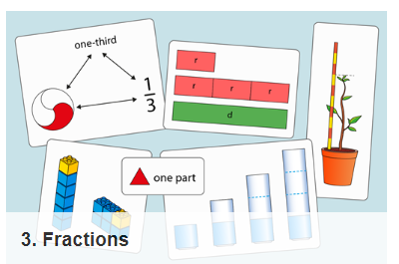
NCETM Professional Development materials
Y1-Y6 Complete
10 segments for Years 3–6, plus a preliminary segment (3.0) with guidance notes on teaching fractions in Key Stage.
Y1-Y6 Complete
30 segments
Y1-Y5 Complete
30 segments
(Y6 partly finished rest to follow)
Y1-Y6 Key features :
Progression in learning within a domain with reference to links across domains (PDF file and PPT file of representations)
CPA approach to emphasise structure and relationships in mathematics
Exemplification of vocabulary and language use needed by pupils to develop reasoning and support sharing of ideas
Exemplification of use of concrete, representations (pictorial) and abstract notation
Anchor tasks
https://www.ncetm.org.uk/resources/50639

Slide 16
NCETM Teaching for Mastery
https://www.ncetm.org.uk/resources/46689

Slide 17
Resources
‘Transition and Catch up Plans for maths’ – Moodle+
Year 6 Four week plan
‘Transition’ summer to autumn plans. Y1 to Y6
Autumn term ‘Catch up Plans’. Y1 to Y6
Home learning ‘open access’
Curriculum schedule
Problem of the week
https://maths.hias.hants.gov.uk/course/index.php?categoryid=135
https://maths.hias.hants.gov.uk/enrol/index.php?id=297

