Slide 1
2018 Key Stage 2 SATs Mathematics
Arithmetic
Reasoning Paper 1
Reasoning Paper 2
End of Key Stage Teacher assessment 2018/19
Pre Key Stage 2 Teacher Assessment 2018/19

Slide 2
Key stage 2 SATs 2018 scaled scores information
Guidance for Key Stage 2 scaled scores
https://www.gov.uk/guidance/scaled-scores-at-key-stage-2
KS2 Scaled score conversion tables for RWM 2018
https://assets.publishing.service.gov.uk/government/uploads/system/uploads/attachment_data/file/723470/2018_KS2_scaled_score_conversion_tables.pdf
Key Stage 2 SATs papers
https://www.gov.uk/government/publications/key-stage-2-tests-2018-mathematics-test-materials?utm_source=786f35bf-7d88-46b9-b9f9-e4f2f3fddc9d&utm_medium=email&utm_campaign=govuk-notifications&utm_content=immediate

Slide 3
2018: KS2 Arithmetic Paper 1 Q1-15

Slide 4
2018: KS2 Arithmetic Paper Q16- 36

Slide 5
2018:KS2 Arithmetic paper Addition and subtraction

Slide 6
2018:KS2 Arithmetic paper Multiplication and Division

Slide 7
2018: KS2 Arithmetic paper Fractions

Slide 8
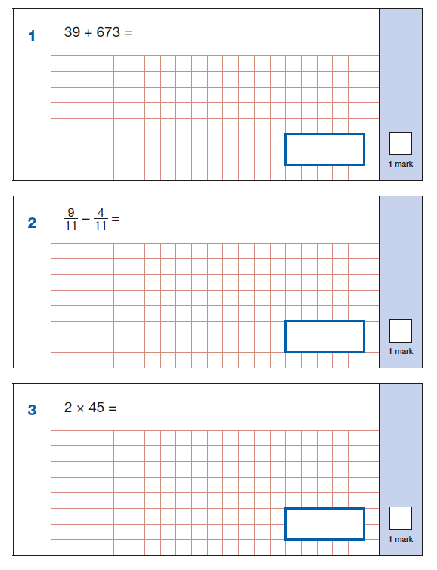
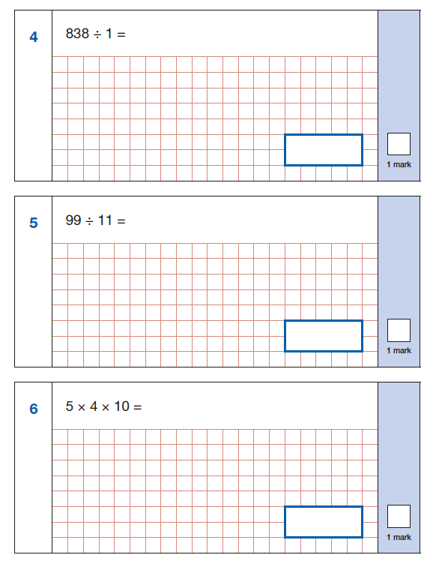
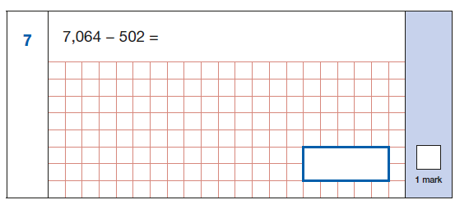
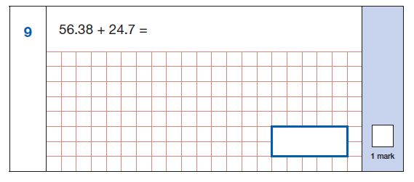
2018 KS2: Arithmetic paper (Y3/4)

Slide 9
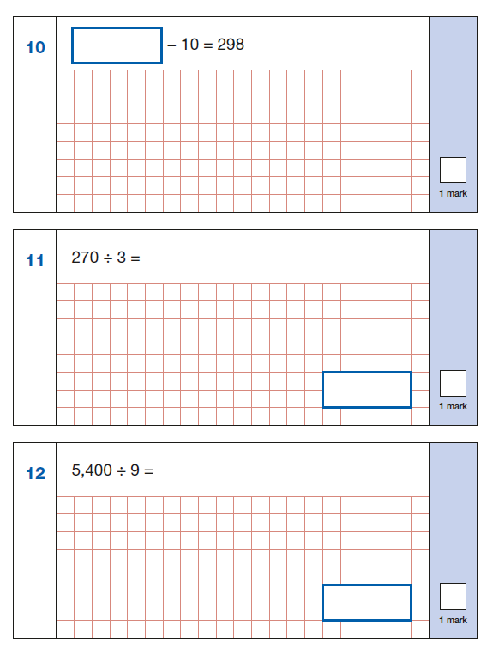
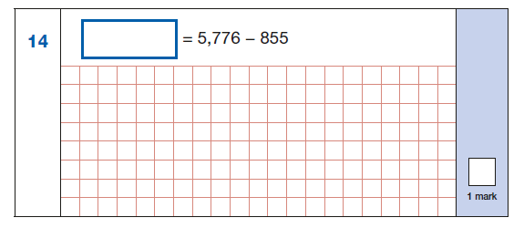
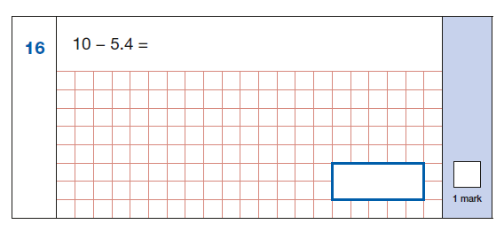
2018 KS2: Arithmetic paper (Y3/4)

Slide 10
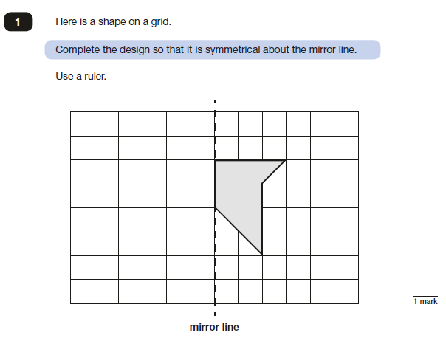
2018: KS2 Paper 2

Slide 11
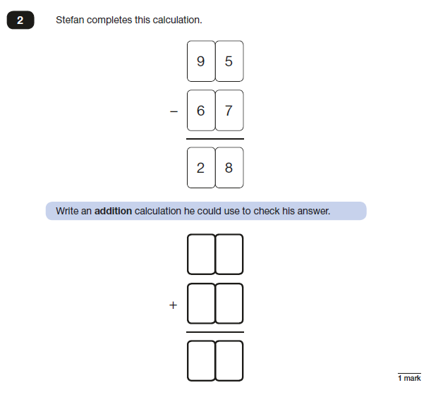
2018: KS2 Paper 2

Slide 12
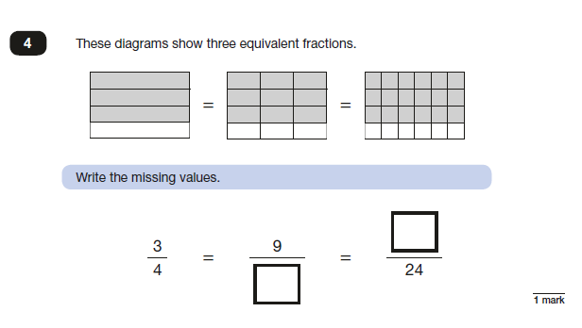
2018: KS2 Paper 2

Slide 13
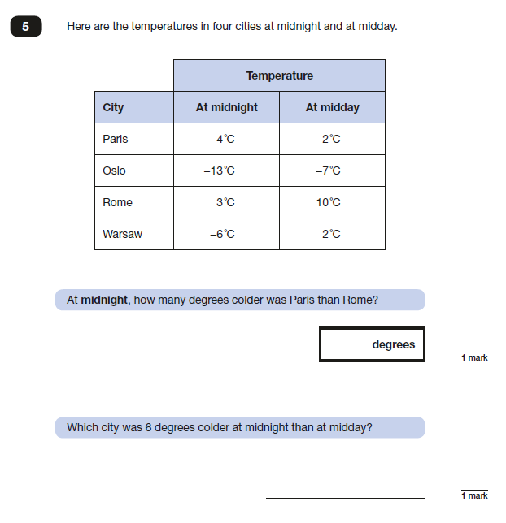
2018: KS2 Paper 2

Slide 14
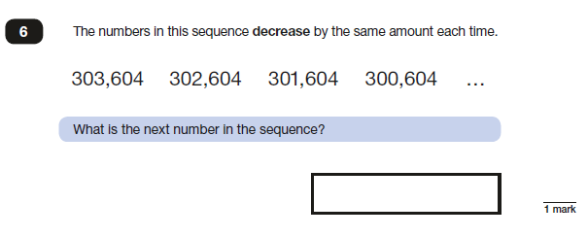
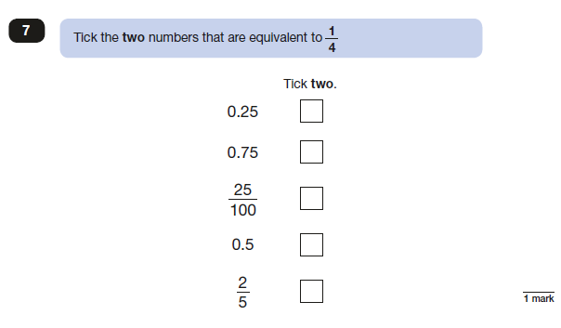
2018: KS2 Paper 2

Slide 15
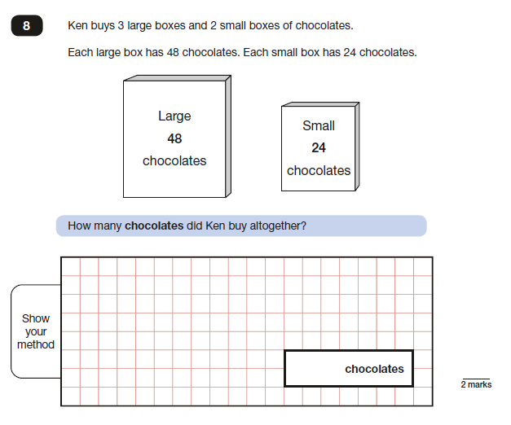
2018: KS2 Paper 2

Slide 16
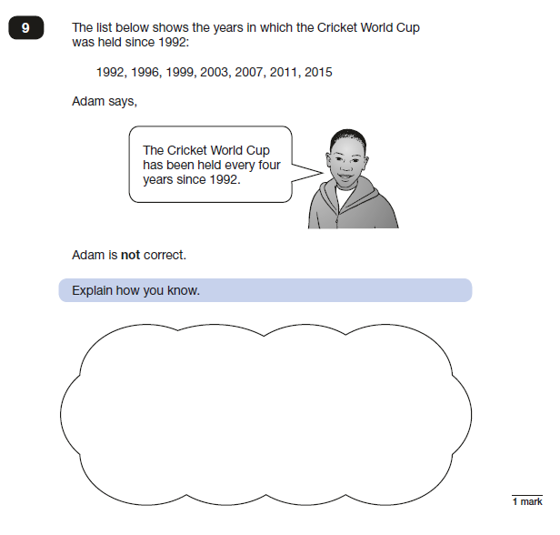
2018: KS2 Paper 2

Slide 17
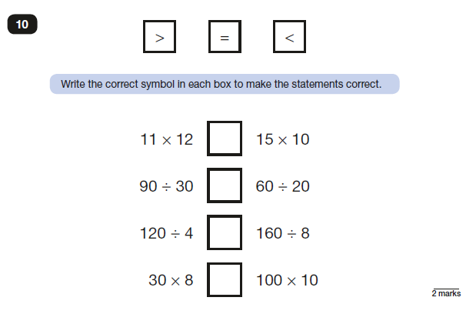
2018: KS2 Paper 2

Slide 18
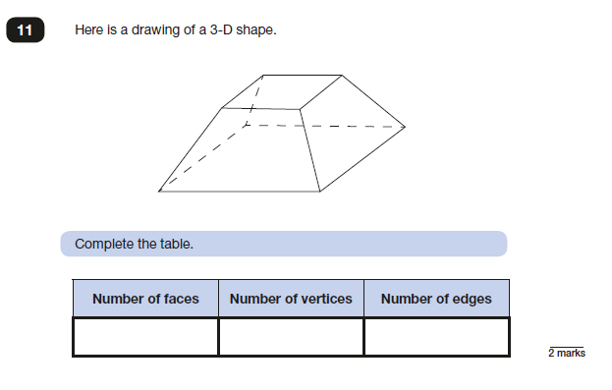
2018: KS2 Paper 2

Slide 19
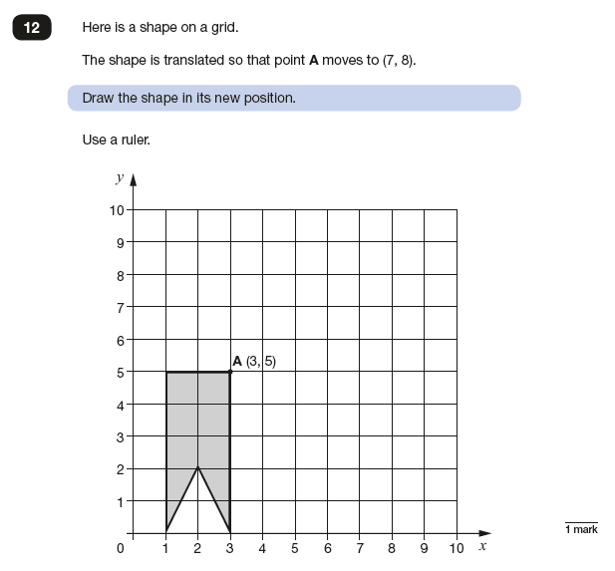
2018: KS2 Paper 2

Slide 20
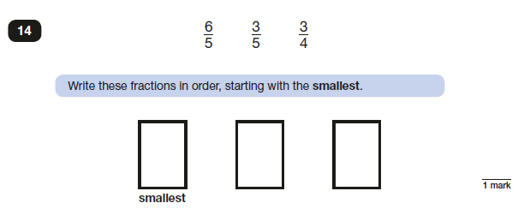
2018: KS2 Paper 2

Slide 21
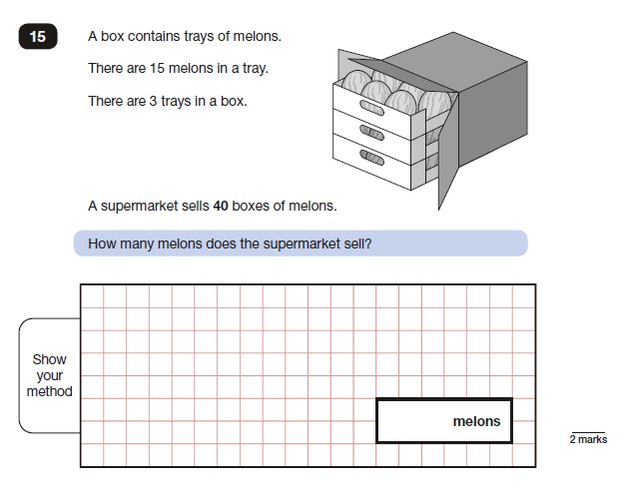
2018: KS2 Paper 2

Slide 22
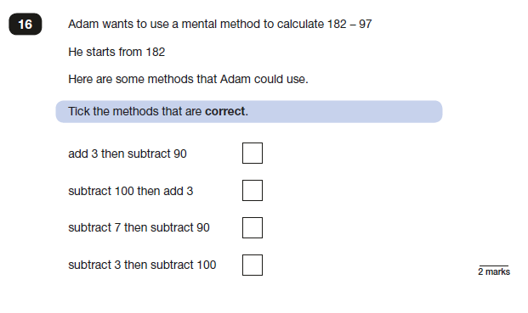
2018: KS2 Paper 2

Slide 23
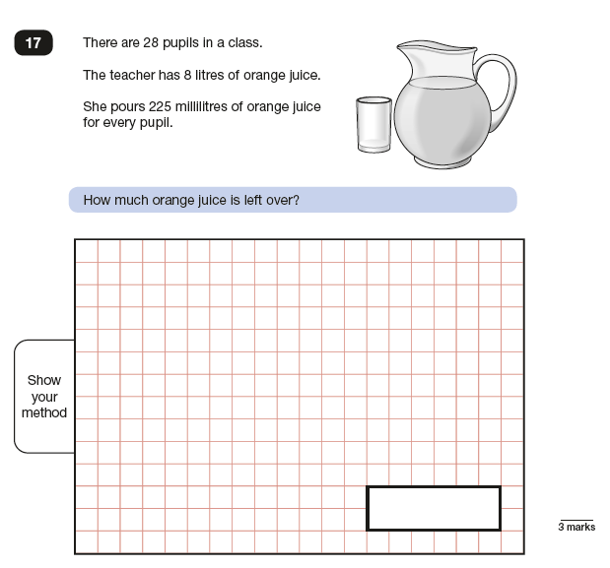
2018: KS2 Paper 2

Slide 24
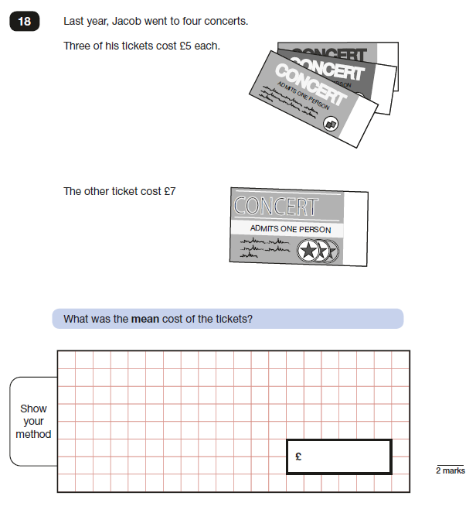
2018: KS2 Paper 2

Slide 25
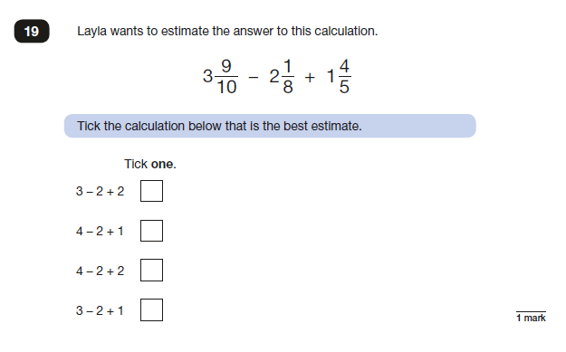
2018: KS2 Paper 2

Slide 26
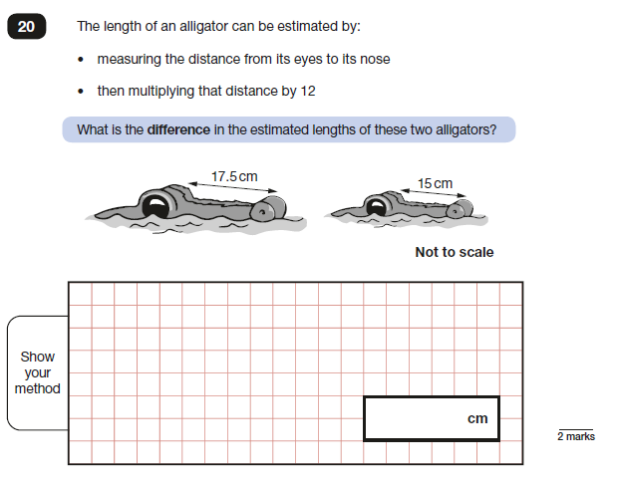
2018: KS2 Paper 2

Slide 27
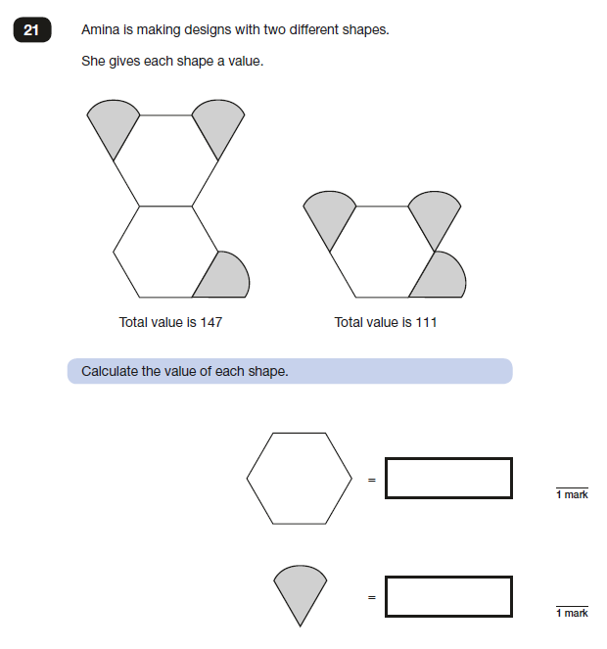
2018: KS2 Paper 2

Slide 28
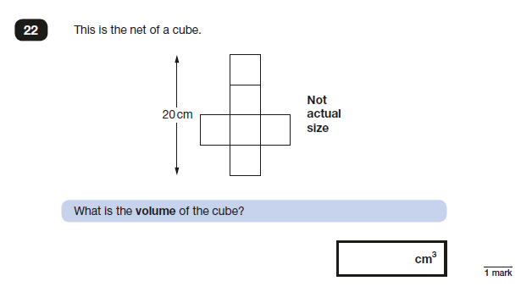
2018: KS2 Paper 2

Slide 29
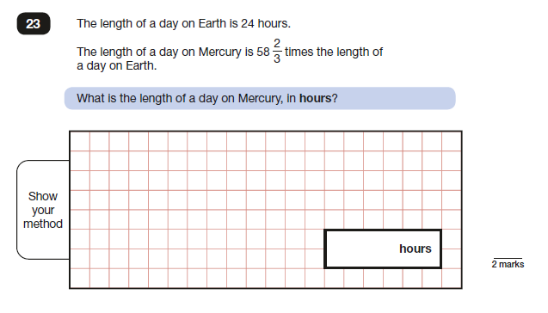
2018: KS2 Paper 2

Slide 30
2018: KS2 Paper 3

Slide 31
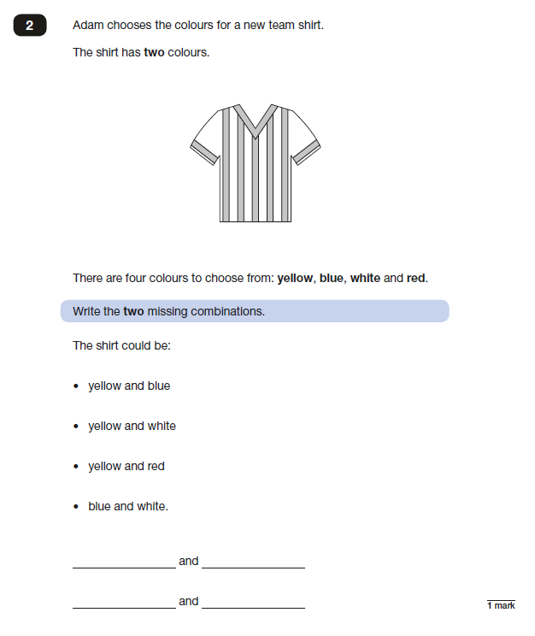
2018: KS2 Paper 3

Slide 32
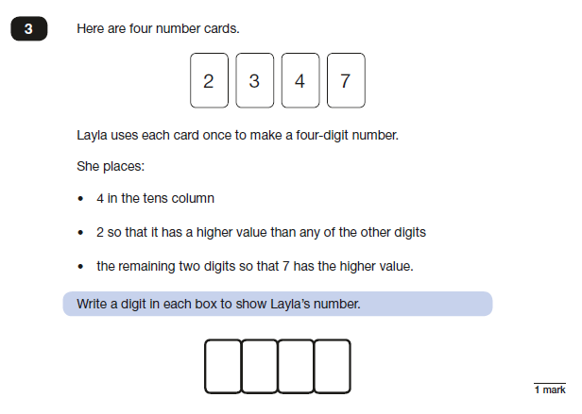
2018: KS2 Paper 3

Slide 33
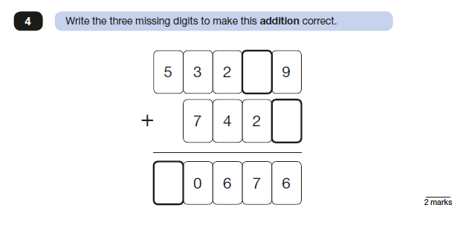
2018: KS2 Paper 3

Slide 34
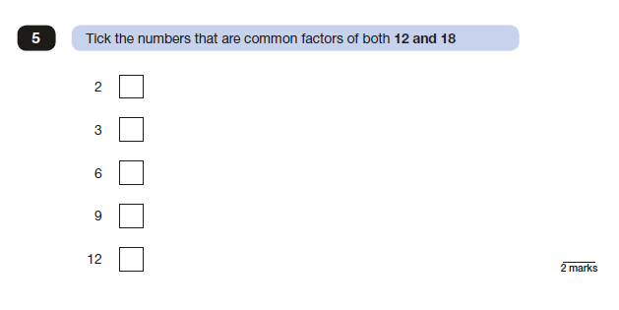
2018: KS2 Paper 3

Slide 35
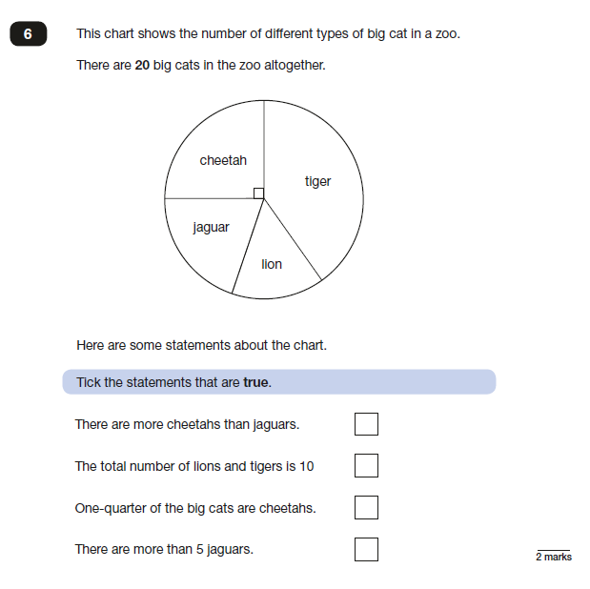
2018: KS2 Paper 3

Slide 36
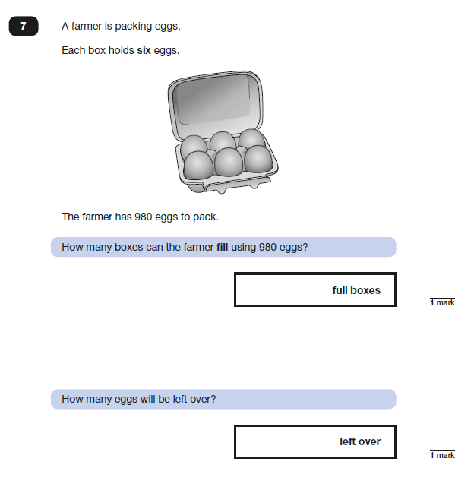
2018: KS2 Paper 3

Slide 37
2018: KS2 Paper 3

Slide 38
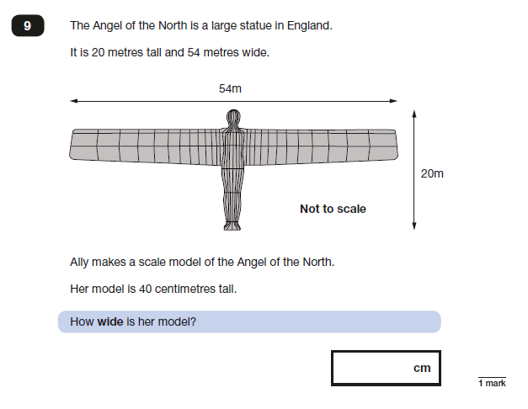
2018: KS2 Paper 3

Slide 39
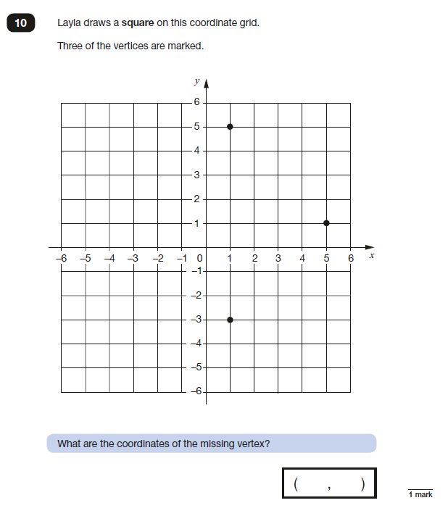
2018: KS2 Paper 3

Slide 40
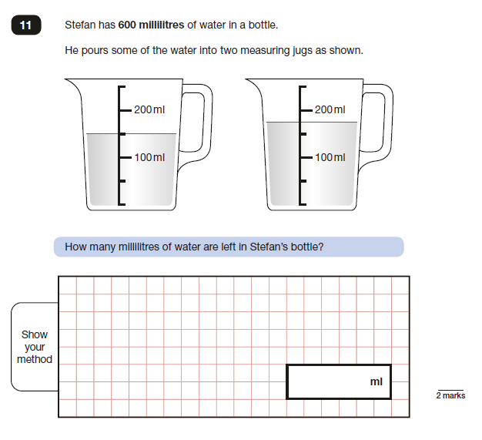
2018: KS2 Paper 3

Slide 41
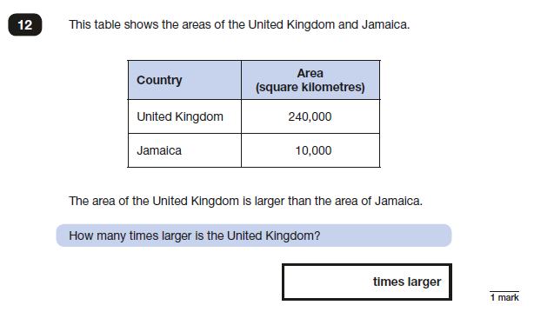
2018: KS2 Paper 3

Slide 42
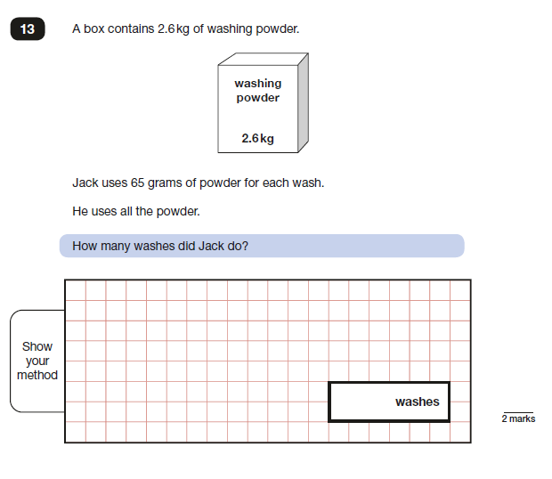
2018: KS2 Paper 3

Slide 43
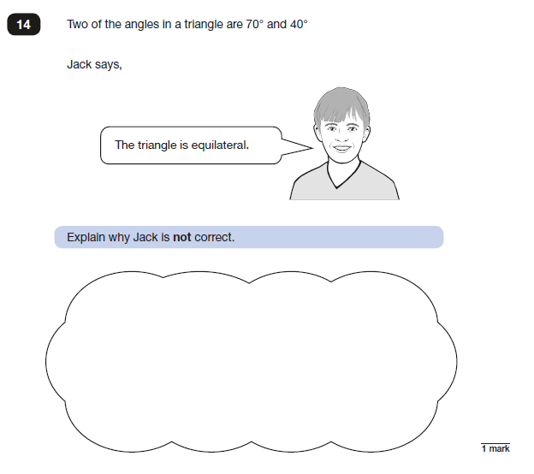
2018: KS2 Paper 3

Slide 44
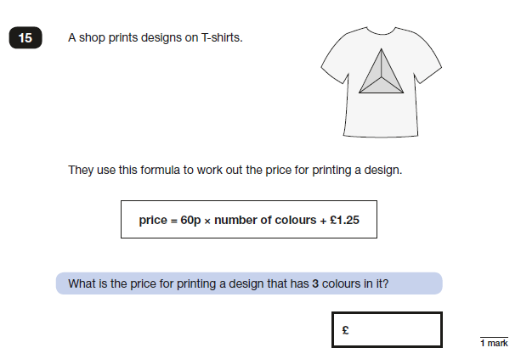
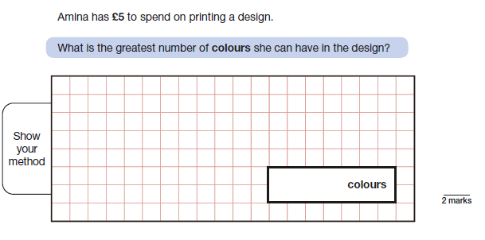
2018: KS2 Paper 3

Slide 45
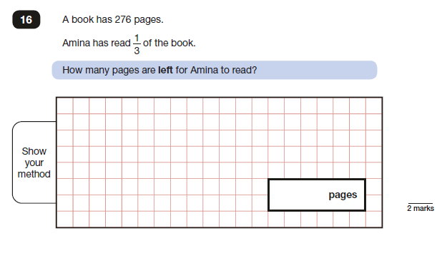
2018: KS2 Paper 3

Slide 46
2018: KS2 Paper 3

Slide 47
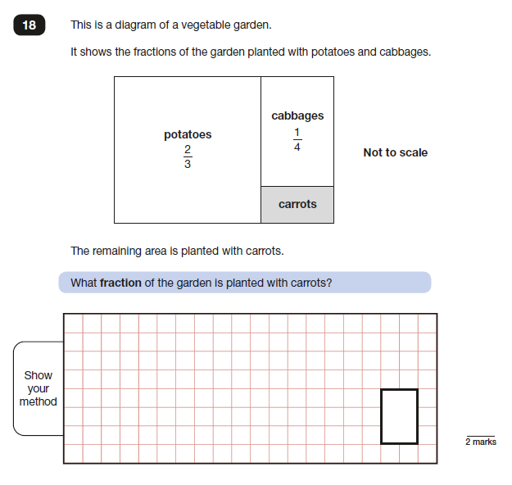
2018: KS2 Paper 3

Slide 48
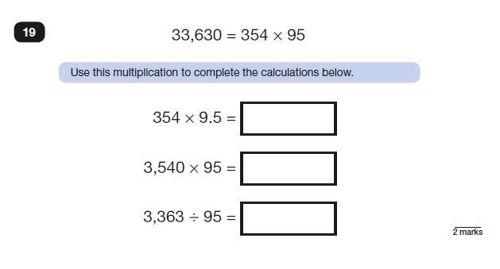
2018: KS2 Paper 3

Slide 49
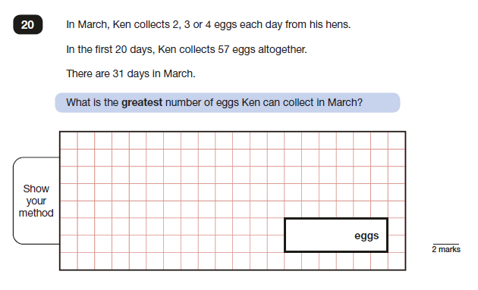
2018: KS2 Paper 3

Slide 50
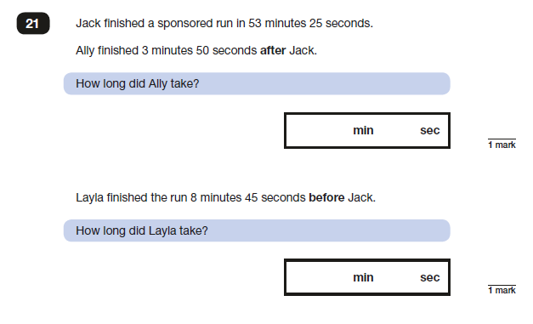
2018: KS2 Paper 3

Slide 51
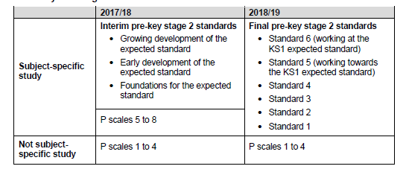
2018/19 Teacher Assessment Frameworks: Pre- KS2
‘The standards are not a formative assessment tool: they should not be used to track progress throughout the key stage or to guide individual programmes of study, classroom practice or methodology…’
‘Those reviewing school performance, including Ofsted inspectors, would not expect them to be used for anything other than summative assessment at the end of key stage 1.’

Slide 52
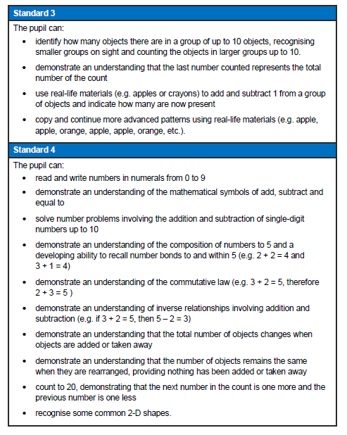
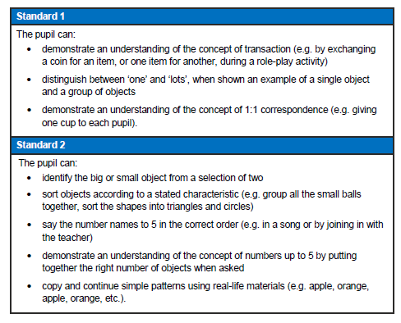
Pre Key Stage 2
…teachers need to have evidence which demonstrates that the pupil meets all of the statements within that standard.’
‘Assess each individual pupil based on their own method of communication, and disregard statements which a pupil is physically unable to access.’

Slide 53
Pre Key Stage 2
Standard 5 and 6
Same wording as KS1 Teacher Assessment Frameworks 2018/19

