Slide 1
2018 Key Stage 1 SATs
Mathematics
Arithmetic
Reasoning Paper
End of Key Stage Teacher assessment 2018/19
Pre Key Stage 1 Teacher Assessment 2018/19

Slide 2
2018: KS1 Scaled Score Information
https://www.gov.uk/guidance/scaled-scores-at-key-stage-1?utm_source=154e084c-6233-46b2-a21d-c827d36af8e4&utm_medium=email&utm_campaign=govuk-notifications&utm_content=immediate
KS1 SATs Materials
https://assets.publishing.service.gov.uk/government/uploads/system/uploads/attachment_data/file/711209/STA187965e_2018_ks1_mathematics_Paper2_reasoning.pdf.pdf
KS2 SATs Materials
https://www.gov.uk/government/publications/key-stage-2-tests-2018-mathematics-test-materials?utm_source=786f35bf-7d88-46b9-b9f9-e4f2f3fddc9d&utm_medium=email&utm_campaign=govuk-notifications&utm_content=immediate

Slide 3

























2018: KS1 Arithmetic

Slide 4
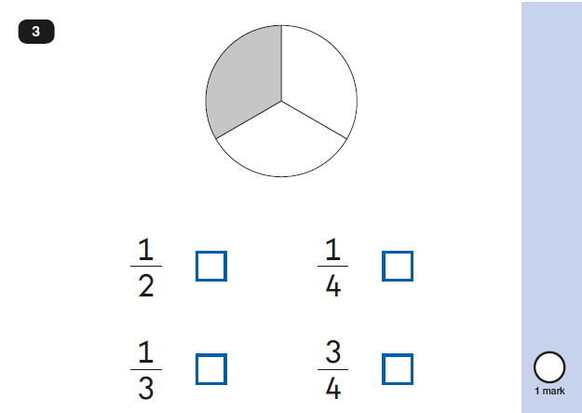
2018: KS1 Paper 2

Slide 5
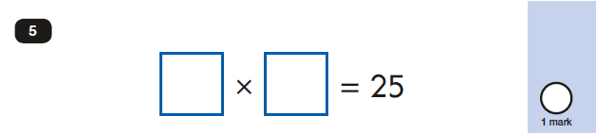
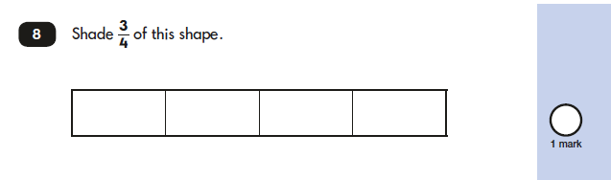
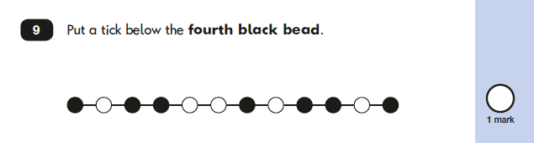
2018: KS1 Paper 2

Slide 6
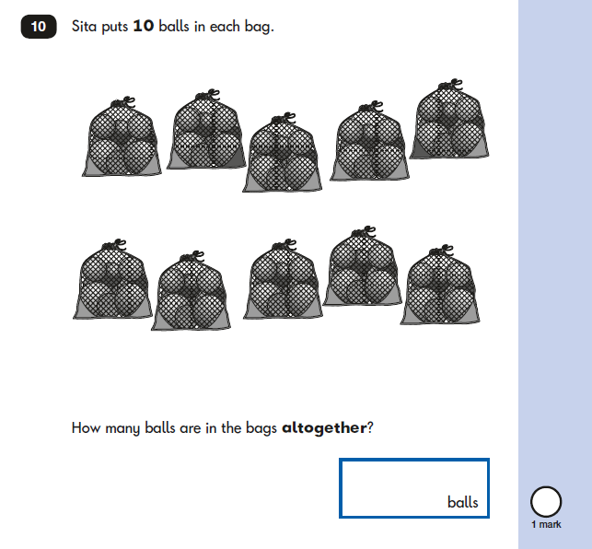
2018: KS1 Paper 2

Slide 7
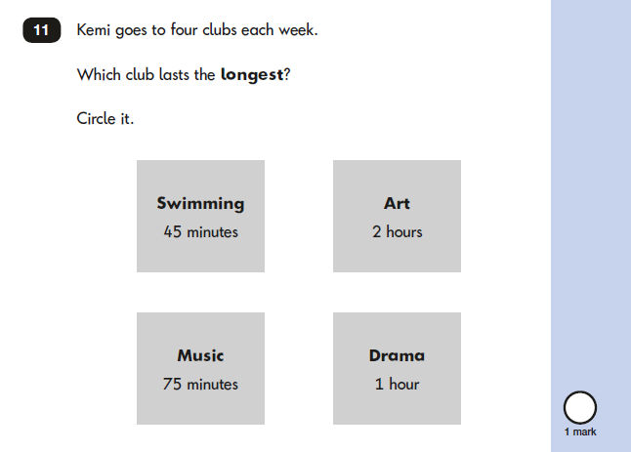
2018: KS1 Paper 2

Slide 8
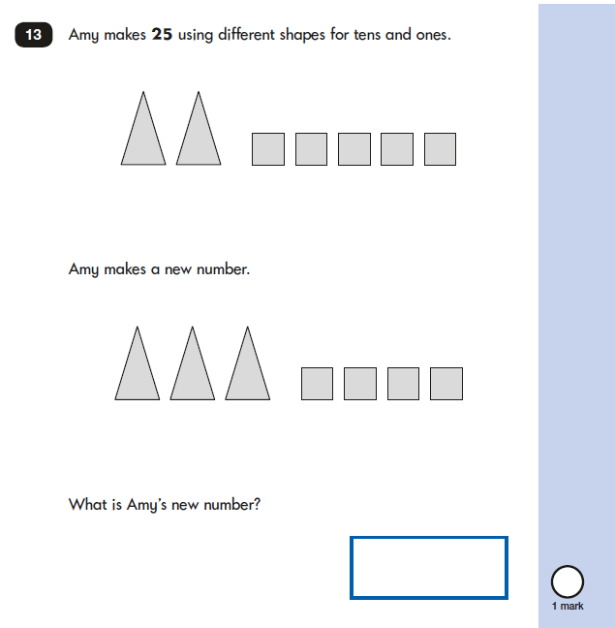
2018: KS1 Paper 2

Slide 9
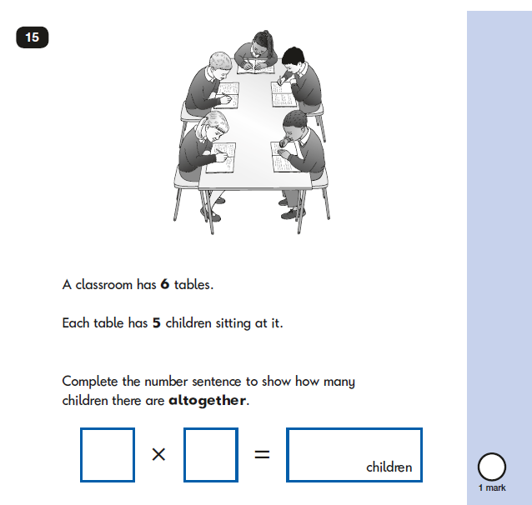
2018: KS1 Paper 2

Slide 10
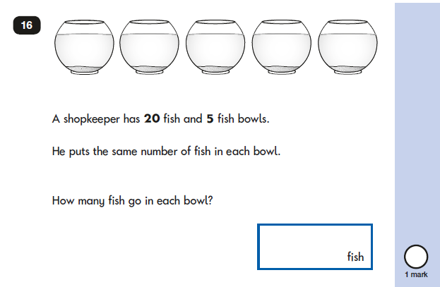
2018: KS1 Paper 2

Slide 11
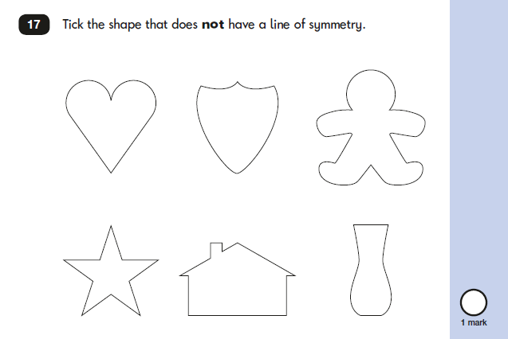
2018: KS1 Paper 2

Slide 12
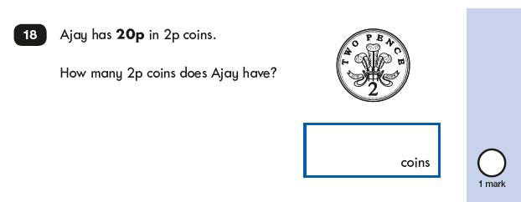
2018: KS1 Paper 2

Slide 13
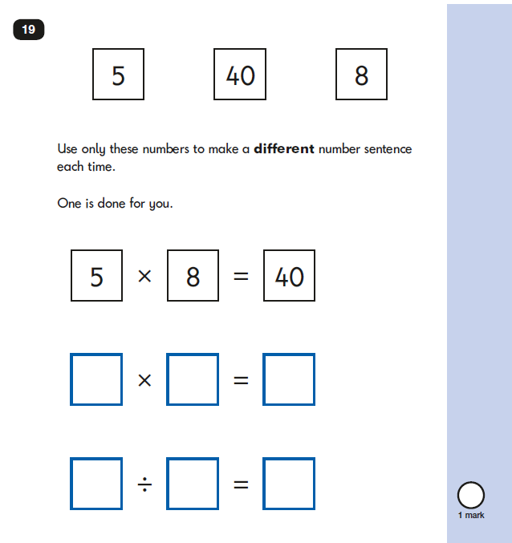

Slide 14
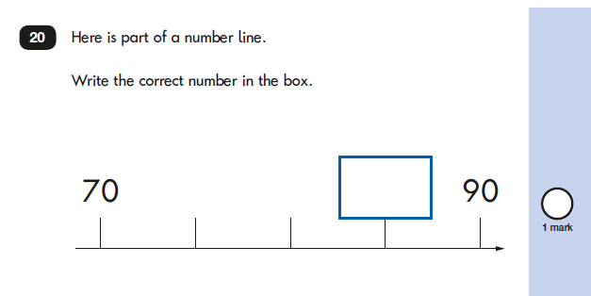
2018: KS1 Paper 2

Slide 15
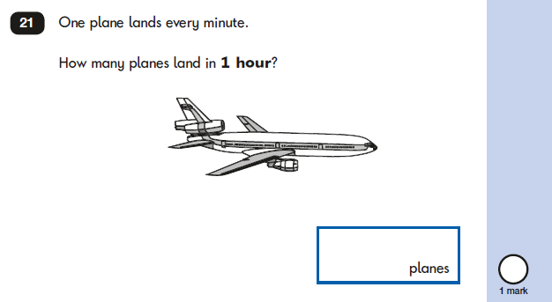
2018: KS1 Paper 2

Slide 16
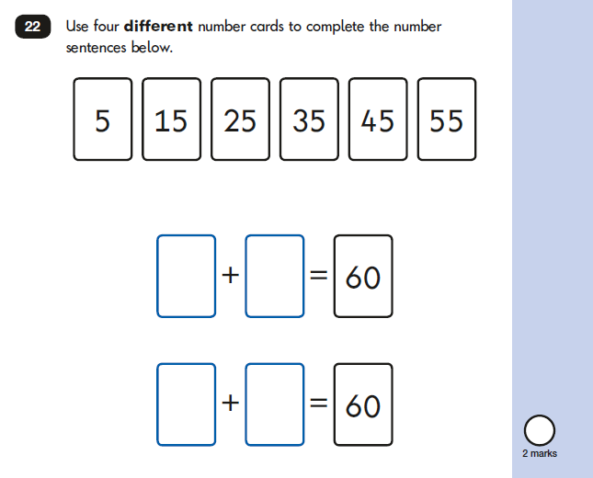
2018: KS1 Paper 2

Slide 17
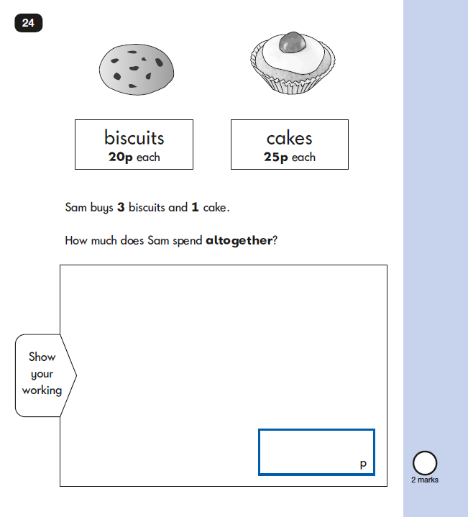
2018: KS1 Paper 2

Slide 18
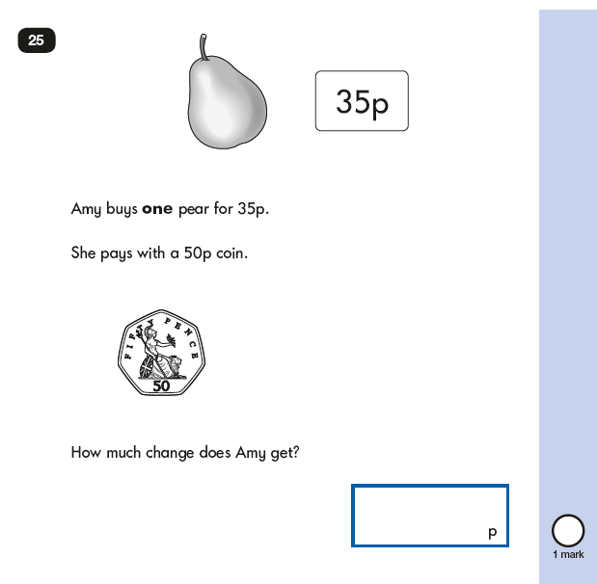
2018: KS1 Paper 2

Slide 19
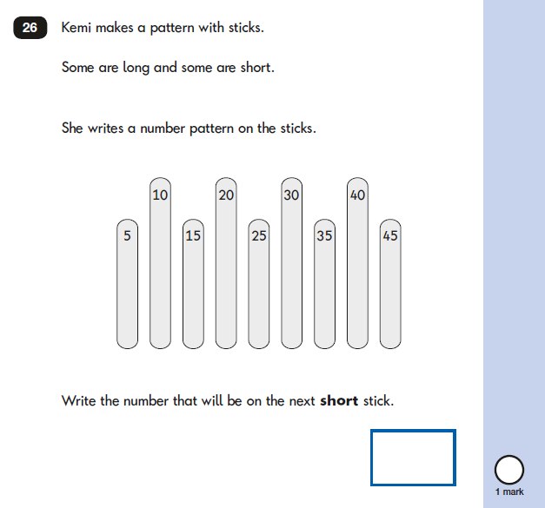
2018: KS1 Paper 2

Slide 20
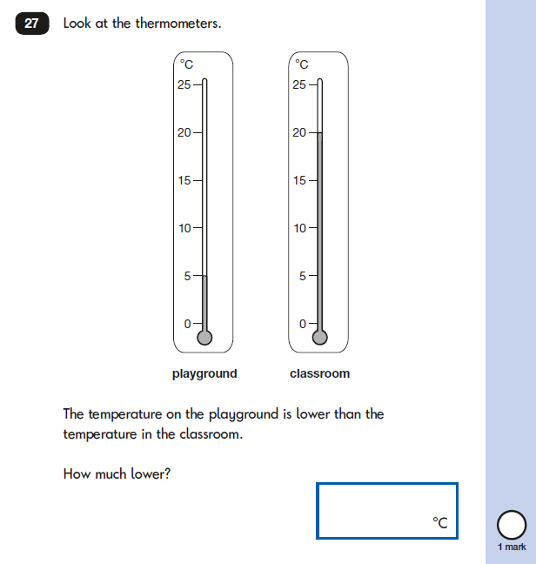
2018: KS1 Paper 2

Slide 21
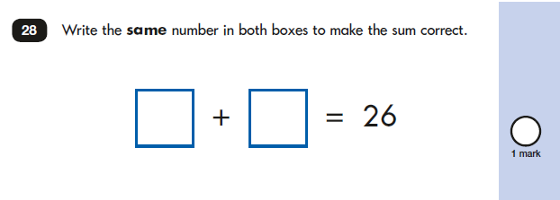
2018: KS1 Paper 2

Slide 22
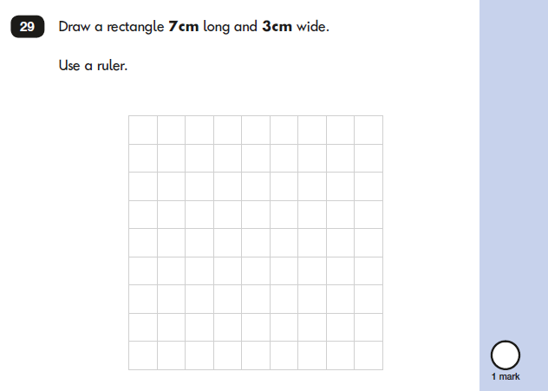
2018: KS1 Paper 2

Slide 23
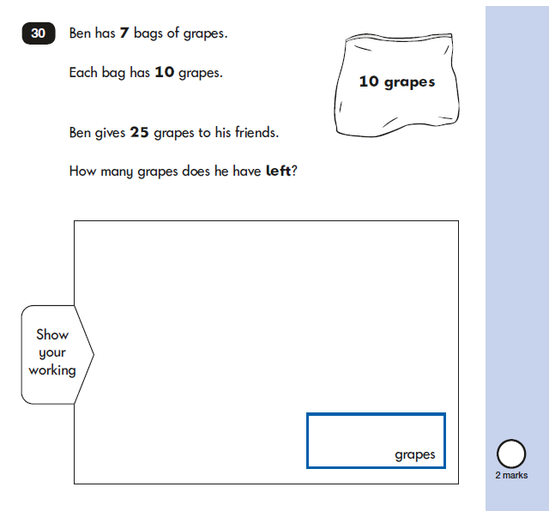
2018: KS1 Paper 2

Slide 24
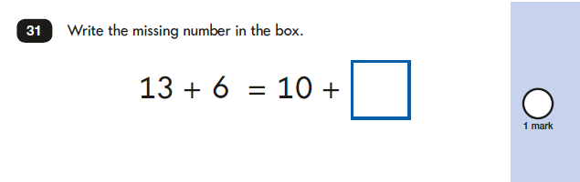
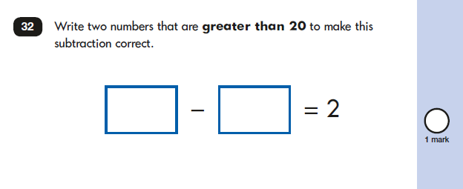
2018: KS1 Paper 2

Slide 25
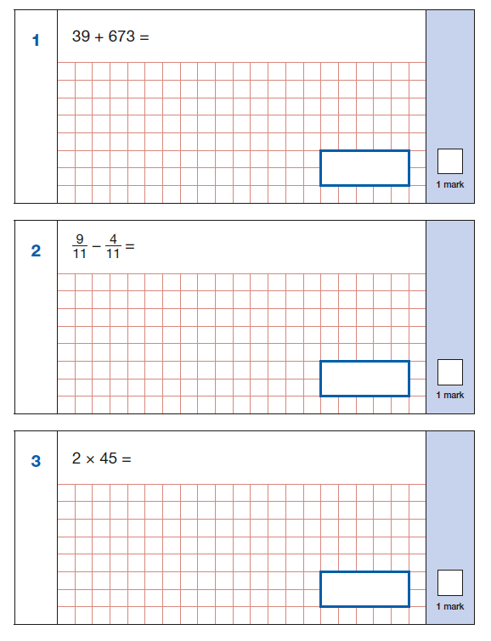
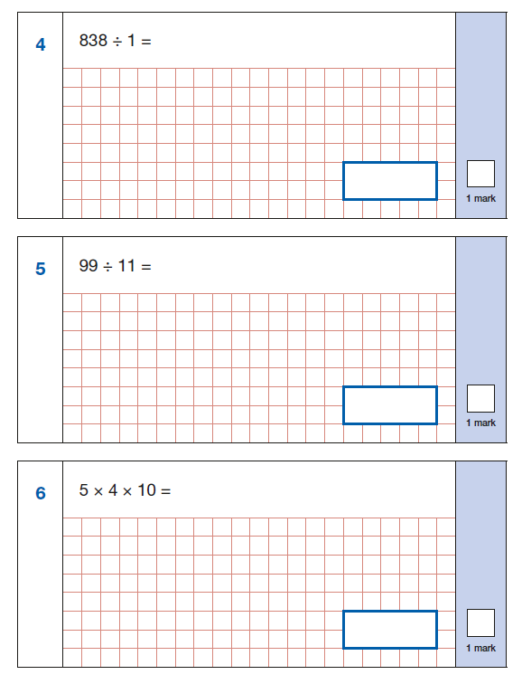
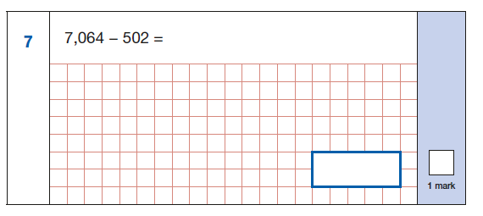
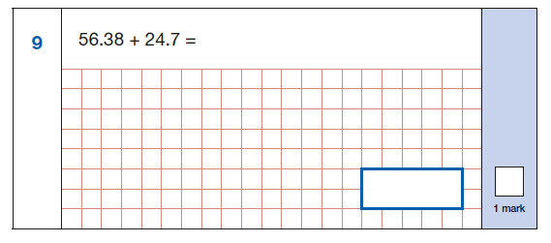
2018 KS2: Arithmetic paper (Y3/4)

Slide 26
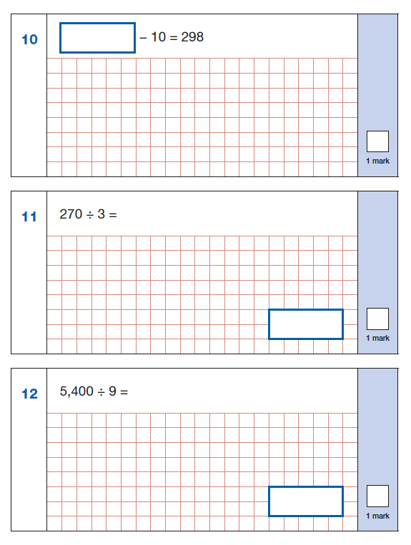
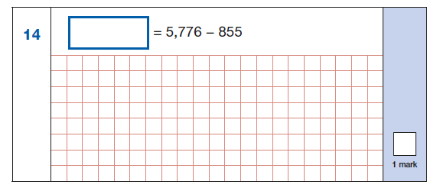
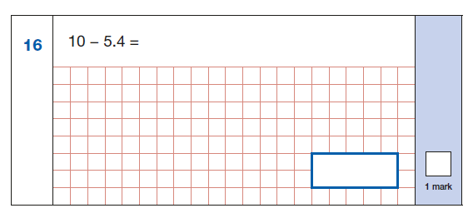
2018 KS2: Arithmetic paper (Y3/4)

Slide 27
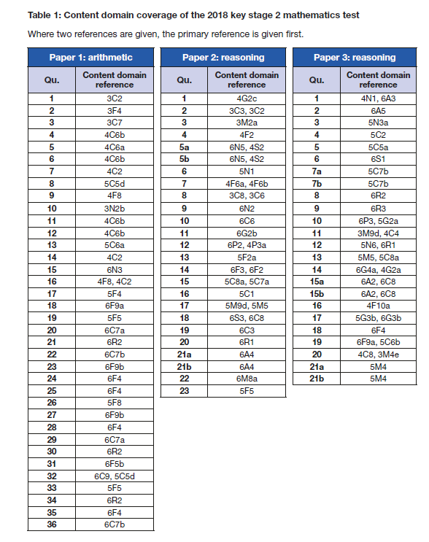
Key Stage 2 SATs
mark scheme
Arithmetic: Y3x4; Y4x9
Paper 2: Y3x3; Y4x3
Paper 3: 4x Y3/4

Slide 28
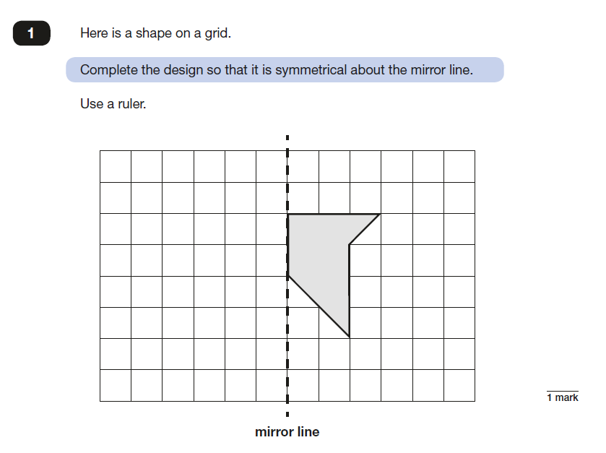
2018 KS2: Paper 2

Slide 29
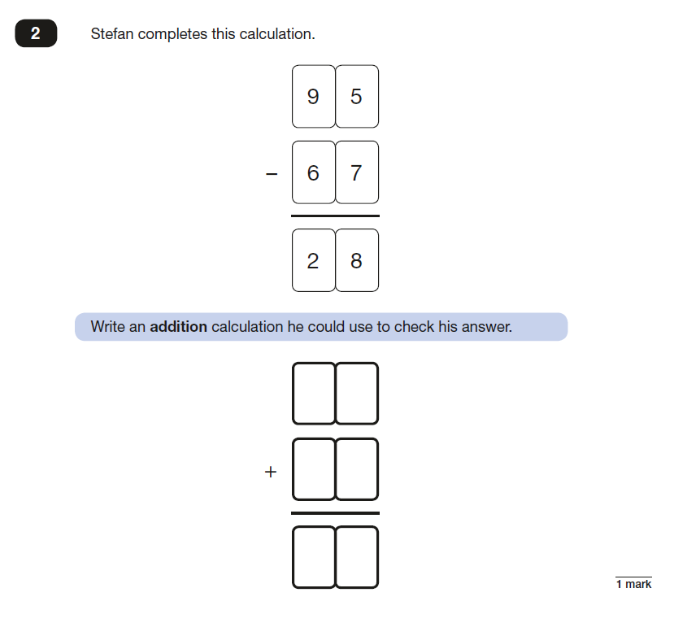
2018 KS2: Paper 2

Slide 30
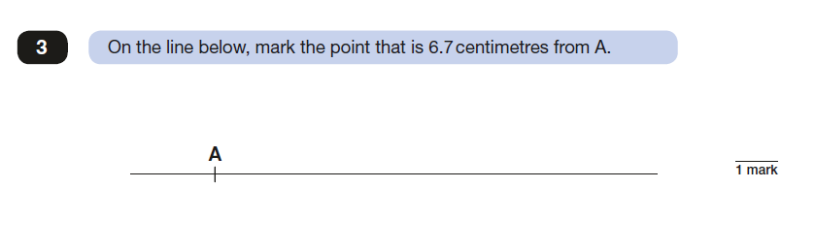
2018 KS2: Paper 2

Slide 31
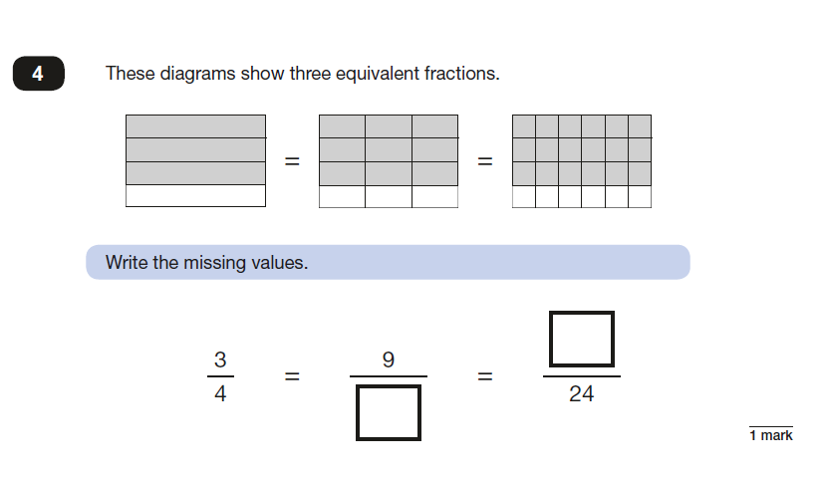
2018 KS2: Paper 2

Slide 32
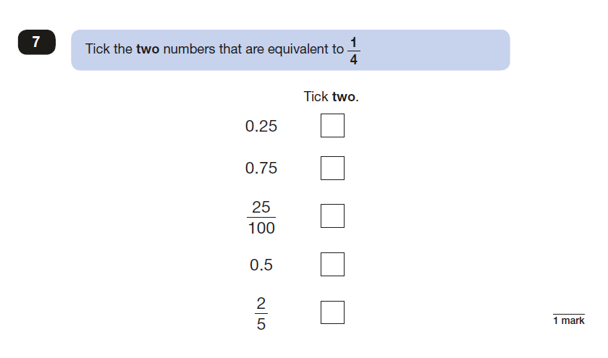
2018 KS2: Paper 2

Slide 33
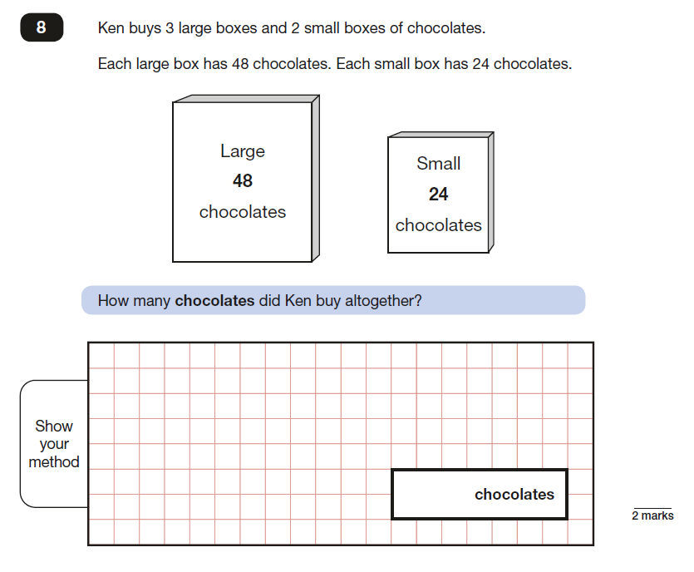
2018 KS2: Paper 2

Slide 34
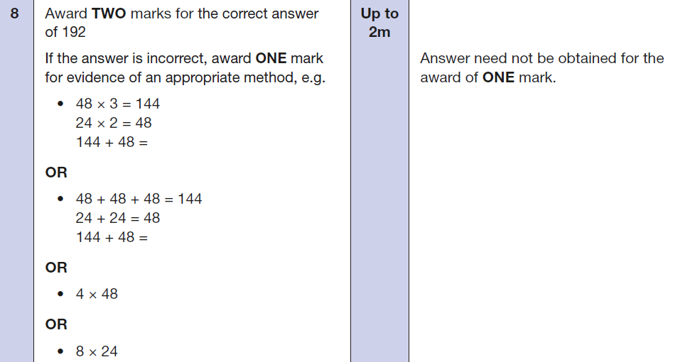
Q8: mark scheme

Slide 35
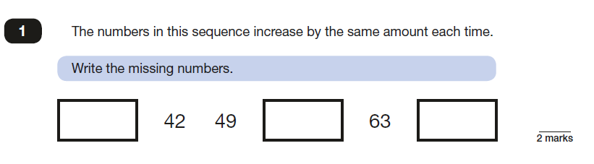
2018 KS2: Paper 3

Slide 36
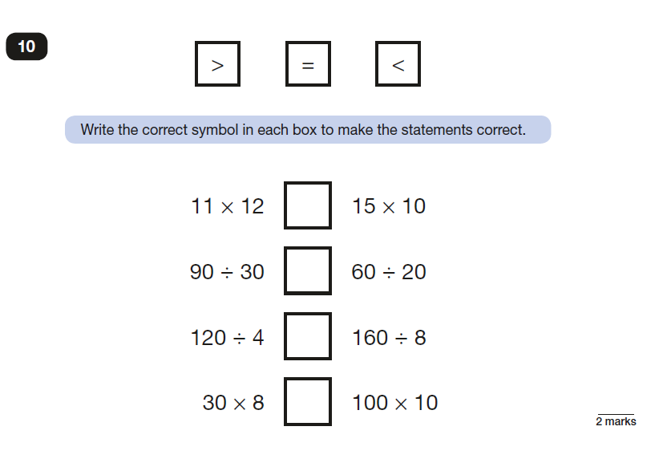
2018 KS2: paper 2
Pupil conferencing
Mental/ written
Fact? Derived facts?

Slide 37
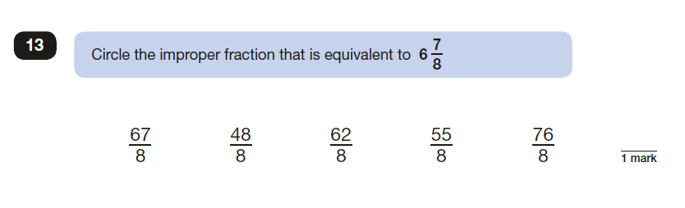
2018: KS2 Paper 2
Pupil Conferencing
Models and images
Conceptual/ procedural understanding
Domain links

Slide 38
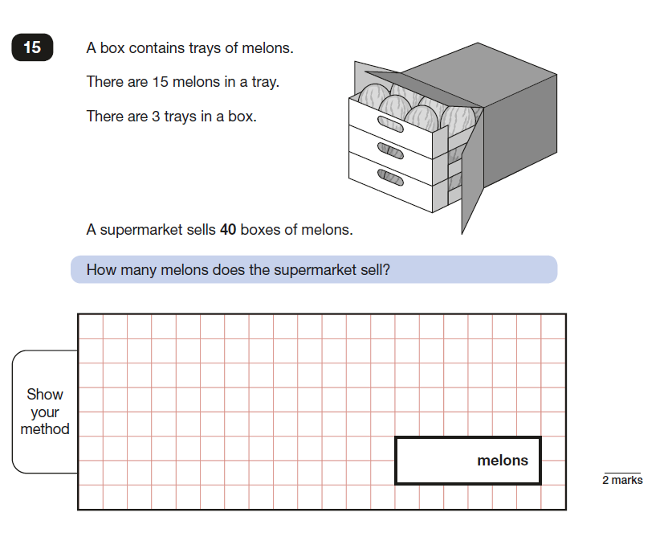
2018: KS2 Paper 2
Pupil Conferencing

Slide 39
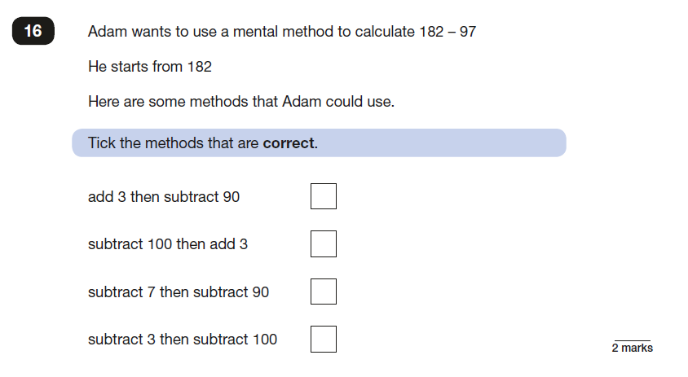
2018: KS2 paper 2
Pupil Conferencing

Slide 40

2018/19 Teacher Assessment Frameworks: KS1
Some changes made to the wording:
AT WTS:
PV the same
Addition and subtraction: A more explicit need to reason – to show understanding – “explaining their method verbally, in pictures, or with apparatus”. Also better wording for number bonds focusing more on understanding structure
Geometry: higher expectation including reasoning about properties not just naming
Money/ coins included (new)
Doubles removed
At EXS: Mostly the same but better wording
Improvements for reading scale
No mention of estimation
Improvements for addition and subtraction
At GDS
Mental calculation possibly now for EXS?
Same but much less wordy for multiplication and division
More focus on reasoning about addition and subtraction
No mention of comparing fractions of amounts
More detail shared at Key Stage 1 moderation sessions when the exemplification published

Slide 41
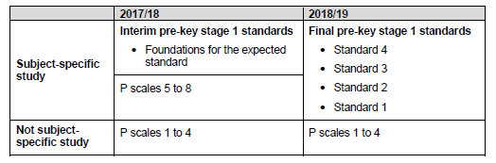

2018/19 Teacher Assessment Frameworks: Pre- KS1
‘Each subject framework has four standards containing ‘pupil can’ statements to support teacher judgements…’
‘The standards are not a formative assessment tool: they should not be used to track progress throughout the key stage or to guide individual programmes of study, classroom practice or methodology…’
‘Those reviewing school performance, including Ofsted inspectors, would not expect them to be used for anything other than summative assessment at the end of key stage 1.’

Slide 42
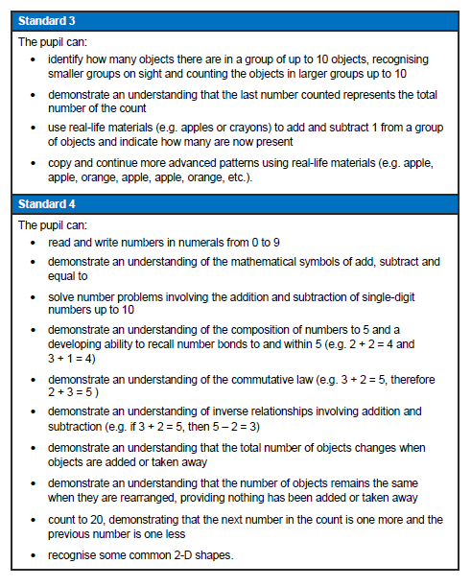
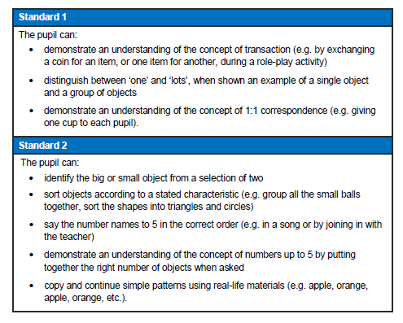
Pre Key stage 1
…teachers need to have evidence which demonstrates that the pupil meets all of the statements within that standard.’
‘Assess each individual pupil based on their own method of communication, and disregard statements which a pupil is physically unable to access.’

Slide 43
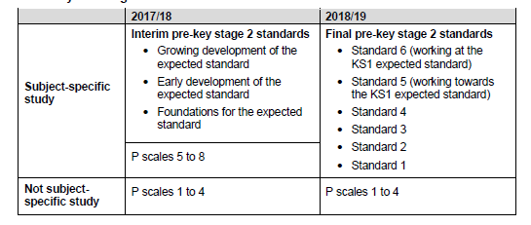

2018/19 Teacher Assessment Frameworks: Pre- KS2
‘The standards are not a formative assessment tool: they should not be used to track progress throughout the key stage or to guide individual programmes of study, classroom practice or methodology…’
‘Those reviewing school performance, including Ofsted inspectors, would not expect them to be used for anything other than summative assessment at the end of key stage 1.’

Slide 44
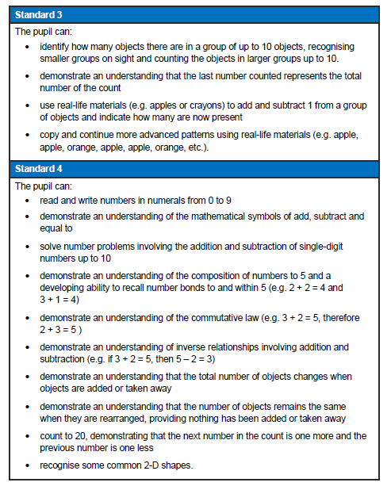
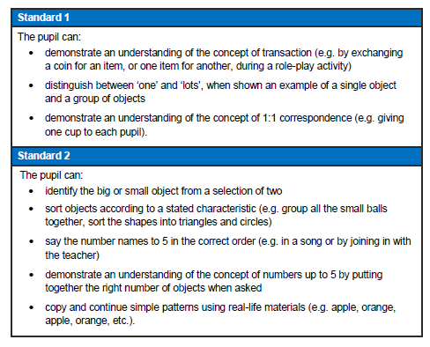
Pre Key Stage 2
…teachers need to have evidence which demonstrates that the pupil meets all of the statements within that standard.’
‘Assess each individual pupil based on their own method of communication, and disregard statements which a pupil is physically unable to access.’

