Slide 1
CW
Tuesday, 19 July 2016
Starter
Solving Equations with the Bar Method
Notes:
1

Slide 2
Tuesday, 19 July 2016
Solving Equations with the Bar Method
VALUE OF A FUNCTION

Slide 3
One Step Equations

Slide 4
What is the value of $x$?
$$x + 5 = 20$$
$x$
5
20

Slide 5
What is the value of $a$?
$$a − 25 = 35$$
$a$
25
35

Slide 6
Can you represent these using a bar method. What is the value of $x$?
$$x + 25 = 35$$
$$x − 6 = 18$$
$x$
$x$
25
6
35
18
$$10 = x − 2$$
$$10 = x + 8$$
$x$
$x$
8
2
10
10
$$10 = 20 − x$$
$$80 + x = 60$$
$20$
80
$x$
60
$x$
10

Slide 7
What is the value of $v$?
$$2v = 28$$
$v$
$v$
28

Slide 8
What is the value of $m$?
$$m÷4 =6$$
$$m$$
$$6$$
$$6$$
$$6$$
$$6$$

Slide 9
Can you represent these using a bar method. What is the value of $x$?
$$5x=35$$
$$18÷x =3$$
$$x$$
$$x$$
$$x$$
$$x$$
$$x$$
$$x$$
$$x$$
$$x$$
35
$$18$$
$$80=10x$$
$$x÷4=5$$
$$x$$
$$x$$
$$x$$
$$x$$
$$x$$
$$x$$
$$x$$
$$x$$
$$x$$
$$x$$
$$\frac{1}{4}x$$
$$\frac{1}{4}x$$
$$\frac{1}{4}x$$
$$\frac{1}{4}x$$
80
$$5$$
$$5$$
$$5$$
$$5$$

Slide 10
Two Step Equations

Slide 11
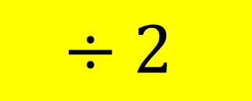
What is the value of $x$?
$$2x +3 = 23$$
$$x$$
$$x$$
$$3$$
$$23$$
$$−3$$
$$x$$
$$x$$
$$20$$
$$÷2$$
$$x$$
$$x=10$$
$$10$$

Slide 12
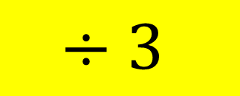
What is the value of $y$?
$$3y +6 = 27$$
$$y$$
$$y$$
$$y$$
$$6$$
$$27$$
$$−6$$
$$y$$
$$y$$
$$y$$
$$21$$
$$÷3$$
$$y$$
$$y=7$$
$$7$$

Slide 13
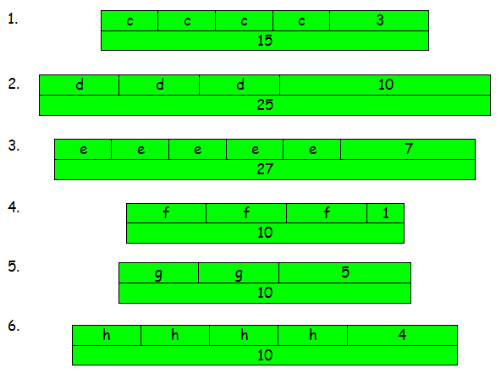

Slide 14
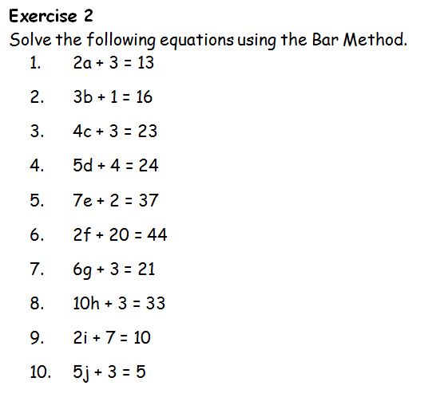

Slide 15
What is the value of $z$?
$$2z −4 =6$$
$2z$
$$4$$
$$+4$$
$$6$$
$2z$
$$6$$
$$4$$
$$÷2$$
$$z=5$$
$$z$$
$$5$$

Slide 16
Two Step Equations (and balancing)

Slide 17
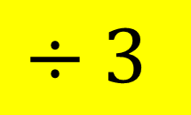
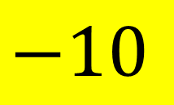
What is the value of $m$?
$$3m+10 =34$$
$$3m+10=34$$
$$3m$$
$$10$$
$$34$$
$$−10$$
$$−10$$
$$−10$$
$$3m =24$$
$$÷3$$
$$÷3$$
$$3m$$
$$m =8$$
$$24$$
$$÷3$$
$$m$$
$$m=8$$
$$8$$

Slide 18
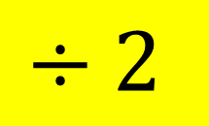
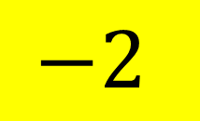
What is the value of $m$?
$$4m+2 =20$$
$$4m+2=20$$
$$4m$$
$$2$$
$$20$$
$$−2$$
$$−2$$
$$−2$$
$$4m =18$$
$$÷4$$
$$÷4$$
$$4m$$
$$m =4.5$$
$$18$$
$$÷2$$
$$m$$
$$m=4.5$$
$$4.5$$

Slide 19
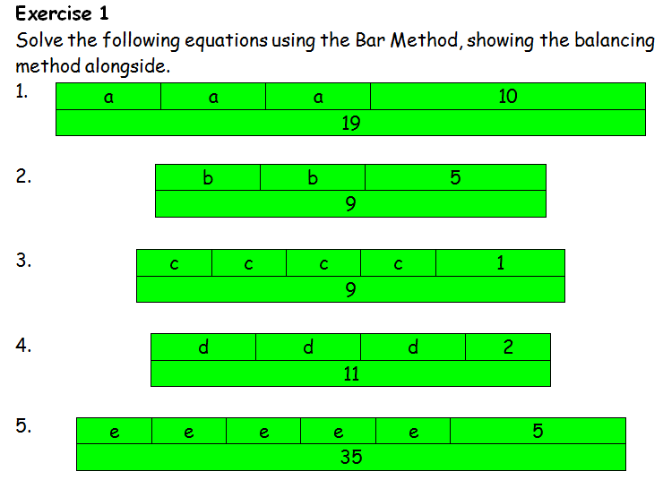

Slide 20
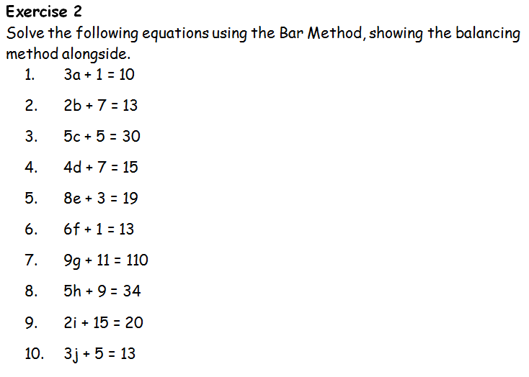

Slide 21
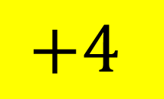
What is the value of $z$?
$$2z −4 =6$$
$2z$
$$2z −4 =6$$
$$4$$
$$6$$
$$+4$$
$$+4$$
$$+4$$
$2z$
$$2z =10$$
$$÷2$$
$$÷2$$
$$z =5$$
$$6$$
$$4$$
$$÷2$$
$$z$$
$$z=5$$
$$5$$

Slide 22
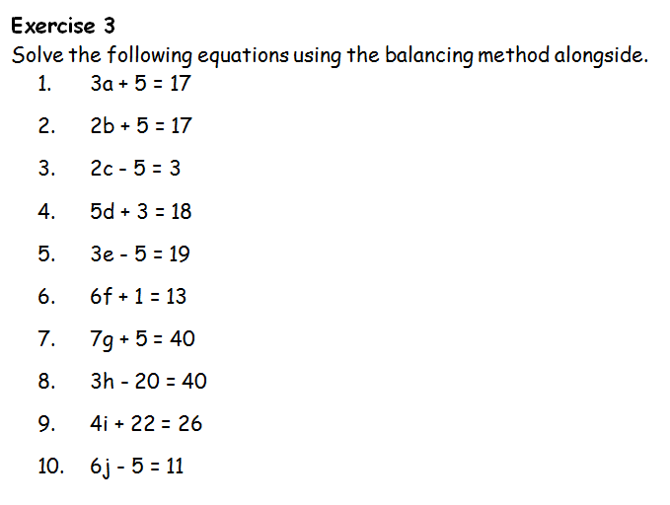

Slide 23
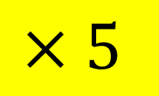
What is the value of $g$?
$$\frac{g}{5}+2 =6$$
$$\frac{1}{5}g$$
$$2$$
$$\frac{g}{5}+2=6$$
$$6$$
$$−2$$
$$−2$$
$$−2$$
$$\frac{g}{5}=4$$
$$\frac{1}{5}g$$
$$×5$$
$$×5$$
$$4$$
$$×5$$
$$g=20$$
$$\frac{1}{5}g$$
$$\frac{1}{5}g$$
$$\frac{1}{5}g$$
$$\frac{1}{5}g$$
$$\frac{1}{5}g$$
$$4$$
$$4$$
$$4$$
$$4$$
$$4$$
$$g=20$$

Slide 24
Equations with unknowns on both sides

Slide 25
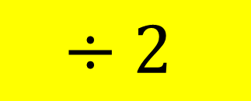
What is the value of $x$?
$$3x +7 =x+13$$
$$x$$
$$x$$
$$x$$
$$7$$
$$x$$
$$13$$
$$−x$$
$$x$$
$$x$$
$$7$$
$$13$$
$$−7$$
$$x$$
$$x$$
$$6$$
$$÷2$$
$$x$$
$$x=3$$
$$3$$

Slide 26
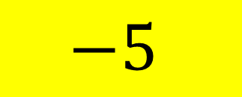
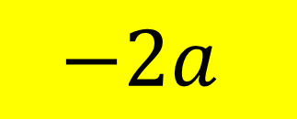
What is the value of $a$?
$$4a +5 =2a+23$$
$$a$$
$$a$$
$$a$$
$$a$$
$$5$$
$$a$$
$$a$$
$$23$$
$$−2a$$
$$a$$
$$a$$
$$5$$
$$23$$
$$−5$$
$$a$$
$$a$$
$$18$$
$$a=9$$
$$÷2$$
$$a$$
$$9$$

Slide 27
What is the value of $a$?
$$4a +5 =2a+23$$
$$a$$
$$a$$
$$a$$
$$a$$
$$5$$
$$a$$
$$a$$
$$23$$
$$−2a$$
$$a$$
$$a$$
$$5$$
$$23$$
$$−5$$
$$a$$
$$a$$
$$18$$
$$a=9$$
$$÷2$$
$$a$$
$$9$$

Slide 28
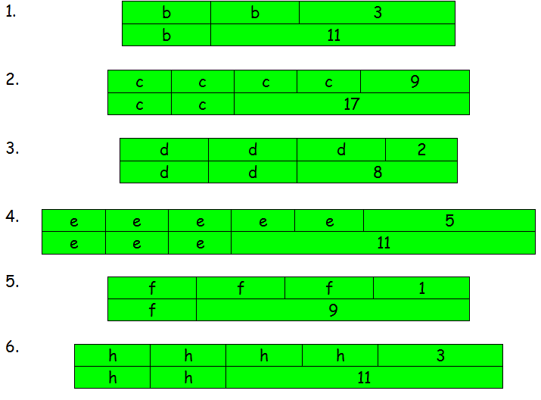

Slide 29
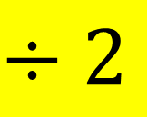
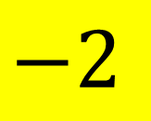
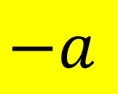
What is the value of $a$?
$$3a +2 =a+12$$
$$a$$
$$a$$
$$a$$
$$2$$
$$a$$
$$12$$
$$−a$$
$$a$$
$$a$$
$$2$$
$$12$$
$$3a +2 =a+12$$
$$−2$$
$$−a$$
$$−2$$
$$a$$
$$a$$
$$2a +2 =12$$
$$10$$
$$−2$$
$$−2$$
$$÷2$$
$$2a=10$$
$$a$$
$$÷2$$
$$÷2$$
$$a=5$$
$$5$$
$$a=5$$

Slide 30
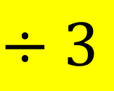
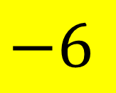
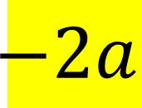
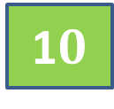
What is the value of $a$?
$$5a +6 =2a+36$$
$$a$$
$$a$$
$$a$$
$$a$$
$$a$$
$$6$$
$$a$$
$$a$$
$$36$$
$$−2a$$
$$a$$
$$a$$
$$a$$
$$6$$
$$36$$
$$5a +6 =2a+36$$
$$−6$$
$$−2a$$
$$−2a$$
$$a$$
$$a$$
$$a$$
$$3a +6 =36$$
$$30$$
$$−6$$
$$−6$$
$$÷3$$
$$3a=30$$
$$a$$
$$÷3$$
$$÷3$$
1$0$
$$a=10$$
$$a=10$$

Slide 31
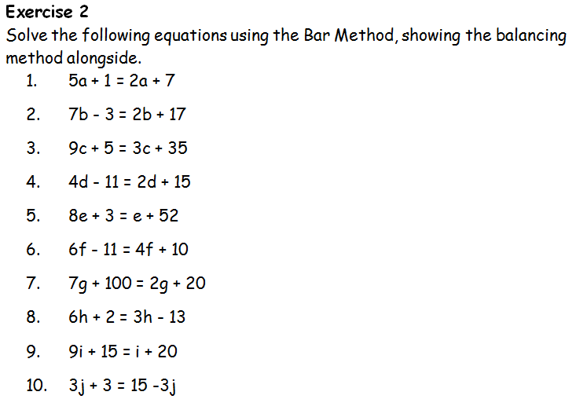

Slide 32
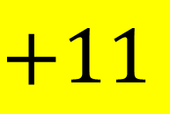
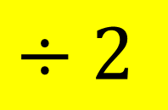
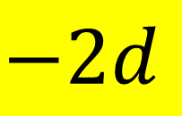
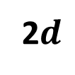
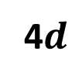
What is the value of $d$?
$$4d−11=2d+15$$
4$d$
$$11$$
$$−2d$$
$$d$$
$$d$$
$$15$$
2$d$
$$4d−11=2d+15$$
$$11$$
$$−2d$$
$$−2d$$
$$+11$$
$$15$$
$$2d−11 =15$$
$$d$$
$$d$$
$$+11$$
$$+11$$
$$15$$
$$11$$
$$2d=26$$
$$÷2$$
$$d$$
$$÷2$$
$$÷2$$
$$d=13$$
$$d=13$$
$$13$$

Slide 33
