Slide 1
Starter:
Out of the strips supplied measure and cut three different coloured strips……
One to a length of 3 cm
One to a length of 8cm
One to a length of 11cm

Slide 2
Creating and Rearranging equations
Grade:
Lesson Objectives:
To be able to use the Singapore bar method to model equations and then be able to use these models to rearrange simple and complex equations.
Key Words:
Equal
Rearrange
Bar Method
Model
Visual
Skills for learning:
Modelling with the Singapore bar method.
Visualising equations.
Rearranging equations.
Learning dispositions needed?
Rate your Smiley!

Slide 3
We can probably all agree on this fact……..
(if we measured accurately)
=
So 3 + 8 = 11
If we take the 11 bar, and chop off 8cm….
=
So 11 – 8 = 3

Slide 4
We can probably all agree on this fact……..
(if we measured accurately)
=
So 3 + 8 = 11
If we take the 11 bar, and chop off 3cm….
=
So 11 – 3 = 8

Slide 5
We can probably all agree on this fact……..
(if we measured accurately)
=
From these three slips of paper we can now create three equations….
3 + 8 = 11 (and also 8 + 3 = 11)
11 – 8 = 3
11 – 3 = 8

Slide 6
We can probably all agree on this fact……..
(if we measured accurately)
=
If we line the bars up like this…..
The three equations are easy to see!
Eg. 11 – 3 = 8
Glue it into your books like this!

Slide 7
This method can be used for algebra too!
Using another three strips, can you model this equation?
a + b = c

Slide 8
This method can be used for algebra too!
a
b
c
What are the four equations we can make from this model?
Glue it into your books like this!

Slide 9
This is the Singapore Bar Method…
….this is how students in Singapore have learnt lots of maths topics for over 20 years!

Slide 10
Using the Bar Method:
Write as many equations as you can from each
x
3
2d
2g
f
4h
y
3a
2b
10
12
2k
2x

Slide 11
Using the Bar Method:
Model these equations and write as many equations as you can from each (you can draw them or cut and stick)
x = y + 5
12 = z + w
2g + h = b
d – 3 = k
2j – 4 = p
3h = 2q - v

Slide 12
Using the Bar Method: Solutions
Remember, your bars don’t need to be the same size as mine, as the quantities and proportions are unknown!
x = y + 5
12 = z + w
2g + h = b
y
5
12
b
x
z
w
2g
h
d – 3 = k
2j – 4 = p
3h = 2q - v
d
2j
v
3h
k
3
4
p
2q

Slide 13
More complex equations:
p
2w
2i
What are the four (or more) equations we can make from this model?
p = 2w + 2i
2w + 2i = p
p – 2w = 2i
p – 2i = 2w
We want w on its own…..so we have to divide both sides by 2!
What if I want to make w the subject of the formula?
p – 2i = 2w
÷2 ÷2
p – 2i = w
2

Slide 14
Using the Bar Method:
Write as many equations as you can from each
3x
z
y
ab
3
4h
2ut
at²
2x
6g
10
7
6w
2s
2x
Extension:
Extension:
Extension:
Make x the subject of the equation
Make w the subject of the equation
Make u the subject of the equation

Slide 15
Bar Vs Balance:
Make u the subject of the equation
2s = 2ut + at²
2s = 2ut + at²
-at² -at²
2ut
at²
2s
2s – at² = 2ut
When we draw a bar model we see….
÷2t ÷2t
2s – at² = 2ut
2s – at² = u
2t
÷2t ÷2t
Remember 2ut means 2 x u x t so to get u alone we divide by 2t
2s – at² = u
2t

Slide 16
Rearranging equations:
Use the method that suits you….
3x = 2y + z + e
4b + 2d = a + c + e
a – 2pz = 3f + s
Main: Make z the subject of the equation
Main: Make c the subject of the equation
Main: Make f the subject of the equation
Extension: Make y the subject of the equation
Extension: Make d the subject of the equation
Extension: Make p the subject of the equation
g = a + 3b - zfq
3a² + 2b – 6 = tr
a² + 4b² = 6ts - 5
Main: Make b the subject of the equation
Main: Make b the subject of the equation
Main: Make t the subject of the equation
Extension: Make f the subject of the equation
Extension: Make a the subject of the equation
Extension: Make b the subject of the equation

Slide 17
Rearranging equations:
Use the method that suits you….
3x = 2y + z + e
4b + 2d = a + c + e
a – 2pz = 3f + s
2y
z
e
a
c
e
a
2x
3x
4b
2d
2pz
s
3f
2x
2x
f = a – 2pz – s
3
p = a – s – 3f
2z
z = 3x - 2y - e
y = 3x – z – e
2
c = 4b + 2d – a - e
d = a + c + e – 4b
2
g = a + 3b - zfq
3a² + 2b – 6 = tr
a² + 4b² = 6ts - 5
g
zfq
3a²
2b
a²
4b²
5
2x
10
a
3b
10
6ts
2x
tr
2x
6
t = a² + 4b² + 5
6s
b = √ 6ts –a² – 5
4
b = g + zq – a
3
f = a + 3b –g
zq
b = tr + 6 – 3a²
2
a = √ tr + 6 - 2b
3
( )
( )

Slide 18
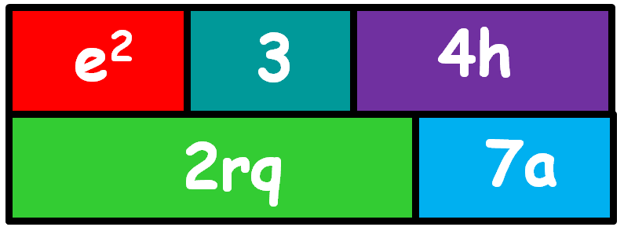
Plenary Check:
So, what can you tell me about this?
Extension: Think of other formulas we know that could be modelled and rearranged using this method?!

Slide 19
It is my intention to add slides looking at rearranging where factorising is required, will be after Jan 22 though!
Amy

Slide 20
What was your effort level today?
100% | I have put in maximum effort throughout the lesson – I have been involved in classroom discussions, worked with others and constantly challenged myself with my learning.
75% | I have put in lots of effort and have challenged myself most of the time. At times I have contributed to classroom discussions and worked with others.
50% | I was not consistent in my efforts and at times I have taken the easy option rather than challenging myself.
25% | I have not made much effort at all and at no point have I challenged myself.
0% | I have not put in any effort today.
Be honest – did you give it your all?

