Slide 1

Welcome
Heads of Maths Network Meeting
19th May 2026
Summer 1 meeting
Jo.Lees@hants.gov.uk
HIAS Mathematics

Slide 2
Hampshire HoDs: Date schedule
All meetings start at 1315 with approximate finish of 1600
Date | Venue
Thursday 9th October 2025 | VOCO Winchester SO21 1HZ
Tuesday 2nd December 2025 | VOCO Winchester SO21 1HZ
Thursday 5th February 2026 | VOCO Winchester SO21 1HZ
Tuesday 17th March 2026 | VOCO Winchester SO21 1HZ
Tuesday 19th May 2026 | VOCO Winchester SO21 1HZ
Tuesday 7th July 2026 | VOCO Winchester SO21 1HZ
GCSE dates :Paper 1 : Thursday 14th May 2026
Paper 2 : Wednesday 3rd June 2026
Paper 3 : Wednesday 10th June 2026
HH2526

Slide 3
Hampshire HoDs: Date schedule
All meetings start at 1330 with approximate finish of 1630
Date | Venue : TBC
Tuesday 6th October 2026
Thursday 19th November 2026
Tuesday 2nd February 2027
Thursday 18th March 2027
Tuesday 22nd June 2027
HH2627

Slide 4
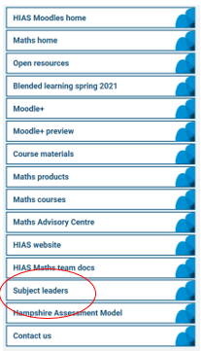



Materials for Hampshire HoDs Meetings
HIAS Maths Moodle (hants.gov.uk)
Subject Leader Meetings 2025/26
HH2526

Slide 5
Agenda : May 19th, 2026
Subject enjoyment: Some maths to get us started
Paper 1 GCSE : Thoughts
AI : Where are we and what is useful and not so useful?
Break
Mixed attainment teaching (EEF secondary maths practice review)
GCSE steps to success project: Engagement and promoting thinking through games
Summary and reflection: A chance to review and adapt your department action plans
AOB / Future foci for meetings
Next time : Tuesday 19th May

Slide 6

Check-in !
How’s it going ?
Successes and challenges ?
Good start to the Summer term?
Transition into new year groups for KS3.
Liaison with primary feeders
Study leave ~ keeping Y11 focussed

Slide 7
Some maths to get us started
a
x
Prove that:
x² = a² + (a – b)²
b

Slide 8
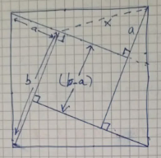
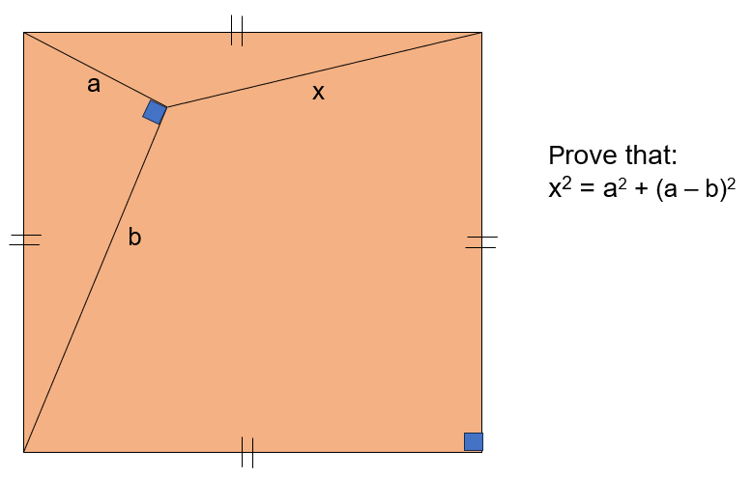
Some maths to get us started
Take the right-angled triangle with short sides ‘a’ and ‘b’
Rotate the triangle by 90⁰ , 3 times
This produces an inner square with side lengths (b-a)
By Pythagoras:
x² = a² + (a – b)²
which is equivalent to
x² = a² + (b – a)²

Slide 9
GCSE Paper 1
Thoughts ?

Slide 10

AI: where are we?
£23m expansion of school edtech and AI pilot announced
Pilot to launch in September, and to involve primary, secondary and further education settings across England
The government is investing £23 million in a four-year pilot to trial artificial intelligence and edtech tools in schools, the education secretary has announced.
It is an expansion of a previous nine-month pilot in which schools and colleges trialled “innovative” edtech tools. It is not clear how many schools took part.
More than 1,000 schools and colleges will be involved in the new project, which will begin in September, the Department for Education confirmed.
Edtech pilot will track impact on staff and pupils
Phillipson told the BETT conference: “We’re investing an additional £23 million to expand our edtech testbed pilot into a four-year programme.
“It recruits schools and colleges to put the latest tech and AI tools through their paces in the cut and thrust of classrooms across the country.
“We’ll track how these tools perform, the difference they make for teachers and, above all, the difference they can make for children.”

Slide 11
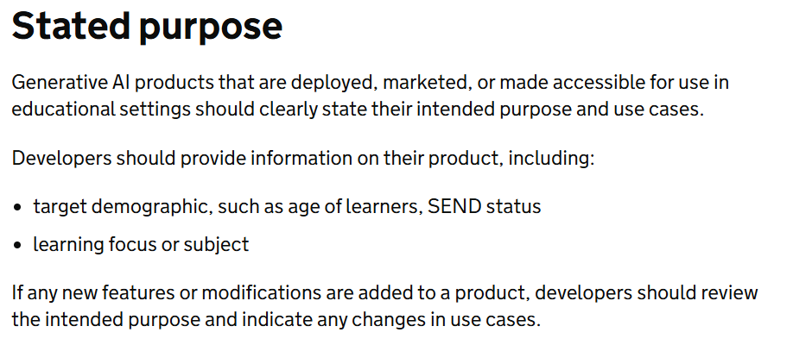
AI: where are we?
£23m expansion of school edtech and AI pilot announced
The DfE said it has already had more than 280 expressions of interest from the edtech sector, from those wanting to be involved in the scheme.
The announcement comes days after the DfE launched new standards for AI tools used in schools, to help protect pupils’ mental health and cognitive development.
Generative AI: product safety standards - GOV.UK
AI products used in schools “should detect signs of learner distress”, such as references to suicide, depression or self-harm, the new non-statutory standards state.
They should also detect spikes in night-time usage, “negative emotional cues” and “patterns of use that indicate crisis”.
If distress is detected, the AI should “follow an appropriate pathway” such as signposting to support and “raising a safeguarding flag” to a school’s lead.

Slide 12
AI: where are we?
£23m expansion of school edtech and AI pilot announced
‘New skills pathways’ announced
Phillipson also announced at BETT that the government will deliver “new skills pathways for…teachers and support staff” to help them “build digital data and tech skills”.
These will not be new qualifications but will instead be incorporated into existing qualifications and training programmes, she said.
Phillipson said she is “so excited about AI”, which she said offers “the chance to make the education system work better for every single learner”.
But she stressed the importance of “human connection”, adding: “There is nothing to match a great teacher at the top of their game.”
“We need to take what’s great about the people in education and combine it with the incredible power of AI.”

Slide 13
AI: where are we?
Ministers to trial AI tutoring in England's schools
Government claims pilot 'could support up to 450,000 children a year on free school meals to access one to one tutoring’
(Blog: Freddie Whittaker)
DfE pilot ~ intends to test “safe AI powered tutoring tools providing personalised, one-to-one learning support – levelling the playing field for those who cannot afford private tutors”.
Government will run a tender for industry to co-create AI tutoring tools with teachers
From the summer term, there will be “teacher-led co-creation of AI tutoring tools with industry”.
Tools available to schools by end of 2027

Slide 14
AI: where are we?
Ministers to trial AI tutoring in England's schools
Key Aspects of AI in UK Maths Education:
Personalised Tutoring: AI tutoring tools can offer one-to-one, voice-based dialogue to simulate human tutoring, adapting to individual pupil needs.
Teacher Support and Efficiency: Educators are using AI to generate lessons and personalise learning.
One Example: Third Space Learning's Skye
Secondary Maths Tutoring From The AI Tutor Built By Teachers- Third Space Learning

Slide 15
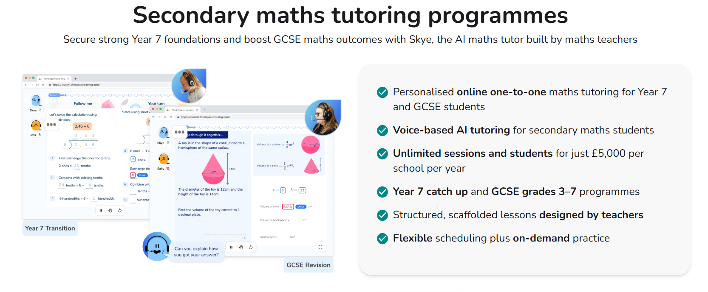
AI: where are we?

Slide 16
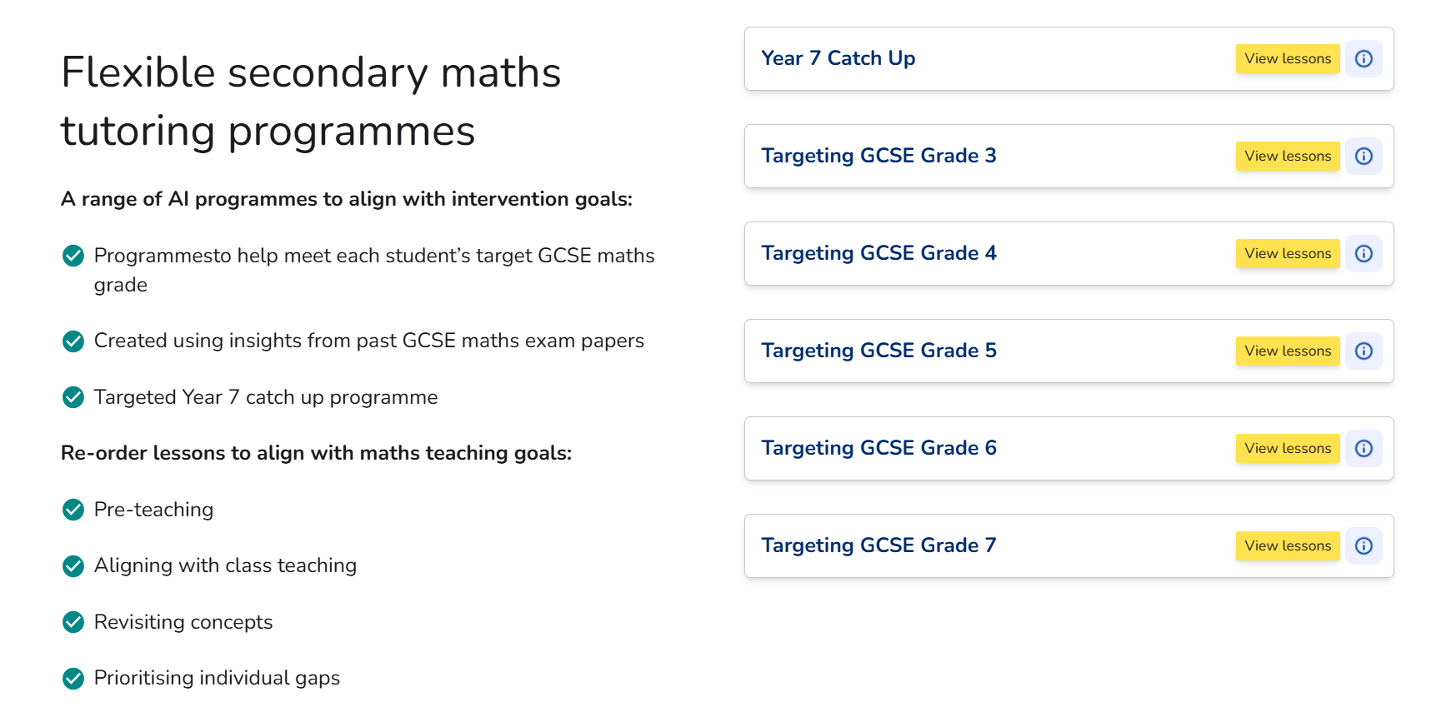
AI: where are we?

Slide 17
AI: where are we?
Thoughts ?

Slide 19
Mixed attainment teaching
Maths pupils ‘make slower progress in mixed ability classes’
Maths pupils 'make slower progress in mixed ability classes’
Using sets for maths also did not 'significantly harm' the attainment of students from poorer backgrounds, finds study (EEF)
Esmé Kenney (Blog)

Slide 20
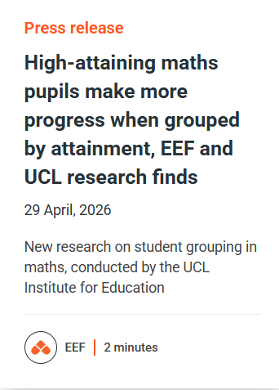
Mixed attainment teaching
Pupils in mixed-ability classes make slower progress in maths compared to those grouped by attainment.
Using sets for maths also did not “significantly harm” the attainment of students from poorer backgrounds, or those with low attainment earlier in school.
The report was published by the Education Endowment Foundation in April 2026, based on research conducted by the UCL Institute of Education. It investigated the impact of different ways of putting pupils in maths classes.
The study compared the attainment and self-confidence of year 7 and 8 pupils taught in mixed-ability classes with those taught in sets between September 2022 and July 2024.

Slide 21
Mixed attainment teaching
Of the 97 schools that took part, 28 of them used mixed attainment groups while 69 used setting for maths.
It found pupils in schools with mixed-ability classes made one month’s less progress in maths compared to pupils who were grouped based on attainment.
Pupils with higher previous attainment in maths made about two months’ less progress when put in mixed ability classes rather than sets.
But pupils with lower previous attainment and those from poorer backgrounds made similar progress regardless of whether they were taught in sets or not.

Slide 22
Mixed attainment teaching
‘Stretch opportunities’ needed in mixed-sets
The report recommended schools should make sure their specialist maths teachers don’t just teach the top sets and make it possible for pupils to move between sets based on attainment.
Lesson observations suggested the content of mixed-ability classes was closer to what was taught in lower sets than higher sets in schools that grouped pupils by ability.
The report also recommended that schools that continued to use mixed-attainment groups make sure teachers provide “stretch opportunities” for higher-achieving pupils.

Slide 23
Mixed attainment teaching
Becky Francis, CEO of the Education Endowment Foundation, called the study an “important step forward”.
“While this is something people have passionate views on, there’s so much we don’t know. Much of the existing evidence is from other contexts and countries.
“These results contribute to our understanding of good practice in maths. We hope more research can expand our understanding on this important topic.”

Slide 24
Mixed attainment teaching
Becky Taylor, of the UCL Institute of Education, said the study “provides the strongest evidence to date on attainment grouping in England and provides new insights into how mathematics teachers can support low and high attaining pupils whether in sets or mixed attainment groups”.
The study also found negative effects on self-confidence in maths for students in mixed attainment schools compared to those in schools using setting, although the negative effects were small for the group as a whole.

Slide 25
Mixed attainment teaching
Thoughts ?

Slide 26
GCSE Steps to Success : Increasing engagement with Top Trumps
Playing Top Trumps in maths lessons: A powerful way to explore mathematical properties and make rich connections in a collaborative, discursive way
Top Trumps can be a rich, low‑threshold‑high‑ceiling tool for exploring mathematical properties, reasoning, and mathematical language.
When designed well, a Top Trumps activity can transform abstract concepts into something accessible, tactile, competitive, and engaging.

Slide 27
GCSE Steps to Success : Increasing engagement with Top Trumps
Why Top Trumps Works in Maths (for example ‘Properties of Integers)
1. It turns properties into comparisons
Students often learn such things as number properties (prime, square, factor-rich, etc.) as isolated facts. Top Trumps encourages them to compare numbers across multiple attributes, which strengthens conceptual understanding.
2. It encourages mathematical justification
To win a round, students must choose the “best” attribute. That choice demands reasoning:
“24 has more factors than 18 because…”
“49 is a square number but 48 isn’t…”
“Prime numbers tend to have fewer factors…”
This is the kind of talk we want in our classrooms

Slide 28
GCSE Steps to Success : Increasing engagement with Top Trumps
Why Top Trumps Works in Maths (for example ‘Properties of Integers)
3. It is naturally accessible to all, with opportunities for success for all
Lower-attaining students can focus on identifying properties.
Higher-attaining students can debate which properties matter most and why.
Everyone participates because the game structure is familiar and accessible.
4. It builds fluency without worksheets
Students repeatedly encounter:
factor pairs
multiples
primes
squares and cubes
place value patterns
divisibility rules
But in a way that feels informal, rather than drill and practice.

Slide 29
GCSE Steps to Success : Increasing engagement with Top Trumps
How you might run the task in class
1. Start with a quick warm‑up
Ask students:
“What properties could we use to compare numbers?”
“Which properties make a number ‘strong’?”
This primes them for the game.
2. Give each pair or group a deck
You can create:
a teacher‑made deck
a mixed deck where students design some cards
a fully student‑generated deck (excellent for deep learning)
3. Play the classic Top Trumps rules
Students take turns choosing an attribute to compete on. The highest (or lowest, if you choose) wins the round.
4. Build in structured talk
Prompts like:
“Explain why you chose that attribute.”
“What do you notice about the numbers in this round?”
“Which attribute is the most powerful in this deck?”
This turns a game into a reasoning task.
5. Debrief mathematically
After the game, ask:
“Which numbers were surprisingly strong?”
“Which attributes dominated?”
“What patterns did you spot?”
This is where the learning consolidates.

Slide 30
GCSE Steps to Success : Increasing engagement with Top Trumps
Ideas for Deepening the Task
1. Create a ‘balanced’ deck
Challenge students to design numbers so no single attribute always wins. This leads to rich discussion about:
primes vs composites
factor density
square numbers
place value structure
2. Link to prime factorisation
Add attributes like:
“Largest prime factor”
“Prime factorisation length”
Students must break numbers down to compare them.
3. Use it as a retrieval routine
Start each lesson with one card on the board:
“What properties can you identify?”
“Which card in the deck would beat this one for ‘number of factors’?”
A brilliant 3‑minute warm‑up.
4. Turn it into a reasoning challenge
Give students two cards and ask:
“Which attribute should you choose to guarantee a win?”
“Is there a situation where neither card is dominant?”
This builds strategic thinking.

Slide 31
GCSE Steps to Success : Increasing engagement with Top Trumps
Which skills and strategies might be developed using top trumps style tasks?
Top Trumps can strengthen:
fluency with number properties
confidence with mathematical vocabulary
strategic reasoning
pattern-spotting
justification and explanation
collaborative problem-solving
Through the enjoyment and engagement in a game, some deep mathematical thinking and conceptual understanding can be developed.

Slide 32
GCSE Steps to Success : Increasing engagement with Top Trumps
“Top Trumps”
Properties of Integers (KS3)
One hundred and twenty-one | 121
Odd ? | Yes
Prime? | No
Number of factors | 3
Square? | Yes
Cube? | No
Triangular? | No
Number of ‘Hundreds’ | One
Number of ‘Tens’ | Two
Sum of the digits | 4
NB: For yes/no answers , the ‘yes’ answer trumps the ‘no’
“Top Trumps”
Properties of Number: KS4
One hundred and forty-four | 144
Irrational ? | No
Prime? | No
Number of factors | 15
Square? | Yes
Cube? | No
Surd ? | No
Value of index | 1
Less than one ? | No
Value of the ones in standard form | 1 . 44 x 10²
NB: For yes/no answers , the ‘yes’ answer trumps the ‘no’
Table Task : Discuss and design

Slide 33
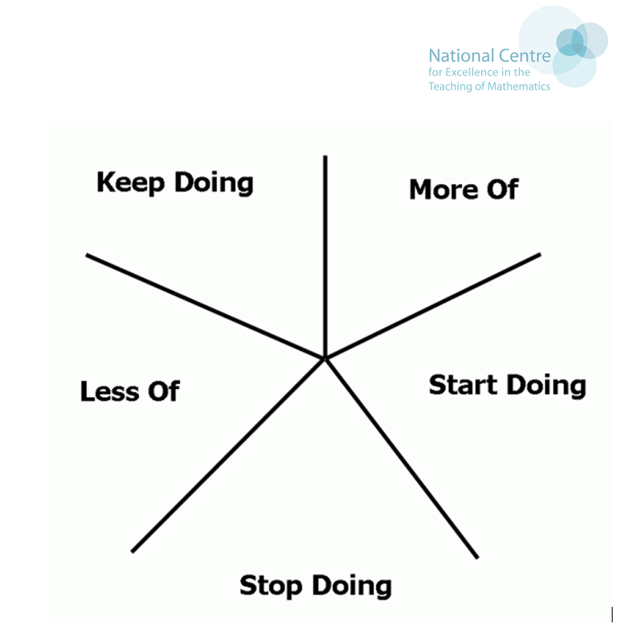
Reflect and Review
Department Action Plan
Take a moment to jot down the key elements of your department action plan for this year and next.
With whom?
When?
How?
Followed up when/ how?

Slide 34
A.O.B
Future priorities and foci?
email me at jo.lees@hants.gov.uk

Slide 35
Next Meeting : VOCO, Winchester
Tuesday 7th July : 1315 start
Look forward to seeing you all there
Password for Moodle materials HH2526

Slide 36
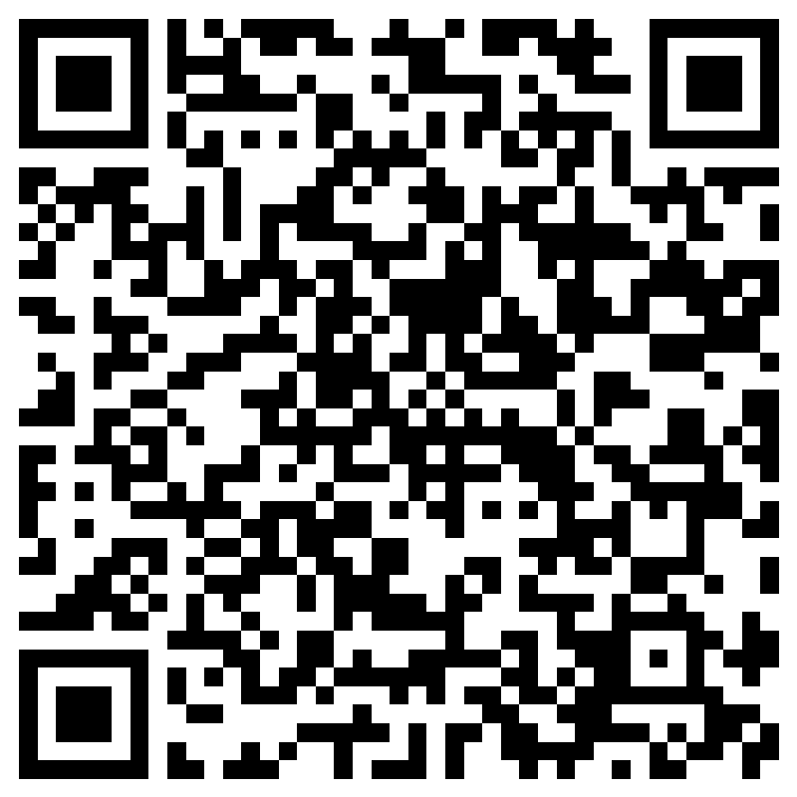
Your feedback matters
Please scan the QR code to complete our online training evaluation form
Or access the form using the URL below:
https://forms.office.com/r/QE21XtDJ2r
Thank you!

