Slide 1
Year 7
HIAS Blended Learning Resource
An Introduction to Probability (unit 7.7)
This unit is about Probability.
This topic is not addressed in the primary curriculum and students will not therefore have met this concept in any
depth before.
This unit introduces the 0-1 probability scale and the idea of outcomes from an event.
Students are required to carry out simple probability experiments, record the outcomes and draw conclusions about
the probability of events based on their results.
These problems are about the chances of selecting coloured counters from a bag.
Students will need to be able to generate equivalent fractions and identify lowest common multiples
HIAS maths Team
Spring 2021
Final version
© Hampshire County Council

Slide 2
HIAS Blended Learning Resource
These slides are intended to support teachers and students with a blended approach to learning, either in-class or online. The tasks are intended to form part of a learning journey and could be the basis of either one lesson or a short sequence of connected lessons.
Teachers should delete, change and add slides to suit the needs of their students. Extra slides with personalised prompts and appropriate examples based on previous teaching may be suitable. When changing the slide-deck, teachers should consider:
Their expectations for the use of representations such as bar models, number lines, arrays and geometric diagrams.
Which strategies and methods students should use and record when solving problems or identifying solutions. This could include a range of informal jottings and diagrams, the use of tables to record solutions systematically and formal or informal calculation methods.
Teachers may also wish to record a ‘voice over’ to talk students through the slides.

Slide 3
HIAS Blended Learning Resource
YEAR 7: SPRING TERM OVERVIEW
Week | HIAS Unit | Topic
1 | Unit 7.6 | Four operations: Fractions (vulgar and decimal)
2 | Unit 7.7 | Probability: 0-1 scale
3 | Unit 7.8 | Geometry: Polygons
4 |  | Geometry: Area
5 |  | Geometry: Volume and 3-D shape
 | Half term
6 | Unit 7.9 | Percentages (of amounts)
7 |  | Percentages (FDP equivalence)
8 |  | Ratio and proportion: Notation and part: whole
9 | Unit 7.10 | Coordinates (four quadrants)
10 |  | Coordinates (linear functions )

Slide 4
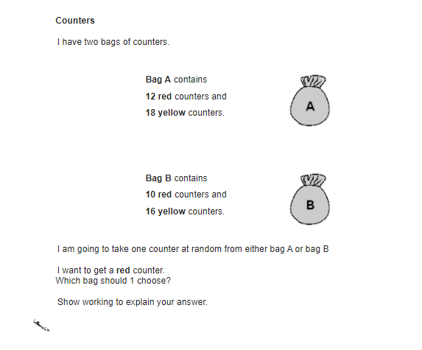
HIAS Blended Learning Resource
5 red counters and
5 yellow counters
4 red counters and
6 yellow counters
Notes:
Solutions
Select Bag A as there is a $\frac{5}{10}$ probability of getting a red counter and Bag B only has a $\frac{4}{10}$
$\frac{5}{10}$ >$\frac{4}{10}$

Slide 5
HIAS Blended Learning Resource
7 red counters and
3 yellow counters
7 red counters and
13 yellow counters
Notes:
Solutions
Select Bag A as there is a $\frac{7}{10}$ probability of getting a red counter and Bag B only has a $\frac{7}{20}$
$\frac{7}{10}$ >$\frac{7}{20}$

Slide 6
HIAS Blended Learning Resource
6 red counters and
2 yellow counter
7 red counters and
2 yellow counters
Notes:
Solutions
Select Bag B as there is a $\frac{7}{9}$ probability of getting a red counter and Bag A only has a $\frac{6}{8}$
$\frac{7}{9}$ >$\frac{6}{8}$ (0.77777 > 0.75)

Slide 7
HIAS Blended Learning Resource
Problem taken from ‘Test Base’
Notes:
Solutions
Select Bag A as there is a $\frac{12}{30}$ = $\frac{2}{5}$ = $\frac{26}{65}$ probability of getting a red counter and Bag B only has a $\frac{10}{26}$ = $\frac{5}{13}$ = $\frac{25}{65}$
$\frac{12}{30}$>$\frac{10}{26}$ (0.4 > 0.38…)

Slide 8
HIAS Blended Learning Resource
3 blue counters and
17 red counters and
5 yellow counters
1 blue counter
17 red counters and
2 yellow counters
Notes:
Solutions
Select Bag B as there is a $\frac{17}{20}$ probability of getting a red counter and Bag A only has a $\frac{17}{25}$
$\frac{17}{20}$ >$\frac{17}{25}$ (85% > 68%)

Slide 9
HIAS Blended Learning Resource
I have three bags of counters
Bag C contains
3 blue counters and
17 red counters and
5 yellow counters
3 blue counters and
4 red counters and
2 yellow counters
C
1 blue counter
7 red counters and
15 yellow counters
I am going to take one counter at random from either bag A, bag B or bag C
I want to get a green counter
Which bag should I choose ?
Notes:
Solutions
There are no green counters. The probability of getting a green counter from any bag is 0

Slide 10
HIAS Blended Learning Resource
I have three bags of counters
Bag C contains
7 blue counters and
2 red counters and
5 yellow counters
9 blue counters and
5 red counters and
4 yellow counters
C
9 blue counter
10 red counters and
8 yellow counters
I am going to take one counter at random from either bag A, bag B or bag C
I want to get a blue counter
Which bag should I choose ?
Notes:
Solutions
Select Bag A or Bag C.
There is a $\frac{9}{18 }$ (=$\frac{1}{2 }$ ) probability of getting a blue counter from Bag A
There is a $\frac{7}{14 }$ (=$\frac{1}{2 }$ ) probability of getting a blue counter from Bag C
There is a $\frac{9}{27 }$ (=$\frac{1}{3 }$ ) probability of getting a blue counter from Bag B
$\frac{1}{2}$ >$\frac{1}{3}$ (0.5 > 0.3333…)

Slide 11
HIAS Maths team
HIAS Blended Learning Resource
The HIAS maths team offer a wide range of high-quality services to support schools in improving outcomes for learners, including courses, bespoke consultancy and in-house training.
For further details, please contact any member of the secondary maths team:
Jo Lees: Jo.Lees@hants.gov.uk
Jenny Burn: Jenny.Burn@hants.gov.uk
Tessa Ingrey: Tessa.Ingrey@hants.gov.uk
For further details on the full range of services available please contact us using the following details:
Tel: 01962 874820 or email: hias.enquiries@hants.gov.uk
For further details on the full range of services available please contact us using the following details:
Tel: 01962 874820 or email: hias.enquiries@hants.gov.uk

