Slide 1
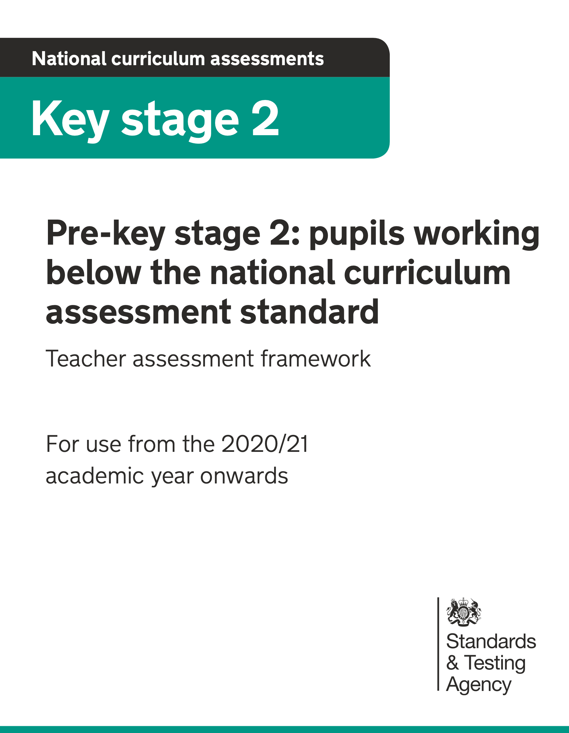
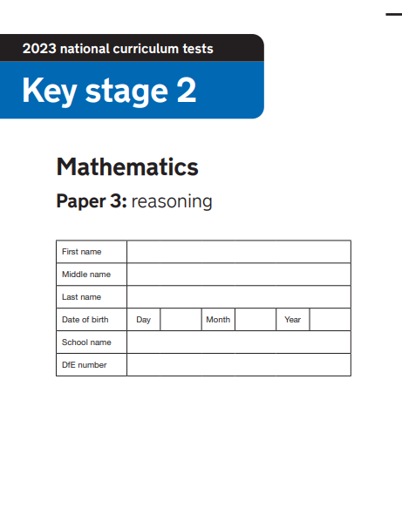
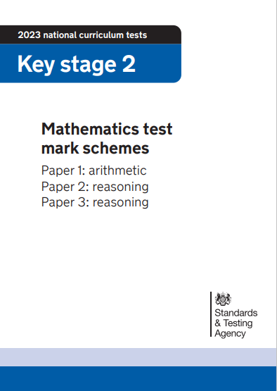
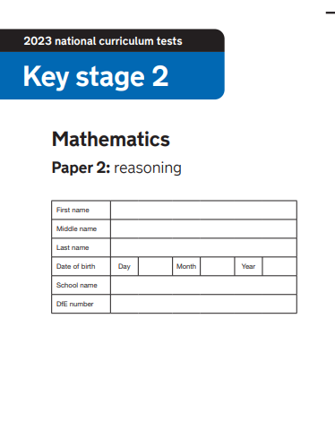
2023 Key Stage 2 SATs Mathematics
Arithmetic Paper 1
Reasoning Paper 2
Reasoning Paper 3
Pre- Key Stage 2 Standards

Slide 2
Key Stage 2 SATs papers 2022
Key stage 2 tests: 2023 mathematics test materials - GOV.UK (www.gov.uk)
Key stage 2 SATs 2023 scaled scores published in July 2023 Guidance
Scaled scores at key stage 2
Information for headteachers, teachers, governors and local authorities about scaled scores and the expected standard for the 2023 national curriculum tests.
Understanding scaled scores at key stage 2 - GOV.UK (www.gov.uk)

Slide 3
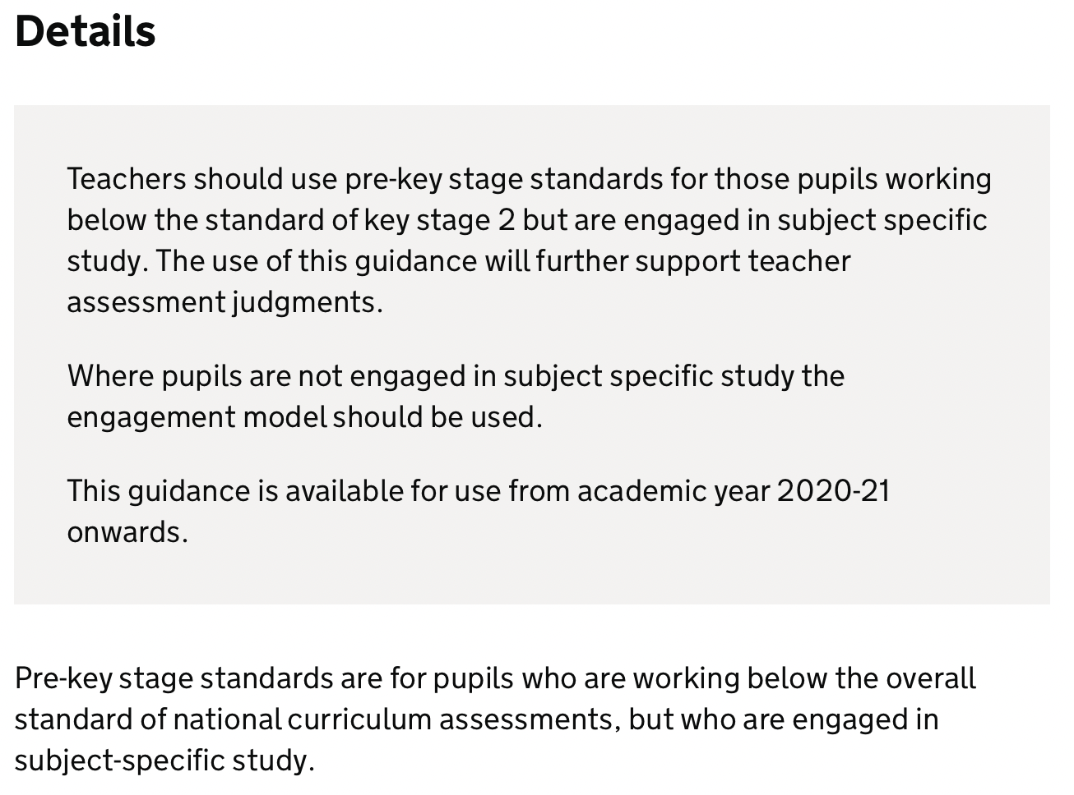
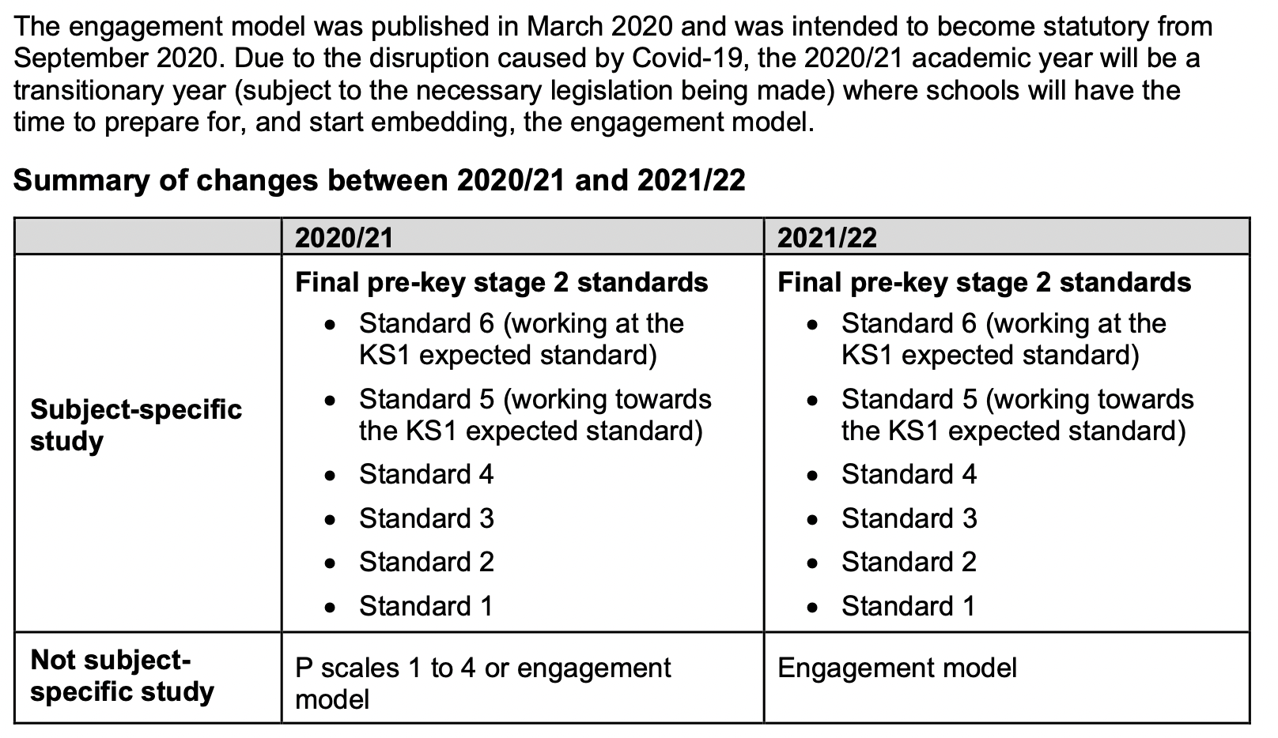
Pre-key stage 2 standards
https://www.gov.uk/government/publications/pre-key-stage-2-standards

Slide 4
Pre Key Stage 2
Using the mathematics pre-key stage standards
The six standards in this framework contain a number of ‘pupil can’ statements. To judge that a pupil is working at a standard in mathematics, teachers need to have evidence which demonstrates that the pupil meets all of the statements within that standard.
As stated on page 3, teachers should assess each individual pupil based on their own method of communication, and disregard statements which a pupil is physically unable to access.

Slide 5
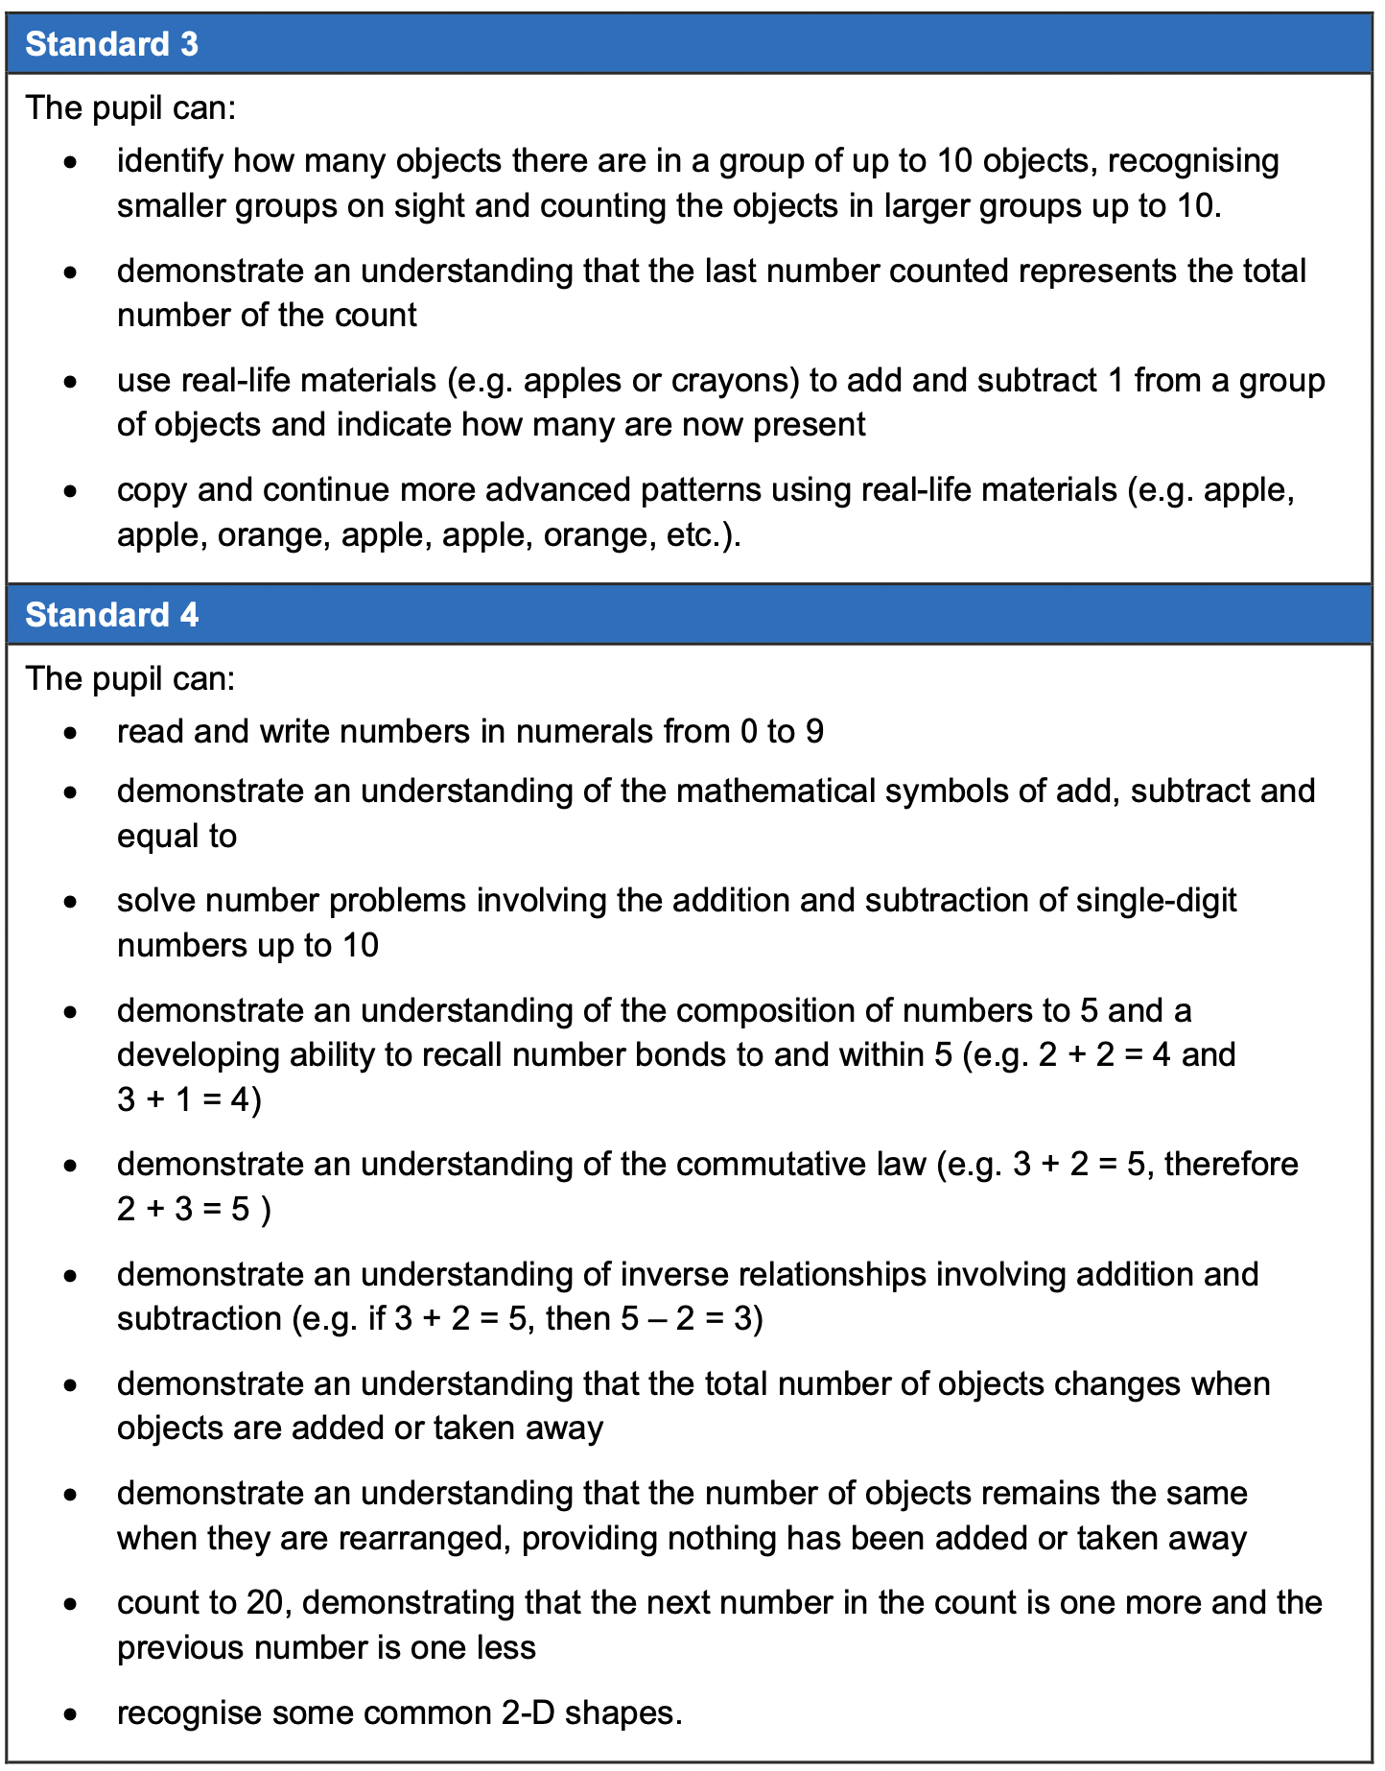
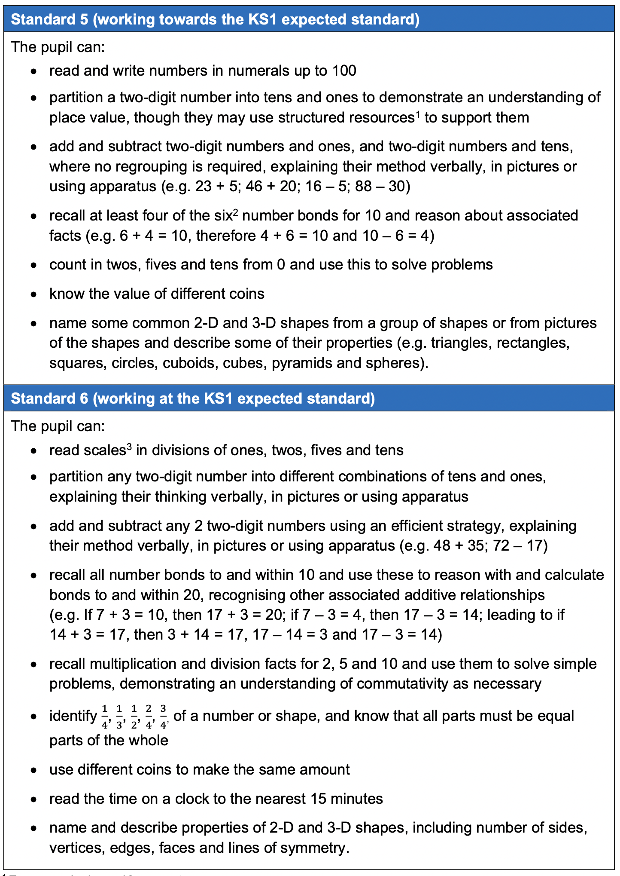

Slide 6
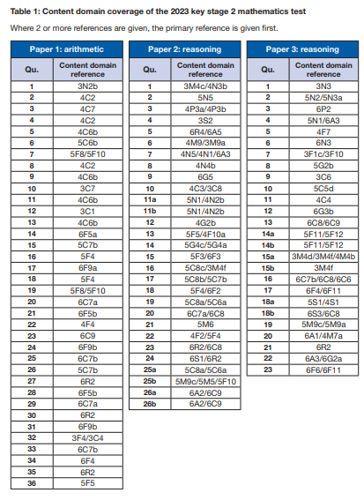
Key Stage 2 Mathematics
Mark Scheme
Content domain coverage
The 2023 test meets the specification in the test framework. Table 1 sets out the areas of the content domain that are assessed in Papers 1, 2 and 3.
The references are taken from the test framework. A question assessing 4C7, for example, sets out to ‘multiply two-digit and three-digit numbers by a one-digit number using a formal written layout’ and is taken from the year 4 programme of study.
2023_key_stage_2_mathematics_mark_schemes.pdf
2016 key stage 2 mathematics test framework (publishing.service.gov.uk)

Slide 7
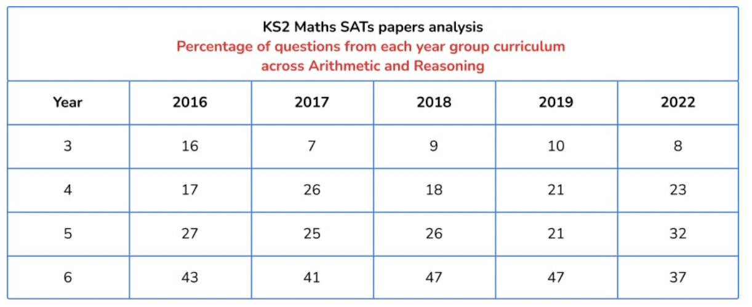
Key Stage 2 Mathematics SATs Papers comparison
Update!
https://thirdspacelearning.com/blog/ks2-sats-papers-2022-maths-question-breakdown/

Slide 8
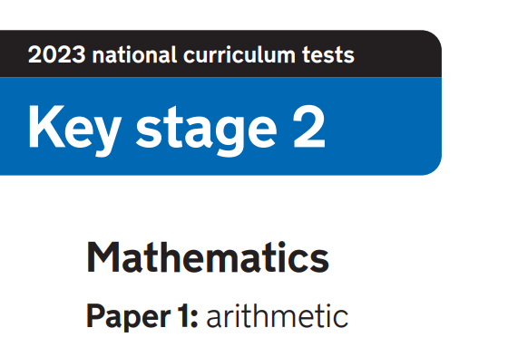
2023_key_stage_2_mathematics_Paper_1_arithmetic.pdf

Slide 9
Key Stage 2 Mathematics
Paper 1: Arithmetic
Arithmetic paper (36Qs)
 | 2016 | 2017 | 2018 | 2019 | 2022 | 2023
Y3 | 8 | 3 | 4 | 4 | 2 | 4
Y4 | 5 | 10 | 9 | 9 | 11 | 9
Y5 | 11 | 7 | 6 | 6 | 6 | 8
Y6 | 12 | 16 | 16 | 16 | 17 | 15
2023_key_stage_2_mathematics_mark_schemes.pdf

Slide 10
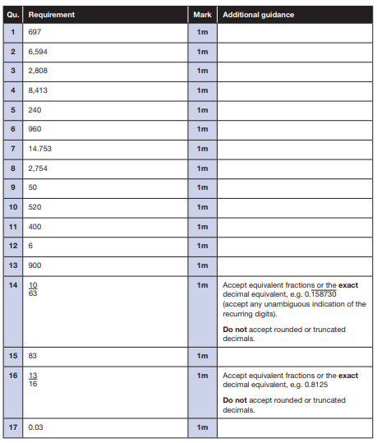
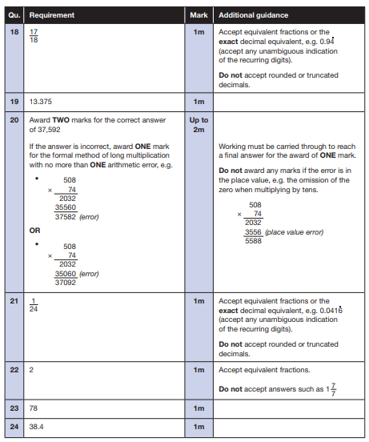
2023_key_stage_2_mathematics_mark_schemes.pdf

Slide 11
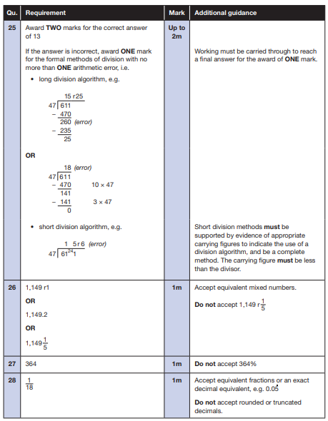
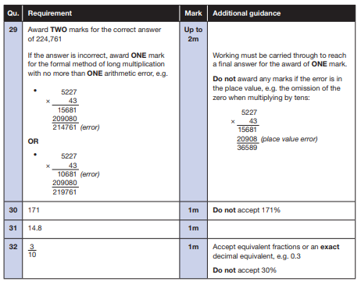
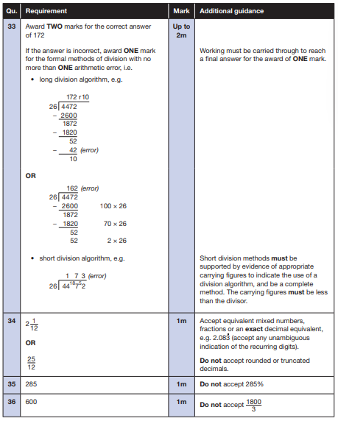
2023_key_stage_2_mathematics_mark_schemes.pdf

Slide 12
Key Stage 2 Arithmetic Paper 2022 Q1- 18
2023_key_stage_2_mathematics_Paper_1_arithmetic.pdf
Notes:
Questions in order of the test top to bottom, left to right..

Slide 13
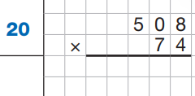
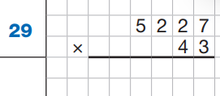
Key Stage 2 Arithmetic Paper 2022 Q19 - 36
https://www.gov.uk/government/publications/key-stage-2-tests-2022-mathematics-test-materials
Notes:
Questions in order of the test top to bottom, left to right..

Slide 14
2023: KS2 Arithmetic Paper Addition and subtraction
2023_key_stage_2_mathematics_Paper_1_arithmetic.pdf
Notes:
Questions in order of the test top to bottom, left to right..

Slide 15
2023: KS2 Arithmetic Paper Multiplication and Division
2023_key_stage_2_mathematics_Paper_1_arithmetic.pdf
Notes:
Questions in order of the test top to bottom, left to right..

Slide 16
2023: KS2 Arithmetic Paper Fractions, Decimals and Percentages
2023_key_stage_2_mathematics_Paper_1_arithmetic.pdf
Notes:
Questions in order of the test top to bottom, left to right..

Slide 17
2023: KS2 Arithmetic Paper Year 3 and 4 questions
2023_key_stage_2_mathematics_Paper_1_arithmetic.pdf
Notes:
Questions in order of the test top to bottom, left to right..

Slide 18
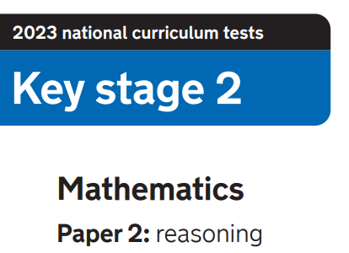
2023_key_stage_2_mathematics_Paper_2_reasoning.pdf

Slide 19
Key Stage 2 Mathematics
Paper 2: Reasoning
Paper2: Reasoning
 | 2016 Q20 | 2017 Q23 | 2018 Q23 | 2019 | 2022 Q25 | 2023 Q26
Y3 | 5 | 0 | 3 | 3 | 2 | 2
Y4 | 2 | 6 | 3 | 4 | 5 | 7
Y5 | 6 | 7 | 6 | 7 | 8 | 13
Y6 | 13 | 8 | 10 | 12 | 10 | 8
*Some are part of a question
2023_key_stage_2_mathematics_mark_schemes.pdf

Slide 20
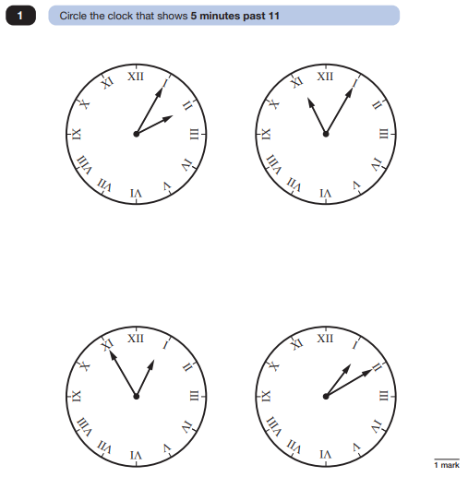
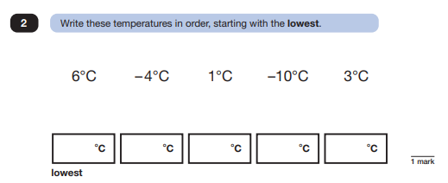
2023 Key Stage 2: Paper 2 Reasoning
2023_key_stage_2_mathematics_Paper_2_reasoning.pdf

Slide 21
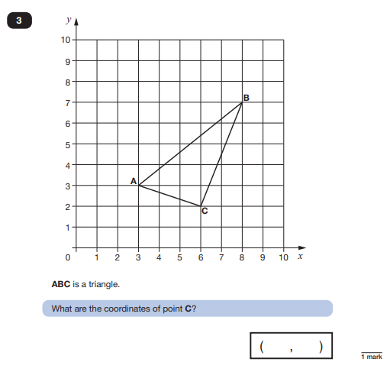
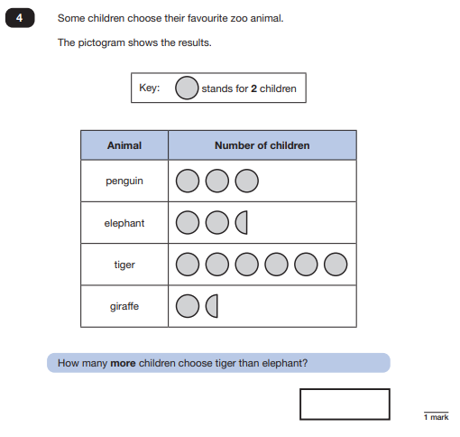
2023 Key Stage 2: Paper 2 Reasoning
2023_key_stage_2_mathematics_Paper_2_reasoning.pdf

Slide 22
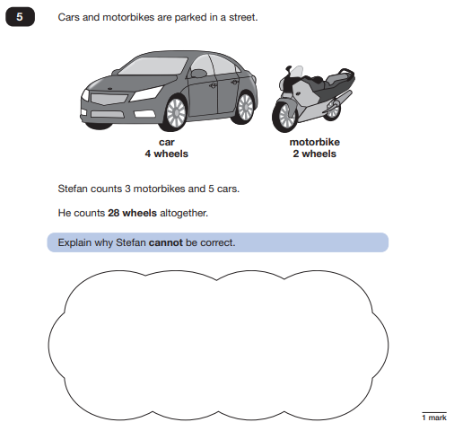
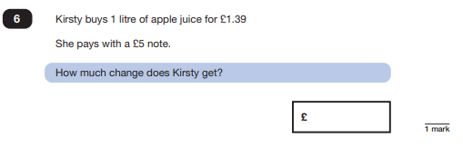
2023 Key Stage 2: Paper 2 Reasoning
2023_key_stage_2_mathematics_Paper_2_reasoning.pdf

Slide 23
2023 Key Stage 2: Paper 2 Reasoning
2023_key_stage_2_mathematics_Paper_2_reasoning.pdf

Slide 24
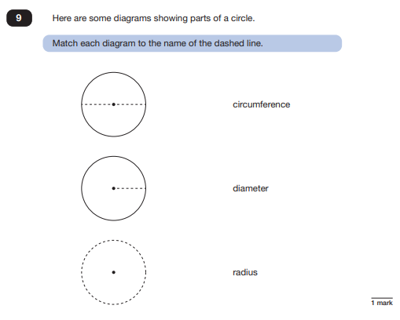
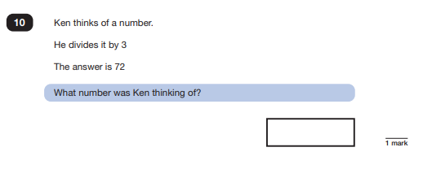
2023 Key Stage 2: Paper 2 Reasoning
2023_key_stage_2_mathematics_Paper_2_reasoning.pdf

Slide 25
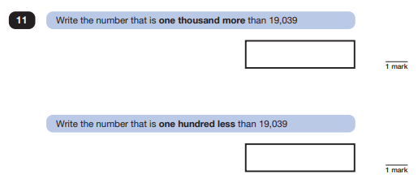
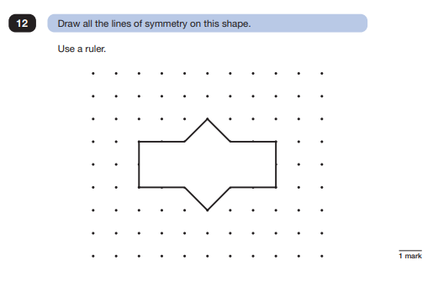
2023 Key Stage 2: Paper 2 Reasoning
2023_key_stage_2_mathematics_Paper_2_reasoning.pdf

Slide 26
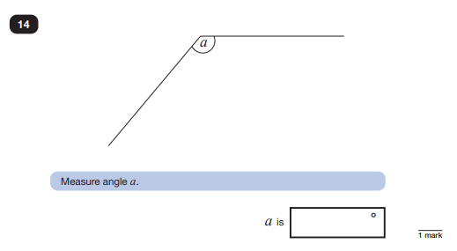
2023 Key Stage 2: Paper 2 Reasoning
2023_key_stage_2_mathematics_Paper_2_reasoning.pdf

Slide 27
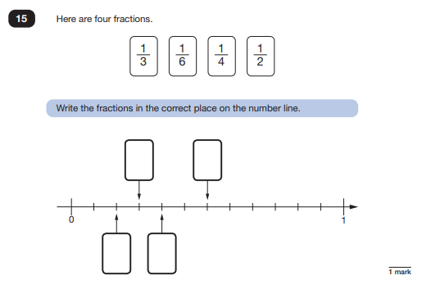
2023 Key Stage 2: Paper 2 Reasoning
2023_key_stage_2_mathematics_Paper_2_reasoning.pdf

Slide 28
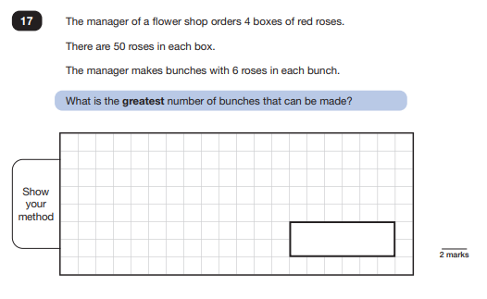
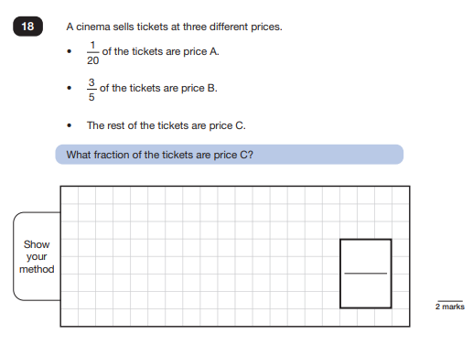
2023 Key Stage 2: Paper 2 Reasoning
2023_key_stage_2_mathematics_Paper_2_reasoning.pdf

Slide 29
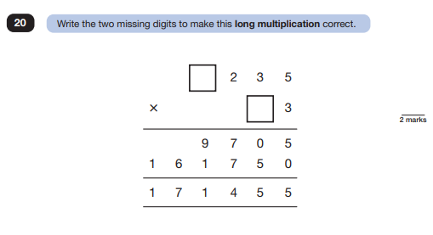
2023 Key Stage 2: Paper 2 Reasoning
2023_key_stage_2_mathematics_Paper_2_reasoning.pdf

Slide 30
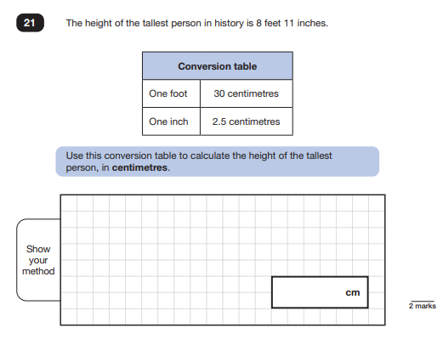
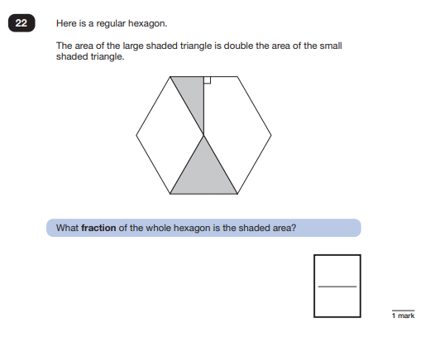
2023 Key Stage 2: Paper 2 Reasoning
2023_key_stage_2_mathematics_Paper_2_reasoning.pdf

Slide 31
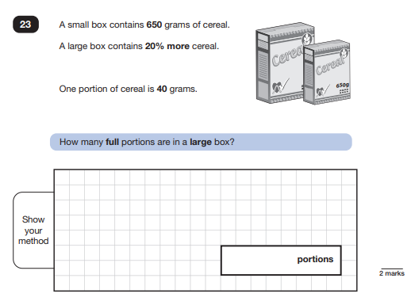
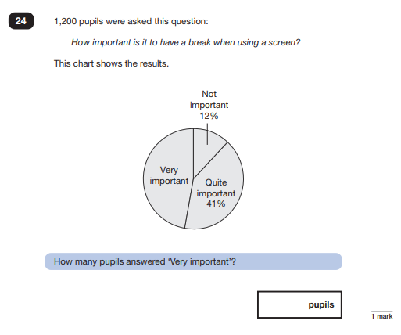
2023 Key Stage 2: Paper 2 Reasoning
2023_key_stage_2_mathematics_Paper_2_reasoning.pdf

Slide 32
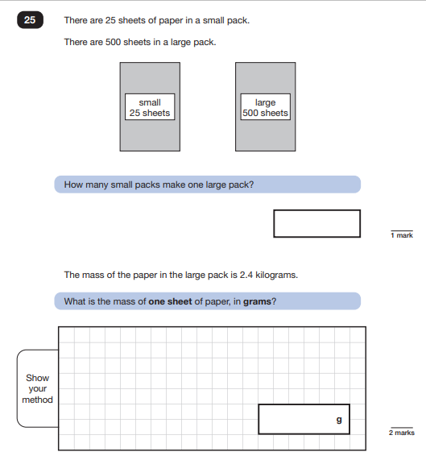
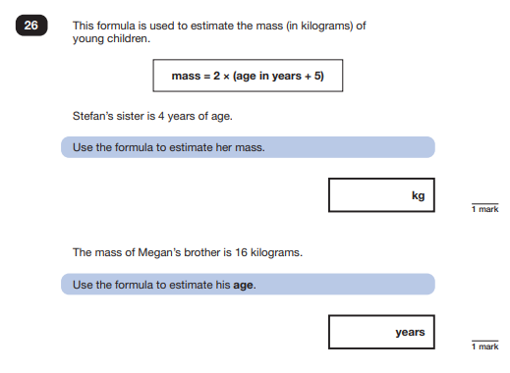
2023 Key Stage 2: Paper 2 Reasoning
2023_key_stage_2_mathematics_Paper_2_reasoning.pdf

Slide 33
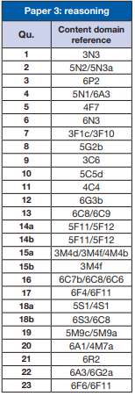
Key Stage 2 Mathematics
Paper 3: Reasoning
Paper2: Reasoning
 | 2016 Q21 | 2017 Q20 | 2018 Q21 | 2019 Q23 | 2022 Q21 | 2023 Q23
Y3 | 1 | 2 | 1 | 5 | 3 | 5
Y4 | 5 | 4 | 3 | 6 | 3 | 2
Y5 | 7 | 5 | 10 | 6 | 12 | 8
Y6 | 13 | 9 | 12 | 11 | 4 | 11
*Some are part of a question
2023_key_stage_2_mathematics_mark_schemes.pdf

Slide 34
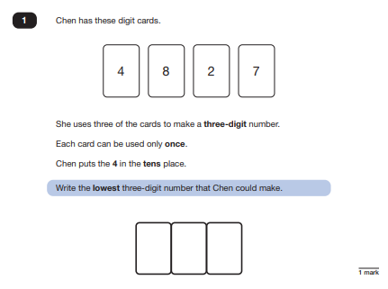
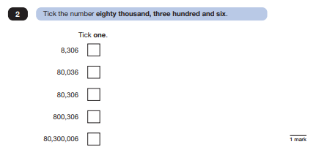
2023 Key Stage 2: Paper 3 Reasoning
2023_key_stage_2_mathematics_Paper_3_reasoning.pdf

Slide 35
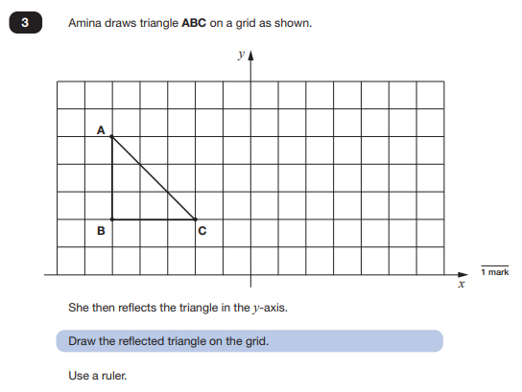
2023 Key Stage 2: Paper 3 Reasoning
2023_key_stage_2_mathematics_Paper_3_reasoning.pdf

Slide 36
2023 Key Stage 2: Paper 3 Reasoning
2023_key_stage_2_mathematics_Paper_3_reasoning.pdf

Slide 37
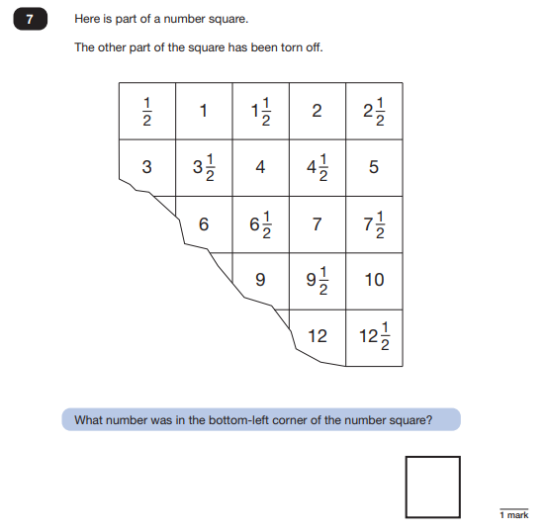
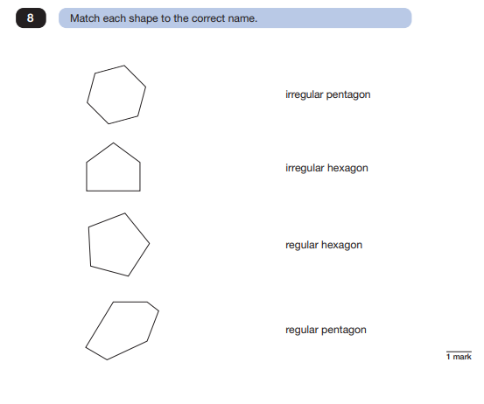
2023 Key Stage 2: Paper 3 Reasoning
2023_key_stage_2_mathematics_Paper_3_reasoning.pdf

Slide 38
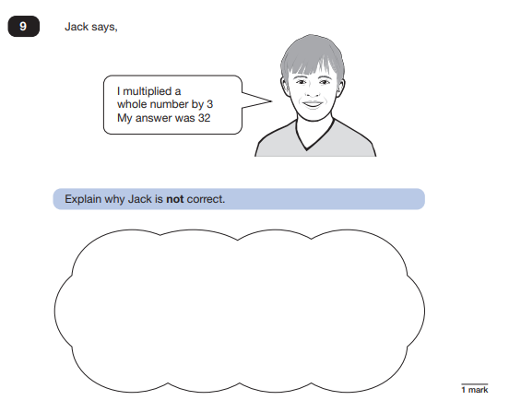
2023 Key Stage 2: Paper 3 Reasoning
2023_key_stage_2_mathematics_Paper_3_reasoning.pdf

Slide 39
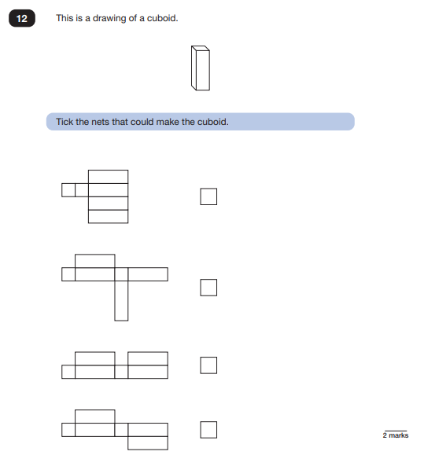
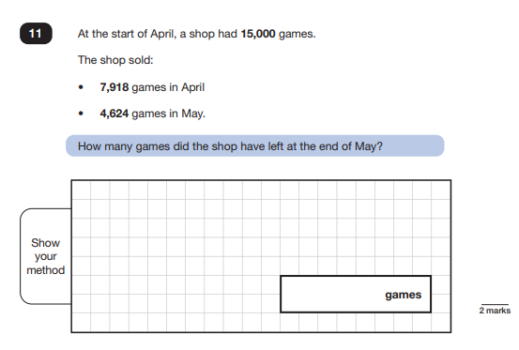
2023 Key Stage 2: Paper 3 Reasoning
2023_key_stage_2_mathematics_Paper_3_reasoning.pdf

Slide 40
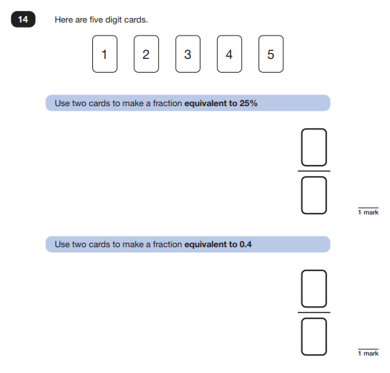
2023 Key Stage 2: Paper 3 Reasoning
2023_key_stage_2_mathematics_Paper_3_reasoning.pdf

Slide 41
2023 Key Stage 2: Paper 3 Reasoning
2023_key_stage_2_mathematics_Paper_3_reasoning.pdf

Slide 42
2023 Key Stage 2: Paper 3 Reasoning
2023_key_stage_2_mathematics_Paper_3_reasoning.pdf

Slide 43
2023 Key Stage 2: Paper 3 Reasoning
2023_key_stage_2_mathematics_Paper_3_reasoning.pdf

Slide 44
2023 Key Stage 2: Paper 3 Reasoning
2023_key_stage_2_mathematics_Paper_3_reasoning.pdf

Slide 45
2023 Key Stage 2: Paper 3 Reasoning
2023_key_stage_2_mathematics_Paper_3_reasoning.pdf

Slide 46
2023 Key Stage 2: Paper 3 Reasoning
2023_key_stage_2_mathematics_Paper_3_reasoning.pdf

