Slide 1
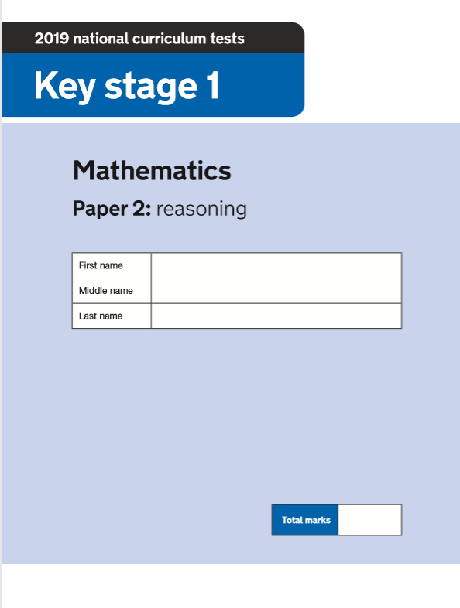
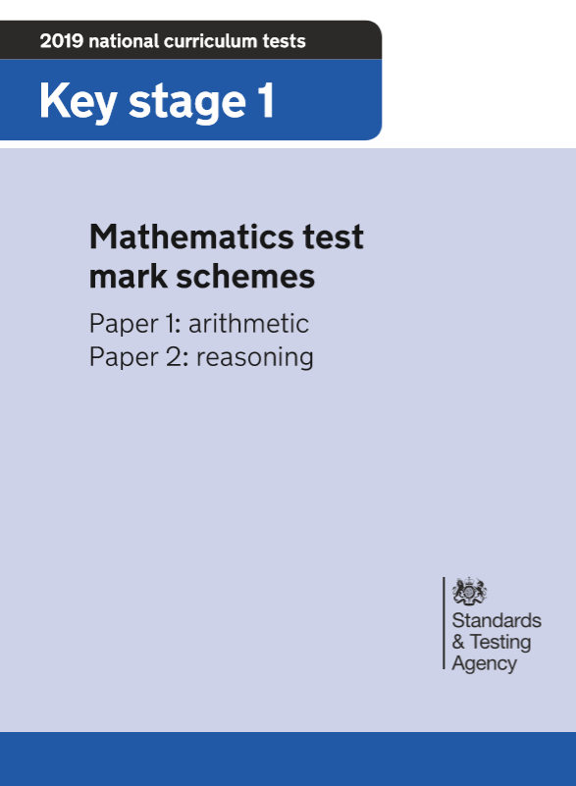
2019 Key Stage 1 SATs Mathematics
Arithmetic Paper 1
Reasoning Paper 2
Pre- Key Stage 1 Standards

Slide 2
Key Stage 1 SATs papers 2019
https://www.gov.uk/government/publications/key-stage-1-tests-2019-mathematics-test-materials?utm_source=e3a18ed3-8191-4d7d-9de6-d98a35b77385&utm_medium=email&utm_campaign=govuk-notifications&utm_content=immediate
Key stage 1 SATs 2019 scaled scores
Details
A scaled score between 100 and 115 shows the pupil has met the expected standard in the test.
The lowest scaled score that can be awarded on a key stage 1 test is 85. The highest score is 115. Pupils need to have a raw score of at least 3 marks to be awarded the minimum scaled score.
The subjects are listed on separate tabs within the Excel spreadsheet.
https://www.gov.uk/government/publications/2019-scaled-scores-at-key-stage-1?utm_source=ac7db3d8-736c-4dbb-a6b2-7da09aa98aee&utm_medium=email&utm_campaign=govuk-notifications&utm_content=immediate
Understanding scaled scores at key stage 1
https://www.gov.uk/guidance/understanding-scaled-scores-at-key-stage-1?utm_source=36c460f0-d4c3-4291-a08d-4227fd051299&utm_medium=email&utm_campaign=govuk-notifications&utm_content=immediate

Slide 3
Understanding scaled scores at key stage 1 https://www.gov.uk/guidance/understanding-scaled-scores-at-key-stage-1?utm_source=36c460f0-d4c3-4291-a08d-4227fd051299&utm_medium=email&utm_campaign=govuk-notifications&utm_content=immediate
What is a scaled score?
Tests are developed to the same specification each year, however, because the questions must be different, the difficulty of tests may vary slightly each year. This means we need to convert the total number of marks a pupil gets in a test (their ‘raw’ score) into a scaled score, to ensure we can make accurate comparisons of pupil performance over time.
Pupils scoring at least 100 will always have met the expected standard on the test. However, given that the difficulty of the tests may vary each year, the number of raw score marks needed to achieve a scaled score of 100 may also change. For example, if the overall difficulty of a test decreases compared with previous years, the raw score required to meet the expected standard will increase. Similarly, if the test is more difficult, the raw score required to meet the expected standard will decrease.
In 2016, panels of teachers set the raw score required to meet the expected standard. We have used data from trialling to maintain that standard for the tests from 2017 onwards.

Slide 4
https://www.gov.uk/guidance/understanding-scaled-scores-at-key-stage-1?utm_source=36c460f0-d4c3-4291-a08d-4227fd051299&utm_medium=email&utm_campaign=govuk-notifications&utm_content=immediate

Slide 5
Range of scaled scores and the expected standard
The range of scaled scores available for each test is the same as set in 2016 and is intended to stay the same in future years. The lowest scaled score that can be awarded on a KS1 test is 85. The highest scaled score is 115.
Pupils scoring at least 100 will have met the expected standard in the test.
A pupil awarded a score of 99 or less has not met the expected standard in the test.
Pupils need a minimum raw score before they can be awarded the lowest scaled score. Pupils who do not achieve the lowest scaled score on the test have not demonstrated sufficient understanding of the KS1 curriculum in the subject. You should award these pupils an N for the test. It is likely that these pupils should be teacher-assessed using the pre-key stage standards.
The conversion tables also show that sometimes 2 or more raw scores convert to the same scaled score. This is because data from pupils showed that the attainment of pupils who score these total marks is not very different.
There are also times when it is not possible to achieve a particular scaled score on this test. This is because of the limited number of questions in these tests, although these scores may be possible on previous or future tests
https://www.gov.uk/guidance/understanding-scaled-scores-at-key-stage-1?utm_source=36c460f0-d4c3-4291-a08d-4227fd051299&utm_medium=email&utm_campaign=govuk-notifications&utm_content=immediate

Slide 6
Using and interpreting test outcomes
You should use evidence from the English reading and mathematics tests to inform your teacher assessment judgement for each pupil. You can also use the optional KS1 English grammar, punctuation and spelling test to inform your teacher assessment judgement in English writing.
The tests can provide evidence that a pupil has met certain ‘pupil can’ statements, as well as evidence to support the judgement overall. Tests and teacher assessment are different forms of assessment, so it is not necessary for the outcomes to be the same.
The national curriculum tests are compensatory – as pupils can score marks from any parts of the tests, pupils with the same total score may achieve their marks in different ways. The teacher assessment frameworks are different and ask teachers to assess pupils against certain aspects of the national curriculum, based on a range of evidence from the classroom.
It is possible for a pupil to have met the expected standard in the test, but not for teacher assessment, because of gaps in their knowledge or understanding. It is also possible for pupils to have demonstrated their attainment of the ‘pupil can’ statements through their classwork, but not to have achieved the mark for a related question on the test. If a pupil gets a question wrong in the test on an area of the curriculum that they have demonstrated in their classwork, the teacher will want to take this into consideration when making their teacher assessment judgement.
Together, the tests and teacher assessment provide a broader picture of pupil attainment
https://www.gov.uk/guidance/understanding-scaled-scores-at-key-stage-1?utm_source=36c460f0-d4c3-4291-a08d-4227fd051299&utm_medium=email&utm_campaign=govuk-notifications&utm_content=immediate

Slide 7
2019 Key Stage 1 Scaled scores: mathematics
https://www.gov.uk/government/publications/2019-scaled-scores-at-key-stage-1

Slide 8
Statutory guidance
Pre-key stage 1 standards
For teachers to report assessment outcomes for pupils working below the standard of national curriculum assessments (commonly called SATs) at the end of KS1.
Details
Pre-key stage standards are for pupils who are working below the overall standard of national curriculum assessments, but who are engaged in subject-specific study.
2018 to 2019 Pre-key stage 1 standards
Teachers must use these standards to make statutory teacher assessment judgements at the end of key stage 1 for pupils who are working below the national curriculum teacher assessment frameworks, and above P scale 4. If a pupil is working below these standards, teachers should report their outcomes using P scales 1 to 4.
These are for use from the 2018 to 2019 academic year onwards. They are the same documents that we originally published in May 2018 to give teachers advance notice of the final standards..
https://www.gov.uk/government/publications/pre-key-stage-1-standards

Slide 9
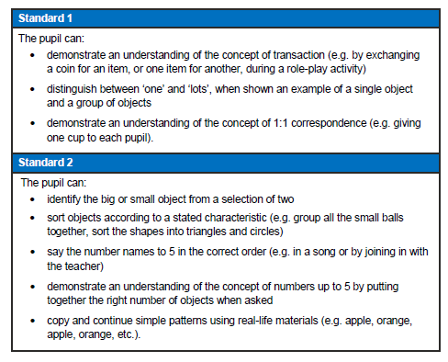
Pre Key Stage 1
…teachers need to have evidence which demonstrates that the pupil meets all of the statements within that standard.’
‘Assess each individual pupil based on their own method of communication, and disregard statements which a pupil is physically unable to access.’

Slide 10
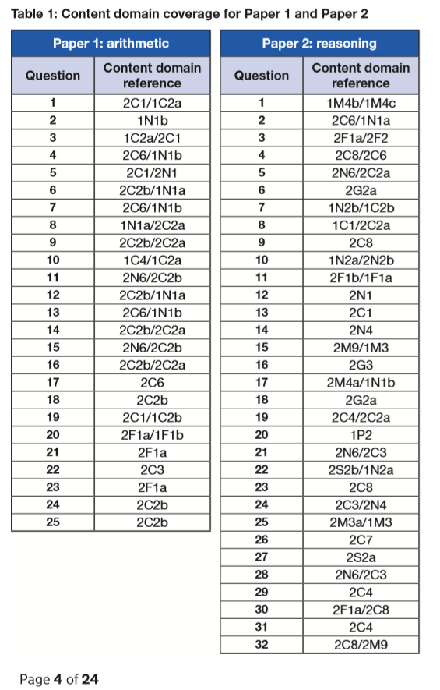
Key Stage 1 Mathematics
Mark Scheme
https://www.gov.uk/government/publications/key-stage-1-tests-2019-mathematics-test-materials

Slide 11
https://www.gov.uk/government/publications/key-stage-1-tests-2019-mathematics-test-materials

Slide 12
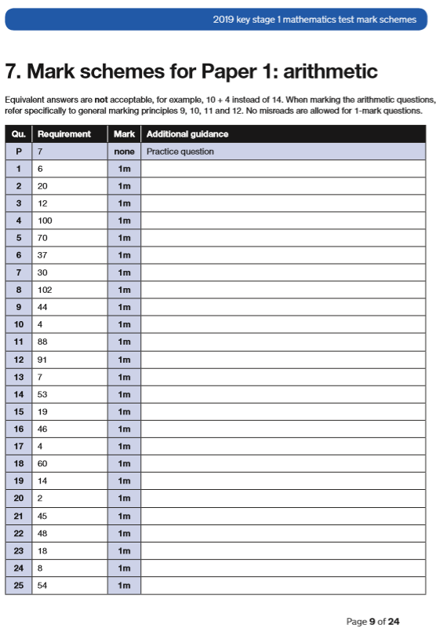
https://www.gov.uk/government/publications/key-stage-1-tests-2019-mathematics-test-materials

Slide 13
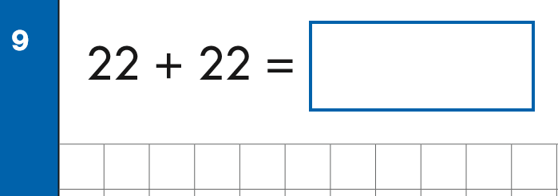
Key Stage 1 Arithmetic Paper 2019
https://www.gov.uk/government/publications/key-stage-1-tests-2019-mathematics-test-materials
Notes:
Questions in order of the test top to bottom, left to right..

Slide 14
Key Stage 1 Arithmetic Paper 2019
https://www.gov.uk/government/publications/key-stage-1-tests-2019-mathematics-test-materials
Notes:
Questions in order of the test top to bottom, left to right..

Slide 15
Key Stage 1 Arithmetic Paper 2019
https://www.gov.uk/government/publications/key-stage-1-tests-2019-mathematics-test-materials

Slide 16
2019: KS1 Arithmetic Paper Addition and subtraction
https://www.gov.uk/government/publications/key-stage-1-tests-2019-mathematics-test-materials
Notes:
Questions in order of the test top to bottom, left to right..

Slide 17
2019: KS1 Arithmetic Paper Multiplication and Division
https://www.gov.uk/government/publications/key-stage-1-tests-2019-mathematics-test-materials

Slide 18
2019: KS1 Arithmetic Paper Fractions
https://www.gov.uk/government/publications/key-stage-1-tests-2019-mathematics-test-materials

Slide 19
https://www.gov.uk/government/publications/key-stage-1-tests-2019-mathematics-test-materials

Slide 20
Key Stage 1 Mathematics
Mark Scheme
https://www.gov.uk/government/publications/key-stage-1-tests-2019-mathematics-test-materials

Slide 21
2019 Key Stage 1: Paper 2 Reasoning

Slide 22
2019 Key Stage 1: Paper 2 Reasoning

Slide 23
2019 Key Stage 1: Paper 2 Reasoning

Slide 24
2019 Key Stage 1: Paper 2 Reasoning

Slide 25
2019 Key Stage 1: Paper 2 Reasoning

Slide 26
2019 Key Stage 1: Paper 2 Reasoning

Slide 27
2019 Key Stage 1: Paper 2 Reasoning

Slide 28
2019 Key Stage 1: Paper 2 Reasoning

Slide 29
2019 Key Stage 1: Paper 2 Reasoning

Slide 30
2019 Key Stage 1: Paper 2 Reasoning

Slide 31
2019 Key Stage 1: Paper 2 Reasoning

Slide 32
2019 Key Stage 1: Paper 2 Reasoning

Slide 33
2019 Key Stage 1: Paper 2 Reasoning

Slide 34
2019 Key Stage 1: Paper 2 Reasoning

Slide 35
2019 Key Stage 1: Paper 2 Reasoning

Slide 36
2019 Key Stage 1: Paper 2 Reasoning

Slide 37
2019 Key Stage 1: Paper 2 Reasoning

Slide 38
2019 Key Stage 1: Paper 2 Reasoning

Slide 39
2019 Key Stage 1: Paper 2 Reasoning

Slide 40
2019 Key Stage 1: Paper 2 Reasoning

Slide 41
2019 Key Stage 1: Paper 2 Reasoning

Slide 42
2019 Key Stage 1: Paper 2 Reasoning

Slide 43
2019 Key Stage 1: Paper 2 Reasoning

Slide 44
2019 Key Stage 1: Paper 2 Reasoning

Slide 45
2019 Key Stage 1: Paper 2 Reasoning

Slide 46
2019 Key Stage 1: Paper 2 Reasoning

Slide 47
2019 Key Stage 1: Paper 2 Reasoning

Slide 48
2019 Key Stage 1: Paper 2 Reasoning

Slide 49
2019 Key Stage 1: Paper 2 Reasoning

Slide 50
2019 Key Stage 1: Paper 2 Reasoning

Slide 51
2019 Key Stage 1: Paper 2 Reasoning

Slide 52
2019 Key Stage 1: Paper 2 Reasoning

