Slide 1
Year 9
HIAS Blended Learning Resource
Probability: Sets and Venn Diagrams (unit 9.6)
Enumerate sets and unions/ intersections of sets systematically, using tables, grids and Venn diagrams
HIAS maths Team
Spring 2021
Final version
© Hampshire County Council

Slide 2
HIAS Blended Learning Resource
These slides are intended to support teachers and students with a blended approach to learning, either in-class or online. The tasks are intended to form part of a learning journey and could be the basis of either one lesson or a short sequence of connected lessons.
Teachers should delete, change and add slides to suit the needs of their students. Extra slides with personalised prompts and appropriate examples based on previous teaching may be suitable. When changing the slide-deck, teachers should consider:
Their expectations for the use of representations such as bar models, number lines, arrays and geometric diagrams.
Which strategies and methods students should use and record when solving problems or identifying solutions. This could include a range of informal jottings and diagrams, the use of tables to record solutions systematically and formal or informal calculation methods.
Teachers may also wish to record a ‘voice over’ to talk students through the slides.

Slide 3
HIAS Blended Learning Resource
YEAR 9: SPRING TERM OVERVIEW
Week | HIAS Unit | Topic
1 | Unit 9.6 | Probability: Sets and Venn diagrams
2 | Unit 9.7 | Statistics: Bivariate data
3 | Unit 9.8 | Proportion: Direct
4 |  | Proportion: Indirect
5 |  | Powers and roots
 | Half term
6 | Unit 7.9 | Approximation
7 |  | Compound units
8 | Unit 9.10 | Geometry: Pythagoras and trigonometry
9 |  | Geometry: Constructions
10 | Unit 9.11 | Algebra: Functions

Slide 4
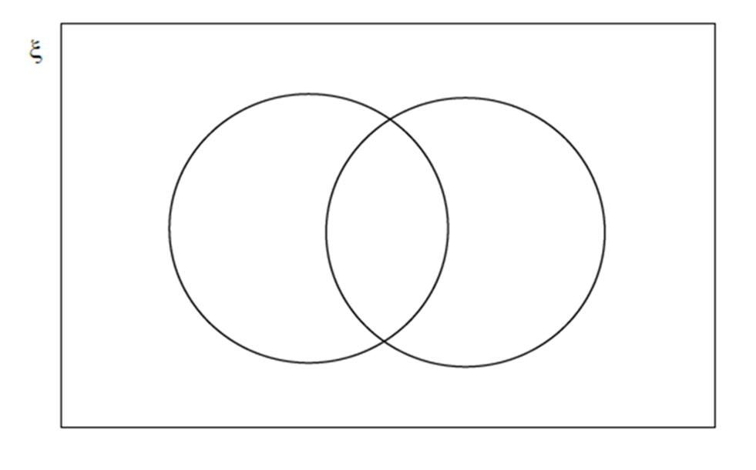
HIAS Blended Learning Resource
50 students are asked if they study Spanish or French.
The Venn diagram shows some information about their answers.
What does the 15 on the diagram represent?
20 students study Spanish but not French.
24 students study French.
Complete the Venn diagram.
Spanish
French
15
Notes:
15 students take both Spanish and French
Venn should show 20 in just Spain (non-intersecting part), 15 in the intersection and 9 (24-15) in just French (non-intersecting part)
6 students don’t study either language and so that number goes inside the box but outside the circles

Slide 5
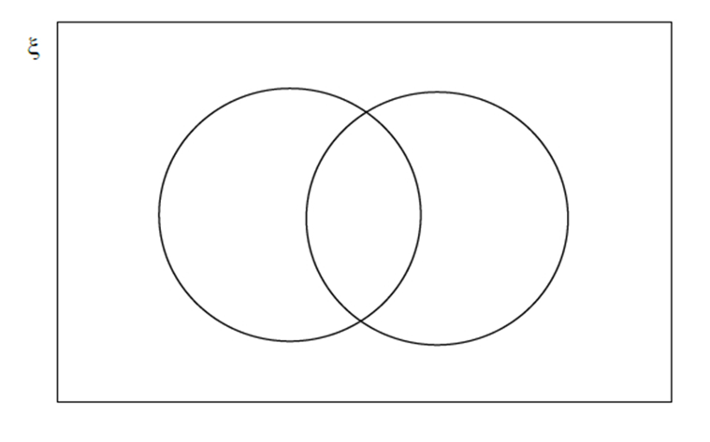
HIAS Blended Learning Resource
During Year 10 a school runs a trip to Austria and a trip to France.
63 students go to Austria.
89 students got to France.
15 students go to both Austria and France.
54 students do not go on either trip.
How many students are there in Year 10?
You may use the Venn diagram to help you.
Testbase
Notes:
191
Just Australia 63-15=48
15 joint
Just France 89-15=74
Neither trip 54 which is placed in the box but outside of the circles
48 + 15 + 74 + 54 = 191

Slide 6
HIAS Blended Learning Resource
In a school:
98 students take Geography only.
34 students take History only.
Twice as many students take Geography.
How many students take both History and Geography?
You may use the Venn diagram to help you.
Notes:
98 in the Geog non-intersecting part and 34 in the History non-intersecting part, unknown (x) in the intersection
or 98 + x
or 34 + x
98 + x = 2(34 + x)
98 + x = 68 + 2x
x = 30

Slide 7
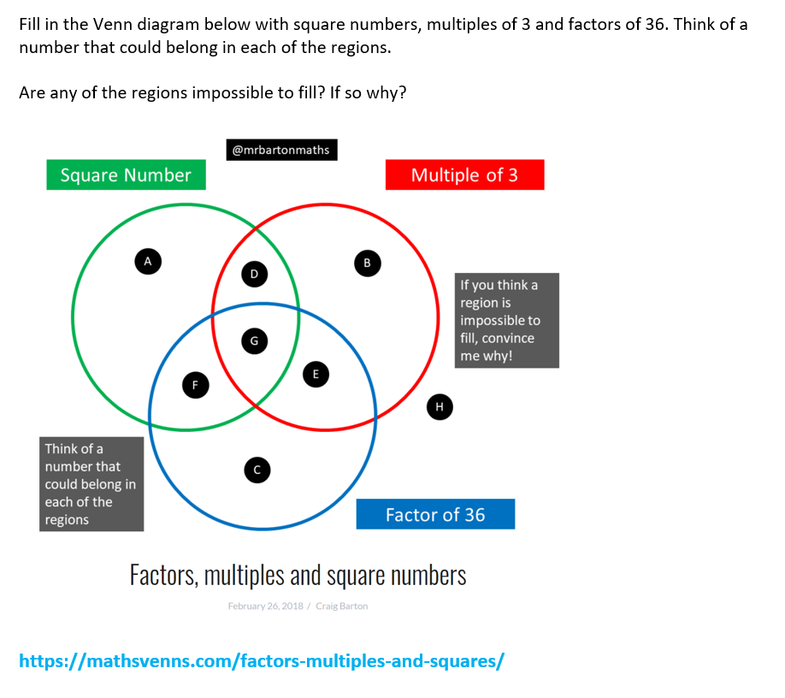
HIAS Blended Learning Resource
Notes:
Square numbers: 1, 4, 9, 16, 25, 36, 49 …
Multiples of 3: 3, 6, 9, 12, 15, 18, 21, 24, 27, 30, 33, 36, 39, 42 …
Factors of 36: 1, 2, 3, 4, 6, 9, 12, 18, 36
A 16, 25, 49
B 15, 21, 24, 27, 30, 33, 39, 42
C 2
D 9
E 3, 6, 12, 18
F 1, 4
G 36
H 5, 7, 8, 10 …

Slide 8
HIAS Maths team
HIAS Blended Learning Resource
The HIAS maths team offer a wide range of high-quality services to support schools in improving outcomes for learners, including courses, bespoke consultancy and in-house training.
For further details, please contact any member of the secondary maths team:
Jo Lees: Jo.Lees@hants.gov.uk
Jenny Burn: Jenny.Burn@hants.gov.uk
Tessa Ingrey: Tessa.Ingrey@hants.gov.uk
For further details on the full range of services available please contact us using the following details:
Tel: 01962 874820 or email: hias.enquiries@hants.gov.uk
For further details on the full range of services available please contact us using the following details:
Tel: 01962 874820 or email: hias.enquiries@hants.gov.uk

