Slide 1
Year 6
HIAS Blended Learning Resource
Statistics
Calculating the mean as an average
HIAS maths Team
Spring 2021
Final version
© Hampshire County Council

Slide 2
HIAS Blended Learning Resource
These slides are intended to support teachers and pupils with a blended approach to learning, either in-class or online. The tasks are intended to form part of a learning journey and could be the basis of either one lesson or a short sequence of connected lessons.
The 4-step Polya model for problem solving has been used to provide a structure to support reasoning. Teachers may need to use more or fewer steps to support the range of learners in their class.
Teachers should delete, change and add slides to suit the needs of their pupils. Extra slides with personalised prompts and appropriate examples based on previous teaching may be suitable. When changing the slide-deck, teachers should consider:
Their expectations for the use of representations such as bar models, number lines, arrays and diagrams.
Which strategies and methods pupils should use and record when solving problems or identifying solutions. This could include a range of informal jottings and diagrams, the use of tables to record solutions systematically and formal or informal calculation methods.
Teachers may also wish to record a ‘voice over’ to talk pupils through the slides.

Slide 3
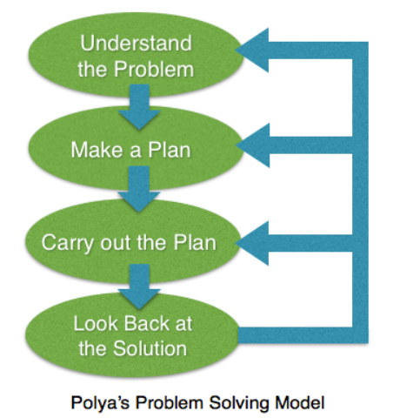
HIAS Blended Learning Resource
1945 George Polya published ‘How To Solve It’ 2nd ed., Princeton University Press, 1957, ISBN 0-691-08097-6.

Slide 4
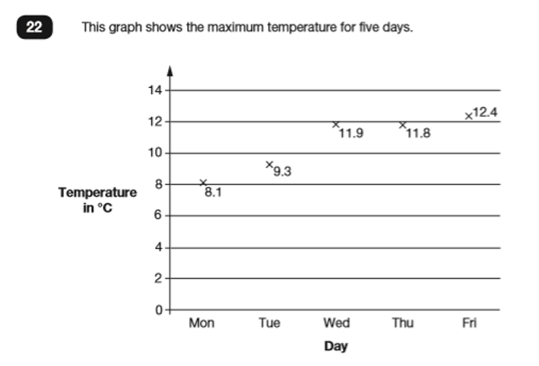
Calculate and interpret the mean as an average.
HIAS Blended Learning Resource
What was the mean maximum temperature?
‘Contains material developed by the Standards and Testing Agency for 2019 national curriculum assessments and licensed under Open Government Licence v3.0’.

Slide 5
Understand the problem
HIAS Blended Learning Resource
The graph shows the maximum temperature recorded for different days of the week.
Key fact: The graph shows the maximum temperature recorded on each day.
Key fact: The maximum temperature for 5 days has been recorded.
Key fact: The day that had the coldest maximum temperature recorded was Monday and the temperature was 8.1 degrees.
Key fact: The day that had the hottest maximum temperature recorded was Friday and the temperature was 12.4 degrees.
Key fact: ‘Mean’ is a particular type of average in mathematics.
The answer will be in degrees as the question asks for the mean temperature.
What was the mean maximum temperature?

Slide 6
Make a Plan
HIAS Blended Learning Resource
Step 1: Represent the problem in a bar model to show the temperatures recorded for the five days.
Step 2:Add together the temperatures from each day to find the total temperature for the five days.
Step 3: Divide the total temperature by the number of days there are to find the mean (average) temperature for the five days.
What was the mean maximum temperature?

Slide 7
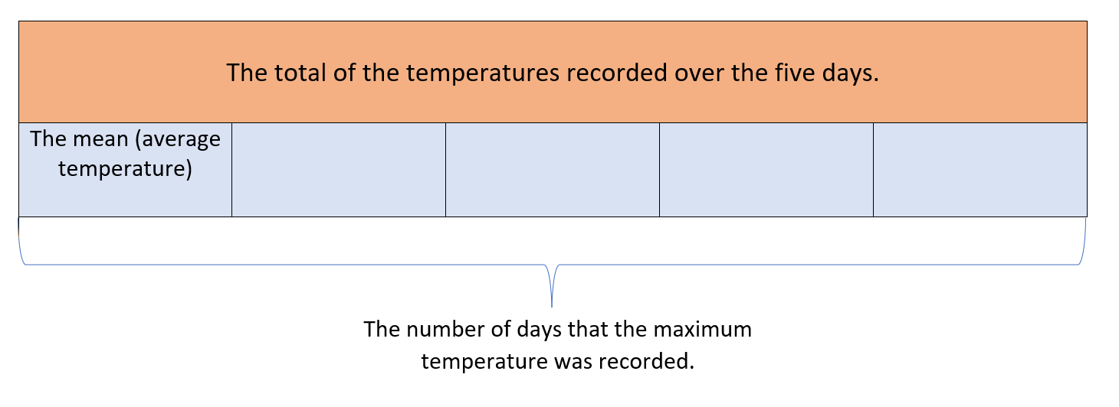
Step 1 & 2
Step 3

Slide 8
Carry out your plan: show your reasoning
HIAS Blended Learning Resource
Step 1: Represent the problem in a bar model to show the temperatures recorded for the five days.
Step 2: Add together the temperatures from each day to find the total temperature for the five days.
8.1 + 9.3 + 11.9 + 11.8 + 12.4 = 53.5 degrees
Step 3: Divide the total temperature by the number of days there are to find the average (mean) temperature for the five days.
53.3 ÷ 5 = 10.7 degrees
10.7 degrees is the mean maximum temperature for the five days.
What was the mean maximum temperature?

Slide 9
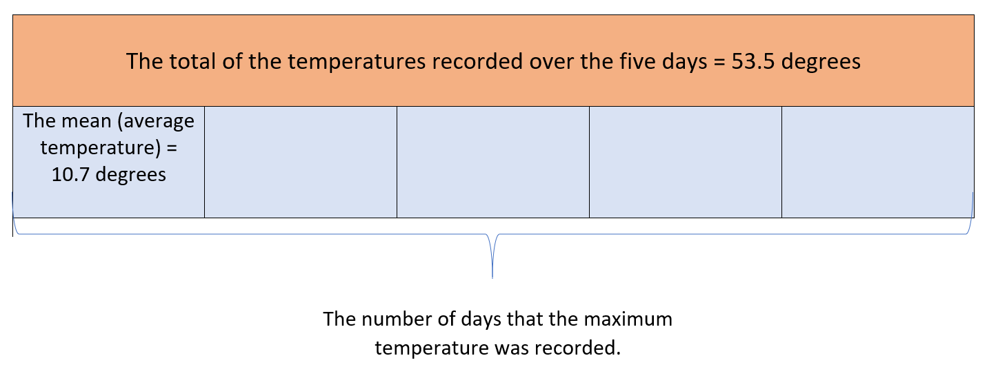
Step 1: Draw the bar model
Step 2: Find the total of the temperatures for the five days: 8.1 + 9.3 + 11.9 + 11.8 + 12.4 = 53.5 degrees
Step 3: Divide the total temperature by the number of days there are:
53.5 ÷ 5 = 10.7 degrees
The mean maximum temperature = 10.7 degrees

Slide 10
Review your solution: does it seem reasonable? Which steps/ parts did you find easy and which harder?
HIAS Blended Learning Resource
How could you check?
Go through the steps you took and check for errors
Remember the question is about temperature. Is your answer recorded as a temperature? Is your answer reasonable in comparison with the temperatures given on the graph.
2. Try to solve the calculation a different way and see if you get the same answer
What was the mean maximum temperature?

Slide 11
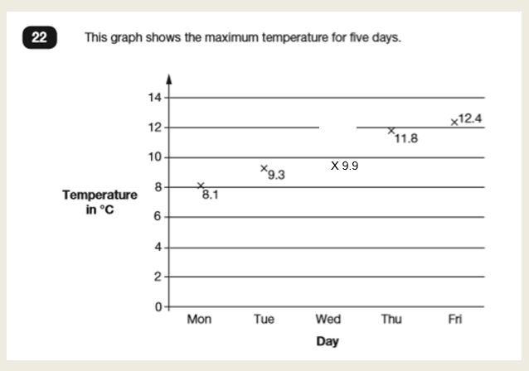
Now try this one
HIAS Blended Learning Resource
Understand the problem
Make a plan
Carry out your plan: show your reasoning
Review your solution: does it seem reasonable?
Think about your learning: which parts of the problem did you find easy and which parts did you find harder?
What was the mean maximum temperature?

Slide 12
HIAS Maths team
HIAS Blended Learning Resource
The HIAS maths team offer a wide range of high-quality services to support schools in improving outcomes for learners, including courses, bespoke consultancy and in-house training.
For further details referring to maths, please contact either of the team leads:
Jacqui Clifft : Jacqui.clifft@hants.gov.uk
Jo Lees: Jo.Lees@hants.gov.uk
For further details on the full range of services available please contact us using the following details:
Tel: 01962 874820 or email: hias.enquiries@hants.gov.uk
For further details on the full range of services available please contact us using the following details:
Tel: 01962 874820 or email: hias.enquiries@hants.gov.uk

