Slide 1
Year 6
HIAS Blended Learning Resource
Solve problems using all four operations.
HIAS maths Team
Spring 2021
Final version
© Hampshire County Council

Slide 2
HIAS Blended Learning Resource
These slides are intended to support teachers and pupils with a blended approach to learning, either in-class or online. The tasks are intended to form part of a learning journey and could be the basis of either one lesson or a short sequence of connected lessons.
The 4-step Polya model for problem solving has been used to provide a structure to support reasoning. Teachers may need to use more or fewer steps to support the range of learners in their class.
Teachers should delete, change and add slides to suit the needs of their pupils. Extra slides with personalised prompts and appropriate examples based on previous teaching may be suitable. When changing the slide-deck, teachers should consider:
Their expectations for the use of representations such as bar models, number lines, arrays and diagrams.
Which strategies and methods pupils should use and record when solving problems or identifying solutions. This could include a range of informal jottings and diagrams, the use of tables to record solutions systematically and formal or informal calculation methods.
Teachers may also wish to record a ‘voice over’ to talk pupils through the slides.

Slide 3
HIAS Blended Learning Resource
1945 George Polya published ‘How To Solve It’ 2nd ed., Princeton University Press, 1957, ISBN 0-691-08097-6.

Slide 4
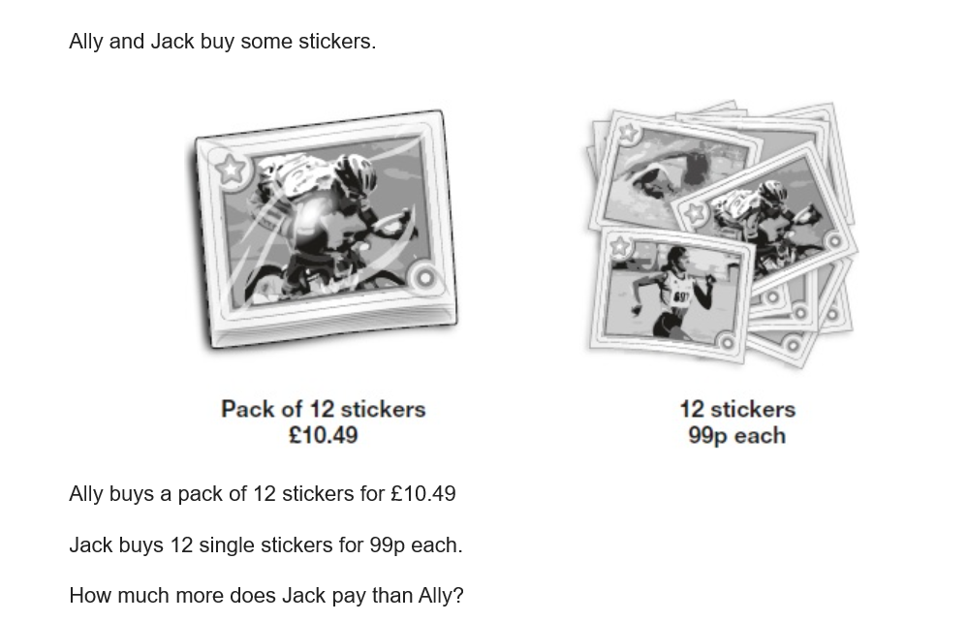
Solve problems involving addition, subtraction, multiplication and division, deciding which operations and methods to use and why.
HIAS Blended Learning Resource
‘Contains material developed by the Standards and Testing Agency for 2018 national curriculum assessments and licensed under Open Government Licence v3.0’.

Slide 5
Understand the problem
HIAS Blended Learning Resource
Ally and Jack buy stickers.
Key fact: A single sticker costs 99p.
Key fact: Jack buys 12 single stickers.
Key fact: A pack of 12 stickers cost £10.49.
Key fact: Ally buys a pack of 12 stickers.
Key fact: Jack pays more than Ally for the stickers.
The question asks us to find out how much more Jack paid for the stickers than Ally.

Slide 6
Make a Plan
HIAS Blended Learning Resource
Step 1: Represent the problem in a bar model so that we can see exactly what the problem is asking us to do.
Step 2: Work out how much Jack paid for the 12 single stickers by multiplying 99p by 12. 99p is close to £1 so rounding and adjusting should help us to solve the calculation efficiently.
Step 3: Find the difference between the amount of money that Jack paid and £10.49.

Slide 8
Carry out your plan: show your reasoning
HIAS Blended Learning Resource
Step 1: Represent the problem in a bar model so that we can see exactly what the problem is asking us to do.
Step 2: Work out how much Jack paid for the 12 single stickers by multiplying 99p by 12. 99p is close to £1 so rounding and adjusting should help us to solve the calculation efficiently.
£0.99 + £0.01= £1.
£1 x 12 = £12.
12 x £0.01 added on so I must take this away. 12 x £0.01 = £0.12
£12 – £0.12 = £11.88
Step 3: Find the difference between the amount of money that Jack paid and £10.49.
£11.88 - £10.49 = £1.39.
Jack paid £1.39 more than Ally.

Slide 9
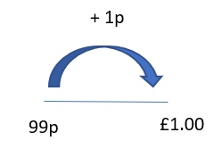
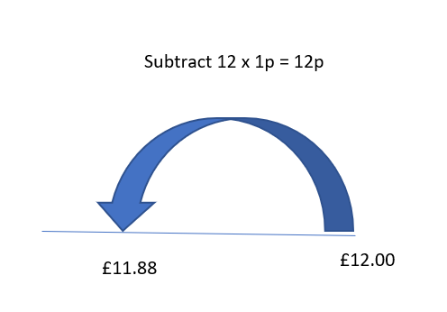
Step 1: Represent the problem using a bar model
Step 2: Rounding and adjusting. Round 99p to £1 by adding on 1p.
Multiply £1 by 12 (the amount of stickers Jack bought).
Take away the 12 lots of 1p’s that was added on to find the total of 99p x 12.

Slide 10
Step 3: Find the difference between the amount that Jack paid and the amount that Ally paid by subtracting £10.49 from £11.88.
£11.88 – 10.49 = £1.39
This tells us that Jack paid £1.39 more than Ally.

Slide 11
Review your solution: does it seem reasonable? Which steps/ parts did you find easy and which harder?
HIAS Blended Learning Resource
How could you check?
Go through the steps you took and check for errors
Remember the question is about finding out how much more Jack spent than Ally. Check your answer using inverse operations.
2. Try to solve the calculation a different way and see if you get the same answer

Slide 12
Now try this one
HIAS Blended Learning Resource
Understand the problem
Make a plan
Carry out your plan: show your reasoning
Review your solution: does it seem reasonable?
Think about your learning: which parts of the problem did you find easy and which parts did you find harder?
£10.51
98p
£10.51
98p each

Slide 13
HIAS Maths team
HIAS Blended Learning Resource
The HIAS maths team offer a wide range of high-quality services to support schools in improving outcomes for learners, including courses, bespoke consultancy and in-house training.
For further details referring to maths, please contact either of the team leads:
Jacqui Clifft : Jacqui.clifft@hants.gov.uk
Jo Lees: Jo.Lees@hants.gov.uk
For further details on the full range of services available please contact us using the following details:
Tel: 01962 874820 or email: hias.enquiries@hants.gov.uk
For further details on the full range of services available please contact us using the following details:
Tel: 01962 874820 or email: hias.enquiries@hants.gov.uk

