Slide 1
Year 9
HIAS Blended Learning Resource
Pythagoras and trigonometry (unit 9.10)
Use Pythagoras Theorem and trigonometric ratios in similar triangles to solve problems involving right-angled triangles
HIAS maths Team
Spring 2021
Final version
© Hampshire County Council

Slide 2
HIAS Blended Learning Resource
These slides are intended to support teachers and students with a blended approach to learning, either in-class or online. The tasks are intended to form part of a learning journey and could be the basis of either one lesson or a short sequence of connected lessons.
Teachers should delete, change and add slides to suit the needs of their students. Extra slides with personalised prompts and appropriate examples based on previous teaching may be suitable. When changing the slide-deck, teachers should consider:
Their expectations for the use of representations such as bar models, number lines, arrays and geometric diagrams.
Which strategies and methods students should use and record when solving problems or identifying solutions. This could include a range of informal jottings and diagrams, the use of tables to record solutions systematically and formal or informal calculation methods.
Teachers may also wish to record a ‘voice over’ to talk students through the slides.

Slide 3
HIAS Blended Learning Resource
YEAR 9: SPRING TERM OVERVIEW
Week | HIAS Unit | Topic
1 | Unit 9.6 | Probability: Sets and Venn diagrams
2 | Unit 9.7 | Statistics: Bivariate data
3 | Unit 9.8 | Proportion: Direct
4 |  | Proportion: Indirect
5 |  | Powers and roots
 | Half term
6 | Unit 9.9 | Approximation
7 |  | Compound units
8 | Unit 9.10 | Geometry: Pythagoras and trigonometry
9 |  | Geometry: Constructions
10 | Unit 9.11 | Algebra: Functions

Slide 4
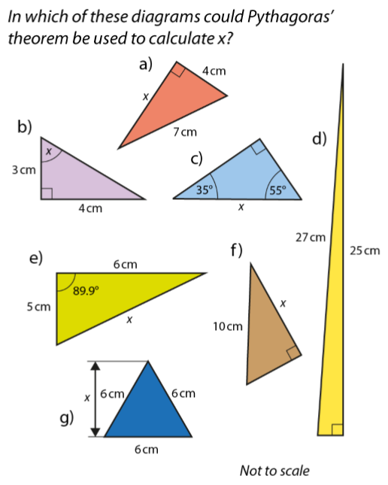
HIAS Blended Learning Resource
In which of these diagrams could Pythagoras’ theorem be used to calculate x? Explain how you know.
Adapted from NCETM
Notes:
e) and g) can
b) Needs trigonometry as we are finding an angle
c) does not have enough information
d) does not have an x
f) does not have enough information

Slide 5
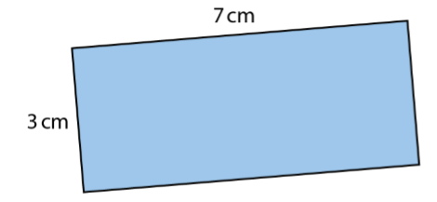
HIAS Blended Learning Resource
Can a straight line that is 8cm long be drawn inside this rectangle?
Adapted from NCETM
Notes:
The longest line you can draw is across the diagonal which means we can use Pythagoras:
3 squared plus 7 squared = 58
as 8 squared is 64 the answer is no (also root 58 is 7.6)

Slide 6
HIAS Blended Learning Resource
Can a straight line that is 13 cm long be drawn inside this rectangle?
12 cm
5cm
Adapted from NCETM
Notes:
The longest line you can draw is across the diagonal which means we can use Pythagoras:
12 squared plus 5 squared = 169
the square root 169 is 13 so the answer is yes (this is a Pythagorean triple 5, 12, 13)

Slide 7
HIAS Blended Learning Resource
If the diagonal of this rectangle is 10cm, what is the width?
8 cm
?
Adapted from NCETM
Notes:
Using Pythagoras:
10 squared minus 6 squared = 64
the square root 64 is 8 so the answer is 8 (this is a Pythagorean triple 6, 8, 10)

Slide 8
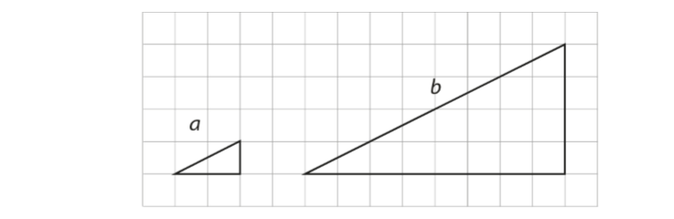
HIAS Blended Learning Resource
In these similar triangles what is the ratio of side a to side b?
Adapted from NCETM
Notes:
Base of a is length 2, base of b is length 8
Height of a is 1, height of b is 4
The multiplier is 4
The ratio of a:b is 1: 4

Slide 9
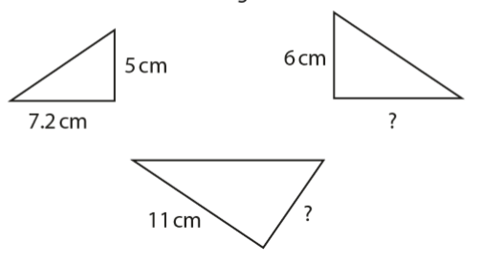
HIAS Blended Learning Resource
Here are three similar triangles.
What is the multiplier between the pair of labelled values for each triangle?
Find the missing values.
Adapted from NCETM
Notes:
Length 5cm is paired with length 6cm so the multiplier is 1.2 (5 x 1.2 = 6)
Length 7.2cm is paired with 11cm so the multiplier is 1.52777 (7.2 x 1.527777 = 11)
Missing values 7.2 x 1.2 = 8.64 for the triangle with a length 6cm
5 x 1.52777 = 7.6288888 for the triangle with a length 11cm

Slide 10
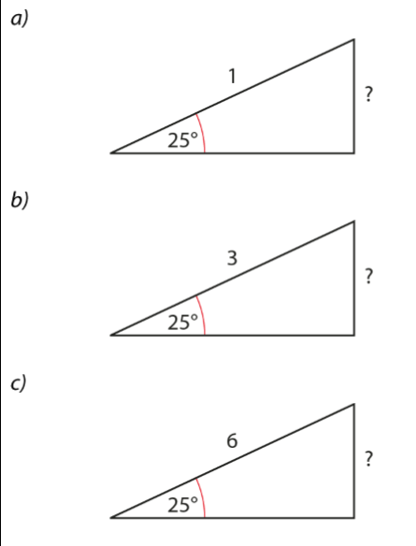
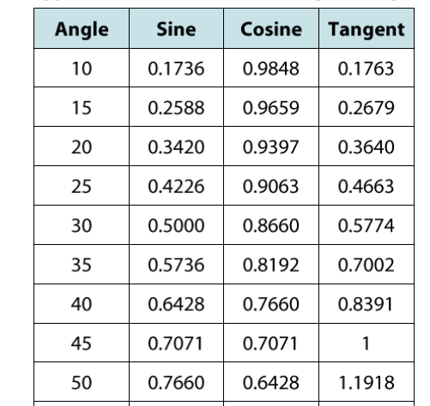
HIAS Blended Learning Resource
Use the relevant values in the table (or using your calculator) find the missing side lengths
Adapted from NCETM
Notes:
All use sin: sin θ = opp /hyp rearrange sin θ x hypotenuse = opposite
0.4266 x 1 = 0.4266
0.4266 x 3 = 1.2679
0.4266 x 6 = 2.5357

Slide 11
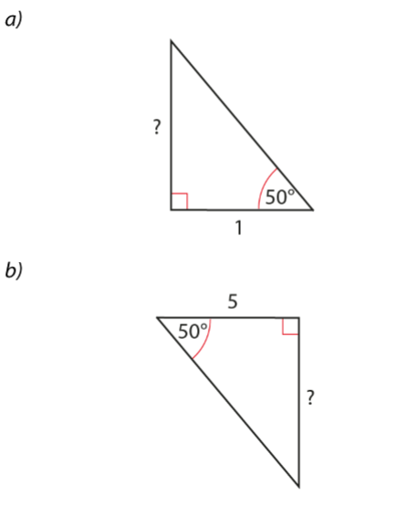
HIAS Blended Learning Resource
Use the relevant values in the table (or using your calculator) find the missing side lengths
Adapted from NCETM
Notes:
All use tan: tan θ = opp /adjacent rearrange tan θ x adjacent = opposite and for c) adjacent = opp/ tan θ
1.1918 x 1 = 1.1918
1.1918 x 5 = 5.959

Slide 12
HIAS Maths team
HIAS Blended Learning Resource
The HIAS maths team offer a wide range of high-quality services to support schools in improving outcomes for learners, including courses, bespoke consultancy and in-house training.
For further details, please contact any member of the secondary maths team:
Jo Lees: Jo.Lees@hants.gov.uk
Jenny Burn: Jenny.Burn@hants.gov.uk
Tessa Ingrey: Tessa.Ingrey@hants.gov.uk
For further details on the full range of services available please contact us using the following details:
Tel: 01962 874820 or email: hias.enquiries@hants.gov.uk
For further details on the full range of services available please contact us using the following details:
Tel: 01962 874820 or email: hias.enquiries@hants.gov.uk

