Slide 1
Year 5
HIAS Blended Learning Resource
Geometry (angle) 1
Know angles are measured in degrees: estimate and compare acute, obtuse and reflex angles.
HIAS maths Team
Spring 2021
Final version
© Hampshire County Council

Slide 2
HIAS Blended Learning Resource
These slides are intended to support teachers and pupils with a blended approach to learning, either in-class or online. The tasks are intended to form part of a learning journey and could be the basis of either one lesson or a short sequence of connected lessons.
The 4-step Polya model for problem solving has been used to provide a structure to support reasoning. Teachers may need to use more or fewer steps to support the range of learners in their class.
Teachers should delete, change and add slides to suit the needs of their pupils. Extra slides with personalised prompts and appropriate examples based on previous teaching may be suitable. When changing the slide-deck, teachers should consider:
Their expectations for the use of representations such as bar models, number lines, arrays and diagrams.
Which strategies and methods pupils should use and record when solving problems or identifying solutions. This could include a range of informal jottings and diagrams, the use of tables to record solutions systematically and formal or informal calculation methods.
Teachers may also wish to record a ‘voice over’ to talk pupils through the slides.

Slide 3
HIAS Blended Learning Resource
1945 George Polya published ‘How To Solve It’ 2nd ed., Princeton University Press, 1957, ISBN 0-691-08097-6.

Slide 4
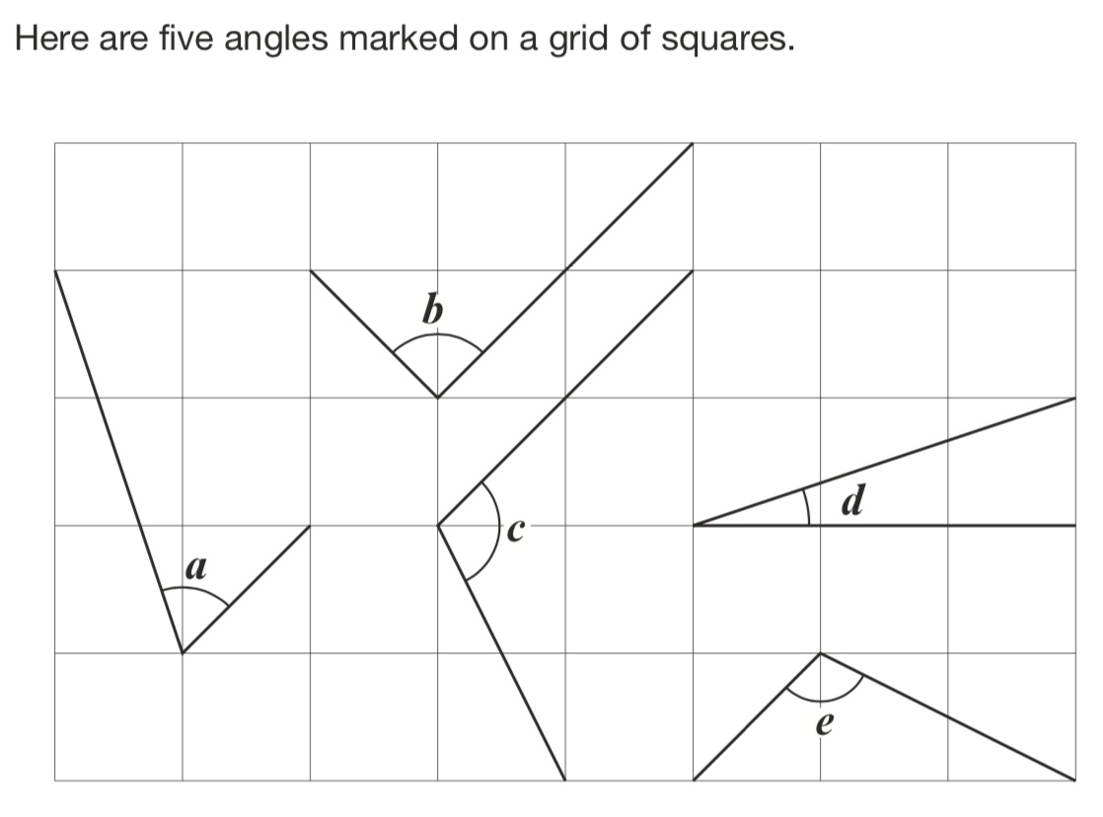
Identifying acute and reflex angles
HIAS Blended Learning Resource
Write the letters of the angles that are obtuse.
Write the letters of the angles that are acute.
Standards and Testing Agency 2016 national curriculum assessments

Slide 5
Understand the problem
HIAS Blended Learning Resource
There are five angles marked on a grid of squares.
We need to decide which ones are obtuse angles and which ones are acute angles (there are no angles shown in this problem that are 180° or greater).
Key fact: An acute angle is a turn that is less than 90° (90 degrees).
Key fact: An obtuse angle is a turn that is greater than 90° (90 degrees) but less than 180°.
Write the letters of the angles that are obtuse.
Write the letters of the angles that are acute.

Slide 6
Make a Plan
HIAS Blended Learning Resource
Step 1: We need to work systematically starting with angle a
Step 2: Comparing each angle to 90° would allow us to decide whether the angle is less than or greater than 90°
Step 3: We need to make sure we record each angle as either obtuse or acute.
Write the letters of the angles that are obtuse.
Write the letters of the angles that are acute.

Slide 7
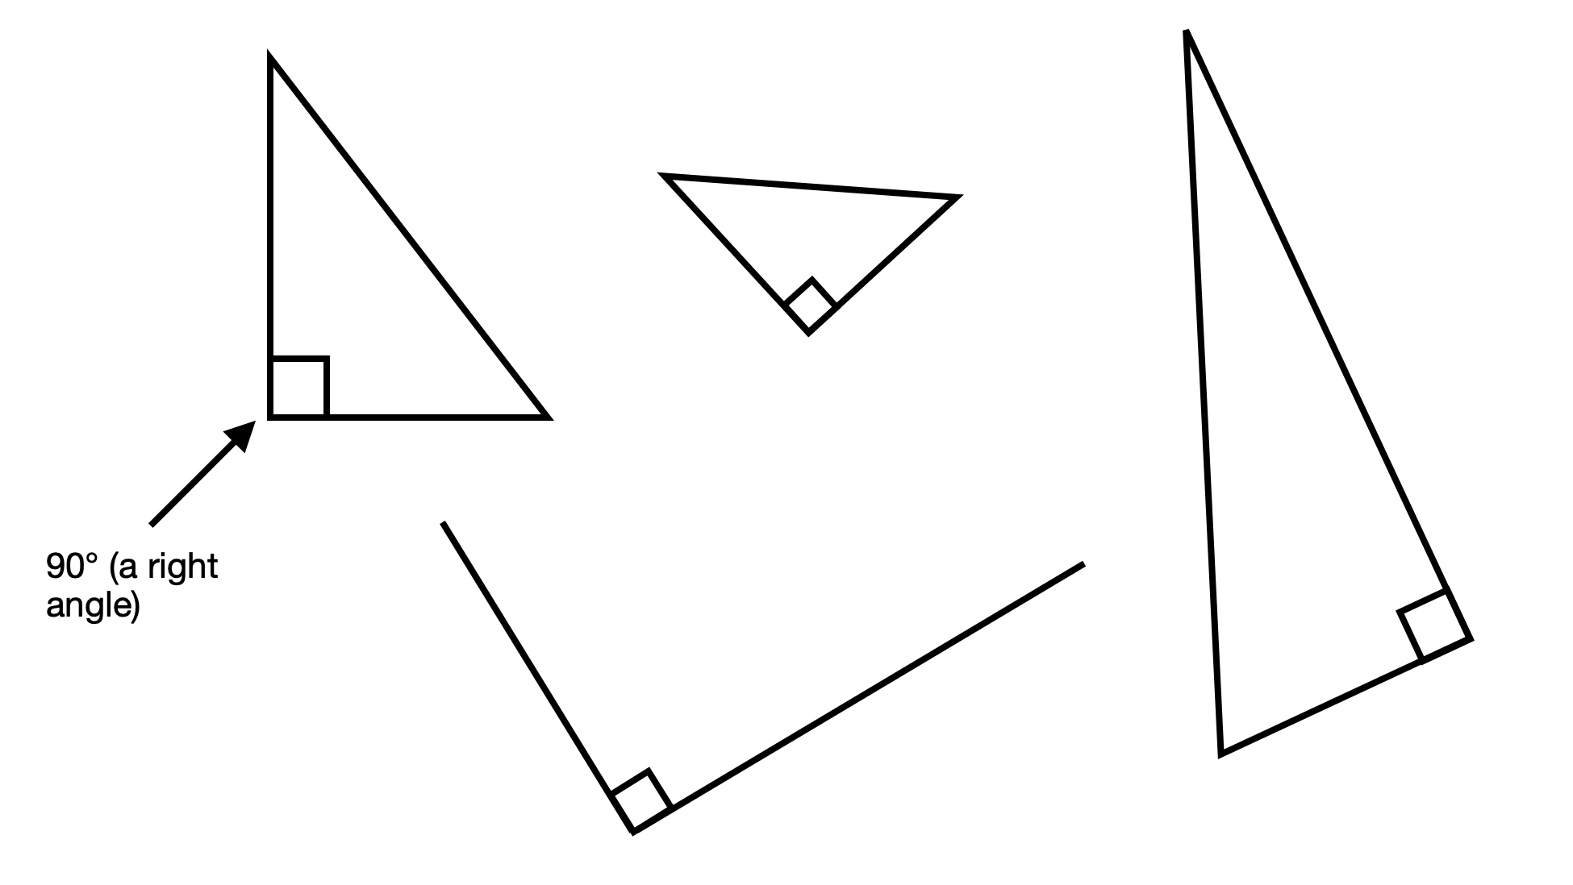
It is helpful to visualise what 90° could like in different orientations.

Slide 8
Carry out your plan: show your reasoning
HIAS Blended Learning Resource
Step 1: Work out if angle a is less than 90° (acute) or more than 90° but less than 180° (obtuse) and record in the correct place.
Step 2: Repeat step 1 for each of the angles b, c, d and e.
Write the letters of the angles that are obtuse.
Write the letters of the angles that are acute.

Slide 9
Review your solution: does it seem reasonable? Which steps/ parts did you find easy and which harder?
HIAS Blended Learning Resource
How could you check?
Go through the steps you took and check for errors
Remember there are five angles to check.
You could use the 90°corner of a piece of paper or card to check the angles.
Write the letters of the angles that are obtuse.
Write the letters of the angles that are acute.

Slide 10
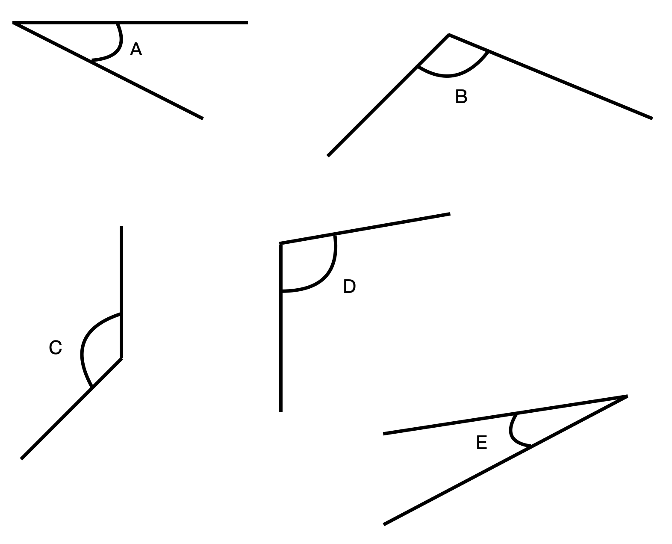
Now try this one
HIAS Blended Learning Resource
Understand the problem
Make a plan
Carry out your plan: show your reasoning
Review your solution: does it seem reasonable?
Think about your learning: which parts of the problem did you find easy and which parts did you find harder?
Here are five angles.
Write the letters of the angles that are obtuse.
Write the letters of the angles that are acute.

Slide 11
HIAS Maths team
HIAS Blended Learning Resource
The HIAS maths team offer a wide range of high-quality services to support schools in improving outcomes for learners, including courses, bespoke consultancy and in-house training.
For further details referring to maths, please contact either of the team leads:
Jacqui Clifft : Jacqui.clifft@hants.gov.uk
Jo Lees: Jo.Lees@hants.gov.uk
For further details on the full range of services available please contact us using the following details:
Tel: 01962 874820 or email: hias.enquiries@hants.gov.uk
For further details on the full range of services available please contact us using the following details:
Tel: 01962 874820 or email: hias.enquiries@hants.gov.uk

