Slide 1
Year 1
HIAS Blended Learning Resource
wk3 1.5 Addition and Subtraction
HIAS maths Team
Spring 2021
Final version
© Hampshire County Council

Slide 2
HIAS Blended Learning Resource
These slides are intended to support teachers and pupils with a blended approach to learning, either in-class or online. The tasks are intended to form part of a learning journey and could be the basis of either one lesson or a short sequence of connected lessons.
The 4-step Polya model for problem solving has been used to provide a structure to support reasoning. Teachers may need to use more or fewer steps to support the range of learners in their class.
Teachers should delete, change and add slides to suit the needs of their pupils. Extra slides with personalised prompts and appropriate examples based on previous teaching may be suitable. When changing the slide-deck, teachers should consider:
Their expectations for the use of representations such as bar models, number lines, arrays and diagrams.
Which strategies and methods pupils should use and record when solving problems or identifying solutions. This could include a range of informal jottings and diagrams, the use of tables to record solutions systematically and formal or informal calculation methods.
Teachers may also wish to record a ‘voice over’ to talk pupils through the slides.

Slide 3
HIAS Blended Learning Resource
1945 George Polya published ‘How To Solve It’ 2nd ed., Princeton University Press, 1957, ISBN 0-691-08097-6.

Slide 4
Maths focus
HIAS Blended Learning Resource
TASK

Slide 5
Understand the problem
HIAS Blended Learning Resource
TASK
There are 8 counters in the bag. This represents the whole.
There are some counters in the bag. This represents unknown 1 part.
There are 5 counters outside of the bag. This is the part we know.

Slide 6
Make a Plan
HIAS Blended Learning Resource
Step 1: Draw a picture to represent the problem. This could be a bar model.
Step 2: Draw a part whole model to show the parts we know and what we need to work out.
Step 3: Write a number sentence to solve it using number facts. Use number bonds to help find the missing part.
TASK

Slide 7
Representation of the problem
5
?
8
8
?
5
8 is the whole
5 is a part
_____ is a part

Slide 8
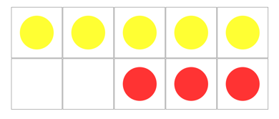
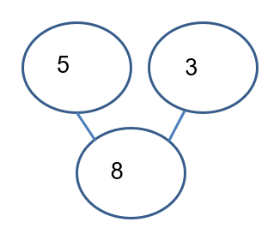
Carry out your plan: show your reasoning
HIAS Blended Learning Resource
Step 1: ? + 5 = 8
Step 2:
Step 3:
Check using tens frames or number line
3 + 5 = 8
8 – 5 = 3
TASK

Slide 9
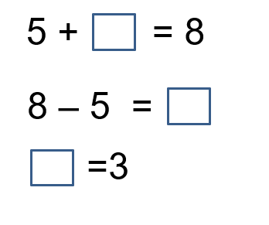
Show the steps to the solution
3
5
8 is the whole
5 is a part
_____ is a part
8

Slide 10
Review your solution: does it seem reasonable? Which steps/ parts did you find easy and which harder?
HIAS Blended Learning Resource
How could you check?
Go through the steps you took and check for errors
Remember the question is about how many counters are in the bag.
There are______ counters in the bag?
Try to solve the calculation a different way and see if you get the same answer.
5 + 3 = 8
3 + 5 = 8
8 – 5 = 3
TASK

Slide 11
Now try this one
HIAS Blended Learning Resource
Understand the problem
Make a plan
Carry out your plan: show your reasoning
Review your solution: does it seem reasonable?
Think about your learning: which parts of the problem did you find easy and which parts did you find harder?
TASK variation
There are some red and yellow counters in the bag.
There are 8 counters altogether.
How many could be red?
How many could be yellow?
Find as many different possibilities as you can.

Slide 12
HIAS Maths team
HIAS Blended Learning Resource
The HIAS maths team offer a wide range of high-quality services to support schools in improving outcomes for learners, including courses, bespoke consultancy and in-house training.
For further details referring to maths, please contact either of the team leads:
Jacqui Clifft : Jacqui.clifft@hants.gov.uk
Jo Lees: Jo.Lees@hants.gov.uk
For further details on the full range of services available please contact us using the following details:
Tel: 01962 874820 or email: hias.enquiries@hants.gov.uk
For further details on the full range of services available please contact us using the following details:
Tel: 01962 874820 or email: hias.enquiries@hants.gov.uk

