Slide 1
Year 7
HIAS Blended Learning Resource
Area (unit 7.8)
This unit is about the area of two-dimensional shapes and constructing polygons. Standard labelling conventions are introduced, and students learn to accurately construct points, lines and polygons. They pay attention to the symmetry
and angles (internal and external) of polygons when constructing them and learn about congruence. The accurate
use of vocabulary and conventions is a focus in this unit.
This set of problems is about the area of rectangles and reasoning about missing information.
HIAS maths Team
Spring 2021
Final version
© Hampshire County Council

Slide 2
HIAS Blended Learning Resource
These slides are intended to support teachers and students with a blended approach to learning, either in-class or online. The tasks are intended to form part of a learning journey and could be the basis of either one lesson or a short sequence of connected lessons.
Teachers should delete, change and add slides to suit the needs of their students. Extra slides with personalised prompts and appropriate examples based on previous teaching may be suitable. When changing the slide-deck, teachers should consider:
Their expectations for the use of representations such as bar models, number lines, arrays and geometric diagrams.
Which strategies and methods students should use and record when solving problems or identifying solutions. This could include a range of informal jottings and diagrams, the use of tables to record solutions systematically and formal or informal calculation methods.
Teachers may also wish to record a ‘voice over’ to talk students through the slides.

Slide 3
HIAS Blended Learning Resource
YEAR 7: SPRING TERM OVERVIEW
Week | HIAS Unit | Topic
1 | Unit 7.6 | Four operations: Fractions (vulgar and decimal)
2 | Unit 7.7 | Probability: 0-1 scale
3 | Unit 7.8 | Geometry: Polygons
4 |  | Geometry: Area
5 |  | Geometry: Volume and 3-D shape
 | Half term
6 | Unit 7.9 | Percentages (of amounts)
7 |  | Percentages (FDP equivalence)
8 |  | Ratio and proportion: Notation and part: whole
9 | Unit 7.10 | Coordinates (four quadrants)
10 |  | Coordinates (linear functions )

Slide 4
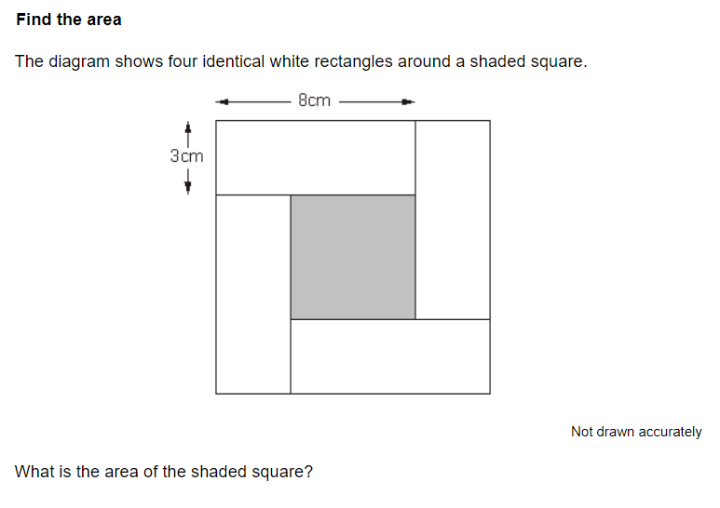
HIAS Blended Learning Resource
10cm
2cm
What is the area of each white rectangle ?
What is the total area of all four white rectangles?
What are the dimensions of the large, outer, square?
What is the total are of the white and shaded parts?
Notes:
Solutions
Area of the white rectangle is 2 x 10 = 20 cm²
Area of all four rectangles together = 4 x 20 = 80cm²
Dimensions of large, outer, square are 12cm x 12cm
Total area is 12 x 12 = 144 cm²

Slide 5
HIAS Blended Learning Resource
15cm
7cm
What is the area of each white rectangle ?
What is the total area of all four white rectangles?
What are the dimensions of the large, outer, square?
What is the total are of the white and shaded parts?
Notes:
Solutions
Area of the white rectangle is 7 x 15 = 105 cm²
Area of all four rectangles together = 4 x 105 = 420cm²
Dimensions of large, outer, square are 22cm x 22cm
Total area is 12 x 12 = 484 cm²

Slide 6
HIAS Blended Learning Resource
21cm
7cm
What is the area of each white rectangle ?
What is the total area of all four white rectangles?
What are the dimensions of the large, outer, square?
What is the total are of the white and shaded parts?
Notes:
Solutions
Area of the white rectangle is 7 x 21 = 147 cm²
Area of all four rectangles together = 4 x 147 = 588 cm²
Dimensions of large, outer, square are 28cm x 28cm
Total area is 28 x 28 = 784 cm²

Slide 7
HIAS Blended Learning Resource
10cm
2cm
Notes:
Solutions
Area of the white rectangle is 2 x 10 = 20 cm²
Area of all four rectangles together = 4 x 20 = 80cm²
Dimensions of large, outer, square are 12cm x 12cm
Total area is 12 x 12 = 144 cm²
Area of shaded square is 144 – 80 = 64 cm²

Slide 8
HIAS Blended Learning Resource
Taken from ‘Test Base’
Notes:
Solutions
Area of shaded square = area of large square – area of 4 x white rectangles = 121 – 4x24 = 25cm²

Slide 9
HIAS Blended Learning Resource
Find the area
The diagram shows a shaded rectangle surround by four white rectangles.
All the white rectangles have the same width.
There are two pairs of identical white rectangles
One pair has a length that is twice the length of the other pair
The longest length has been given
10cm
Hint:
Draw the diagram and
label all the information
Not drawn accurately
2cm
What is the area of the shaded rectangle ?
Notes:
Solution
Dimensions of longer pair of rectangles is 2 x 10
Dimensions of shorter pair of rectangles is 2 x 5
This gives the dimensions of the shaded area as 8 x 3 = 24 cm²

Slide 10
HIAS Blended Learning Resource
Taken from ‘Test Base’
Notes:
Total area = 10 x 5 = 50 cm²
Area of two triangles = 2 x 0.5 x 3 x 5 = 15 cm²
Area of parallelogram = 50-15 = 35 cm²

Slide 11
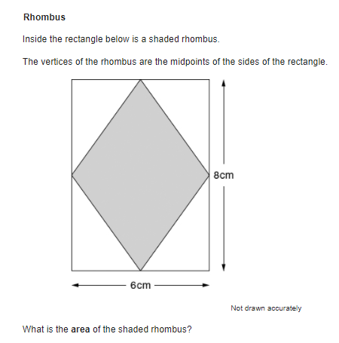
HIAS Blended Learning Resource
Taken from ‘Test Base’
Notes:
Total area = 6 x 8 = 48 cm²
Area of triangles = 4 x 0.5 x 4 x 3 = 24 cm²
Area of rhombus = 48-24 = 24 cm²

Slide 12
HIAS Maths team
HIAS Blended Learning Resource
The HIAS maths team offer a wide range of high-quality services to support schools in improving outcomes for learners, including courses, bespoke consultancy and in-house training.
For further details, please contact any member of the secondary maths team:
Jo Lees: Jo.Lees@hants.gov.uk
Jenny Burn: Jenny.Burn@hants.gov.uk
Tessa Ingrey: Tessa.Ingrey@hants.gov.uk
For further details on the full range of services available please contact us using the following details:
Tel: 01962 874820 or email: hias.enquiries@hants.gov.uk
For further details on the full range of services available please contact us using the following details:
Tel: 01962 874820 or email: hias.enquiries@hants.gov.uk

