Slide 1
Year 4
HIAS Blended Learning Resource
Fractions 2
Solve problems involving increasingly harder fractions to calculate quantities and fractions to divide quantities, including non-unit fractions where the answer is a whole number.
HIAS maths Team
Spring 2021
Final version
© Hampshire County Council

Slide 2
HIAS Blended Learning Resource
These slides are intended to support teachers and pupils with a blended approach to learning, either in-class or online. The tasks are intended to form part of a learning journey and could be the basis of either one lesson or a short sequence of connected lessons.
The 4-step Polya model for problem solving has been used to provide a structure to support reasoning. Teachers may need to use more or fewer steps to support the range of learners in their class.
Teachers should delete, change and add slides to suit the needs of their pupils. Extra slides with personalised prompts and appropriate examples based on previous teaching may be suitable. When changing the slide-deck, teachers should consider:
Their expectations for the use of representations such as bar models, number lines, arrays and diagrams.
Which strategies and methods pupils should use and record when solving problems or identifying solutions. This could include a range of informal jottings and diagrams, the use of tables to record solutions systematically and formal or informal calculation methods.
Teachers may also wish to record a ‘voice over’ to talk pupils through the slides.

Slide 3
HIAS Blended Learning Resource
1945 George Polya published ‘How To Solve It’ 2nd ed., Princeton University Press, 1957, ISBN 0-691-08097-6.

Slide 4
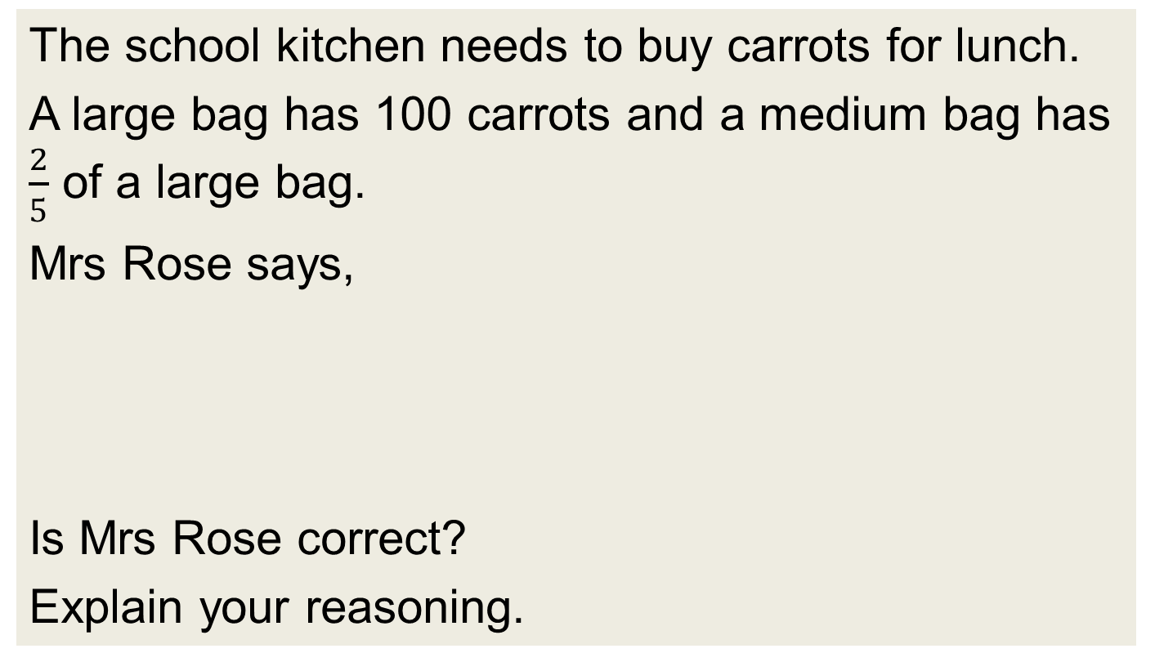
Working out fractions of amounts
HIAS Blended Learning Resource
The school kitchen needs to buy carrots for lunch.
A large bag has 100 carrots and a medium bag has $\frac{2}{5}$ of a large bag.
Mrs Rose says,
Is Mrs Rose correct?
Explain your reasoning.
I need 50 carrots so I will have to buy a large bag.

Slide 5
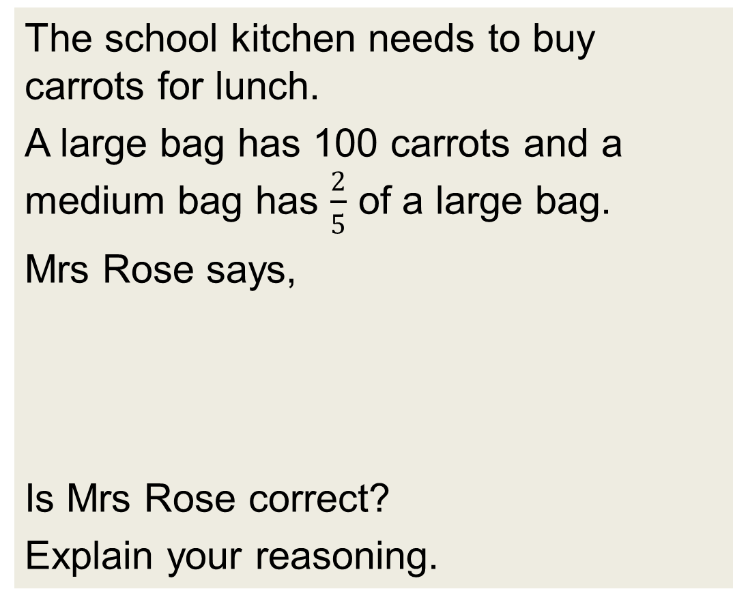
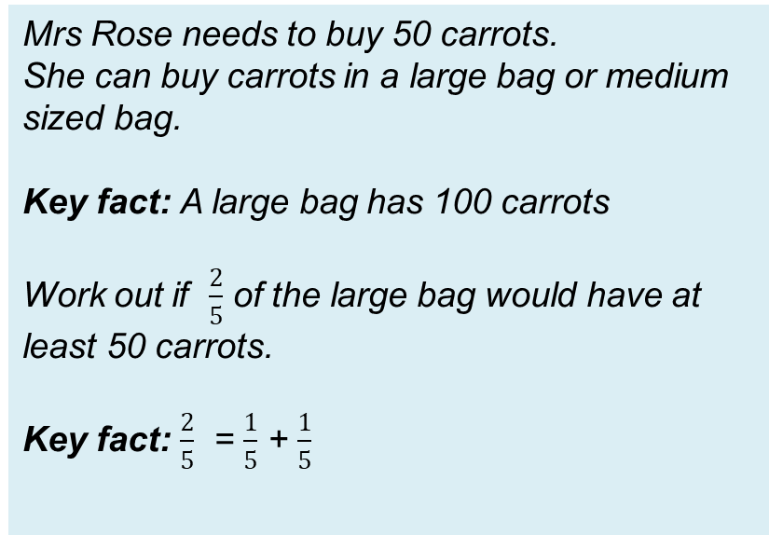
Understand the problem
HIAS Blended Learning Resource
The school kitchen needs to buy carrots for lunch.
A large bag has 100 carrots and a medium bag has $\frac{2}{5}$ of a large bag.
Mrs Rose says,
Is Mrs Rose correct?
Explain your reasoning.
Mrs Rose needs to buy 50 carrots.
She can buy carrots in a large bag or medium sized bag.
Key fact: A large bag has 100 carrots
Work out if $\frac{2}{5}$ of the large bag would have at least 50 carrots.
Key fact: $\frac{2}{5}$ = $\frac{1}{5}$ + $\frac{1}{5}$
I need 50 carrots so I will have to buy a large bag.

Slide 6
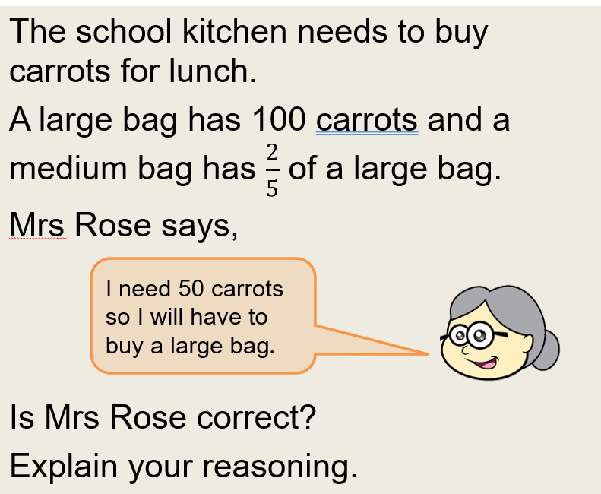
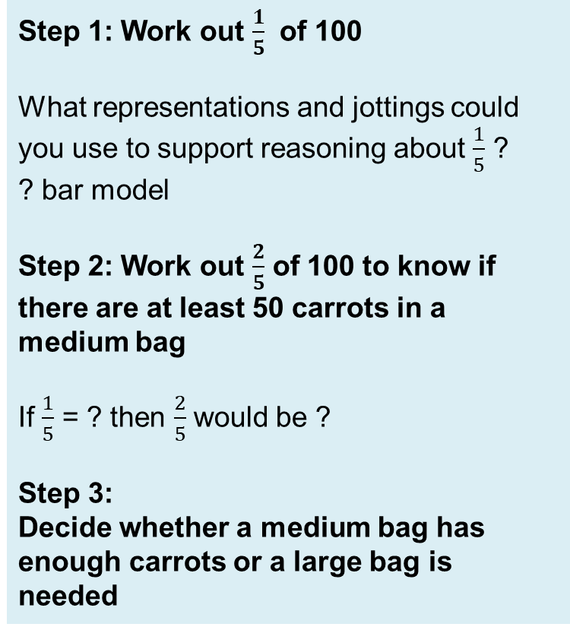
Make a Plan
HIAS Blended Learning Resource
Step 1: Work out $\frac{1}{5}$ of 100
What representations and jottings could you use to support reasoning about $\frac{1}{5}$ ?
? bar model
Step 2: Work out $\frac{2}{5}$ of 100 to know if there are at least 50 carrots in a medium bag
If $\frac{1}{5}$ = ? then $\frac{2}{5}$ would be ?
Step 3:
Decide whether a medium bag has enough carrots or a large bag is needed

Slide 8
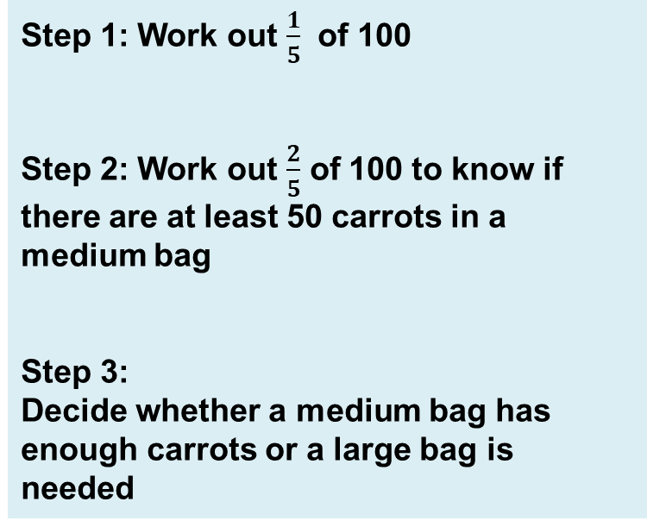
Carry out your plan: show your reasoning
HIAS Blended Learning Resource
Step 1: Work out $\frac{1}{5}$ of 100
Step 2: Work out $\frac{2}{5}$ of 100 to know if there are at least 50 carrots in a medium bag
Step 3:
Decide whether a medium bag has enough carrots or a large bag is needed

Slide 9
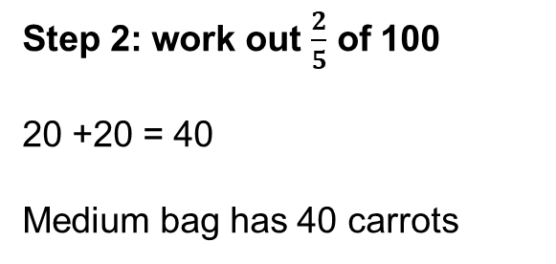
Step 1: Work out $\frac{1}{5}$ of 100
Step 3:
Decide whether a medium bag has enough carrots or a large bag is needed
Mrs Rose needs to buy a large bag because there are fewer than 50 carrots in the medium bag.
Step 2: work out $\frac{2}{5}$ of 100
20 +20 = 40
Medium bag has 40 carrots

Slide 10
Review your solution: does it seem reasonable? Which steps/ parts did you find easy and which harder?
HIAS Blended Learning Resource
How could you check?
Go through the steps you took and check for errors
Remember the question is about which bag Mrs Rose should choose and why
Try to solve the calculation a different way and see if you get the same answer

Slide 11
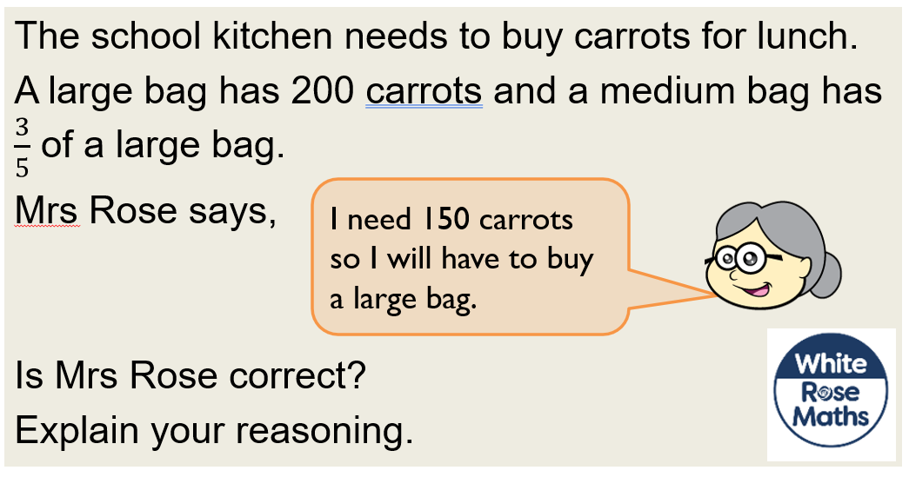
Now try this one
HIAS Blended Learning Resource
Understand the problem
Make a plan
Carry out your plan: show your reasoning
Review your solution: does it seem reasonable?
Think about your learning: which parts of the problem did you find easy and which parts did you find harder?

Slide 12
HIAS Maths team
HIAS Blended Learning Resource
The HIAS maths team offer a wide range of high-quality services to support schools in improving outcomes for learners, including courses, bespoke consultancy and in-house training.
For further details referring to maths, please contact either of the team leads:
Jacqui Clifft : Jacqui.clifft@hants.gov.uk
Jo Lees: Jo.Lees@hants.gov.uk
For further details on the full range of services available please contact us using the following details:
Tel: 01962 874820 or email: hias.enquiries@hants.gov.uk
For further details on the full range of services available please contact us using the following details:
Tel: 01962 874820 or email: hias.enquiries@hants.gov.uk

