Slide 1
Year 6
HIAS Blended Learning Resource
Addition and subtraction / Number and Place value
patterning and linear sequences
HIAS maths Team
Spring 2021
Final version
© Hampshire County Council

Slide 2
HIAS Blended Learning Resource
These slides are intended to support teachers and pupils with a blended approach to learning, either in-class or online. The tasks are intended to form part of a learning journey and could be the basis of either one lesson or a short sequence of connected lessons.
The 4-step Polya model for problem solving has been used to provide a structure to support reasoning. Teachers may need to use more or fewer steps to support the range of learners in their class.
Teachers should delete, change and add slides to suit the needs of their pupils. Extra slides with personalised prompts and appropriate examples based on previous teaching may be suitable. When changing the slide-deck, teachers should consider:
Their expectations for the use of representations such as bar models, number lines, arrays and diagrams.
Which strategies and methods pupils should use and record when solving problems or identifying solutions. This could include a range of informal jottings and diagrams, the use of tables to record solutions systematically and formal or informal calculation methods.
Teachers may also wish to record a ‘voice over’ to talk pupils through the slides.

Slide 3
HIAS Blended Learning Resource
1945 George Polya published ‘How To Solve It’ 2nd ed., Princeton University Press, 1957, ISBN 0-691-08097-6.

Slide 4
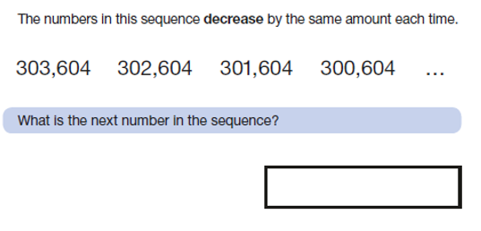
Generate and describe linear number sequences
HIAS Blended Learning Resource
‘Contains material developed by the Standards and Testing Agency for 2018 national curriculum assessments and licensed under Open Government Licence v3.0’.

Slide 5
Understand the problem
HIAS Blended Learning Resource
I can see four numbers that are in a sequence.
Key fact: All the numbers have 6 digits.
Key fact: There are hundreds of thousands, ten of thousands, thousands, hundreds, tens and ones in each number.
Key fact: The numbers are in a sequence.
Key fact: The numbers in the sequence decrease (get smaller).
Key fact: The numbers decrease by the same amount each time.
The answer is the next number in the sequence.

Slide 6
Make a Plan
HIAS Blended Learning Resource
Step 1: Look carefully at each number and the place value of the digits. Read the number aloud and make each number using place value counters.
Step 2: Look at each number comparing what is the same and what is different. Identify how the numbers in the sequence are different to one another. Work out the difference.
Step 3: Work out the next number in the sequence by taking away the same difference from the final number given.

Slide 7
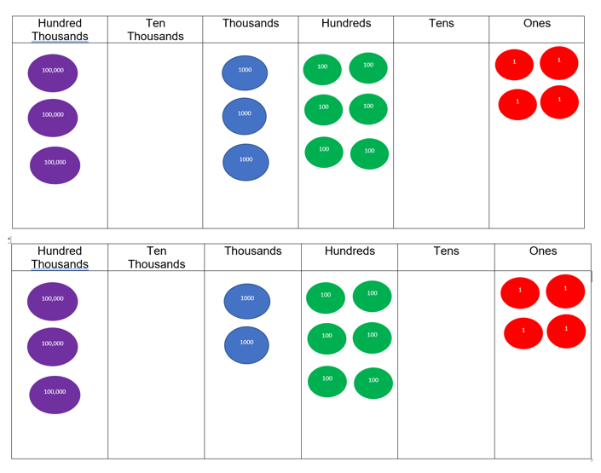
303,604 represented using place value counters.
302,604 represented using place value counters.

Slide 8
Carry out your plan: show your reasoning
HIAS Blended Learning Resource
Step 1: Look carefully at each number and the place value of the digits. Read the number aloud and make each number using place value counters.
303,604 = 300,000 + 3000 + 600 + 4
302,604 = 300,000 + 2000 + 600 + 4
Step 2: Look at each number comparing what is the same and what is different. Identify how the numbers in the sequence are different to one another. Work out the difference.
303,604 – 1000 = 302,604.
302,604 – 1000 = 301,604
Step 3: Work out the next number in the sequence by taking away the same difference from the final number given.
300,604 – 1000 = 299,604

Slide 9
The difference between 303,604 and 302,604 is 1000. The sequence is decreasing by 1000.
If I take away 1000 from 300,604 the answer is 299,604.

Slide 10
Review your solution: does it seem reasonable? Which steps/ parts did you find easy and which harder?
HIAS Blended Learning Resource
How could you check?
Go through the steps you took and check for errors
Remember the question is about the next number in the sequence. The sequence decreases each time therefore is your answer less than 300,604?
2. Try to solve the calculation a different way and see if you get the same answer

Slide 11
Now try this one
HIAS Blended Learning Resource
Understand the problem
Make a plan
Carry out your plan: show your reasoning
Review your solution: does it seem reasonable?
Think about your learning: which parts of the problem did you find easy and which parts did you find harder?
The numbers in the sequence decrease by the same amount each time.
303,404 303,304 303,204 303, 104 …..
What is the next number in the sequence?

Slide 12
HIAS Maths team
HIAS Blended Learning Resource
The HIAS maths team offer a wide range of high-quality services to support schools in improving outcomes for learners, including courses, bespoke consultancy and in-house training.
For further details referring to maths, please contact either of the team leads:
Jacqui Clifft : Jacqui.clifft@hants.gov.uk
Jo Lees: Jo.Lees@hants.gov.uk
For further details on the full range of services available please contact us using the following details:
Tel: 01962 874820 or email: hias.enquiries@hants.gov.uk
For further details on the full range of services available please contact us using the following details:
Tel: 01962 874820 or email: hias.enquiries@hants.gov.uk

