Slide 1
Year 7
HIAS Blended Learning Resource
Volume (unit 7.8)
This unit is about three-dimensional shapes. Standard labelling conventions are introduced, and students learn to accurately construct points, lines and polygons. The link between polygons and the faces of solids is made as the properties of familiar solids are explored. Formulae to calculate the volume of cubes and cuboids is developed in this unit. The accurate use of vocabulary and conventions is a focus in this unit.
This set of problems is about the volume of cubes and cuboids.
HIAS maths Team
Spring 2021
Final version
© Hampshire County Council

Slide 2
HIAS Blended Learning Resource
These slides are intended to support teachers and students with a blended approach to learning, either in-class or online. The tasks are intended to form part of a learning journey and could be the basis of either one lesson or a short sequence of connected lessons.
Teachers should delete, change and add slides to suit the needs of their students. Extra slides with personalised prompts and appropriate examples based on previous teaching may be suitable. When changing the slide-deck, teachers should consider:
Their expectations for the use of representations such as bar models, number lines, arrays and geometric diagrams.
Which strategies and methods students should use and record when solving problems or identifying solutions. This could include a range of informal jottings and diagrams, the use of tables to record solutions systematically and formal or informal calculation methods.
Teachers may also wish to record a ‘voice over’ to talk students through the slides.

Slide 3
HIAS Blended Learning Resource
YEAR 7: SPRING TERM OVERVIEW
Week | HIAS Unit | Topic
1 | Unit 7.6 | Four operations: Fractions (vulgar and decimal)
2 | Unit 7.7 | Probability: 0-1 scale
3 | Unit 7.8 | Geometry: Polygons
4 |  | Geometry: Area
5 |  | Geometry: Volume and 3-D shape
 | Half term
6 | Unit 7.9 | Percentages (of amounts)
7 |  | Percentages (FDP equivalence)
8 |  | Ratio and proportion: Notation and part: whole
9 | Unit 7.10 | Coordinates (four quadrants)
10 |  | Coordinates (linear functions )

Slide 4
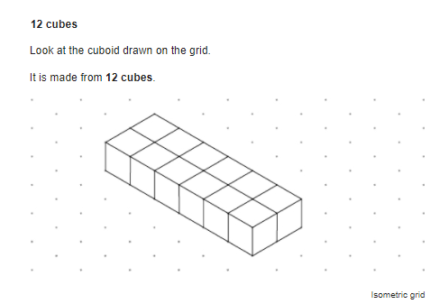
HIAS Blended Learning Resource
This cuboid is made from 12 centimetre cubes
It has a volume of 12 cm³
How many other cuboids can you find with a volume of 12 cm³
Taken from ‘Test Base’
Notes:
Solution
Assuming integer answers:
1 x 1 x 12
1 x 2 x 6
1 x 3 x 4
2 x 2 x 3

Slide 5
HIAS Blended Learning Resource
How many centimetre cubes does Kaylee need to make the larger cube?
What is the volume (in cm³ ) of her cube ?
Taken from ‘Test Base’
Notes:
Solution:
6 x 6 x 6 = 216
Volume = 216 cm³

Slide 6
HIAS Blended Learning Resource
10cm
Not drawn accurately
10 cm
10cm
What is the volume of this cube ?
Notes:
Solution
10 x 10 x 10 = 1000 cm³

Slide 7
HIAS Blended Learning Resource
20cm
Not drawn accurately
10 cm
10cm
What is the volume of this cuboid ?
Notes:
Solution
10 x 10 x 20 = 2000 cm³

Slide 8
HIAS Blended Learning Resource
10cm
3 cm
Not drawn accurately
2cm
What is the volume of this cuboid ?
Notes:
Solution
10 x 3 x 2 = 60 cm³

Slide 9
HIAS Blended Learning Resource
6cm
x cm
Not drawn accurately
2cm
This cuboid has a volume of 24cm³
What is the value of x in cm ?
Notes:
Solution
6 x 2 x 2 = 24 cm³
x = 2cm

Slide 10
HIAS Blended Learning Resource
x cm
3 cm
Not drawn accurately
1cm
This cuboid has a volume of 24cm³
What is the value of x in cm ?
Notes:
Solution
8 x 3 x 1 = 24 cm³
x = 8 cm

Slide 11
HIAS Blended Learning Resource
y cm
x cm
Not drawn accurately
x cm
This cuboid has a volume of 100 cm³
What could the values of x and y be in cm ?
Notes:
Solution
Any combination that have a product of 100 (using x²y= volume)
25 x 2 x 2
1 x 1 x 100
5 x 5 x 4
10 x 10 x 1

Slide 12
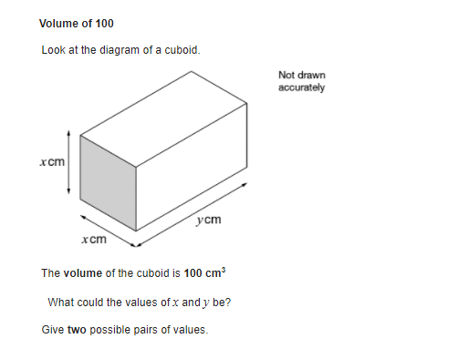
HIAS Blended Learning Resource
Taken from ‘Test Base’
Notes:
Solution
10 x 3 x 2 = 60 cm³

Slide 13
HIAS Blended Learning Resource
Work out the volume of cuboid A
Work out the value of the length marked x
Taken from ‘Test Base’
Notes:
Solutions
Volume of A = 3 x 5 x 4 = 60 cm²
2 x 5 = 10
60 / 10 = 6
x = 6 cm

Slide 14
HIAS Maths team
HIAS Blended Learning Resource
The HIAS maths team offer a wide range of high-quality services to support schools in improving outcomes for learners, including courses, bespoke consultancy and in-house training.
For further details, please contact any member of the secondary maths team:
Jo Lees: Jo.Lees@hants.gov.uk
Jenny Burn: Jenny.Burn@hants.gov.uk
Tessa Ingrey: Tessa.Ingrey@hants.gov.uk
For further details on the full range of services available please contact us using the following details:
Tel: 01962 874820 or email: hias.enquiries@hants.gov.uk
For further details on the full range of services available please contact us using the following details:
Tel: 01962 874820 or email: hias.enquiries@hants.gov.uk

