Slide 1
HIAS Maths Team Planning and Assessment Documents Webinar: 24 March or 21 April 2021
Summer Term 2021
Jacqui.Clifft@hants.gov.uk
Jo.Lees@hants.gov.uk

Slide 2
Maths Moodle: Planning Documents

Slide 3
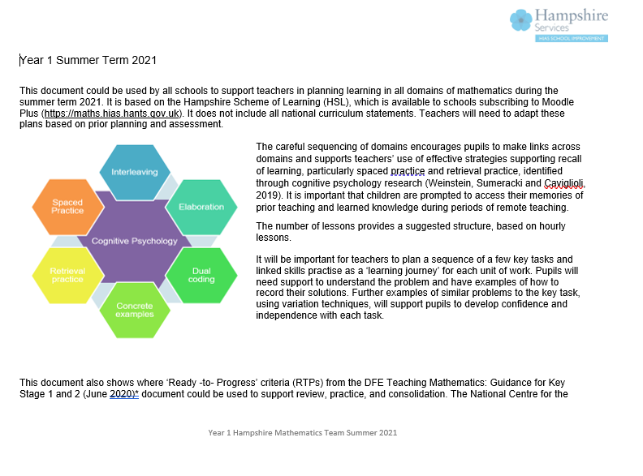
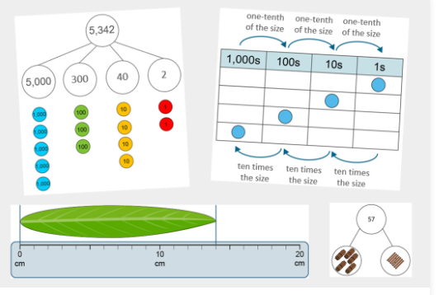
Curriculum Plans for the summer term
HIAS Maths moodle
Year 1 to Year 6
Planning for 2/3 week units of work covering all domains across the term
Can be used alongside school’s own resources eg White Rose, text books
DfE ‘Ready- to- Progress’ (RTPs) criteria identified as appropriate in units of work
Each of the RTPs have ppt resources developed by NCETM
RTPs could be used to support interventions
Support with 2020 DfE guidance | NCETM

Slide 4
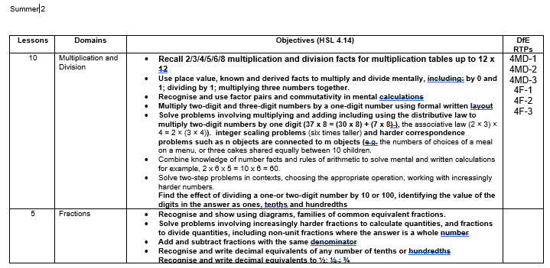
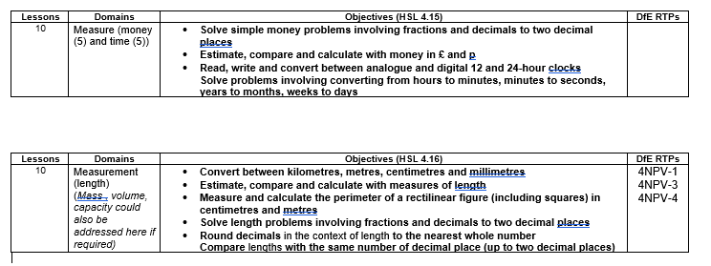
Summer term: Year 4
3 week block: Multiplication and Division; Fractions
3 week block: Multiplication and Division (NPV)
2 week block on Measurement (money, NPV)
2 (1) week block on Geometry
2 week block on Measurement (length, capacity, mass, NPV)
Provides a possible structure to adapt-
Use AfL for appropriate objectives
2 week block on Addition and Subtraction (NPV)

Slide 5
HIAS Assessment Guidance for primary schools: English and mathematics
HIAS assessment, English, and mathematics teams
- aims to influence how assessment can be used to shape the curriculum and support transition into the next academic year.
The document is organised in 2 sections:
support for formative assessment to inform curriculum planning
supports schools in undertaking meaningful summative assessment at the end of the summer term
The PDF of the full guidance document (English and maths) sent out to schools by email
(Thursday 18 March 2021 )
Online Training - Maths Moodle: Summer 2021 planning and assessment (hants.gov.uk)

Slide 6
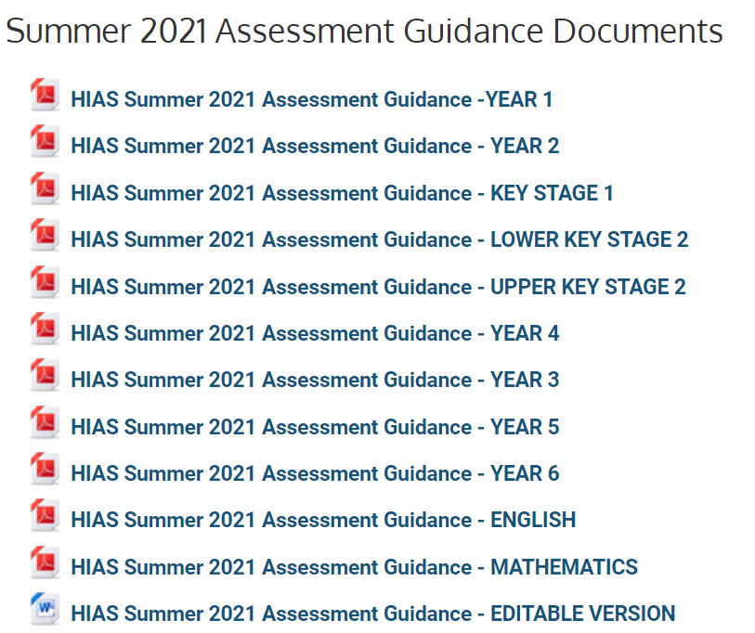
Mathematics
Assessment Guidance
National Curriculum summary descriptors
Year group versions and editable versions available on HIAS Assessment in Moodle Plus
Online Training - Course: Summer 2021 Assessment Guidance (hants.gov.uk)

Slide 7
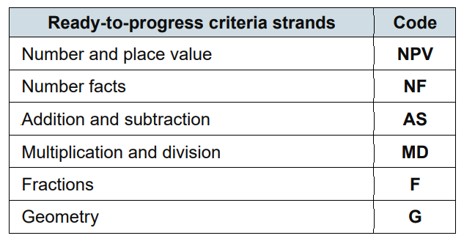
DfE: Ready –to- Progress Criteria (RTPs)
The ready-to-progress criteria in this document are organised into 6 strands
Measurement and Statistics are integrated as applications of number criteria,
elements of measurement that relate to shape are included in the Geometry strand.
Teaching mathematics in primary schools - GOV.UK (www.gov.uk)

Slide 8
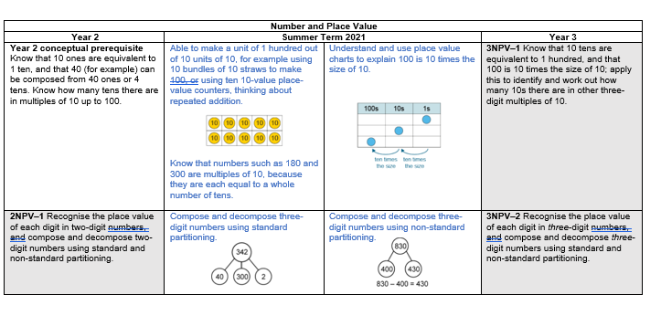
Assessment Guidance
Year 1 to Year 6:
Based around the RTPs and a few national curriculum objectives
RTP criteria identify the most important conceptual knowledge and understanding within each year group pupils need in order to progress successfully into the following year group’s curriculum
HIAS maths team have provided interim checkpoints to support assessment towards end of year attainment
Not a ‘learning journey’ or scheme of learning.
Statutory requirement to teach the whole curriculum

Slide 9
DfE Ready to Progress Criteria: 6 strands
NPV (Y1- Y6); Number Facts (Y1-Y5); Addition and subtraction (Y1-3,Y6); Multiplication and Division (Y2-Y6); Fractions (Y3-Y6), Geometry (Y1-Y6)
E.G Y3 Assessment Guidance
Summer term steps
RTPs (or NC objectives)
National curriculum objectives identified for fractions in KS1 and measurement in KS2
Interim steps

Slide 10
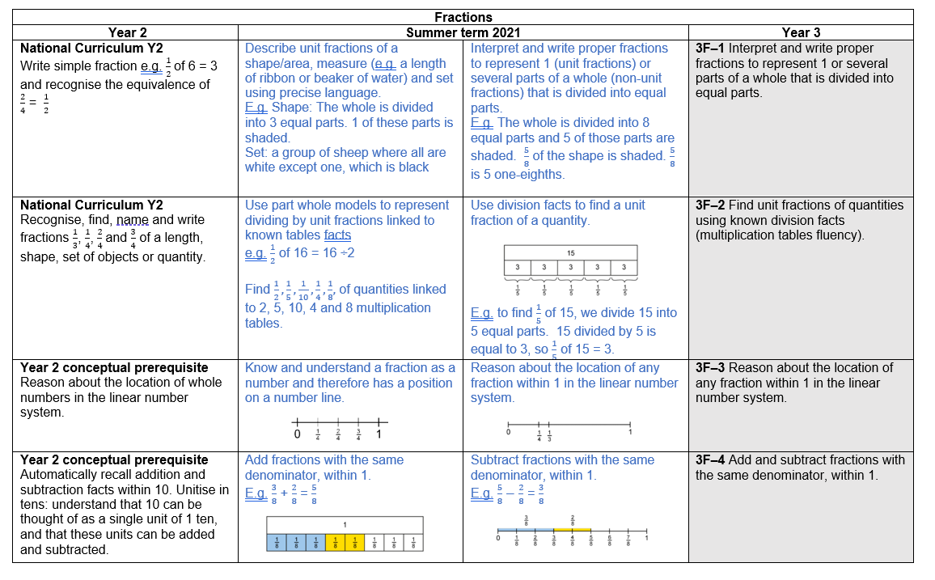
NC objectives
RTPs
Key concept

Slide 11
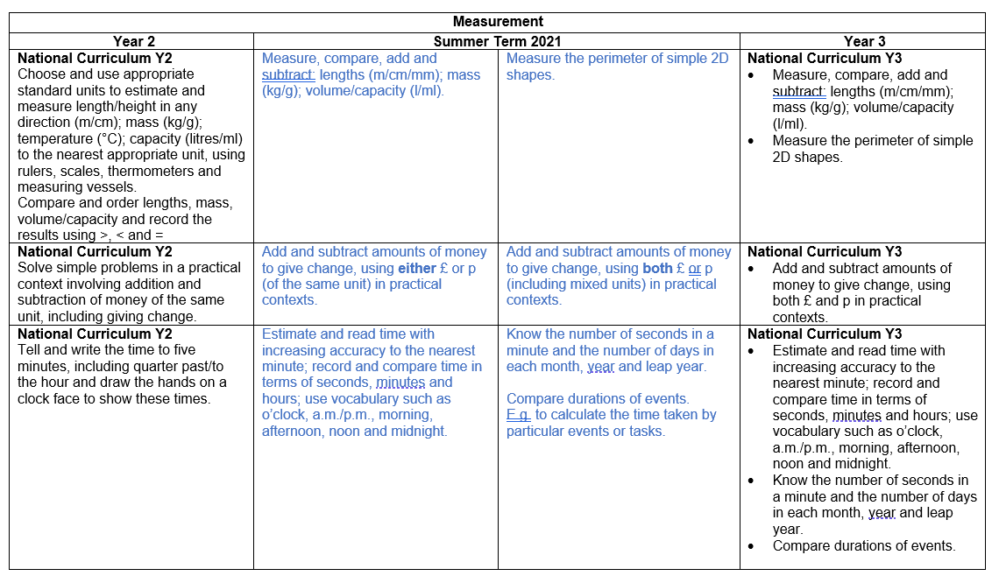
NC objectives
NC objectives

Slide 12
HIAS Maths team: National Curriculum summary descriptors End of year assessment: ‘Minimum sufficiency’ and ‘Typically’
For Year 1 to Year 6
Still need to secure to make progress in next curriculum…
Aim for ‘typically’ before moving on…
enable children to progress into the adapted autumn curriculum…
Notes:
From HIAS Assessment Guidance for Primary schools:
Recognising the inconsistent experiences of children this year, and the remaining time before the summer break, teachers will need to chart an achievable curriculum, informed by diagnostic assessment and focused on the most important areas that will support transition into the next academic year.
It will not be possible (or desirable) to try to formally assess everything you would normally have considered as part of a secure summative assessment of the entire curriculum. However, we hope the materials will be a support in helping schools determine the curriculum expectations to aim for by the end of the current year, for almost all children.
We have termed this expectation the “minimum sufficiency” that represents the breadth and depth of curriculum knowledge (skills, understanding and behaviours) that will enable children to progress into the adapted autumn curriculum for children in the next year group. This expectation is neither indicative of the usual curriculum breadth nor the typical curriculum mastery that would have been achieved in previous years but will support any catch-up required over the course of next year.

Slide 13
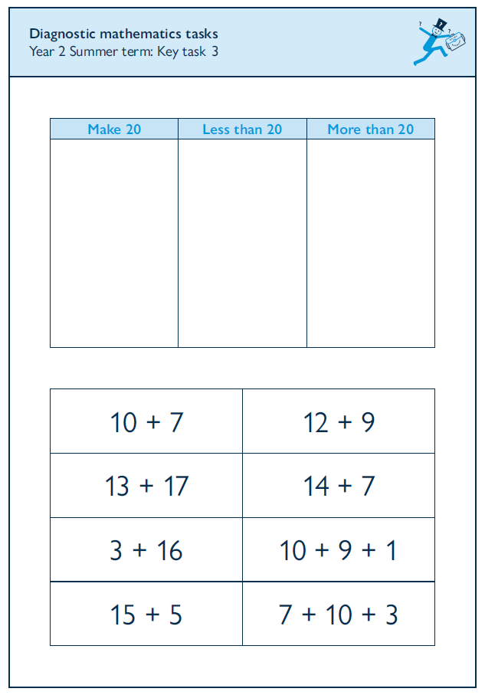
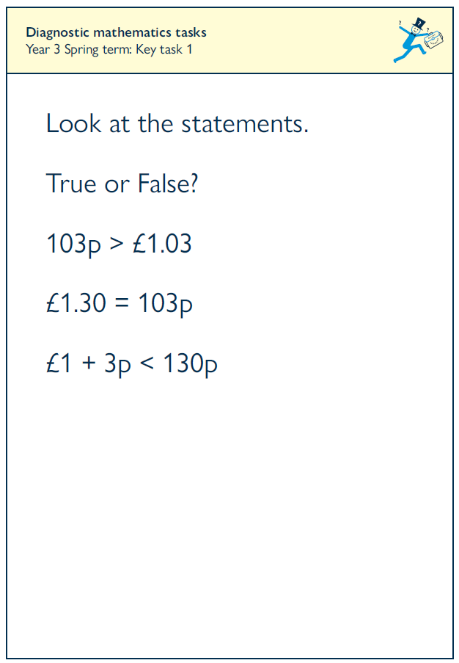
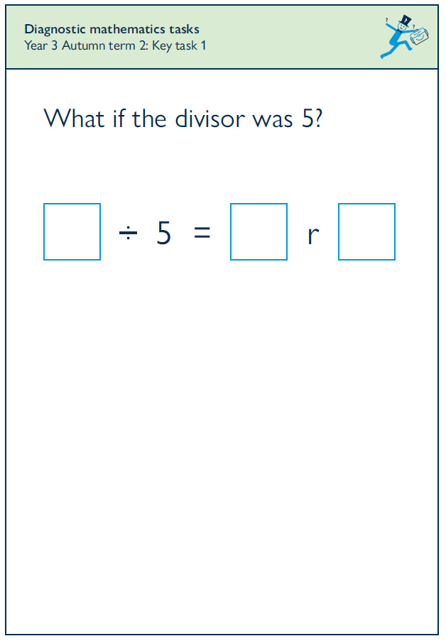
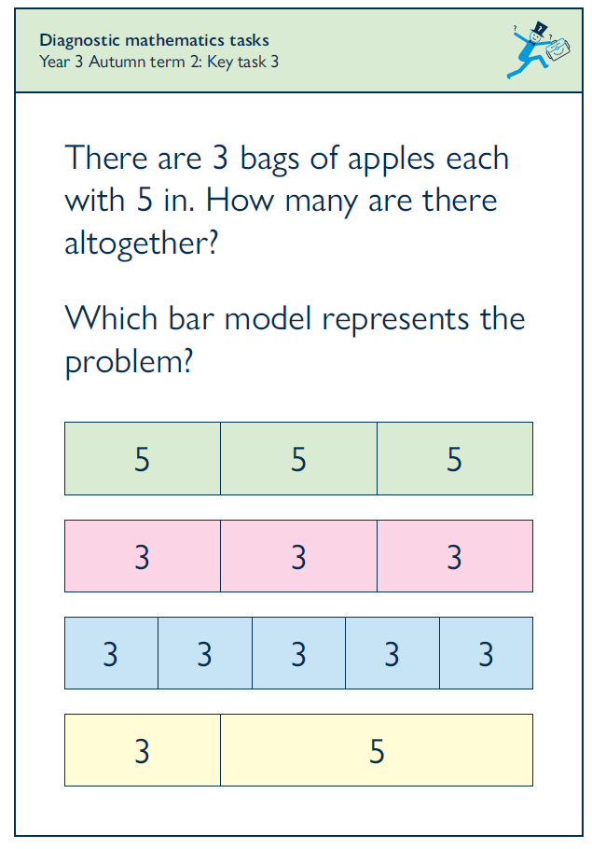
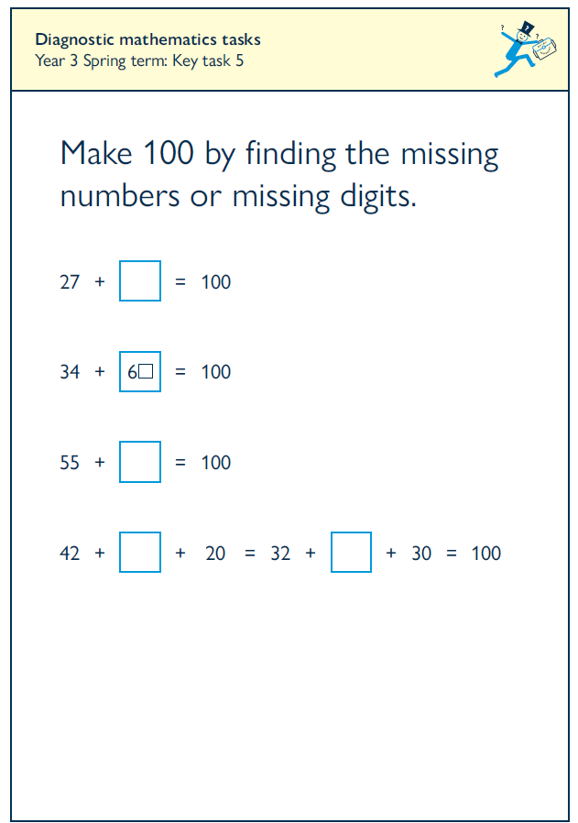
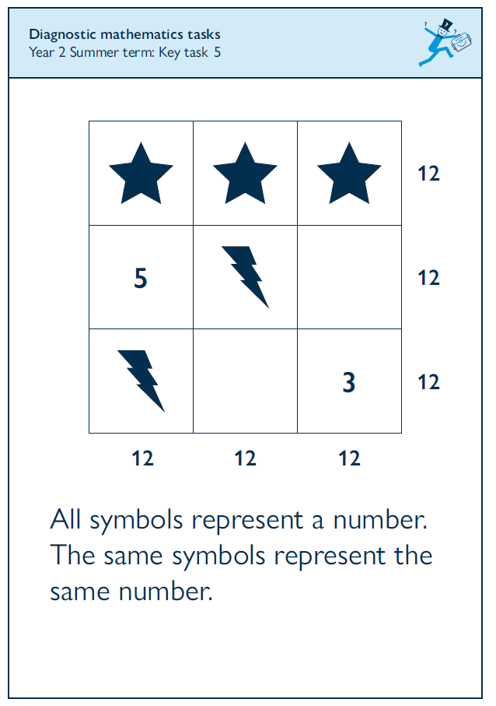
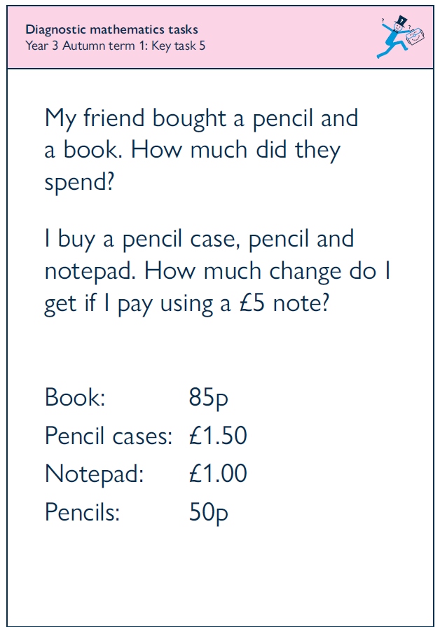
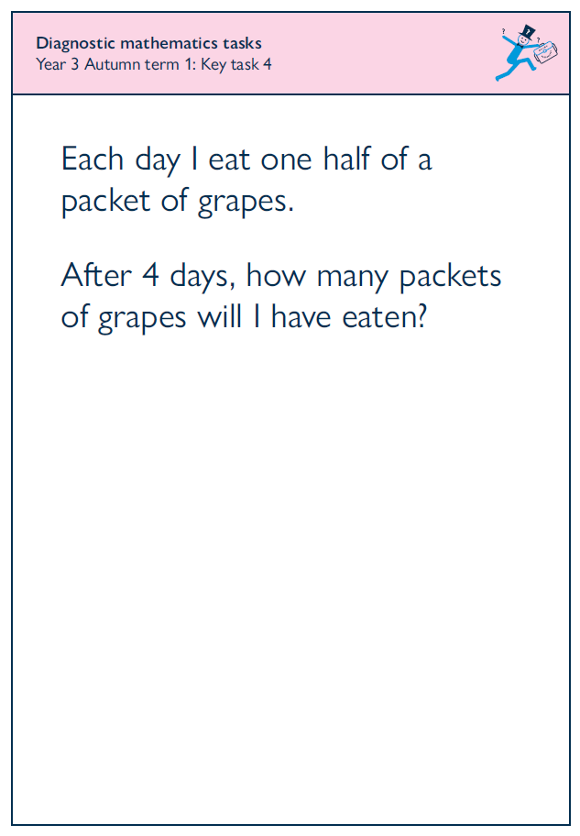
Diagnostic Mathematics Tasks Key Stage 1 and 2
Each pack contains:
Introductory rationale and principles booklet
Teacher booklet containing 24 tasks and suggested questions with NC links
Teacher booklet with space for notes
Individual A5 task cards for using with pupils
New
Year R to Year 1 available
YR to Year 1
Year 1 to Year 2
Year 2 to Year 3
Year 3 to Year 4
Year 4 to Year 5
Year 5 to Year 6
£45 per individual set
£40 per set when purchasing two or more sets

Slide 14
Further support for planning and assessment summer to autumn term
Mathematics Planning and assessment webinar
(Learning Zone)
Class teachers and maths manager
(Core Provision meetings in June)
Year 1/ 2:
10 May 2021
Year 3/ 4:
12 May 2021
Year 5/ 6:
13 May 2021
Further support through:
Core Provision meetings start again in June-
Using Diagnostic Tasks – Learning zone
2 x half day course
29 April (Infant)
6 May 2021 (Primary/ Junior)
Bespoke MP support
Leadership support to :
develop bespoke curriculum plans KS1/2
Develop intervention strategies for individuals and groups of pupils
Planning with class teachers to
meet the range of learners
Identify steps in learning for pupils with SEND

