Slide 1
Year 8
HIAS Blended Learning Resource
Formulae for perimeters and areas (unit 8.6)
Calculate and solve problems involving perimeters of 2-d shapes, including circles, areas of circles and composite shapes
HIAS maths Team
Spring 2021
Final version
© Hampshire County Council

Slide 2
HIAS Blended Learning Resource
These slides are intended to support teachers and students with a blended approach to learning, either in-class or online. The tasks are intended to form part of a learning journey and could be the basis of either one lesson or a short sequence of connected lessons.
Teachers should delete, change and add slides to suit the needs of their students. Extra slides with personalised prompts and appropriate examples based on previous teaching may be suitable. When changing the slide-deck, teachers should consider:
Their expectations for the use of representations such as bar models, number lines, arrays and geometric diagrams.
Which strategies and methods students should use and record when solving problems or identifying solutions. This could include a range of informal jottings and diagrams, the use of tables to record solutions systematically and formal or informal calculation methods.
Teachers may also wish to record a ‘voice over’ to talk students through the slides.

Slide 3
HIAS Blended Learning Resource
YEAR 8 : SPRING TERM OVERVIEW
Week | HIAS Unit | Topic
1 | Unit 8.6 | Geometry: Formulae for perimeters and areas
2 | Unit 8.7 | Accuracy, powers, and roots
3 | Unit 8.8 | Compound measures
4 | Unit 8.9 | Statistics: Graphs and charts
5 |  | Statistics: averages for numerical data
 | Half term
6 | Unit 8.10 | Number: Standard form (representing numbers)
 |  | Number: Standard form (simple calculations)
7 |  | Number: Standard form (simple calculations)
 |  | Number: Prime factorisations
8 |  | Number: Prime factorisations
9 | Unit 8.11 | Graphs: Linear and quadratic
10 |  | Graphs: Simultaneous equations

Slide 4
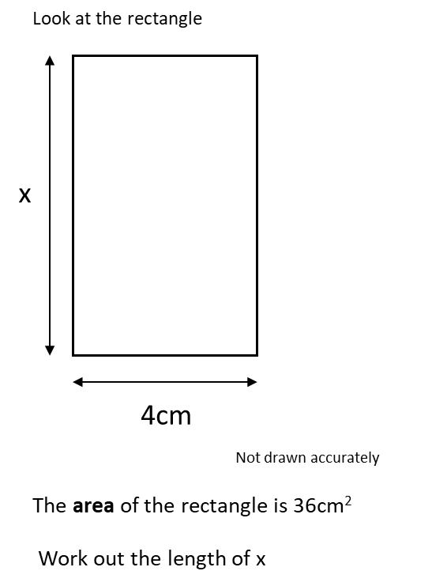
HIAS Blended Learning Resource
Notes:
Solution:
X = 36÷4 = 9cm

Slide 5
HIAS Blended Learning Resource
Notes:
Solution
X = 46 ÷ 4 = 11.5

Slide 6
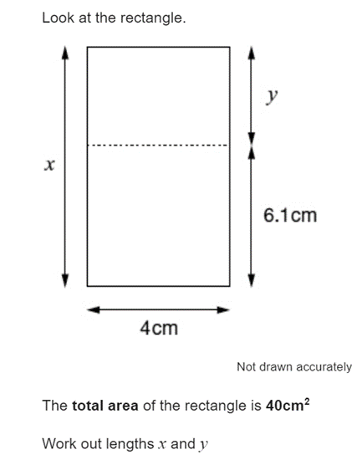
HIAS Blended Learning Resource
Testbase question
Notes:
Solution
X = 40÷4 = 10cm
Y = 10 – 6.1 = 3.9cm

Slide 7
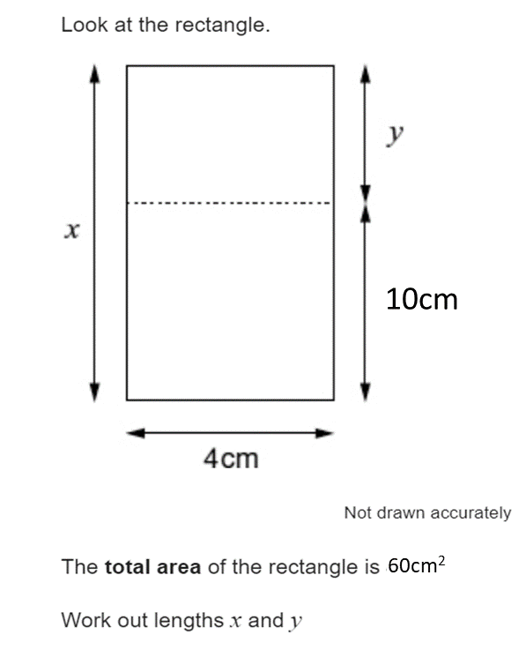
HIAS Blended Learning Resource
Can you find two ways of working out x and y?
Notes:
Solution
X= 60÷4 = 15cm
Y = 15-10=cm
OR
10x4=40, so area top rectangle is 60-40=20cm²
So, y = 20÷4 = 5cm
X=10+5 =15cm

Slide 8
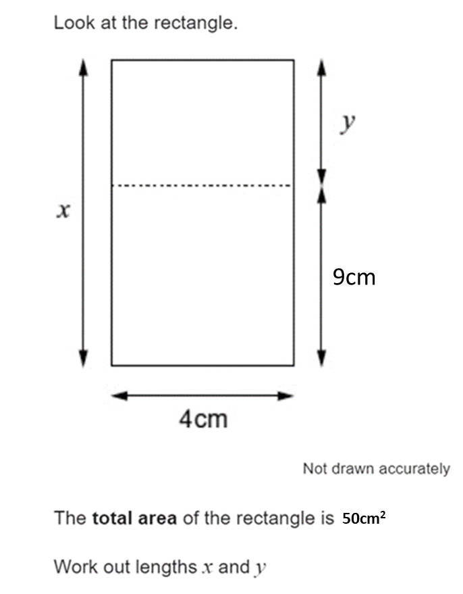
HIAS Blended Learning Resource
Now find the dimensions of three rectangles, with the same area as this rectangle. The dimensions must be whole numbers.
Notes:
Solution
X=50÷4=12.5cm
Y=12.5-9= 3.5cm
Three rectangles with the same area are:
1cm by 50cm
2cm by 25cm
5cm by 10cm

Slide 9
HIAS Maths team
HIAS Blended Learning Resource
The HIAS maths team offer a wide range of high-quality services to support schools in improving outcomes for learners, including courses, bespoke consultancy and in-house training.
For further details, please contact any member of the secondary maths team:
Jo Lees: Jo.Lees@hants.gov.uk
Jenny Burn: Jenny.Burn@hants.gov.uk
Tessa Ingrey: Tessa.Ingrey@hants.gov.uk
For further details on the full range of services available please contact us using the following details:
Tel: 01962 874820 or email: hias.enquiries@hants.gov.uk
For further details on the full range of services available please contact us using the following details:
Tel: 01962 874820 or email: hias.enquiries@hants.gov.uk

