Slide 1
Year 3
HIAS Blended Learning Resource
Multiplication and Division 2
Solve problems including missing number problems involving multiplication and division
HIAS maths Team
Spring 2021
Final version
© Hampshire County Council

Slide 2
HIAS Blended Learning Resource
These slides are intended to support teachers and pupils with a blended approach to learning, either in-class or online. The tasks are intended to form part of a learning journey and could be the basis of either one lesson or a short sequence of connected lessons.
The 4-step Polya model for problem solving has been used to provide a structure to support reasoning. Teachers may need to use more or fewer steps to support the range of learners in their class.
Teachers should delete, change and add slides to suit the needs of their pupils. Extra slides with personalised prompts and appropriate examples based on previous teaching may be suitable. When changing the slide-deck, teachers should consider:
Their expectations for the use of representations such as bar models, number lines, arrays and diagrams.
Which strategies and methods pupils should use and record when solving problems or identifying solutions. This could include a range of informal jottings and diagrams, the use of tables to record solutions systematically and formal or informal calculation methods.
Teachers may also wish to record a ‘voice over’ to talk pupils through the slides.

Slide 3
HIAS Blended Learning Resource
1945 George Polya published ‘How To Solve It’ 2nd ed., Princeton University Press, 1957, ISBN 0-691-08097-6.

Slide 4
Solving problems including missing number problems involving multiplication and division
HIAS Blended Learning Resource
By the pool, there are 18 sunbeds.
The lifeguard stacks the sunbeds in piles of three.
The lifeguard is given another 24 sunbeds.
How many stacks of 3 can he make altogether?
Adapted from ‘Dip and Pick’

Slide 5
Understand the problem
HIAS Blended Learning Resource
TASK
This problem is about stacking sunbeds in piles of 3.
Key Fact: There are 18 sunbeds which are stacked in piles of 3
Have to calculate how many stacks of 3 sunbeds you can make (3x table)
Key fact: There are another 24 sunbeds which are stacked in piles of 3
Have to calculate how many stacks of 3 sunbeds you can make (3x table)
How many stacks of 3 sunbeds are there altogether?
Have to add the total number of stacks of sunbeds together
By the pool, there are 18 sunbeds.
The lifeguard stacks the sunbeds in piles of three.
The lifeguard is given another 24 sunbeds.
How many stacks of 3 can he make altogether?
Adapted from ‘Dip and Pick’

Slide 6
Make a Plan
HIAS Blended Learning Resource
Step 1: Know that sunbeds are stacked in piles of 3 (x3 table facts)
Step 2: There are 18 sunbeds which are stacked in piles of 3. How many stacks can be made? (18 ÷ 3 = ?)
Step 3: There are another 24 sunbeds which are stacked in piles of 3. How many more stacks can be made?
(24 ÷ 3 = ?)
Step 4: How many stacks of 3 sunbeds are there altogether?
Have to add the total number of stacks of sunbeds together (Step 2 + Step 3)
TASK
By the pool, there are 18 sunbeds.
The lifeguard stacks the sunbeds in piles of three.
The lifeguard is given another 24 sunbeds.
How many stacks of 3 can he make altogether?
Adapted from ‘Dip and Pick’

Slide 7
We could represent the problem on a bar model:
We could represent the problem on a number line:
We could use an array:
Total number of sunbeds
18
?
3
3
Stacks of 3 sunbeds at a time
-3
-3
-3
0
?
?
?
18

Slide 8
Carry out your plan: show your reasoning
HIAS Blended Learning Resource
Step 1: Know that sunbeds are stacked in piles of 3 (x3 table facts)
1 x 3 = 3 3 x 3 = 9 etc…
2 x 3 = 6
Step 2: There are 18 sunbeds which are stacked in piles of 3. How many stacks can be made?
18 ÷ 3 = ?
Step 3: There are another 24 sunbeds which are stacked in piles of 3. How many more stacks can be made?
24 ÷ 3 = ?
Step 4: How many stacks of 3 sunbeds are there altogether?
Add the answer from step 2 to step 3
TASK
By the pool, there are 18 sunbeds.
The lifeguard stacks the sunbeds in piles of three.
The lifeguard is given another 24 sunbeds.
How many stacks of 3 can he make altogether?
Adapted from ‘Dip and Pick’

Slide 9
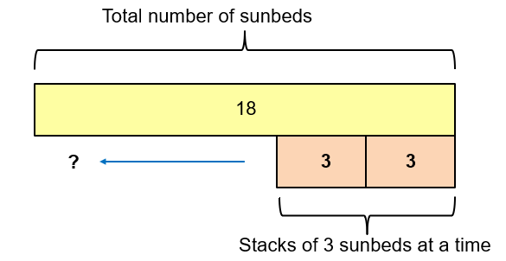
Step 1: Know that sunbeds are stacked in piles of 3 (x3 table facts)
1 x 3 = 3 3 x 3 = 9 etc…
2 x 3 = 6
Step 2: There are 18 sunbeds which are stacked in piles of 3. How many stacks can be made?
18 ÷ 3 = ?
18 – 3 = 15
15 – 3 = 12
12 – 3 = 9
9 – 3 = 6
6 – 3 = 3
3 – 3 = 0
18 ÷ 3 = 6
‘If there are 18 sunbeds which are stacked in piles of 3, then there are 6 stacks which can be made.’
1 stack 2 stacks etc… 6 stacks

Slide 10
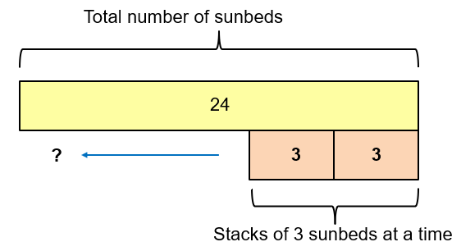
Step 3: There are another 24 sunbeds which are stacked in piles of 3. How many
more stacks can be made?
24 ÷ 3 = ?
‘If there are 24 sunbeds which are stacked in piles of 3,
then there are 8 stacks which can be made.’
Step 4: How many stacks of 3 sunbeds are there altogether?
6 stacks + 8 stacks = 14 stacks of sunbeds altogether
24 – 3 = 21
21 – 3 = 18
18 – 3 = 15
15 – 3 = 12
12 – 3 = 9
9 – 3 = 6
6 – 3 = 3
3 – 3 = 0
24 ÷ 3 = 8
1 stack 2 stacks etc… 8 stacks

Slide 11
Review your solution: does it seem reasonable? Which steps/ parts did you find easy and which harder?
HIAS Blended Learning Resource
TASK
How could you check?
Go through the steps you took and check for errors
Remember the question is about how many
stacks of sunbeds there are altogether
2. Try to solve the calculation in a
different way and see if you get the
same answer
By the pool, there are 18 sunbeds.
The lifeguard stacks the sunbeds in piles of three.
The lifeguard is given another 24 sunbeds.
How many stacks of 3 can he make altogether?
Adapted from ‘Dip and Pick’

Slide 12
Now try this one
HIAS Blended Learning Resource
Understand the problem
Make a plan
Carry out your plan: show your reasoning
Review your solution: does it seem reasonable?
Think about your learning: which parts of the problem did you find easy and which parts did you find harder?
At the pool, the lifeguard puts the sunbeds in stacks of 4.
He makes 6 stacks of sunbeds and then makes another 5 stacks.
He says that there are 46 sunbeds in total.
Is he correct? Explain how you know.
Adapted from ‘Dip and Pick’

Slide 13
HIAS Maths team
HIAS Blended Learning Resource
The HIAS maths team offer a wide range of high-quality services to support schools in improving outcomes for learners, including courses, bespoke consultancy and in-house training.
For further details referring to maths, please contact either of the team leads:
Jacqui Clifft : Jacqui.clifft@hants.gov.uk
Jo Lees: Jo.Lees@hants.gov.uk
For further details on the full range of services available please contact us using the following details:
Tel: 01962 874820 or email: hias.enquiries@hants.gov.uk
For further details on the full range of services available please contact us using the following details:
Tel: 01962 874820 or email: hias.enquiries@hants.gov.uk

