Slide 1
Year 5
HIAS Blended Learning Resource
Multiplication and division (tables and related facts) 2
Solve problems involving multiplication and division, including using their knowledge of factors and multiples
HIAS maths Team
Spring 2021
Final version
© Hampshire County Council

Slide 2
HIAS Blended Learning Resource
These slides are intended to support teachers and pupils with a blended approach to learning, either in-class or online. The tasks are intended to form part of a learning journey and could be the basis of either one lesson or a short sequence of connected lessons.
The 4-step Polya model for problem solving has been used to provide a structure to support reasoning. Teachers may need to use more or fewer steps to support the range of learners in their class.
Teachers should delete, change and add slides to suit the needs of their pupils. Extra slides with personalised prompts and appropriate examples based on previous teaching may be suitable. When changing the slide-deck, teachers should consider:
Their expectations for the use of representations such as bar models, number lines, arrays and diagrams.
Which strategies and methods pupils should use and record when solving problems or identifying solutions. This could include a range of informal jottings and diagrams, the use of tables to record solutions systematically and formal or informal calculation methods.
Teachers may also wish to record a ‘voice over’ to talk pupils through the slides.

Slide 3
HIAS Blended Learning Resource
1945 George Polya published ‘How To Solve It’ 2nd ed., Princeton University Press, 1957, ISBN 0-691-08097-6.

Slide 4
Solve problems involving division
HIAS Blended Learning Resource
A farmer is packing eggs.
Each egg box holds 12 eggs.
The farmer has 161 eggs to pack.
How many boxes can the farmer fill using 161 eggs?
How many eggs will be left over?

Slide 5
Understand the problem
HIAS Blended Learning Resource
A farmer has 161 eggs to pack. The eggs are to be packed in boxes of 12 eggs.
We need to calculate how many boxes of 12 eggs can be filled altogether.
We also need to calculate how many eggs will be left over. As the boxes hold 12 eggs the most eggs that could be left over is 11.
A farmer is packing eggs.
Each egg box holds 12 eggs.
The farmer has 161 eggs to pack.
How many boxes can the farmer fill using 161 eggs?
How many eggs will be left over?

Slide 6
Make a Plan
HIAS Blended Learning Resource
Step 1: We need to visualise the problem. Representing it with a number line should help us.
Step 2: : We need to calculate how many boxes of 12 the farmer can fill.
If we think about what we know that could help us with this problem we can remember that
12 x 12 = 144
144 is only 17 less than 161. This should be useful.
We also need to find how many eggs will be left over.
Step 3: We need to record both the number of boxes that the farmer can fill and the number of eggs that will be left over. The most eggs that could be left over is 11.
A farmer is packing eggs.
Each egg box holds 12 eggs.
The farmer has 161 eggs to pack.
How many boxes can the farmer fill using 161 eggs?
How many eggs will be left over?

Slide 7
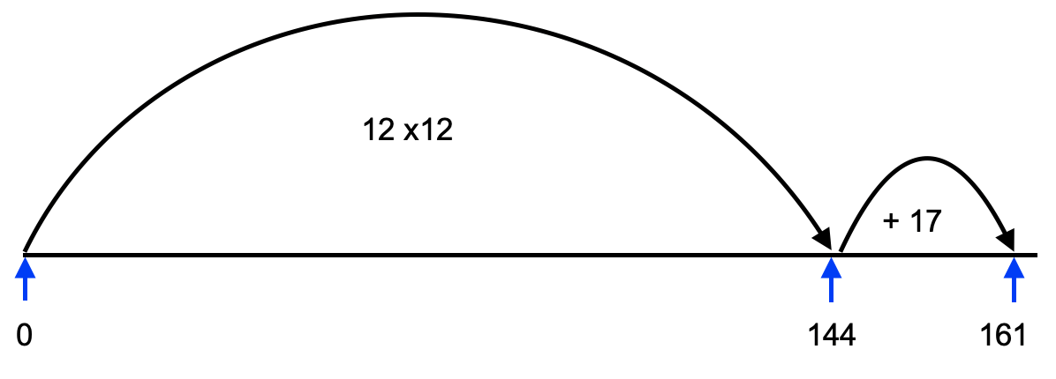
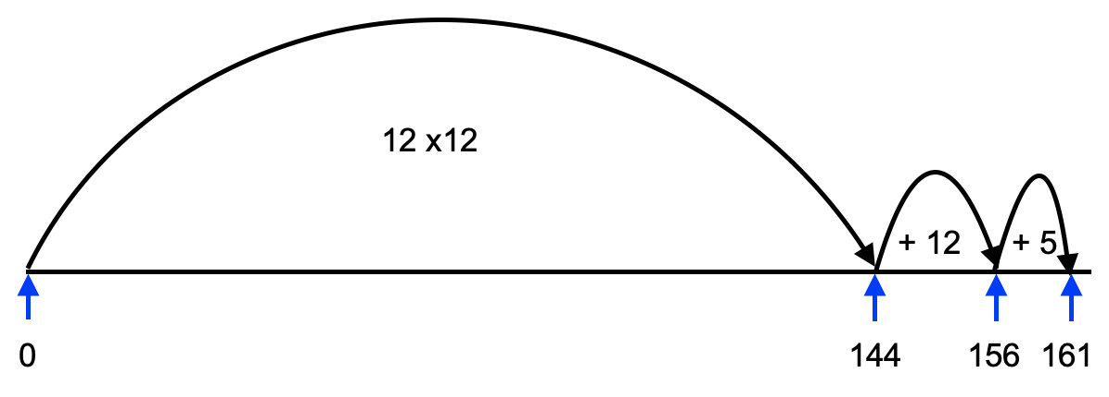
We know that 12 x 12 = 144
144 is just 17 less than 161
We can see that we could make another group of 12 eggs from 17. This would leave us with 5 eggs.

Slide 8
Carry out your plan: show your reasoning
HIAS Blended Learning Resource
Step 1: Draw the number line to represent the problem.
Step 2: We can see from our number line that the farmer can fill 13 boxes of eggs:
(12 x 12) + (1 x 12) = 13 x 12 = 156
This will mean some eggs will be left over as the farmer had 161 eggs to pack:
161 - 156 = 5
So there will be 5 eggs left over.
This is reasonable as we know that the most that could be left over was 11.
Step 3: The answers to the problem are the farmer can fill 13 boxes and there will be 5 eggs left over.
A farmer is packing eggs.
Each egg box holds 12 eggs.
The farmer has 161 eggs to pack.
How many boxes can the farmer fill using 161 eggs?
How many eggs will be left over?

Slide 9
Looking at our representation of the problem we can see 12 groups of 12 plus another group of 12:
12 X 12 = 144
1 x 12 = 12
So 13 groups of 12 altogether:
13 x 12 = 156
We cannot make another group of 12 with the 5 left.
So the farmer can fill 13 egg boxes and will have 5 eggs left over.

Slide 10
Review your solution: does it seem reasonable? Which steps/ parts did you find easy and which harder?
HIAS Blended Learning Resource
How could you check?
Go through the steps you took and check for errors.
Can use your knowledge of multiplication to check your division calculation?
A farmer is packing eggs.
Each egg box holds 12 eggs.
The farmer has 161 eggs to pack.
How many boxes can the farmer fill using 161 eggs?
How many eggs will be left over?

Slide 11
Now try this one
HIAS Blended Learning Resource
Understand the problem
Make a plan
Carry out your plan: show your reasoning
Review your solution: does it seem reasonable?
Think about your learning: which parts of the problem did you find easy and which parts did you find harder?
A farmer is packing eggs.
Each egg box holds 6 eggs.
The farmer has 615 eggs to pack.
How many boxes can the farmer fill using 615 eggs?
How many eggs will be left over?

Slide 12
HIAS Maths team
HIAS Blended Learning Resource
The HIAS maths team offer a wide range of high-quality services to support schools in improving outcomes for learners, including courses, bespoke consultancy and in-house training.
For further details referring to maths, please contact either of the team leads:
Jacqui Clifft : Jacqui.clifft@hants.gov.uk
Jo Lees: Jo.Lees@hants.gov.uk
For further details on the full range of services available please contact us using the following details:
Tel: 01962 874820 or email: hias.enquiries@hants.gov.uk
For further details on the full range of services available please contact us using the following details:
Tel: 01962 874820 or email: hias.enquiries@hants.gov.uk

