Slide 1
Year 5
HIAS Blended Learning Resource
Statistics (line graphs including temperature graphs and negative numbers)
Interpret negative numbers in context, count forwards and backwards with positive and negative numbers through zero (link number-line to a thermometer)
Interpret information in tables.
HIAS maths Team
Spring 2021
Final version
© Hampshire County Council

Slide 2
HIAS Blended Learning Resource
These slides are intended to support teachers and pupils with a blended approach to learning, either in-class or online. The tasks are intended to form part of a learning journey and could be the basis of either one lesson or a short sequence of connected lessons.
The 4-step Polya model for problem solving has been used to provide a structure to support reasoning. Teachers may need to use more or fewer steps to support the range of learners in their class.
Teachers should delete, change and add slides to suit the needs of their pupils. Extra slides with personalised prompts and appropriate examples based on previous teaching may be suitable. When changing the slide-deck, teachers should consider:
Their expectations for the use of representations such as bar models, number lines, arrays and diagrams.
Which strategies and methods pupils should use and record when solving problems or identifying solutions. This could include a range of informal jottings and diagrams, the use of tables to record solutions systematically and formal or informal calculation methods.
Teachers may also wish to record a ‘voice over’ to talk pupils through the slides.

Slide 3
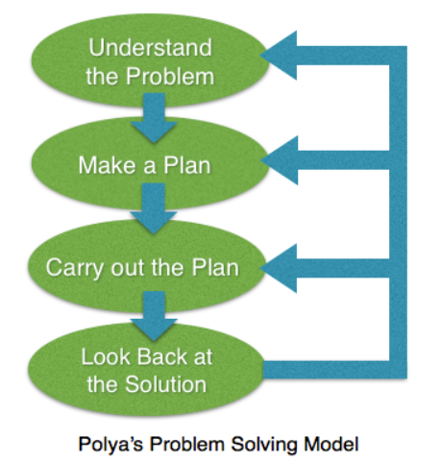
HIAS Blended Learning Resource
1945 George Polya published ‘How To Solve It’ 2nd ed., Princeton University Press, 1957, ISBN 0-691-08097-6.

Slide 4
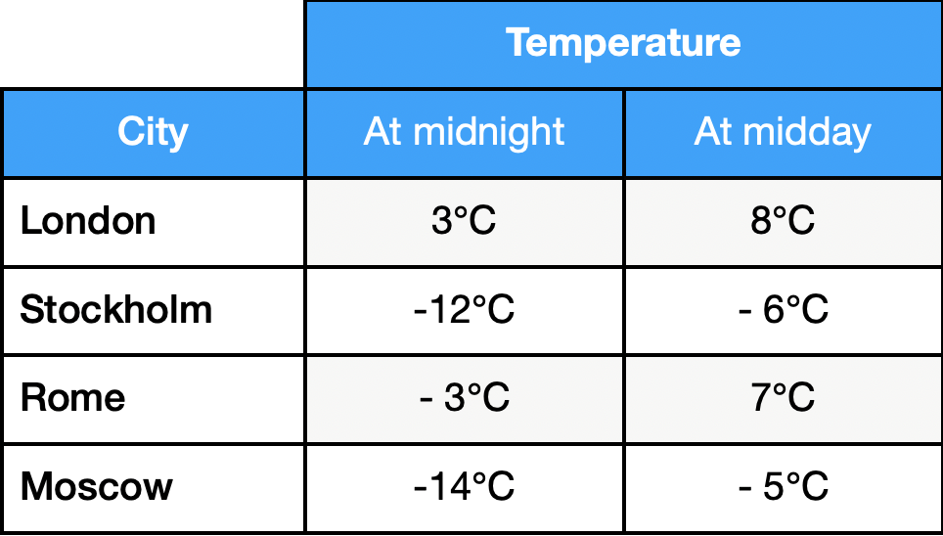
Interpret negative numbers in context and interpret information in tables
HIAS Blended Learning Resource
Here are the temperatures in four cities at midnight and midday.
Which city had the greatest difference between it’s midnight and midday temperatures?

Slide 5
Understand the problem
HIAS Blended Learning Resource
Key fact: Some of the temperatures are positive numbers – greater than zero degrees Celsius and some are negative numbers -. less than zero degrees Celsius.
Key fact: There are four cities to consider.
Key fact: To find the difference between two numbers we need to find out how much greater the larger number is than the smaller number.
Working with negative numbers can be tricky at first so drawing some number lines should help us.
Here are the temperatures in four cities at midnight and midday.
Which city had the greatest difference between it’s midnight and midday temperatures?

Slide 6
Make a Plan
HIAS Blended Learning Resource
Step 1: We need to visualise this problem so we can be sure we understand it fully. Using some number lines will help.
Step 2: We need to check the difference for each of the four cities for their midnight and midday temperatures. We can work systematically through the table and record the differences as we go.
Step 3: Once we worked out the differences for each city we can see which one is the greatest difference.
Step 4: We need to record the city as our answer.
Here are the temperatures in four cities at midnight and midday.
Which city had the greatest difference between it’s midnight and midday temperatures?

Slide 7
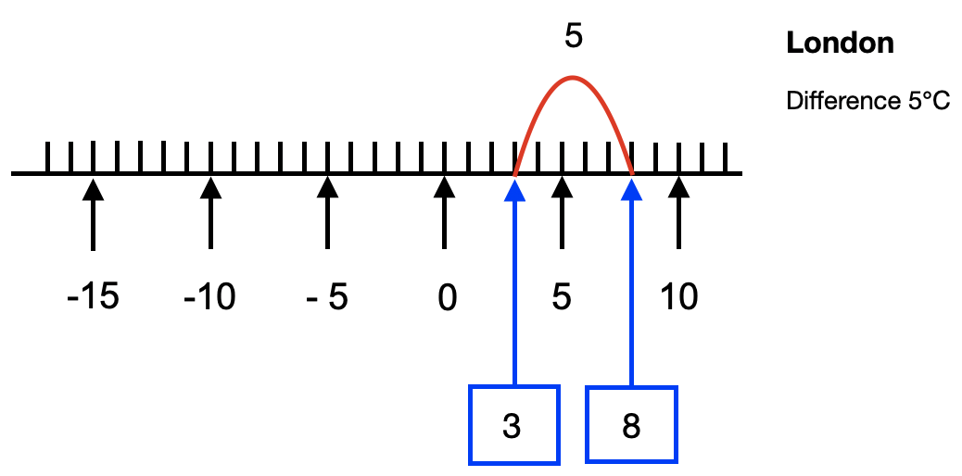
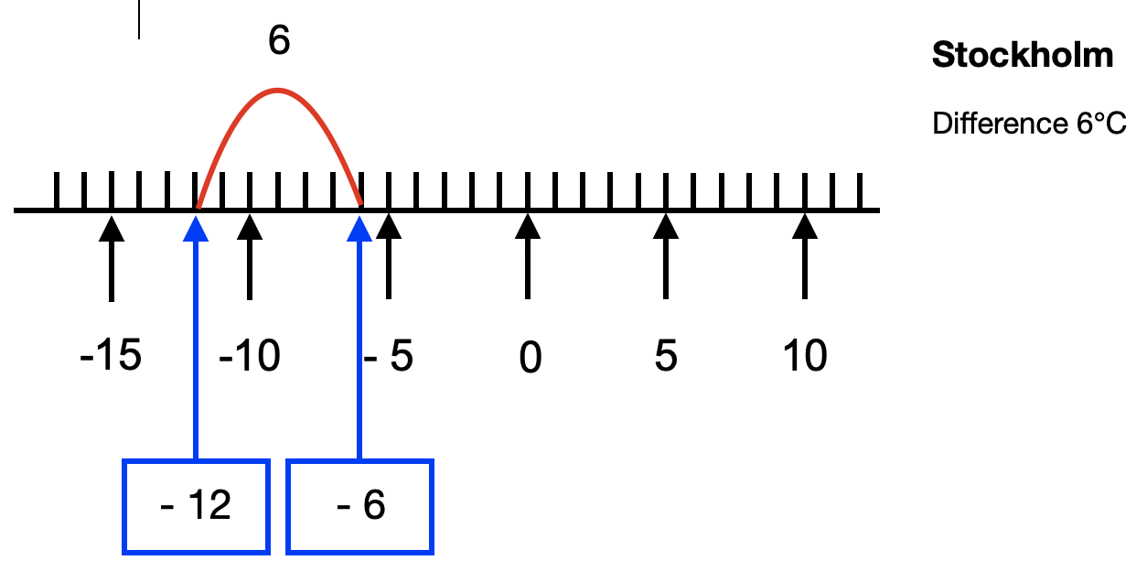
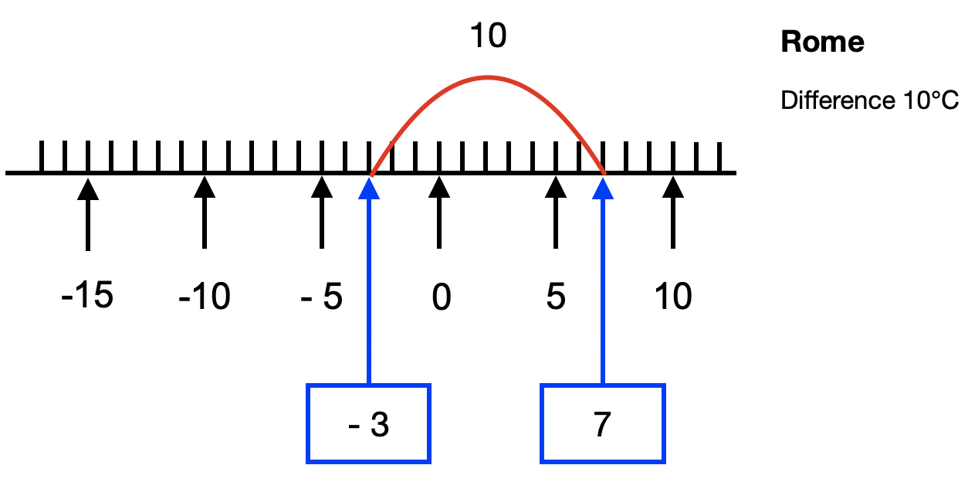
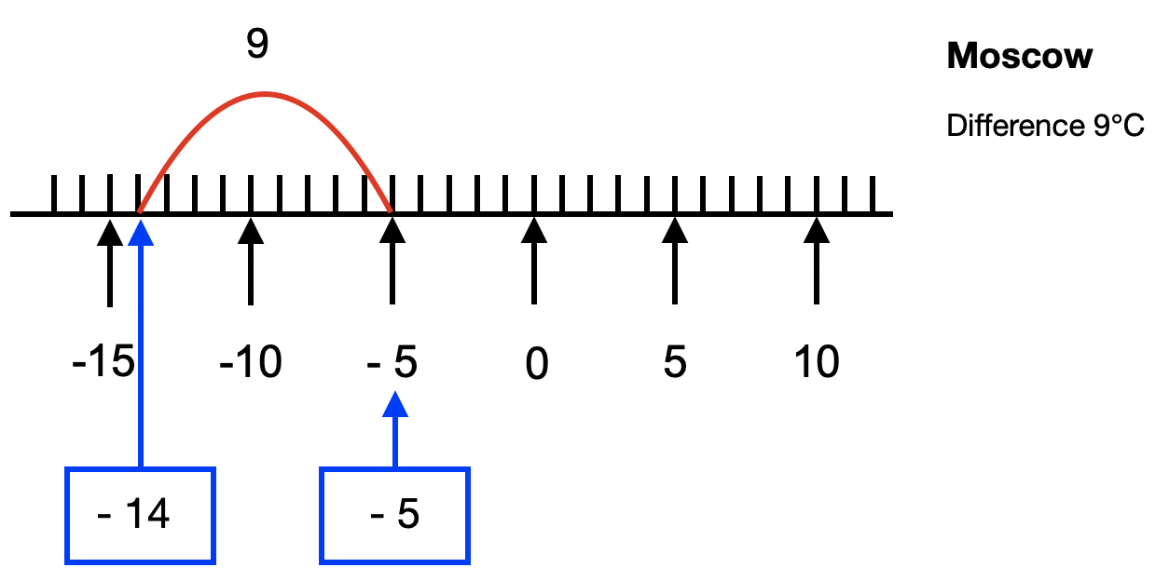

Slide 8
Carry out your plan: show your reasoning
HIAS Blended Learning Resource
Step 1: We can see from the number lines the differences between the midnight and midday temperatures in the four cities.
Step 2: Looking at the number lines we can see the differences for each city:
London 5⁰C
Stockholm 6⁰C
Rome 10⁰C
Moscow 9⁰C
Step 3:
Looking at this list we can see Rome has the greatest difference between the midnight and midday temperature (10⁰C).
Step 4:
We can now answer the problem: the city that had the greatest difference between it’s midnight and midday temperature is Rome with a difference of 10⁰C.
Here are the temperatures in four cities at midnight and midday.
Which city had the greatest difference between it’s midnight and midday temperatures?

Slide 9
Review your solution: does it seem reasonable? Which steps/ parts did you find easy and which harder?
HIAS Blended Learning Resource
Here are the temperatures in four cities at midnight and midday.
Which city had the greatest difference between it’s midnight and midday temperatures?
How could you check?
Go through the steps you took and check for errors.
Remember to check that the temperatures have all been copied correctly from the table. Are the jumps on the number lines correct?
You could use a different method to check your answers – count forward or backwards on the number lines.

Slide 10
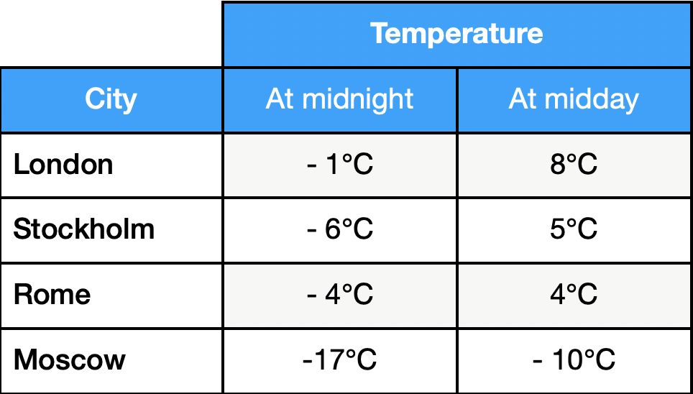
Now try this one
HIAS Blended Learning Resource
Understand the problem
Make a plan
Carry out your plan: show your reasoning
Review your solution: does it seem reasonable?
Think about your learning: which parts of the problem did you find easy and which parts did you find harder?
Here are the temperatures in four cities at midnight and midday.
Which city had the greatest difference between it’s midnight and midday temperatures?

Slide 11
HIAS Maths team
HIAS Blended Learning Resource
The HIAS maths team offer a wide range of high-quality services to support schools in improving outcomes for learners, including courses, bespoke consultancy and in-house training.
For further details referring to maths, please contact either of the team leads:
Jacqui Clifft : Jacqui.clifft@hants.gov.uk
Jo Lees: Jo.Lees@hants.gov.uk
For further details on the full range of services available please contact us using the following details:
Tel: 01962 874820 or email: hias.enquiries@hants.gov.uk
For further details on the full range of services available please contact us using the following details:
Tel: 01962 874820 or email: hias.enquiries@hants.gov.uk

