Slide 1
Year 7
HIAS Blended Learning Resource
Ratio and Proportion (unit 7.9)
This unit is about This unit is about percentages and ratio. Students will develop an understanding of percentages as parts per hundred and how this links to fraction and decimal notations. They will solve problems involving percentages in the context of measure and pure number to make links across the domains. The idea of parts and the whole is explored using ratio notation. Students will use multiplicative knowledge to simplify ratios and divide quantities into equal and unequal parts.
This set of problems is about 3-part ratios to compare heights and best buys
HIAS maths Team
Spring 2021
Final version
© Hampshire County Council

Slide 2
HIAS Blended Learning Resource
These slides are intended to support teachers and students with a blended approach to learning, either in-class or online. The tasks are intended to form part of a learning journey and could be the basis of either one lesson or a short sequence of connected lessons.
Teachers should delete, change and add slides to suit the needs of their students. Extra slides with personalised prompts and appropriate examples based on previous teaching may be suitable. When changing the slide-deck, teachers should consider:
Their expectations for the use of representations such as bar models, number lines, arrays and geometric diagrams.
Which strategies and methods students should use and record when solving problems or identifying solutions. This could include a range of informal jottings and diagrams, the use of tables to record solutions systematically and formal or informal calculation methods.
Teachers may also wish to record a ‘voice over’ to talk students through the slides.

Slide 3
HIAS Blended Learning Resource
YEAR 7: SPRING TERM OVERVIEW
Week | HIAS Unit | Topic
1 | Unit 7.6 | Four operations: Fractions (vulgar and decimal)
2 | Unit 7.7 | Probability: 0-1 scale
3 | Unit 7.8 | Geometry: Polygons
4 |  | Geometry: Area
5 |  | Geometry: Volume and 3-D shape
 | Half term
6 | Unit 7.9 | Percentages (of amounts)
7 |  | Percentages (FDP equivalence)
8 |  | Ratio and proportion: Notation and part: whole
9 | Unit 7.10 | Coordinates (four quadrants)
10 |  | Coordinates (linear functions )

Slide 4
HIAS Blended Learning Resource
Russian dolls
The heights of the Russian dolls are in the ratio 1 : 2 : 4
The smallest doll is 18cm tall
The middle doll is ____cm tall
The tallest doll is _____cm tall
Adapted from ‘Test Base’
Notes:
Solutions:
Middle doll is 2 x 18 = 36cm tall
Tallest doll is 4 x 18 = 72cm tall

Slide 5
HIAS Blended Learning Resource
Russian dolls
The heights of the Russian dolls are in the ratio 1 : 2 : 4
The smallest doll is ____cm tall
The middle doll is 12 cm tall
The tallest doll is _____cm tall
Adapted from ‘Test Base’
Notes:
Solutions:
Smallest doll is 12 ÷ 2 = 6cm tall
Tallest doll is 2 x 12 = 24 cm tall

Slide 6
HIAS Blended Learning Resource
Russian dolls
The heights of the Russian dolls are in the ratio 1 : 2 : 4
The smallest doll is ____cm tall
The middle doll is _____cm tall
The tallest doll is 64cm tall
Adapted from ‘Test Base’
Notes:
Solutions:
Smallest doll is 64 ÷ 4 = 16cm tall
Middle doll is 64 ÷ 2 = 32 cm tall

Slide 7
HIAS Blended Learning Resource
Russian dolls
The heights of the Russian dolls are in the ratio 2 : 3 : 6
The smallest doll is 8 cm tall
The middle doll is _____cm tall
The tallest doll is ____cm tall
Adapted from ‘Test Base’
Notes:
Solutions:
Middle doll is 8 ÷ 2 x 3 = 12cm tall
Tallest doll is 8 ÷ 2 x 6 = 24cm tall

Slide 8
HIAS Blended Learning Resource
Russian dolls
The heights of the Russian dolls are in the ratio 2 : 3 : 6
The smallest doll is ____cm tall
The middle doll is 18 cm tall
The tallest doll is ____cm tall
Adapted from ‘Test Base’
Notes:
Solutions:
Smallest doll is 18 ÷ 3 x 2 = 12cm tall
Tallest doll is 18 ÷ 3 x 6 = 36cm tall

Slide 9
HIAS Blended Learning Resource
Russian dolls
The heights of the Russian dolls are in the ratio 2 : 3 : 6
The smallest doll is ____cm tall
The middle doll is ____cm tall
The tallest doll is 66cm tall
Adapted from ‘Test Base’
Notes:
Solutions:
Smallest doll is 66 ÷ 6 x 2 = 22cm tall
Middle doll is 66 ÷ 6 x 3 = 33cm tall

Slide 10
HIAS Blended Learning Resource
Taken from ‘Test Base’

Slide 11
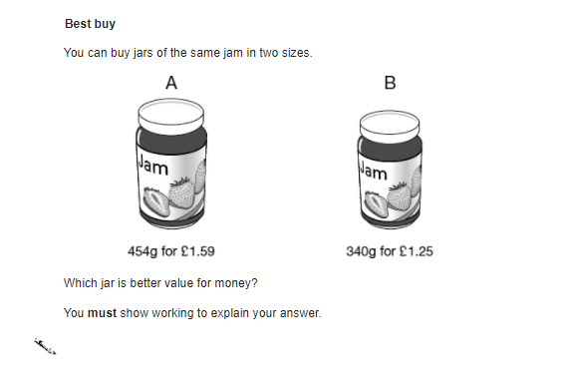
HIAS Blended Learning Resource
150g for £1
80g for 50p
Which jar is better value for money ?
Adapted from ‘Test Base’
Notes:
Solutions
Jar B is the better value for money
A: 454g per 159p: 454 ÷159 = 2.86g per 1p (so £1 buys you 286g)
B: 340g per 125p: 340 ÷125 = 2.72g per 1p (so £1 buys you 272g)

Slide 12
HIAS Blended Learning Resource
315g for £2.10
280g for £2
Which jar is better value for money ?
Adapted from ‘Test Base’
Notes:
Solutions
Jar A is the better value for money
A: 315÷210 = 1.5g per 1p
B: 280 ÷200 = 1.4g per 1p

Slide 13
HIAS Blended Learning Resource
Taken from ‘Test Base’
Notes:
Solutions
Jar A is the better value for money
A: 454g per 159p: 454 ÷159 = 2.86g per 1p (so £1 buys you 286g)
B: 340g per 125p: 340 ÷125 = 2.72g per 1p (so £1 buys you 272g)

Slide 14
HIAS Maths team
HIAS Blended Learning Resource
The HIAS maths team offer a wide range of high-quality services to support schools in improving outcomes for learners, including courses, bespoke consultancy and in-house training.
For further details, please contact any member of the secondary maths team:
Jo Lees: Jo.Lees@hants.gov.uk
Jenny Burn: Jenny.Burn@hants.gov.uk
Tessa Ingrey: Tessa.Ingrey@hants.gov.uk
For further details on the full range of services available please contact us using the following details:
Tel: 01962 874820 or email: hias.enquiries@hants.gov.uk
For further details on the full range of services available please contact us using the following details:
Tel: 01962 874820 or email: hias.enquiries@hants.gov.uk

