Slide 1
Year 1
HIAS Blended Learning Resource
Multiplication & Division-Doubles
HIAS maths Team
Spring 2021
Final version
© Hampshire County Council

Slide 2
HIAS Blended Learning Resource
These slides are intended to support teachers and pupils with a blended approach to learning, either in-class or online. The tasks are intended to form part of a learning journey and could be the basis of either one lesson or a short sequence of connected lessons.
The 4-step Polya model for problem solving has been used to provide a structure to support reasoning. Teachers may need to use more or fewer steps to support the range of learners in their class.
Teachers should delete, change and add slides to suit the needs of their pupils. Extra slides with personalised prompts and appropriate examples based on previous teaching may be suitable. When changing the slide-deck, teachers should consider:
Their expectations for the use of representations such as bar models, number lines, arrays and diagrams.
Which strategies and methods pupils should use and record when solving problems or identifying solutions. This could include a range of informal jottings and diagrams, the use of tables to record solutions systematically and formal or informal calculation methods.
Teachers may also wish to record a ‘voice over’ to talk pupils through the slides.

Slide 3
HIAS Blended Learning Resource
1945 George Polya published ‘How To Solve It’ 2nd ed., Princeton University Press, 1957, ISBN 0-691-08097-6.

Slide 4
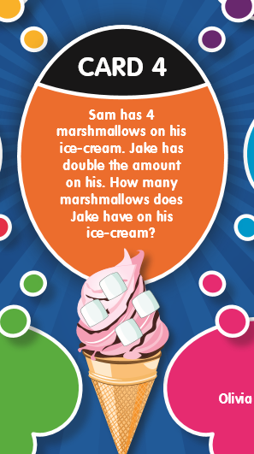
Maths focus: Multiplication & Division-Doubles
HIAS Blended Learning Resource
TASK
Dip and Pick Y1

Slide 5
Understand the problem
HIAS Blended Learning Resource
There are 4 marshmallows on 1 ice cream.
Jake has double. This means the same as “twice as many”.
This is the same as adding the same number again.
It is linked to counting in 2s.
TASK

Slide 6
Make a Plan
HIAS Blended Learning Resource
Step 1: Represent the problem for Sam’s ice cream. Use counters on a tens frame.
Step 2: Add the same number again for Jake’s ice cream (doubling). Use tens frames.
Step 3: Count the total marshmallows on Jake’s ice cream. Use a number line to keep track.
TASK

Slide 7
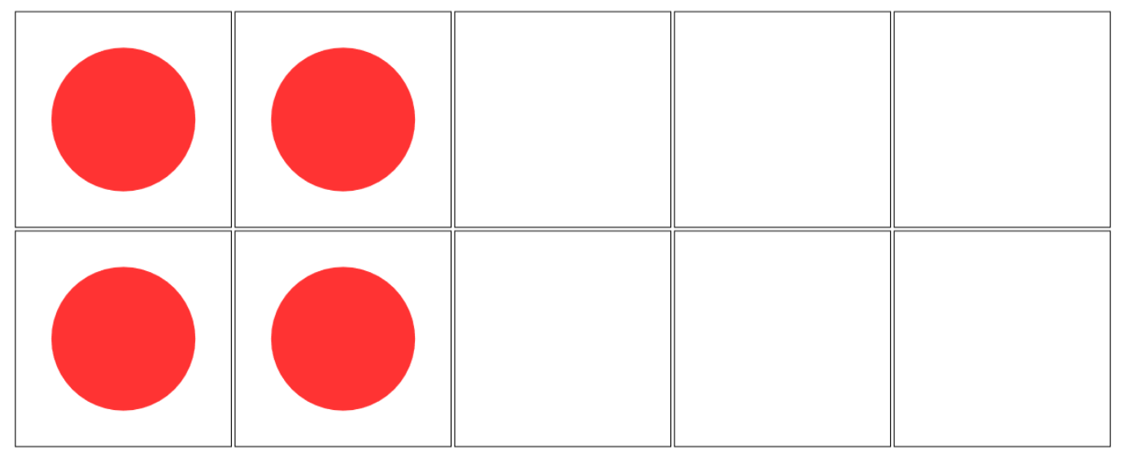
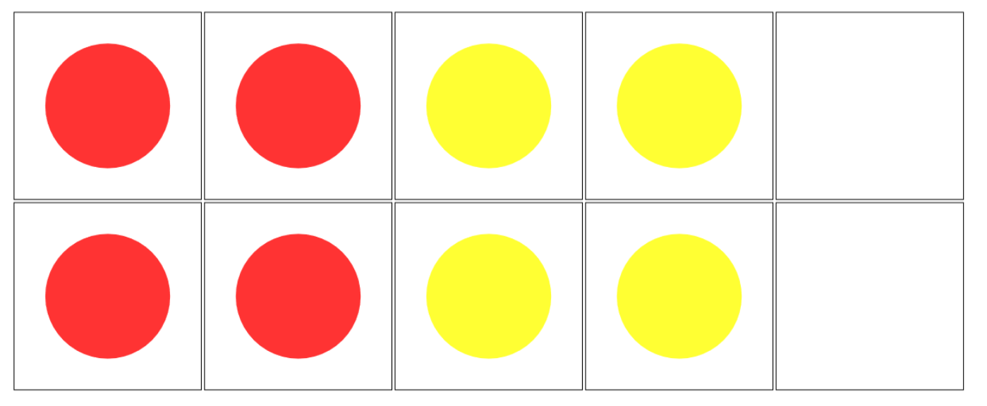
Step 1: Draw a picture to represent the problem.
1 counter represents 1 marshmallow
Jake
Sam
Step 2: Add the same number again for Jake’s ice cream (doubling).
Step 3: Count the total marshmallows on Jake’s ice cream.
4 + 4 = 8

Slide 8
Carry out your plan: show your reasoning
HIAS Blended Learning Resource
Step 1: 1 counter = 1 marshmallow
Step 2: Represent Sam’s and Jake’s
Step 3:
Sam has 4
Jake has double. 4 + 4 = 8
TASK

Slide 9
Review your solution: does it seem reasonable? Which steps/ parts did you find easy and which harder?
HIAS Blended Learning Resource
How could you check?
Go through the steps you took and check for errors
Remember the question is about how many marshmallows Jake has.
Jake has 8 marshmallows on his ice cream.
Some children may use their understanding of counting in 2s to check double 4, counting in 2s four times = 8
TASK

Slide 10
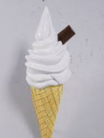
Now try this one
HIAS Blended Learning Resource
Understand the problem
Make a plan
Carry out your plan: show your reasoning
Review your solution: does it seem reasonable?
Think about your learning: which parts of the problem did you find easy and which parts did you find harder?
TASK variation
Jake has 6 flakes in his ice cream.
Sam has half this amount.
How many did Sam have?

Slide 11
HIAS Maths team
HIAS Blended Learning Resource
The HIAS maths team offer a wide range of high-quality services to support schools in improving outcomes for learners, including courses, bespoke consultancy and in-house training.
For further details referring to maths, please contact either of the team leads:
Jacqui Clifft : Jacqui.clifft@hants.gov.uk
Jo Lees: Jo.Lees@hants.gov.uk
For further details on the full range of services available please contact us using the following details:
Tel: 01962 874820 or email: hias.enquiries@hants.gov.uk
For further details on the full range of services available please contact us using the following details:
Tel: 01962 874820 or email: hias.enquiries@hants.gov.uk

