Slide 1
Year 5
HIAS Blended Learning Resource
Measurement (volume and capacity/reading scales / imperial conversions)
Solve problems involving capacity, including reading a range of scales.
HIAS maths Team
Spring 2021
Final version
© Hampshire County Council

Slide 2
HIAS Blended Learning Resource
These slides are intended to support teachers and pupils with a blended approach to learning, either in-class or online. The tasks are intended to form part of a learning journey and could be the basis of either one lesson or a short sequence of connected lessons.
The 4-step Polya model for problem solving has been used to provide a structure to support reasoning. Teachers may need to use more or fewer steps to support the range of learners in their class.
Teachers should delete, change and add slides to suit the needs of their pupils. Extra slides with personalised prompts and appropriate examples based on previous teaching may be suitable. When changing the slide-deck, teachers should consider:
Their expectations for the use of representations such as bar models, number lines, arrays and diagrams.
Which strategies and methods pupils should use and record when solving problems or identifying solutions. This could include a range of informal jottings and diagrams, the use of tables to record solutions systematically and formal or informal calculation methods.
Teachers may also wish to record a ‘voice over’ to talk pupils through the slides.

Slide 3
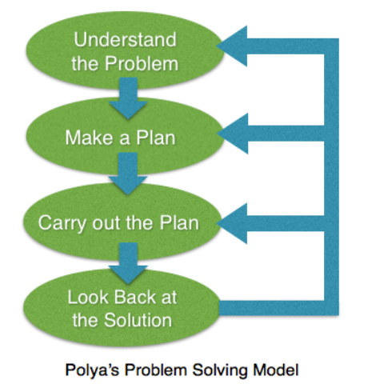
HIAS Blended Learning Resource
1945 George Polya published ‘How To Solve It’ 2nd ed., Princeton University Press, 1957, ISBN 0-691-08097-6.

Slide 4
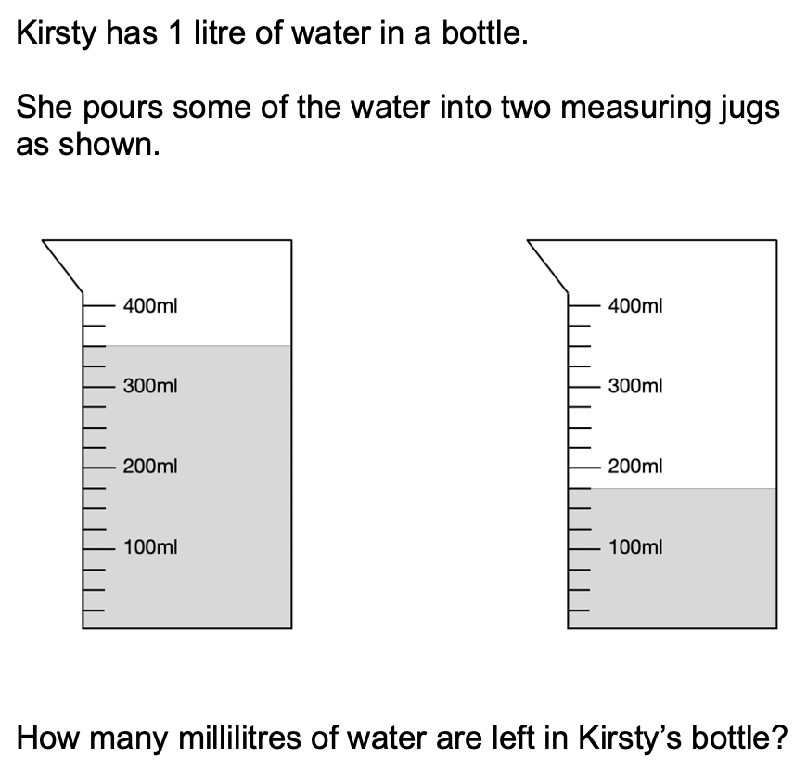
Solve problems involving capacity, including reading a range of scales.
HIAS Blended Learning Resource

Slide 5
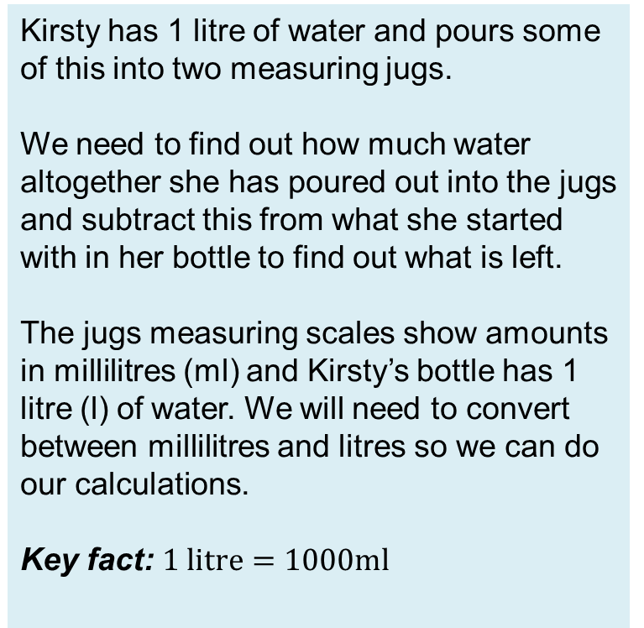
Understand the problem
HIAS Blended Learning Resource
Kirsty has 1 litre of water and pours some of this into two measuring jugs.
We need to find out how much water altogether she has poured out into the jugs and subtract this from what she started with in her bottle to find out what is left.
The jugs measuring scales show amounts in millilitres (ml) and Kirsty’s bottle has 1 litre (l) of water. We will need to convert between millilitres and litres so we can do our calculations.
Key fact: $1 litre=1000ml$

Slide 6
Make a Plan
HIAS Blended Learning Resource
Step 1: We need to read the scales carefully to find out how much water has been poured into the jugs.
Step 2: We need to visualise the problem. Representing the parts with bar models should help us.
Step 3: We need to find out how much water altogether Kirsty has poured out into the jugs and subtract this from what she started with in her bottle.
Step 4: We need to record how many millilitres of water Kirsty has left in her bottle as the answer to the problem.

Slide 7
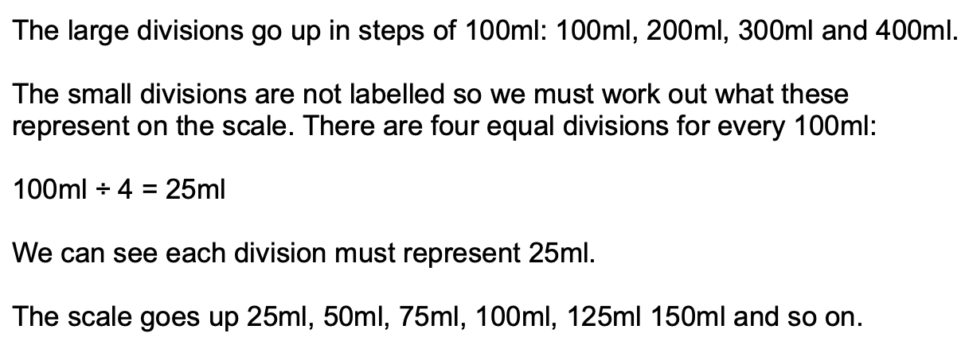
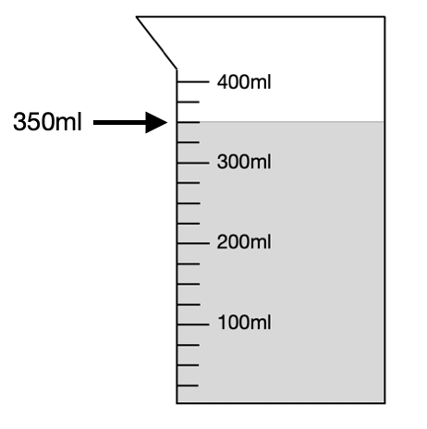
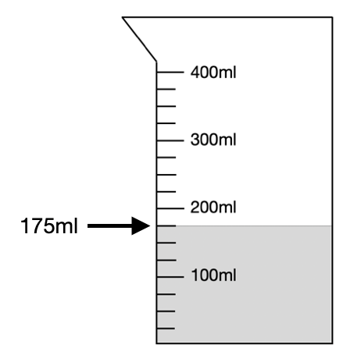
Count up from the last labelled division, 300ml and count on two steps of 25ml:
300ml + 25ml + 25ml = 350ml
Count up from the last labelled division, 100ml and count on three steps of 25ml:
100ml + 25ml + 25ml + 25ml = 175ml

Slide 8
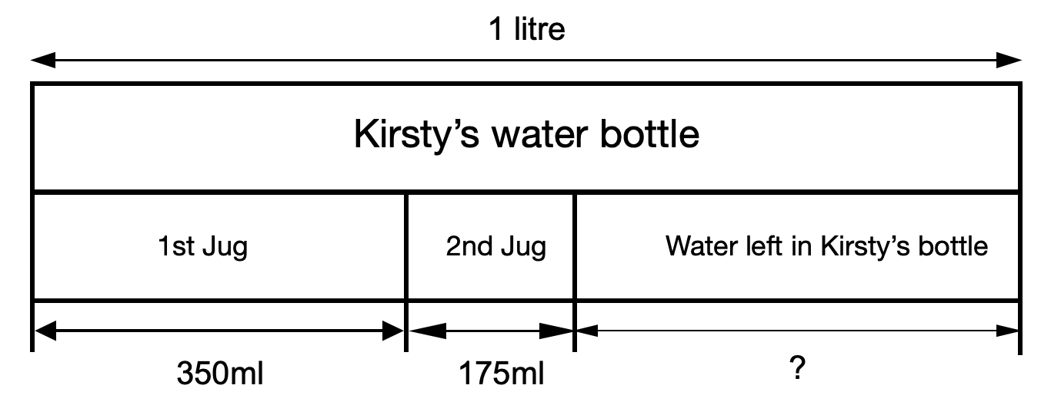

Slide 9
Carry out your plan: show your reasoning
HIAS Blended Learning Resource
Step 1: Interpret the scales on the jugs to find out what Kirsty has poured into each.
Step 2: Use the bar model diagram to visualise the problem.
Step 3: Add the water in both jugs together:
350ml + 175ml = 525ml
Now subtract this from what Kirsty had in her bottle:
1000ml - 525ml = 475ml
Step 4: Answer the question:
Kirsty has 475ml left in her bottle.

Slide 10
Review your solution: does it seem reasonable? Which steps/ parts did you find easy and which harder?
HIAS Blended Learning Resource
How could you check?
Go through the steps you took and check for errors.
Remember to check the readings on the scales. Are the answers to the calculations reasonable?
You could use a different method to do the calculations to check your answers.

Slide 11
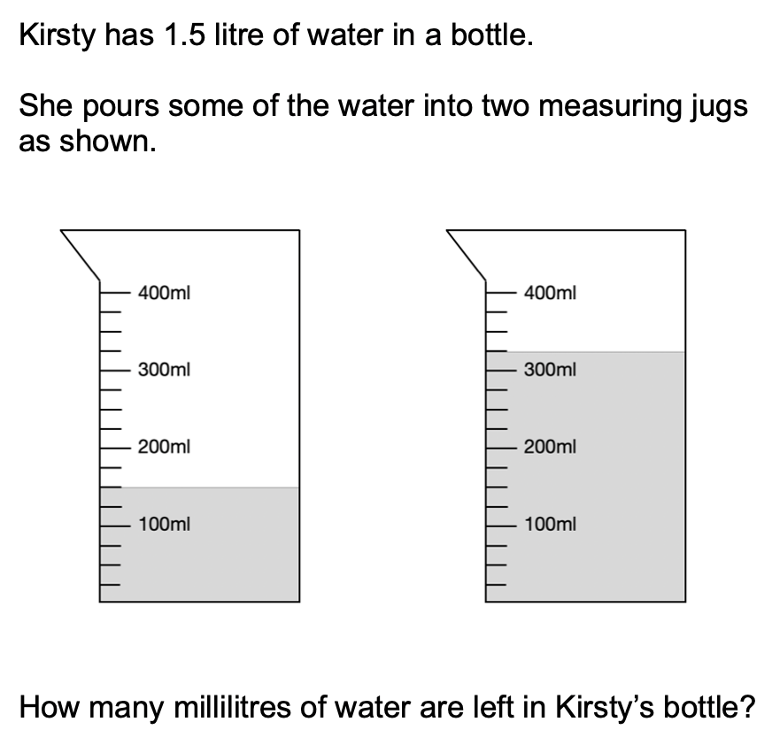
Now try this one
HIAS Blended Learning Resource
Understand the problem
Make a plan
Carry out your plan: show your reasoning
Review your solution: does it seem reasonable?
Think about your learning: which parts of the problem did you find easy and which parts did you find harder?

Slide 12
HIAS Maths team
HIAS Blended Learning Resource
The HIAS maths team offer a wide range of high-quality services to support schools in improving outcomes for learners, including courses, bespoke consultancy and in-house training.
For further details referring to maths, please contact either of the team leads:
Jacqui Clifft : Jacqui.clifft@hants.gov.uk
Jo Lees: Jo.Lees@hants.gov.uk
For further details on the full range of services available please contact us using the following details:
Tel: 01962 874820 or email: hias.enquiries@hants.gov.uk
For further details on the full range of services available please contact us using the following details:
Tel: 01962 874820 or email: hias.enquiries@hants.gov.uk

