Slide 1
Year 2
HIAS Blended Learning Resource
Addition and subtraction
HIAS maths Team
Spring 2021
Final version
© Hampshire County Council

Slide 2
HIAS Blended Learning Resource
These slides are intended to support teachers and pupils with a blended approach to learning, either in-class or online. The tasks are intended to form part of a learning journey and could be the basis of either one lesson or a short sequence of connected lessons.
The 4-step Polya model for problem solving has been used to provide a structure to support reasoning. Teachers may need to use more or fewer steps to support the range of learners in their class.
Teachers should delete, change and add slides to suit the needs of their pupils. Extra slides with personalised prompts and appropriate examples based on previous teaching may be suitable. When changing the slide-deck, teachers should consider:
Their expectations for the use of representations such as bar models, number lines, arrays and diagrams.
Which strategies and methods pupils should use and record when solving problems or identifying solutions. This could include a range of informal jottings and diagrams, the use of tables to record solutions systematically and formal or informal calculation methods.
Teachers may also wish to record a ‘voice over’ to talk pupils through the slides.

Slide 3
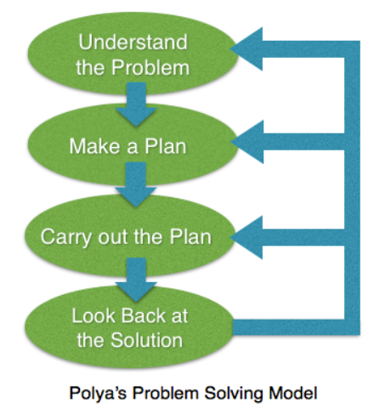
HIAS Blended Learning Resource
1945 George Polya published ‘How To Solve It’ 2nd ed., Princeton University Press, 1957, ISBN 0-691-08097-6.

Slide 4
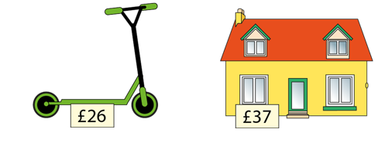
Addition
HIAS Blended Learning Resource
Tara and Ravi spent their Christmas
money on a scooter and dolls house.
How much did they spend altogether?

Slide 5
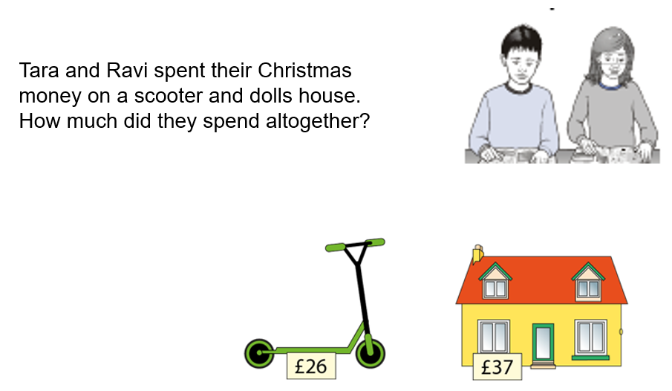
Understand the problem
HIAS Blended Learning Resource
We need to work out how much Tara and Ravi spent altogether. They bought a scooter for £26 and a dolls house for £37, so we need to add together 26 and 37 to find the total.

Slide 6
Make a Plan
HIAS Blended Learning Resource
Step 1: We need to find the total of 26 + 37. We will start with one of the numbers and partition the other. First, we’ll add on the multiples of ten
Step 2: Then, we will add on the ones (using number bonds to bridge through the “tens” numbers). We can do this mentally, using a number line jotting and some known facts.

Slide 7
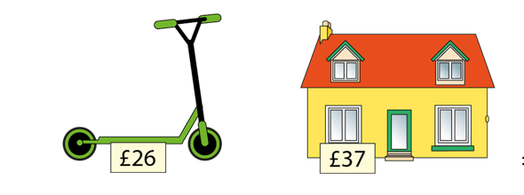

Slide 8
Carry out your plan: show your reasoning
HIAS Blended Learning Resource
Step 1: 26 + 30 = 56 (We could do this in our heads because we can add a multiple of 10 to a 2-digit number)
Step 2: 56 + 7 = 63 (We could do this in our heads by bridging through 60 and using number facts. 56 + 4 = 60, then 60 + 3 is 63 (we partitioned the 7 into 4 and 3)
Step 3: We use our calculation to answer the question – the total is £63

Slide 9
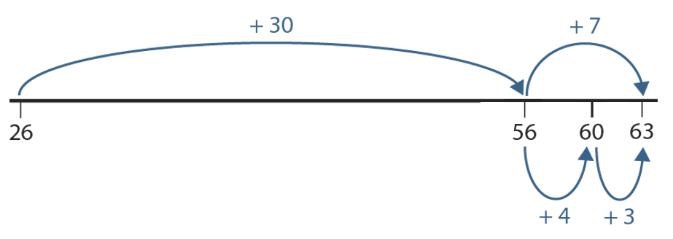

Slide 10
Review your solution: does it seem reasonable? Which steps/ parts did you find easy and which harder?
HIAS Blended Learning Resource
How could you check?
Go through the steps you took and check for errors
Remember the question is about accurate addition
Try to solve the calculation a different way and see if you get the same answer. You could try using dienes – partition and re-combine.

Slide 11
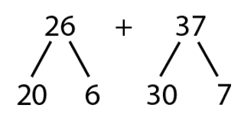
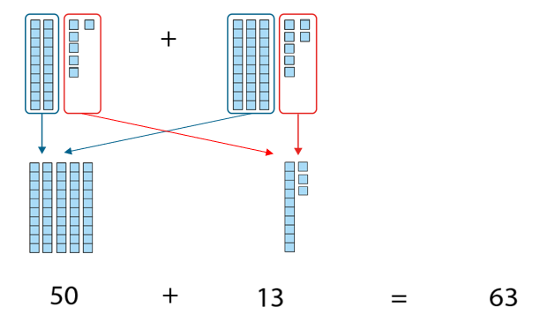
HIAS Blended Learning Resource
Checking with dienes:

Slide 12
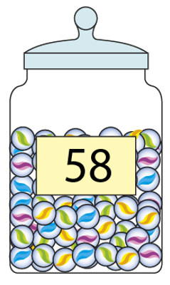
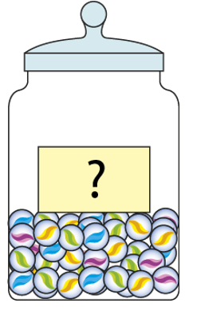
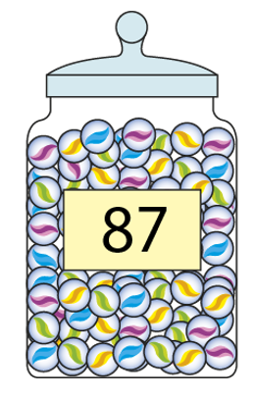
Now try this one
HIAS Blended Learning Resource
Understand the problem
Make a plan
Carry out your plan: show your reasoning
Review your solution: does it seem reasonable?
Think about your learning: which parts of the problem did you find easy and which parts did you find harder?
Lotte and Pippa had a total of 87 marbles. Pippa had 58 marbles. Can you work out how many Lotte had?
+
=

Slide 13
HIAS Maths team
HIAS Blended Learning Resource
The HIAS maths team offer a wide range of high-quality services to support schools in improving outcomes for learners, including courses, bespoke consultancy and in-house training.
For further details referring to maths, please contact either of the team leads:
Jacqui Clifft : Jacqui.clifft@hants.gov.uk
Jo Lees: Jo.Lees@hants.gov.uk
For further details on the full range of services available please contact us using the following details:
Tel: 01962 874820 or email: hias.enquiries@hants.gov.uk
For further details on the full range of services available please contact us using the following details:
Tel: 01962 874820 or email: hias.enquiries@hants.gov.uk

