Slide 1
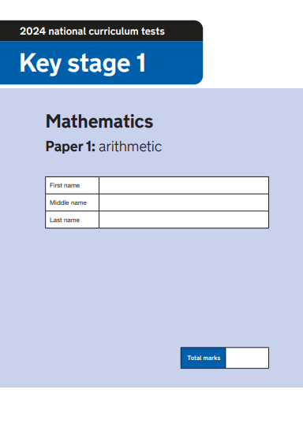
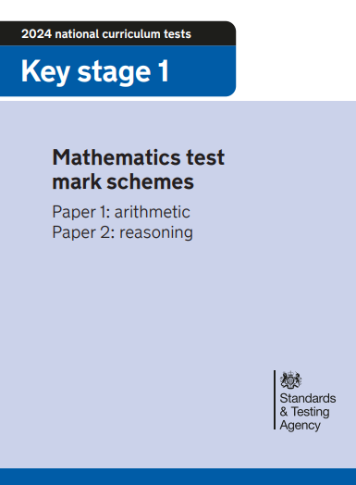
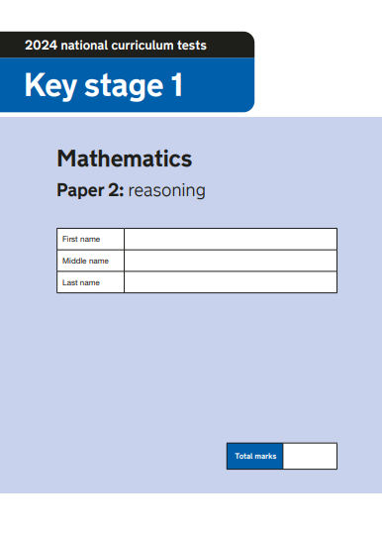
2024 Key Stage 1 optional SATs
Arithmetic Paper 1
Reasoning Paper 2
Pre-key stage 1 standards

Slide 2
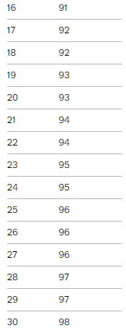
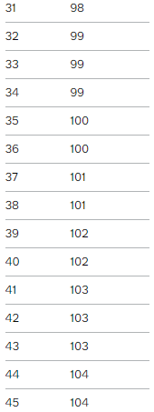
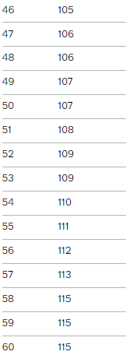
Key Stage 1 SATs papers 2023
Optional key stage 1 tests: 2024 mathematics test materials - GOV.UK (www.gov.uk)
Key stage 1 SATs 2024 scaled scores
A scaled score between 100 and 115 shows the pupil has met the expected standard in the test.
The lowest scaled score that can be awarded on a key stage 1 test is 85. The highest score is 115. Pupils need to have a raw score of at least 3 marks to be awarded the minimum scaled score.
Optional key stage 1 tests: 2024 scaled scores - GOV.UK (www.gov.uk)

Slide 3
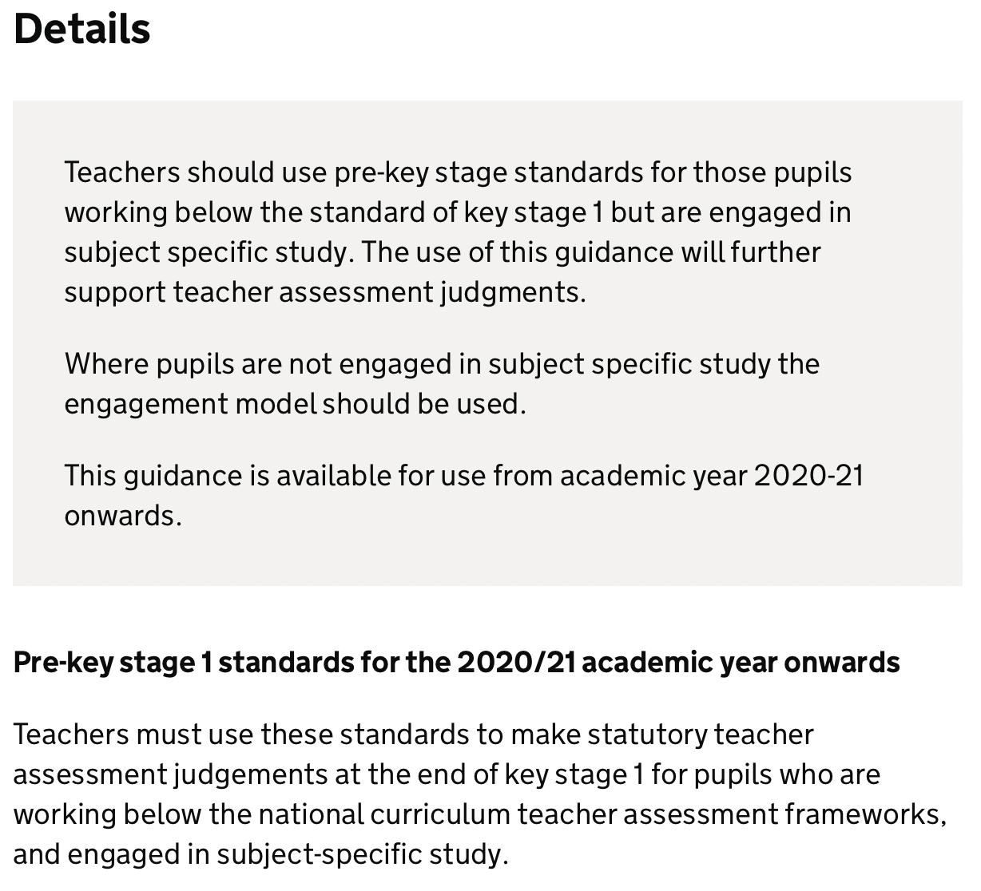
Statutory guidance - Pre-key stage 1 standards
For teachers to report assessment outcomes for pupils working below the standard of national curriculum assessments (commonly called SATs) at the end of KS1.
https://www.gov.uk/government/publications/pre-key-stage-1-standards

Slide 4
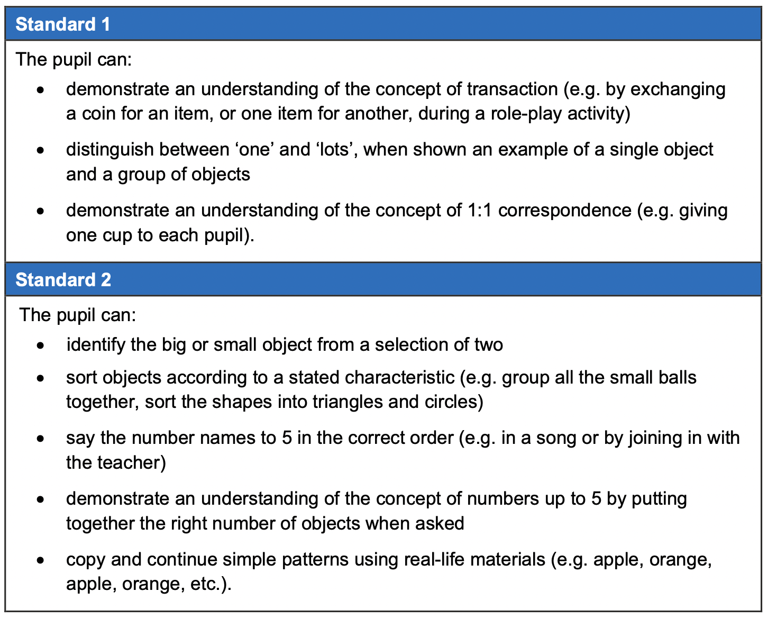
Pre-key stage 1

Slide 5
Pre-key stage 1

Slide 6
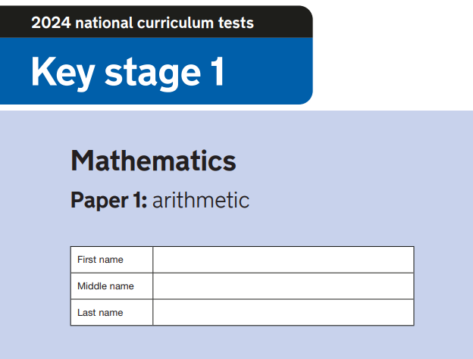
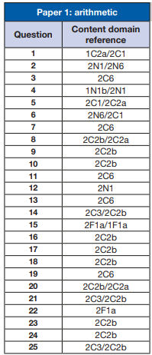
2024 key stage 1 mathematics Paper 1: arithmetic (publishing.service.gov.uk)

Slide 7
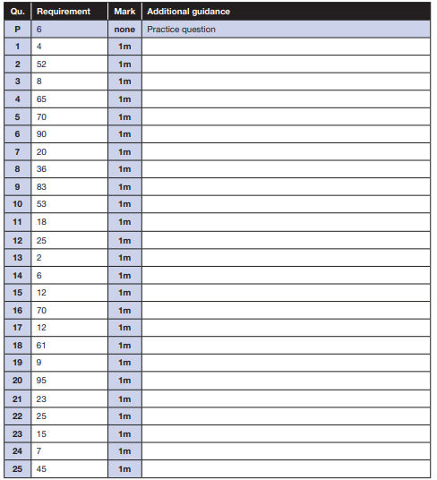
Equivalent answers are not acceptable, for example, 10 + 4 instead of 14. When marking the arithmetic questions, refer specifically to general marking principles 9, 10, 11 and 12. No misreads are allowed for 1-mark questions.
2024 key stage 1 mathematics test mark schemes (publishing.service.gov.uk)

Slide 8
Key Stage 1 Arithmetic Paper 2024

Slide 9
Key Stage 1 Arithmetic Paper 2024 Addition and Subtraction

Slide 10
Key Stage 1 Arithmetic Paper 2024 Multiplication and Division

Slide 11
Key Stage 1 Arithmetic Paper 2024 Fractions

Slide 12
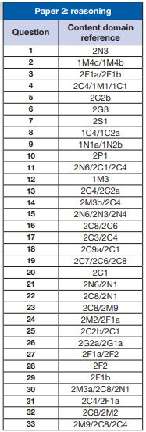
2024 key stage 1 mathematics Paper 2: reasoning (publishing.service.gov.uk)

Slide 13
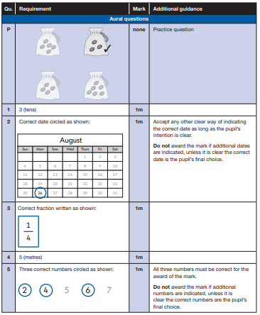
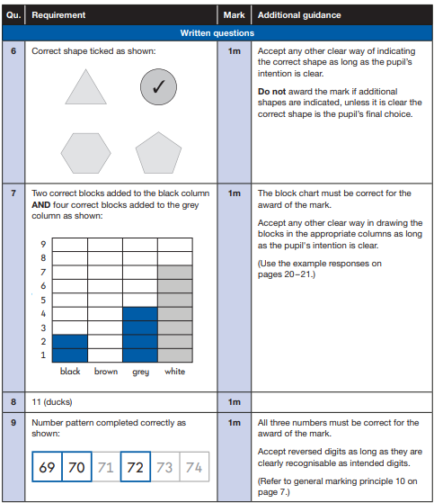
2024 key stage 1 mathematics test mark schemes Paper 1: arithmetic and Paper 2: reasoning (publishing.service.gov.uk)

Slide 14
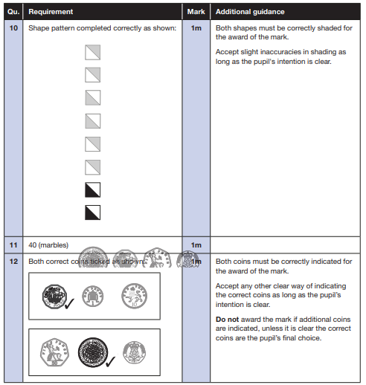
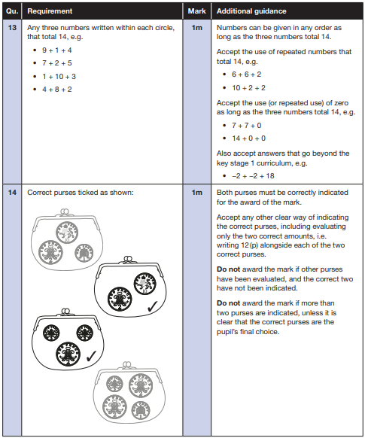
2024 key stage 1 mathematics test mark schemes Paper 1: arithmetic and Paper 2: reasoning (publishing.service.gov.uk)

Slide 15
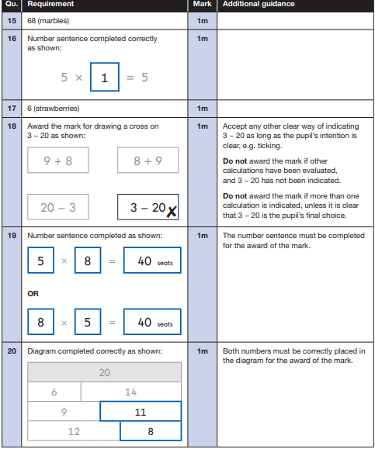
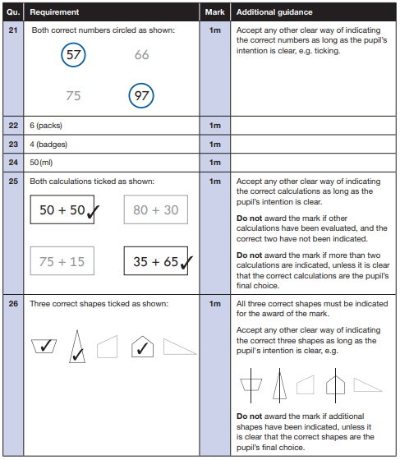
2024 key stage 1 mathematics test mark schemes Paper 1: arithmetic and Paper 2: reasoning (publishing.service.gov.uk)

Slide 16
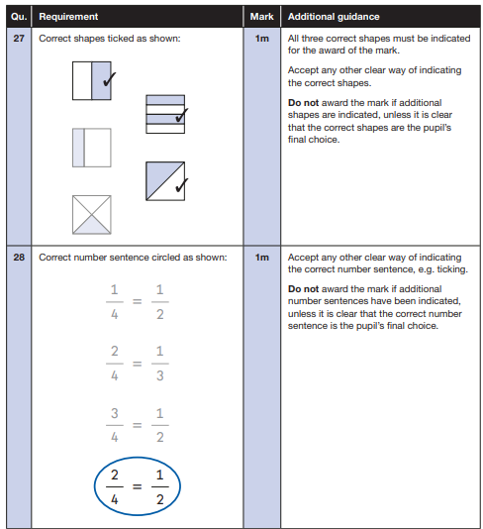
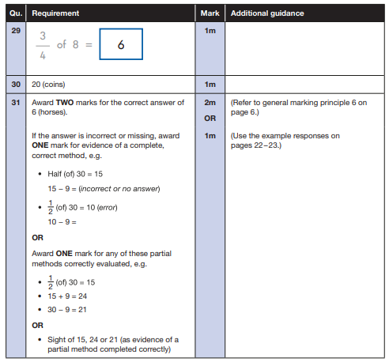
2024 key stage 1 mathematics test mark schemes Paper 1: arithmetic and Paper 2: reasoning (publishing.service.gov.uk)

Slide 17
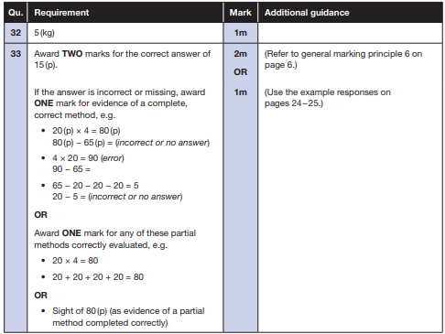
2024 key stage 1 mathematics test mark schemes Paper 1: arithmetic and Paper 2: reasoning (publishing.service.gov.uk)

Slide 18
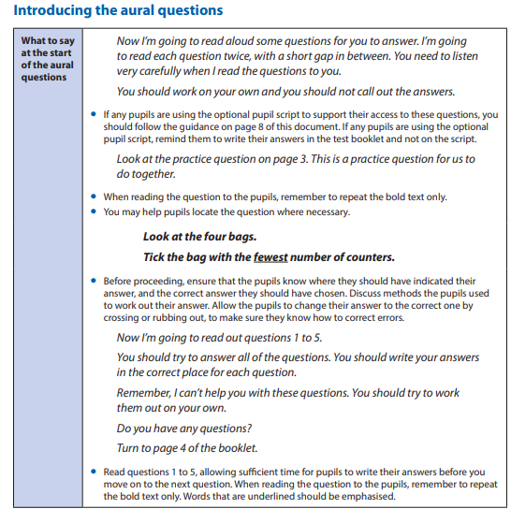
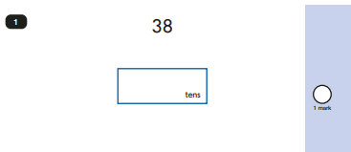
2024 key stage 1 mathematics Administering Paper 2: reasoning (publishing.service.gov.uk)

Slide 19
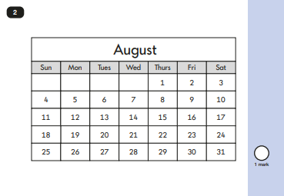
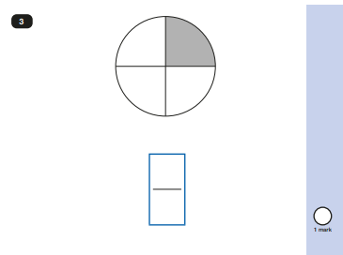

Slide 20
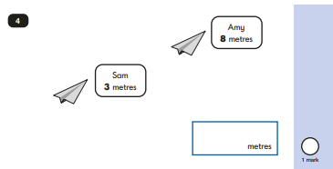

Slide 21
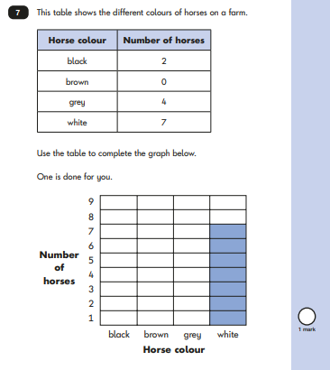
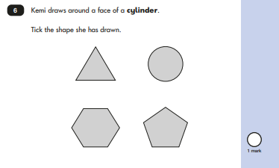

Slide 22
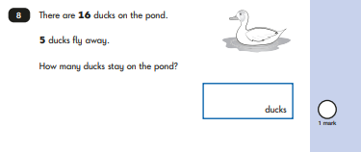
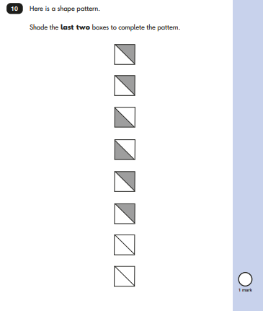
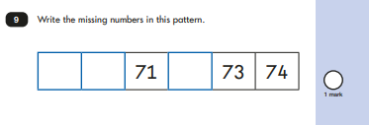

Slide 23
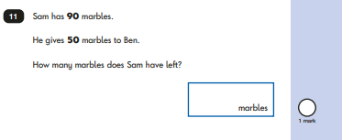
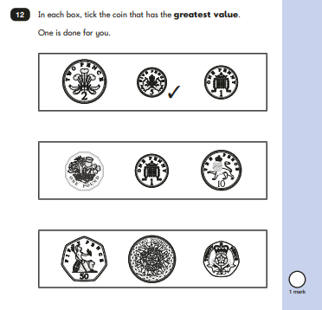

Slide 24
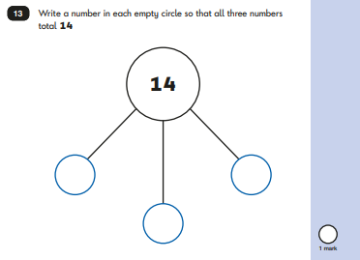
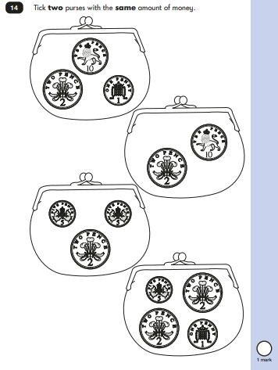

Slide 25
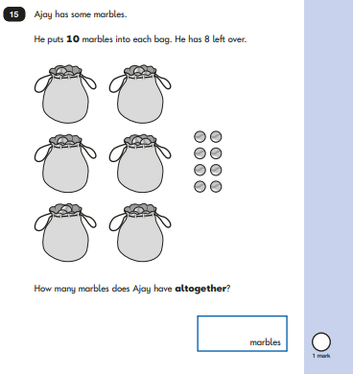

Slide 26
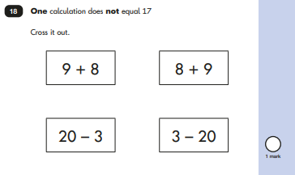
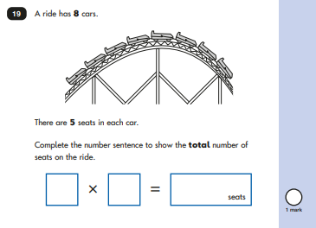

Slide 27
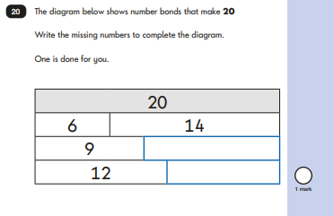
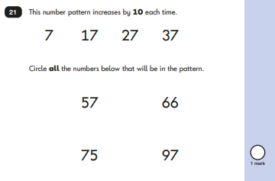

Slide 28
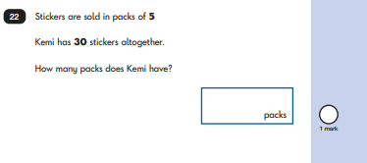
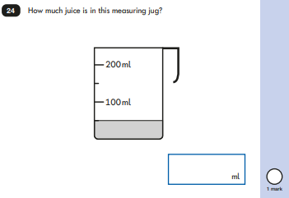
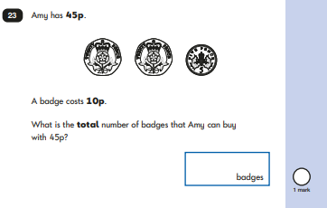

Slide 29
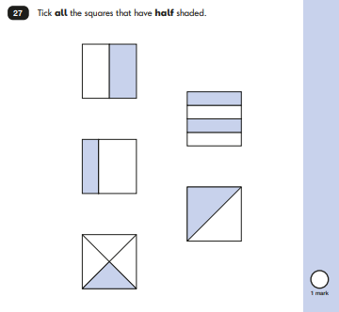

Slide 30
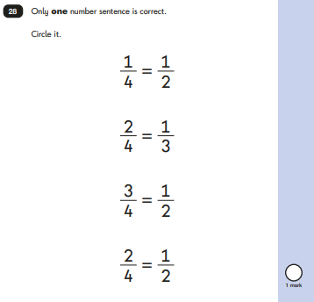

Slide 31
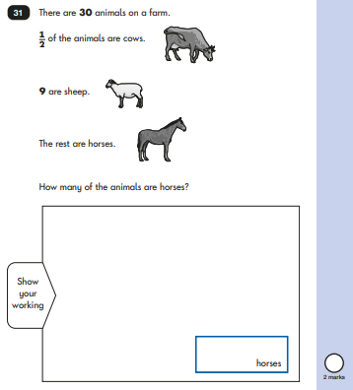
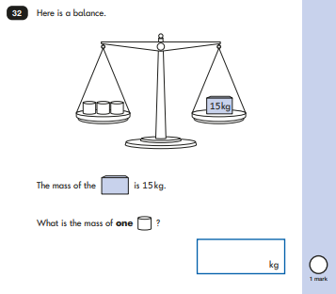

Slide 32
