Slide 1
Year 8
HIAS Blended Learning Resource
Number: Standard Form and Prime Factorisation (unit 8.10)
This unit is about representing numbers in different ways. This will include exploring very small and very large numbers , representing and calculating in standard and ordinary form, and application of prime factorisation.
HIAS maths Team
Spring 2021
Final version
© Hampshire County Council

Slide 2
HIAS Blended Learning Resource
These slides are intended to support teachers and students with a blended approach to learning, either in-class or online. The tasks are intended to form part of a learning journey and could be the basis of either one lesson or a short sequence of connected lessons.
Teachers should delete, change and add slides to suit the needs of their students. Extra slides with personalised prompts and appropriate examples based on previous teaching may be suitable. When changing the slide-deck, teachers should consider:
Their expectations for the use of representations such as bar models, number lines, arrays and geometric diagrams.
Which strategies and methods students should use and record when solving problems or identifying solutions. This could include a range of informal jottings and diagrams, the use of tables to record solutions systematically and formal or informal calculation methods.
Teachers may also wish to record a ‘voice over’ to talk students through the slides.

Slide 3
HIAS Blended Learning Resource
YEAR 8 : SPRING TERM OVERVIEW
Week | HIAS Unit | Topic
1 | Unit 8.6 | Geometry: Formulae for perimeters and areas
2 | Unit 8.7 | Accuracy, powers, and roots
3 | Unit 8.8 | Compound measures
4 | Unit 8.9 | Statistics: Graphs and charts
5 |  | Statistics: averages for numerical data
 | Half term
6 | Unit 8.10 | Number: Standard form (representing numbers)
 |  | Number: Standard form (simple calculations)
7 |  | Number: Standard form (simple calculations)
 |  | Number: Prime factorisations
8 |  | Number: Prime factorisations
9 | Unit 8.11 | Graphs: Linear and quadratic
10 |  | Graphs: Simultaneous equations

Slide 4
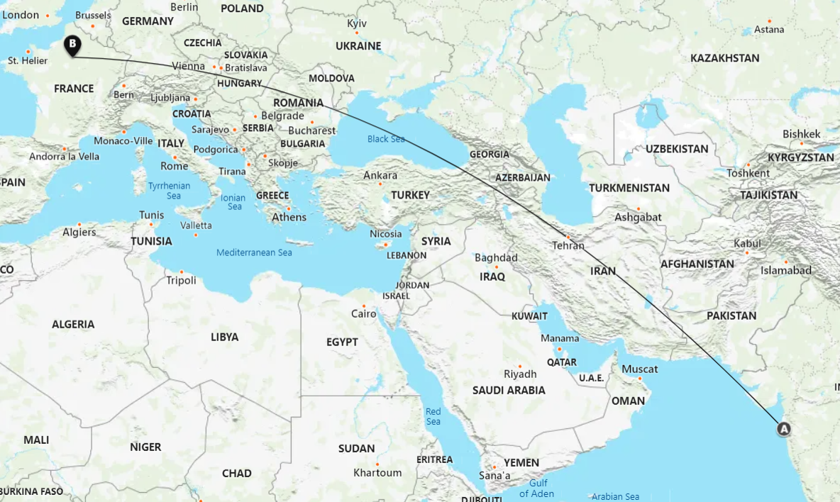
HIAS Blended Learning Resource
Representing numbers in standard form
The distance between the city of Mumbai in India and the city of Paris in France is approximately 7000 kms
Write this number in standard form
Notes:
7000 = 7 x 10³

Slide 5
HIAS Blended Learning Resource
Representing numbers in standard form
The distance between the city of Mumbai in India and the city of Paris in France is approximately 4.4 x 10³ miles
Write this number as an ordinary number
Notes:
4400 = 4.4 x 10³

Slide 6
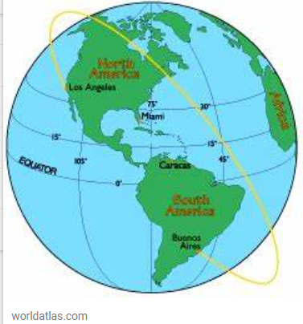
HIAS Blended Learning Resource
Representing numbers in standard form
The distance around planet earth , using the equator is approximately 4.01 x 10⁴ kms
Write this number as an ordinary number
Notes:
40100 = 4.01 x 10⁴

Slide 7
HIAS Blended Learning Resource
Representing numbers in standard form
The distance around planet earth , using the equator is approximately 24,901 miles
Write this number in standard form
Notes:
24901 = 2.4901 x 10⁴

Slide 8
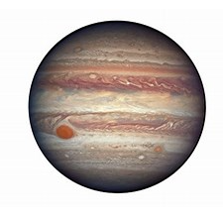
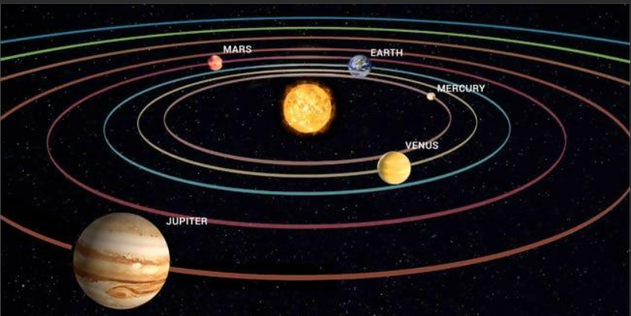
HIAS Blended Learning Resource
Representing numbers in standard form
Test Base question
Notes:
780000000 = 7.8 x 10⁸

Slide 9
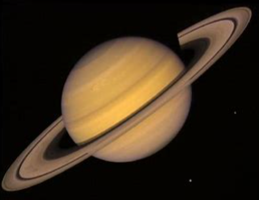
HIAS Blended Learning Resource
Representing numbers in standard form
Saturn is 8.867 x 10⁸ million miles away from the Sun, write this as an ordinary number
Saturn is 550.9 million miles from Earth, write this in standard form
Saturn has a diameter of 74,600 miles, write this in standard form
Notes:
886.7 million = 886 700 000 = 8.867 x 10⁸
550.9 million = 550 900 000 = 5.509 x 10⁸
74,600 = 74.6 x 10⁴

Slide 10
HIAS Maths team
HIAS Blended Learning Resource
The HIAS maths team offer a wide range of high-quality services to support schools in improving outcomes for learners, including courses, bespoke consultancy and in-house training.
For further details, please contact any member of the secondary maths team:
Jo Lees: Jo.Lees@hants.gov.uk
Jenny Burn: Jenny.Burn@hants.gov.uk
Tessa Ingrey: Tessa.Ingrey@hants.gov.uk
For further details on the full range of services available please contact us using the following details:
Tel: 01962 874820 or email: hias.enquiries@hants.gov.uk
For further details on the full range of services available please contact us using the following details:
Tel: 01962 874820 or email: hias.enquiries@hants.gov.uk

