Slide 1
Year 3
HIAS Blended Learning Resource
Statistics 2
Interpret and present data using bar charts, pictograms and tables
HIAS maths Team
Spring 2021
Final version
© Hampshire County Council

Slide 2
HIAS Blended Learning Resource
These slides are intended to support teachers and pupils with a blended approach to learning, either in-class or online. The tasks are intended to form part of a learning journey and could be the basis of either one lesson or a short sequence of connected lessons.
The 4-step Polya model for problem solving has been used to provide a structure to support reasoning. Teachers may need to use more or fewer steps to support the range of learners in their class.
Teachers should delete, change and add slides to suit the needs of their pupils. Extra slides with personalised prompts and appropriate examples based on previous teaching may be suitable. When changing the slide-deck, teachers should consider:
Their expectations for the use of representations such as bar models, number lines, arrays and diagrams.
Which strategies and methods pupils should use and record when solving problems or identifying solutions. This could include a range of informal jottings and diagrams, the use of tables to record solutions systematically and formal or informal calculation methods.
Teachers may also wish to record a ‘voice over’ to talk pupils through the slides.

Slide 3
HIAS Blended Learning Resource
1945 George Polya published ‘How To Solve It’ 2nd ed., Princeton University Press, 1957, ISBN 0-691-08097-6.

Slide 4
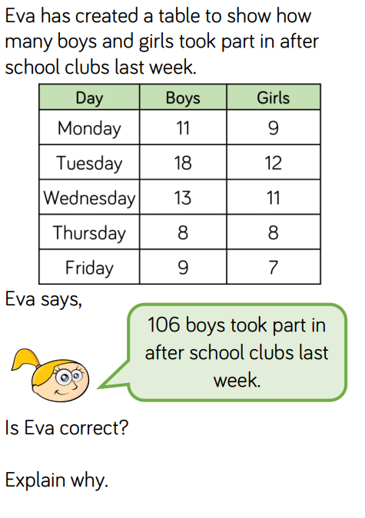
Interpreting data using bar charts, pictograms and tables.
HIAS Blended Learning Resource

Slide 5
Understand the problem
HIAS Blended Learning Resource
TASK
This problem is about how many boys and girls took part in after school clubs last week.
Key Fact: Eva says that 106 boys took part in after school clubs last week
How can we find out how many boys took part in after school clubs last week from the table?
How many boys took part in after school clubs from Monday to Friday last week?
Have to calculate the total number of boys
How does your total number of boys that took part in after school clubs last week compare to Eva’s (106)?
Is Eva correct? Explain why.

Slide 6
Make a Plan
HIAS Blended Learning Resource
Step 1: How can we find out how many boys took part in after school clubs last week from the table?
Step 2: How many boys took part in after school clubs from Monday to Friday last week?
(11+18+…..= ?)
Step 3: How does your total number of boys that took part in after school clubs last week compare to Eva’s (106)?
Find the difference between your answer to Step 2 and 106
Step 4: Is Eva correct? Explain why
TASK

Slide 7
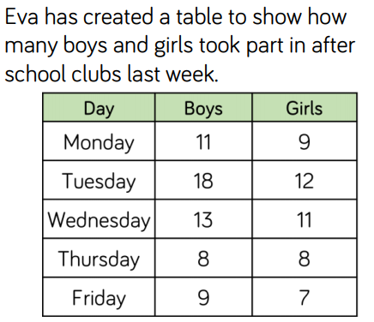
We could use a number line to calculate the total number of boys:
11 + 9 = ? (pairs of numbers that equal 20)
Monday + Friday
18 + 13 = ? (Tuesday + Wednesday) + 8 = ? (Thursday)
+ No. boys on Wednesday
+10
+3
18
?
?
No. boys on Tuesday

Slide 8
Carry out your plan: show your reasoning
HIAS Blended Learning Resource
Step 1: How can we find out how many boys took part in after school clubs last week from the table?
Step 2: How many boys took part in after school clubs from Monday to Friday last week?
(11+18+…..= ?)
Step 3: How does your total number of boys that took part in after school clubs last week compare to Eva’s (106)?
Find the difference between your answer to Step 2 and 106
Step 4: Is Eva correct? Explain why
TASK
Step 1: Know that sunbeds are stacked in piles of 3 (x3 table facts)
1 x 3 = 3 3 x 3 = 9 etc…
2 x 3 = 6
Step 2: There are 18 sunbeds which are stacked in piles of 3. How many stacks can be made?
18 ÷ 3 = ?
Step 3: There are another 24 sunbeds which are stacked in piles of 3. How many more stacks can be made?
24 ÷ 3 = ?
Step 4: How many stacks of 3 sunbeds are there altogether?
Add the answer from step 2 to step 3

Slide 9
11 + 9 = 20 (pairs of numbers that equal 20)
Monday + Friday
18 + 13 = 31 (Tuesday + Wednesday) + 8 (Thursday) = 39
39 + 20 = 59 (Monday + Tuesday + Wednesday + Thursday + Friday) = total number of boys that took part in after school clubs last week
+ No. boys on Weds
+ No. boys on Thurs
‘Eva is incorrect. She has counted all the children rather than just the boys. 59 boys took part in after school clubs last week.’
+10
+3
+8
18
28
31
39
No. boys on Tuesday

Slide 10
Review your solution: does it seem reasonable? Which steps/ parts did you find easy and which harder?
HIAS Blended Learning Resource
TASK
How could you check?
Go through the steps you took and check for errors
Remember the question is about how many
boys took part in after school clubs last
week
2. Try to solve the calculation in a
different way and see if you get the
same answer

Slide 11
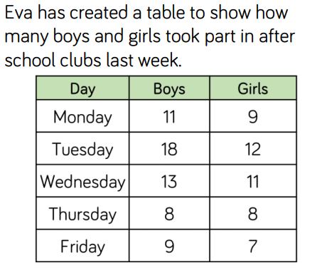
Now try this one
HIAS Blended Learning Resource
Understand the problem
Make a plan
Carry out your plan: show your reasoning
Review your solution: does it seem reasonable?
Think about your learning: which parts of the problem did you find easy and which parts did you find harder?
How many more boys than girls took part in after school clubs last week?
Explain how you know.

Slide 12
HIAS Maths team
HIAS Blended Learning Resource
The HIAS maths team offer a wide range of high-quality services to support schools in improving outcomes for learners, including courses, bespoke consultancy and in-house training.
For further details referring to maths, please contact either of the team leads:
Jacqui Clifft : Jacqui.clifft@hants.gov.uk
Jo Lees: Jo.Lees@hants.gov.uk
For further details on the full range of services available please contact us using the following details:
Tel: 01962 874820 or email: hias.enquiries@hants.gov.uk
For further details on the full range of services available please contact us using the following details:
Tel: 01962 874820 or email: hias.enquiries@hants.gov.uk

