Slide 1
Pearson Edexcel
GCSE (9-1) Mathematics
Support update
Autumn 2021

Slide 2
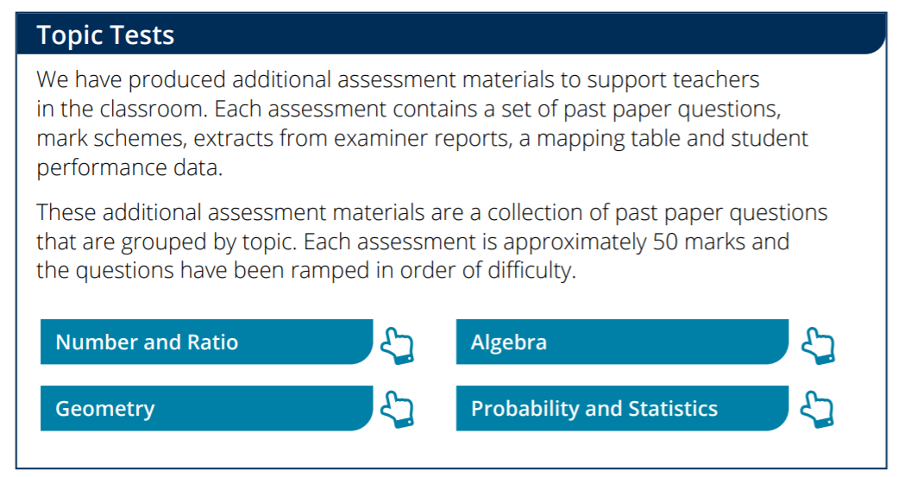
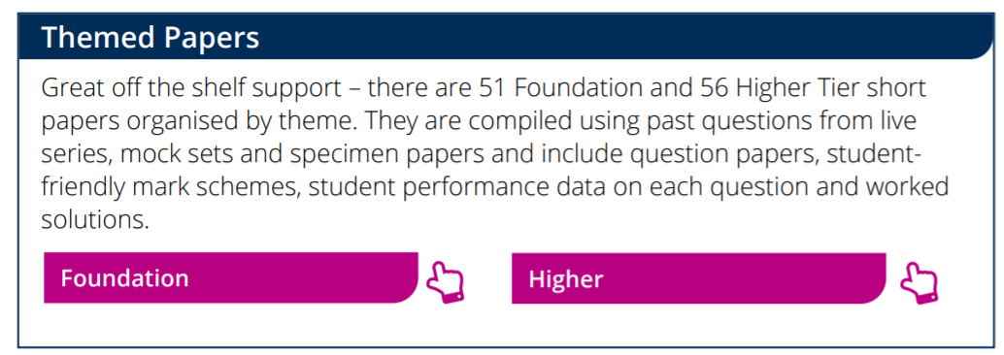
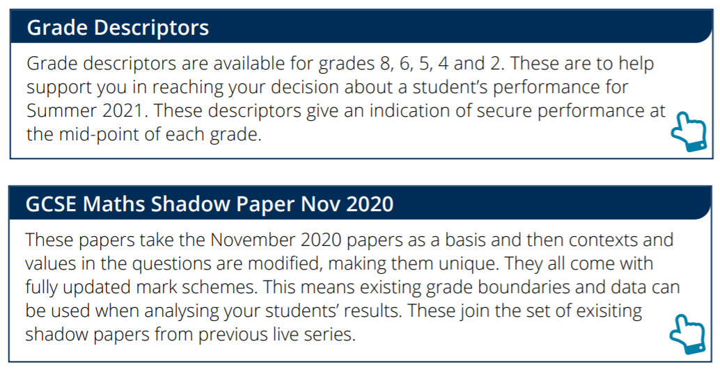
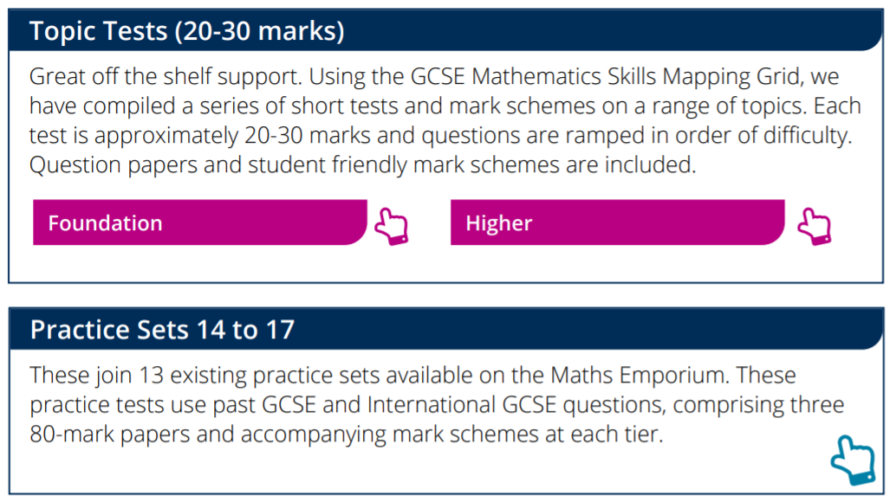
June 2021 Series – Key support

Slide 3
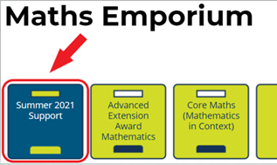
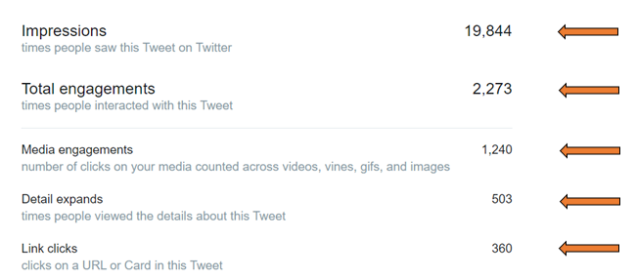
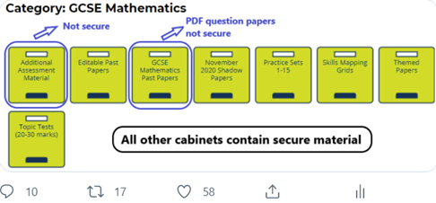
June 2021 Series – Key support

Slide 4
Our Customers are Our Priority

Slide 5
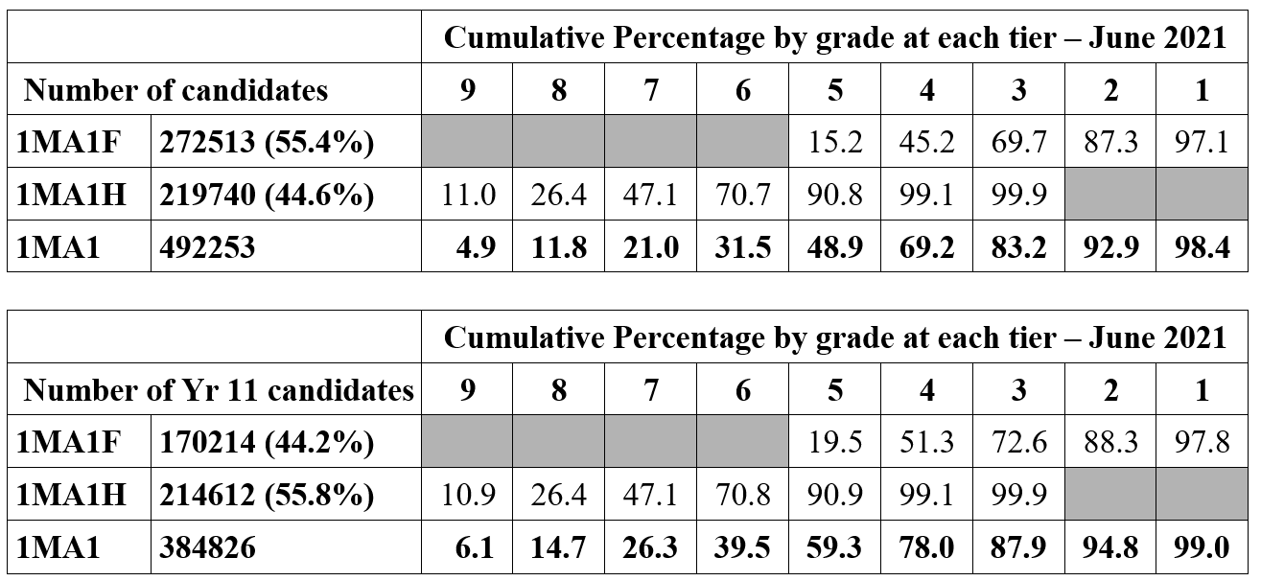
Summer 2021 TAG Statistics

Slide 6
CAG vs TAG Statistics

Slide 7
November Series – Key dates
Date | Activity
Paper 1F/1H | Tuesday 2nd November
Paper 2F/2H | Thursday 4th November
Paper 3F/3H | Monday 8th November
GCSE High late/ refund/ amendment deadline | Sunday 31st October
GCSE High late/ amendment deadline | Monday 1st November
Results day – GCSE Maths | 13th January 2022

Slide 8
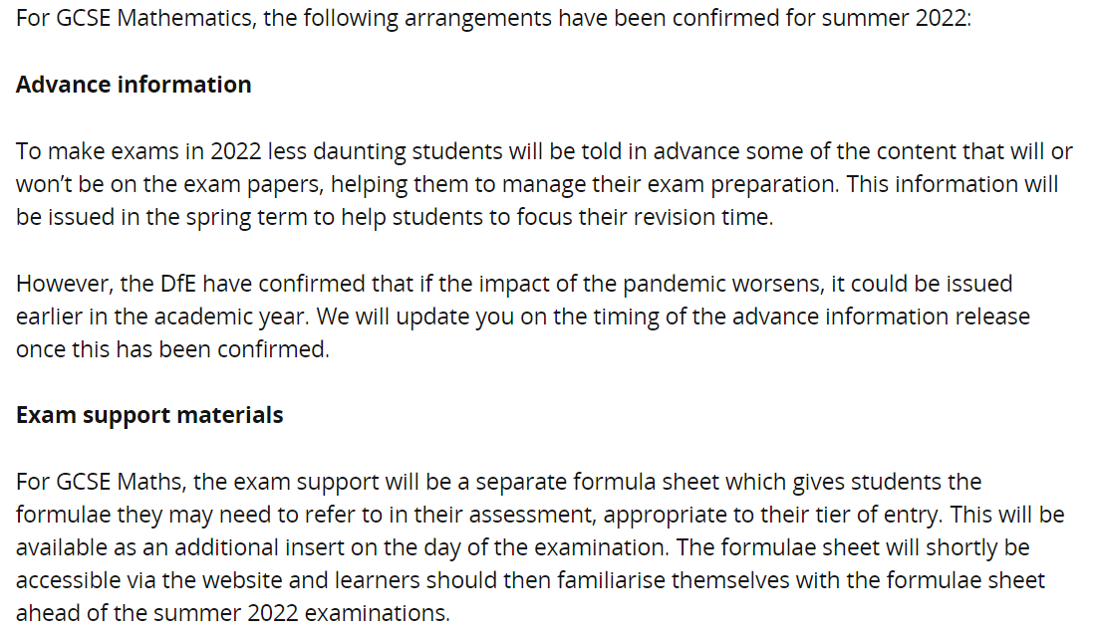
Summer 2022 Support

Slide 9
Case studies
Link here

Slide 10
Practice Papers
GCSE Mathematics November 2020 Shadow Papers
More topic tests on the emporium, ~ 20-30 marks each
17 Practice Sets
AO3 Bronze/Silver Gold papers
Enhanced Skills Mapping Grids - collection of the last 7 series of performance data
KS3 Maths support – Escape rooms and Key Skills at KS3
Free diagnostic tests for GCSE Maths here
Foundation Tier Themed papers and Higher Tier themed papers
Free Pearson Revise Posters and Teacher Guides - 3 sets of Pearson Revise Posters (6 in total) and two accompanying Teacher Revision Guides which have a focus on the topics new to Foundation and Higher Tier in the GCSE (9-1) Mathematics specification. Teacher's guide to new topics to Higher and Foundation Tier, and new topics to Foundation tier only can be found here.
GCSE Maths Lessons - recordings of a range of GCSE Maths topics that focus on real-life problem solving.
Key GCSE Maths support PDF - a quick guide to our key GCSE Maths resources available.
Our new and improved GCSE Maths November 2020 Exemplars which exemplies AO2 and AO3 questions can be found here.

Slide 11
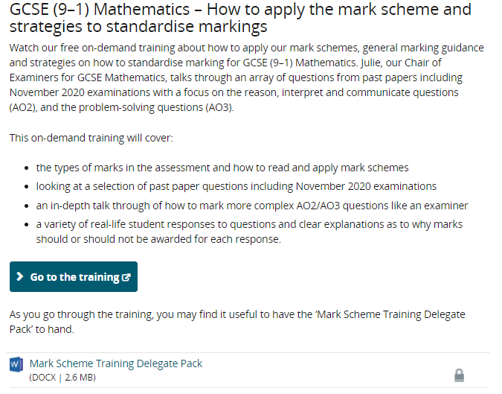
Marking / Standardisation Support
Link here

Slide 12
Marking / Standardisation Support
1.
2. Mark scheme training video – past network recording – link here
3. Grade characteristics – link here
4. Standardisation Packs, Higher/Foundation – November 2020 – link here
5. Marking training pack – link here
Link here

Slide 13
Coming Soon
Mock Set 7 (January 2022)
GCSE Gold Silver Bronze November 2020 Papers
GCSE Statistics Shadow Papers
Edexcel Awards Themed Papers
Myth busting for ELC and Edexcel Awards
Mark scheme training updated
DE&I – Maths Activities
1 year Crossover SoW

Slide 14
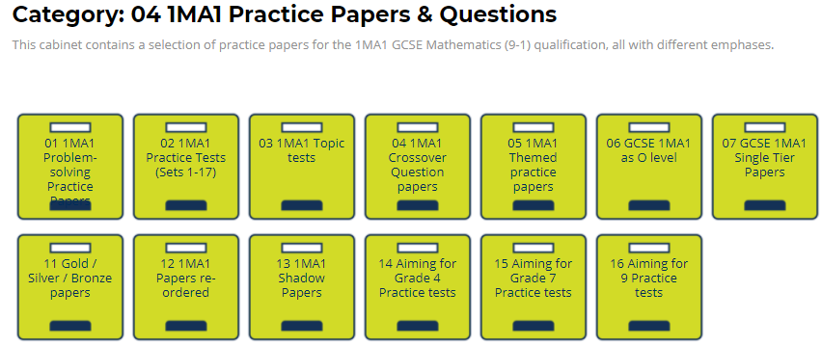
Maths Emporium
The Maths Emporium contains a rich source of resources for GCSE Mathematics teachers. This includes:
- shadow papers,
- themed papers with worked solutions,
- 17 practice sets,
- AO3 Bronze, Silver, Gold practice papers
- common question papers,
- mock papers (Mock Set 6 can be found here)
- past papers, mark schemes, examiner reports,
If you are not registered with the Maths Emporium, ​you can sign up using the Login/ Register button at www.mathsemporium.com.

Slide 15
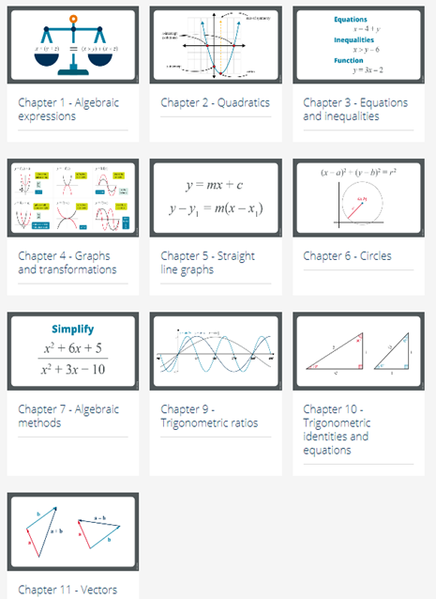
GCSE Maths Transition to A level Maths
The transition from GCSE to A level Maths can be challenging but, with plenty of practice, it most certainly is a rewarding experience. The chapters below focus on activities which help students to master the key skills that are needed in both AS and A level Mathematics. The topics are mainly those found in the overlap between GCSE and AS mathematics.
We have over 123 FREE videos
10 Chapters
Practice Questions
End of Chapter Exam Questions
More information can be found here

Slide 16
KS3 Maths
Key Skills at KS3 – Year 7, 8 and 9
Escape Rooms – link here

Slide 17
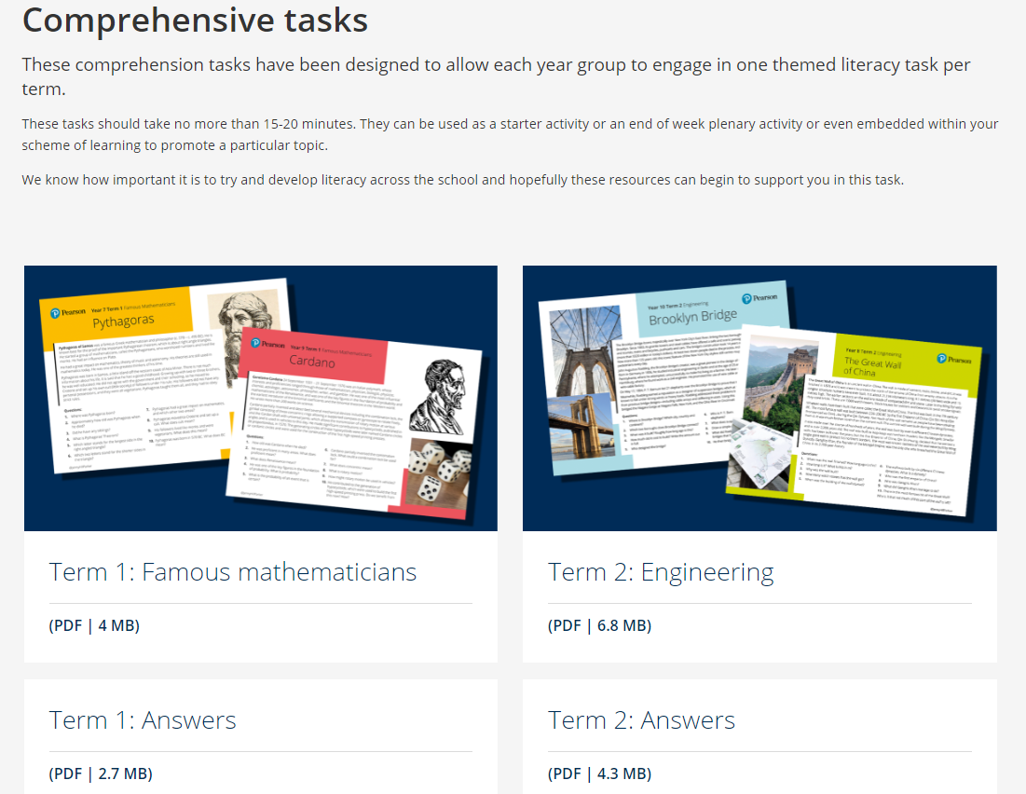
Diversity and Inclusivity in Maths
Famous Mathematicians and Comprehension tasks Posters

Slide 18
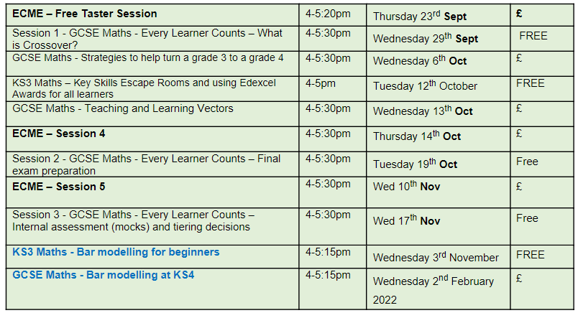
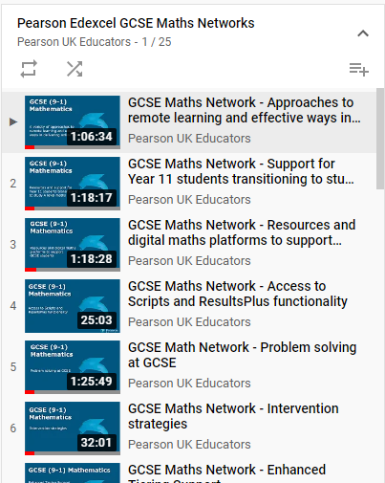
Upcoming Networks
We regularly add new networks to the list.
Browse and book our networks here.
You can watch a selection of past network recordings here.

Slide 19
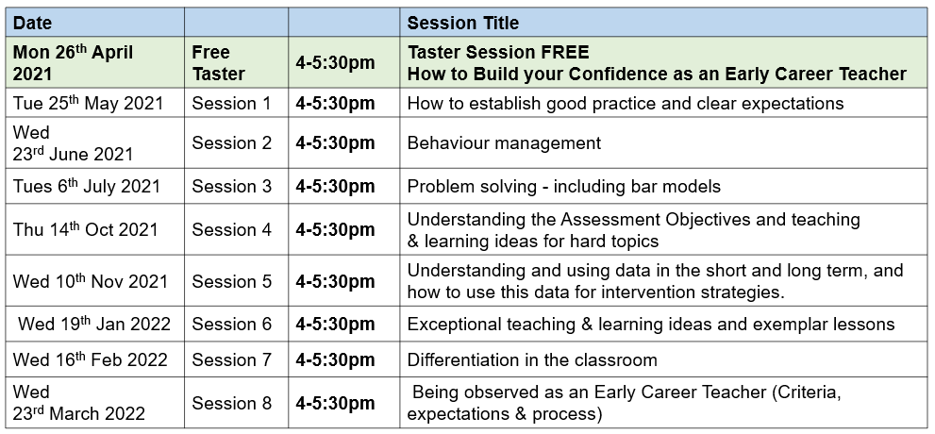
NEW Course: Early Career Maths Teacher Essentials
Who is this course for?
This series of short modules is aimed at:
Early career or trainee maths teachers
Non-subject specialists who intend start teaching maths
A teacher returning to the profession after a career break
Anyone who would like to pursue a career as a maths teacher
Browse and book our networks here

Slide 20
NEW Podcast: The Right Angle
The Right Angle invites topical discussions, debates and insights from a range of thought leaders, award-winning maths educators and facilitators. Our subject partner hosts, Mark Heslop and Nicola Woodford-Smith lead conversations on themes such as the evolution of technology to support learning, student engagement and diversity and inclusion across the education of mathematics.
Ep 01: 'Addressing the gaps' with Nicola Whiston
In our first episode, Nicola chats to award winning Nicola Whiston, Director of Maths at Ormiston Horizon Academy. They discuss how to engage learners from disadvantaged backgrounds as well as how to approach some lost learning due to the pandemic.
Click here to listen

