Slide 1
GCSE (9-1) Mathematics
October 2021 update
Neil Ogden | OCR Maths Subject Advisor | October 2021

Slide 2
ocr.org.uk/gcsemaths
@OCR_Maths
National GCSE (9-1) Maths results – All ages (summer series)
Year | Grade 9 (%) | Grade 8 (%) | Grade 7 (%) | Grade 6 (%) | Grade 5 (%) | Grade 4 (%) | Grade 3 (%) | Grade 2 (%) | Grade 1 (%) | Ungraded (%)
2021 | 4.8 | 6.8 | 9.1 | 10.1 | 17.9 | 20.5 | 14 | 9.7 | 5.5 | 1.6
2020 | 4.2 | 6.2 | 8.6 | 10.1 | 16.6 | 20.9 | 17.8 | 10.4 | 4.5 | 0.7
2019 | 2.9 | 5.6 | 7.4 | 9 | 14.8 | 19.9 | 18.6 | 12.6 | 6.9 | 2.3
2018 | 2.9 | 5.4 | 7.4 | 9.4 | 15.2 | 19.4 | 18.6 | 12.8 | 6.6 | 2.3
2017 | 3.5 | 6.4 | 9.3 | 10.6 | 18.3 | 20.8 | 13.1 | 9.5 | 6.4 | 2.1
Notes:
National data for all GCSE (9-1) Mathematics qualifications.
Source: Ofqual (2021, 2020 & 2019) & JCQ (2018 & 2017).

Slide 3
ocr.org.uk/gcsemaths
@OCR_Maths
National GCSE (9-1) Maths results – age 16 (summer series)
Year | Grade 9 (%) | Grade 8 (%) | Grade 7 (%) | Grade 6 (%) | Grade 5 (%) | Grade 4 (%) | Grade 3 (%) | Grade 2 (%) | Grade 1 (%) | Ungraded (%)
2021 | 6 | 8.6 | 11.4 | 12.7 | 20.4 | 18.8 | 9.9 | 7 | 4.3 | 0.9
2020 | 5.4 | 7.9 | 11 | 13 | 20.1 | 19.7 | 11.1 | 7.2 | 4 | 0.6
2019 | 3.7 | 7.1 | 9.5 | 11.5 | 18.2 | 21.4 | 12.8 | 8.6 | 5.4 | 1.8
2018 | 3.6 | 6.9 | 9.5 | 11.9 | 18.5 | 20.6 | 12.9 | 8.9 | 5.4 | 1.8
2017 | 3.5 | 6.7 | 9.7 | 11.1 | 18.7 | 21 | 12.4 | 8.8 | 6.1 | 2
Notes:
National data for all GCSE (9-1) Mathematics qualifications.
Source: Ofqual - https://analytics.ofqual.gov.uk/apps/GCSE/Outcomes/
16 year olds accounted for 77.6% of the whole entry in 2021.

Slide 4
ocr.org.uk/gcsemaths
@OCR_Maths
Autumn 2021 details
The deadline for making entries for GCSE qualifications in the autumn 2021 series was Monday 4 October.
The exam dates are…
Paper 1 (Foundation) / Paper 4 (Higher) - calculator - Tue 2 Nov am
Paper 2 (Foundation) / Paper 5 (Higher) - non-calculator - Thu 4 Nov am
Paper 3 (Foundation) / Paper 6 (Higher) - calculator - Mon 8 Nov am

Slide 5
ocr.org.uk/gcsemaths
@OCR_Maths
Summer 2022 details
The outcome of the recent Ofqual and DfE consultation on 2022 assessments in GCSE, AS and A Level qualifications has now been published.
The consultation received 6725 responses in total, with almost a quarter from students.
We’ve published a summary of the outcomes for you, or you can read the full outcome.
Advance information will be issued for GCSE, AS & A Level maths qualifications. These will be released by 7 February 2022.
A formulae sheet will be issued for GCSE (9-1) Maths. Students will be given a clean copy in the examination.

Slide 6
ocr.org.uk/gcsemaths
@OCR_Maths
Summer 2022 details
For the summer 2022 assessments, we can also confirm that…
advance information will be issued for Core Maths qualifications
advance information and a formulae sheet will be issued for Level 3 FSMQ: Additional Mathematics.
Provisional summer 2022 timetables are available on the OCR website.
GCSE (9-1) Maths paper 1 & paper 4 – Friday 20 May 2022 (tbc)
GCSE (9-1) Maths paper 2 & paper 5 – Tuesday 7 June 2022 (tbc)
GCSE (9-1) Maths paper 3 & paper 6 – Monday 13 June 2022 (tbc)

Slide 7
ocr.org.uk/gcsemaths
@OCR_Maths
Summer 2022 details
Ofqual has confirmed that grade boundaries in 2022 will be set ‘based on a profile that reflects a midpoint between 2021 and pre-pandemic grading’.
This will be based on an average of 2019 and 2021 results for each subject.
The aim is then in 2023 to return to results in line with pre-pandemic years.

Slide 8
ocr.org.uk/gcsemaths
@OCR_Maths
November 2022 details
For the GCSE (9-1) Maths November 2022 series…
advance information will be issued in July 2022,
students will again be issued a formulae sheet in the exam.

Slide 9
ocr.org.uk/gcsemaths
@OCR_Maths
Past paper publishing
Question papers/mark schemes/examiners’ reports/Analysis Grids from the November 2020 series will be moved from Interchange to the OCR public website in early July 2022.
View our past paper schedule page to see when past papers and related materials will be publicly published.
On the GCSE (9-1) Maths ‘Assessment’ webpage, 2 sets of practice papers and 2 sets of Alternative Papers also remain secure.

Slide 10
ocr.org.uk/gcsemaths
@OCR_Maths
OCR GCSE (9-1) Mathematics entries

Slide 11
ocr.org.uk/gcsemaths
@OCR_Maths
Accessibility
Accessibility is a key consideration in setting OCR GCSE (9-1) Maths materials, determined by OCR’s research-informed Accessibility Principles.
Simplicity of language.
Contexts are kept succinct, without excess wording.
A simple assessment structure.
An easy to follow paper layout and easy to read fonts used.
Our question papers begin with the lowest demand questions, developing candidate’s confidence as they go.
Notes:
We review all OCR GCSE maths papers to ensure that wording used is as clear and simple as possible for students. Contexts used are kept succinct, without excess wording.
All OCR GCSE maths papers begin with the simpler questions targeting the lower grades at each tier, before moving on and building steadily through the paper to questions targeting the upper grades at each tier, developing candidate’s confidence as they go.

Slide 12
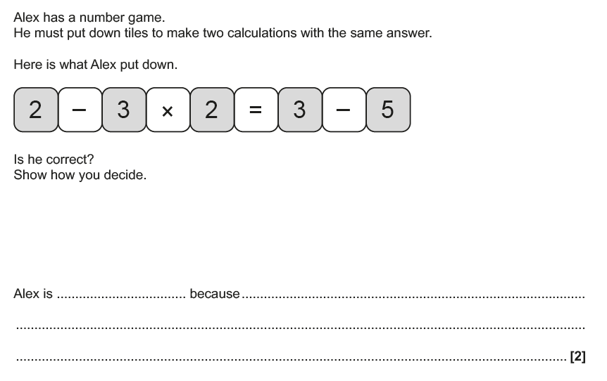
ocr.org.uk/gcsemaths
@OCR_Maths
Accessibility
Accessibility is a key consideration in setting OCR GCSE (9-1) Maths materials, determined by OCR’s research-informed Accessibility Principles.
We’ve published a list of character names we’ll use, so students can become familiar with them.
Arial font is accessible and easy to read.
Sentence prompts are included, to help students understand what is required and to structure their answer.
We read from left to right, so text is left aligned to help students spot and read given information.
Notes:
We review all OCR GCSE maths papers to ensure that wording used is as clear and simple as possible for students. Contexts used are kept succinct, without excess wording.
All OCR GCSE maths papers begin with the simpler questions targeting the lower grades at each tier, before moving on and building steadily through the paper to questions targeting the upper grades at each tier, developing candidate’s confidence as they go.

Slide 13
ocr.org.uk/gcsemaths
@OCR_Maths
Accessibility
To discover more about how we write our question papers, download our ‘Exploring our question papers’ guide from the GCSE (9-1) Maths website.
As well as detailing our Accessibility Principles, it includes
a list of command words with definitions
command words posters
a list of character names
formulae guides
annotated questions
…and more!
Notes:
We review all OCR GCSE maths papers to ensure that wording used is as clear and simple as possible for students. Contexts used are kept succinct, without excess wording.
All OCR GCSE maths papers begin with the simpler questions targeting the lower grades at each tier, before moving on and building steadily through the paper to questions targeting the upper grades at each tier, developing candidate’s confidence as they go.

Slide 14
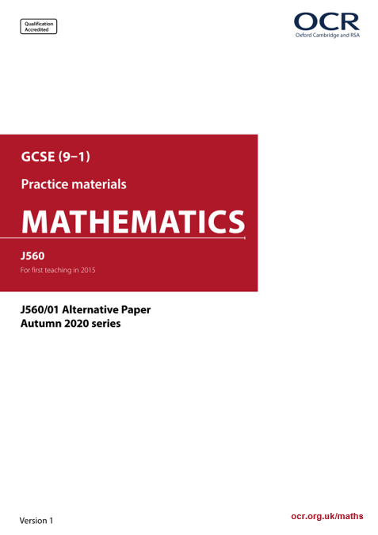
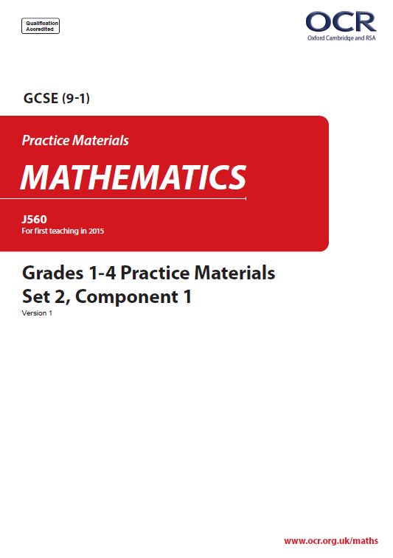
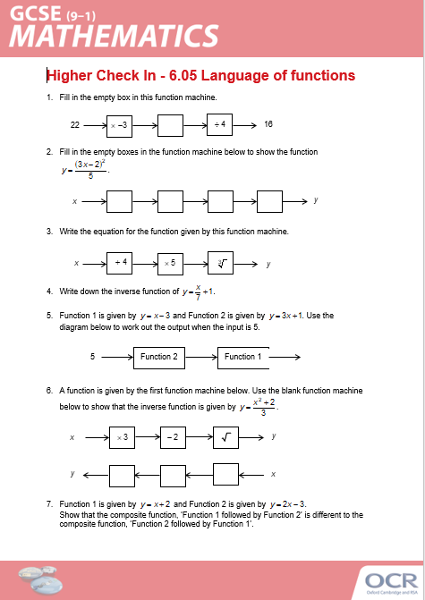
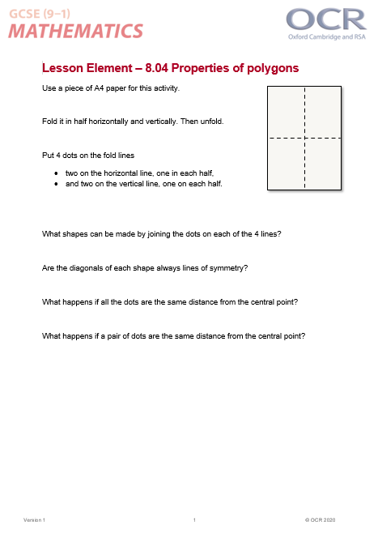
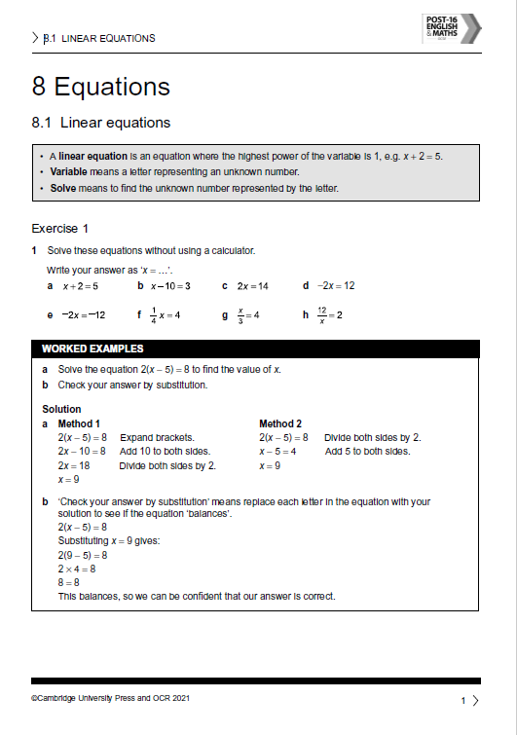
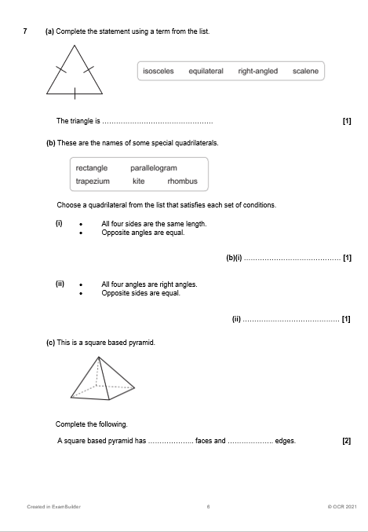
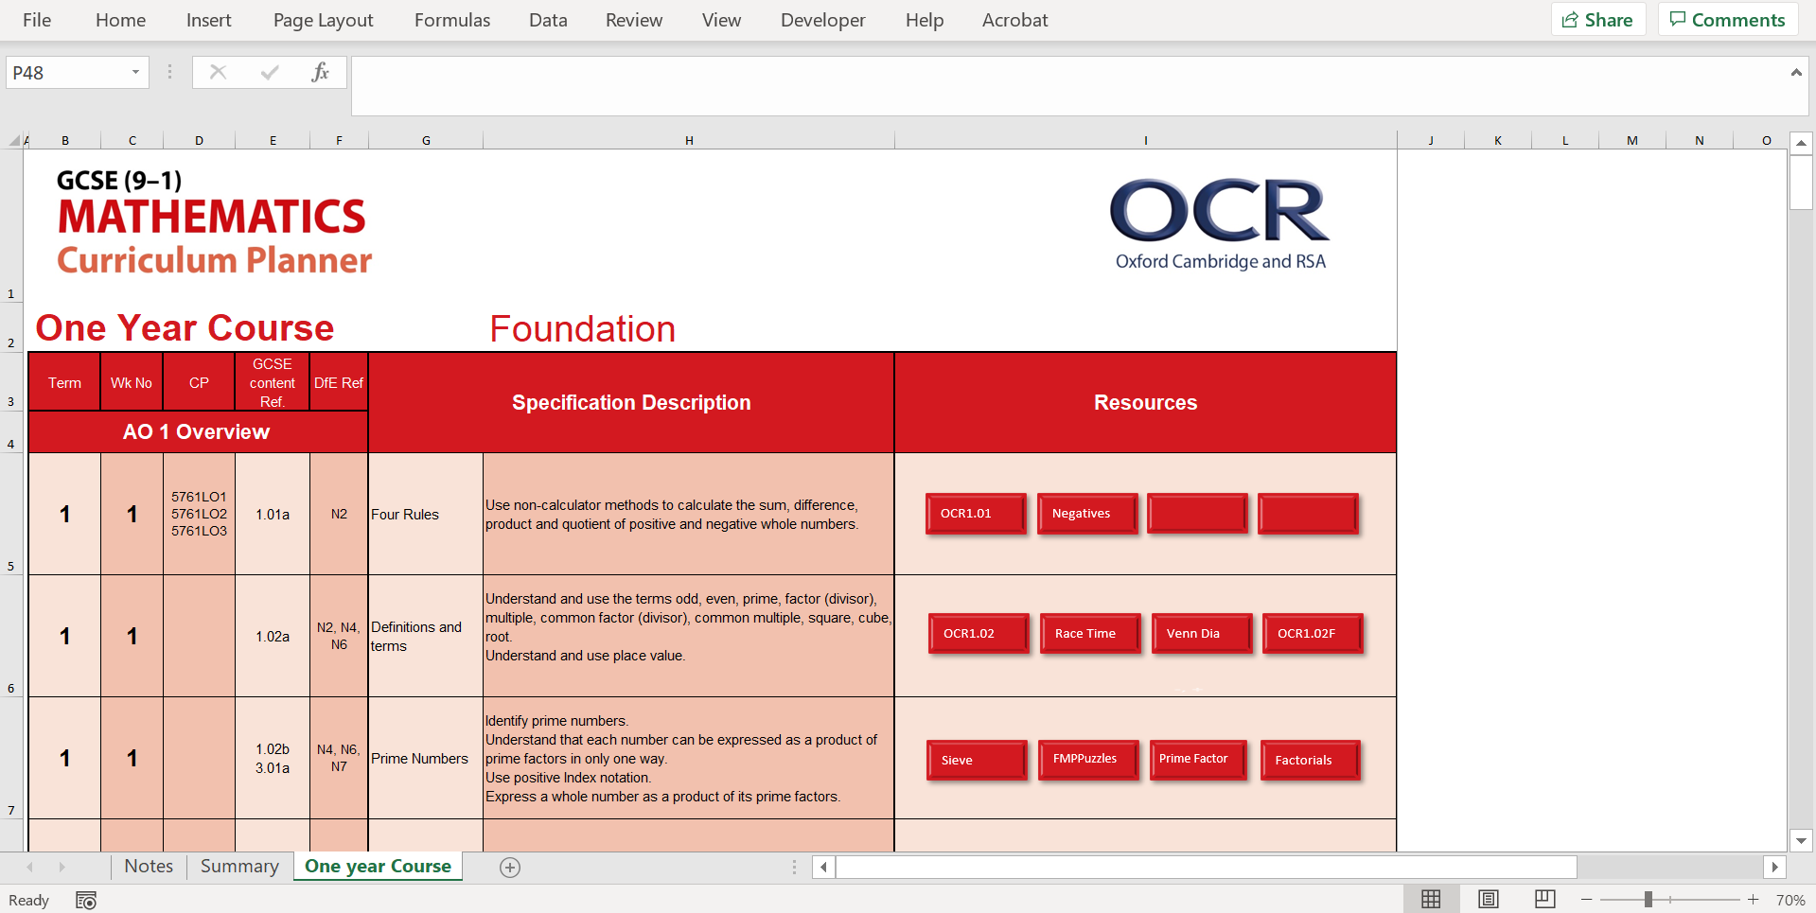
ocr.org.uk/gcsemaths
@OCR_Maths
Recent resources
Recently published resources include…
exploring our question papers guide,
alternative papers (summer 2019 & November 2020),
grade 1-4 practice materials,
more check in tests,
an updated 1-year Curriculum planner,
more teaching activities,
OCR / Cambridge University Press topic worksheets,
ExamBuilder topic tests.
Plus even more to come…
All are available from ocr.org.uk/gcsemaths, along with many other resources.

Slide 15
ocr.org.uk/gcsemaths
@OCR_Maths
OCR GCSE (9-1) Maths Specification update
We recently made some small updates to our GCSE (9-1) Maths Specification. You can download the latest version from ocr.org.uk/gcsemaths.
Most amends are updated links to qualification & admin support.
No content has been changed, but we've added a couple of clarifications.
This includes confirmation that students are not required to know Venn diagram notation (union, intersection and complement symbols) for our qualification.
For full information, please see our subject information update.

Slide 16
OCR GCSE (9-1) Maths support
1
Download the specification & resources
ocr.org.uk/gcsemaths
2
Book onto CPD Training
ocr.org.uk/gcsemathscpd
3
Sign up to teach
ocr.org.uk/teachwithocr
4
Talk to us
maths@ocr.org.uk/@OCR_Maths/01223 553 998

