Slide 1
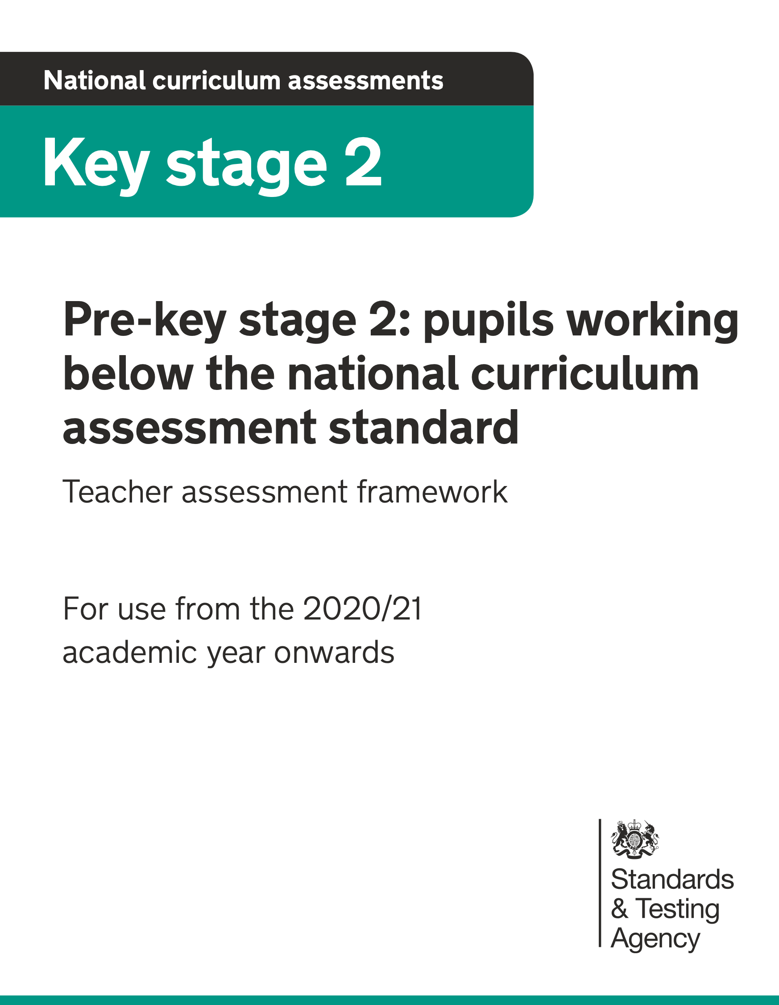
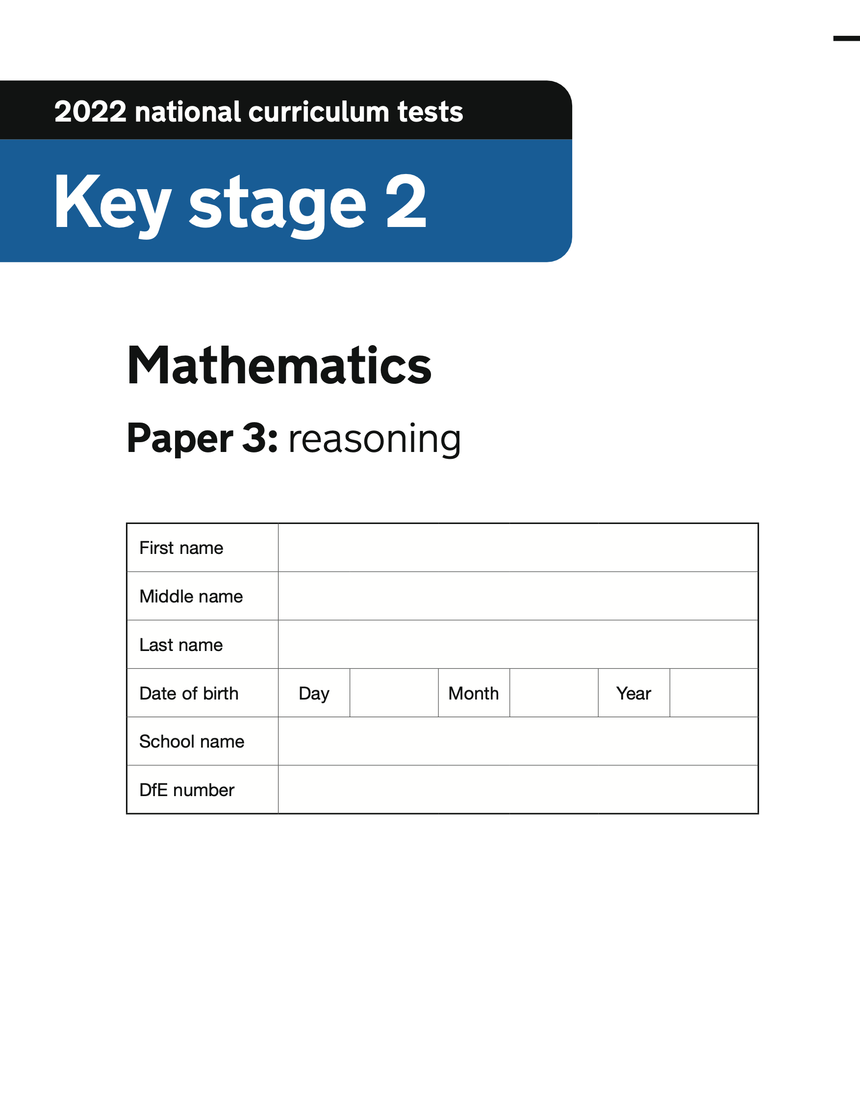
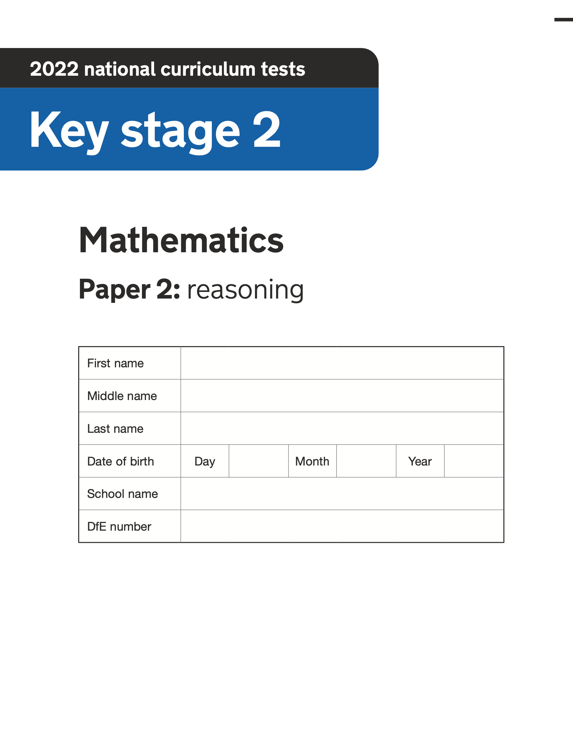
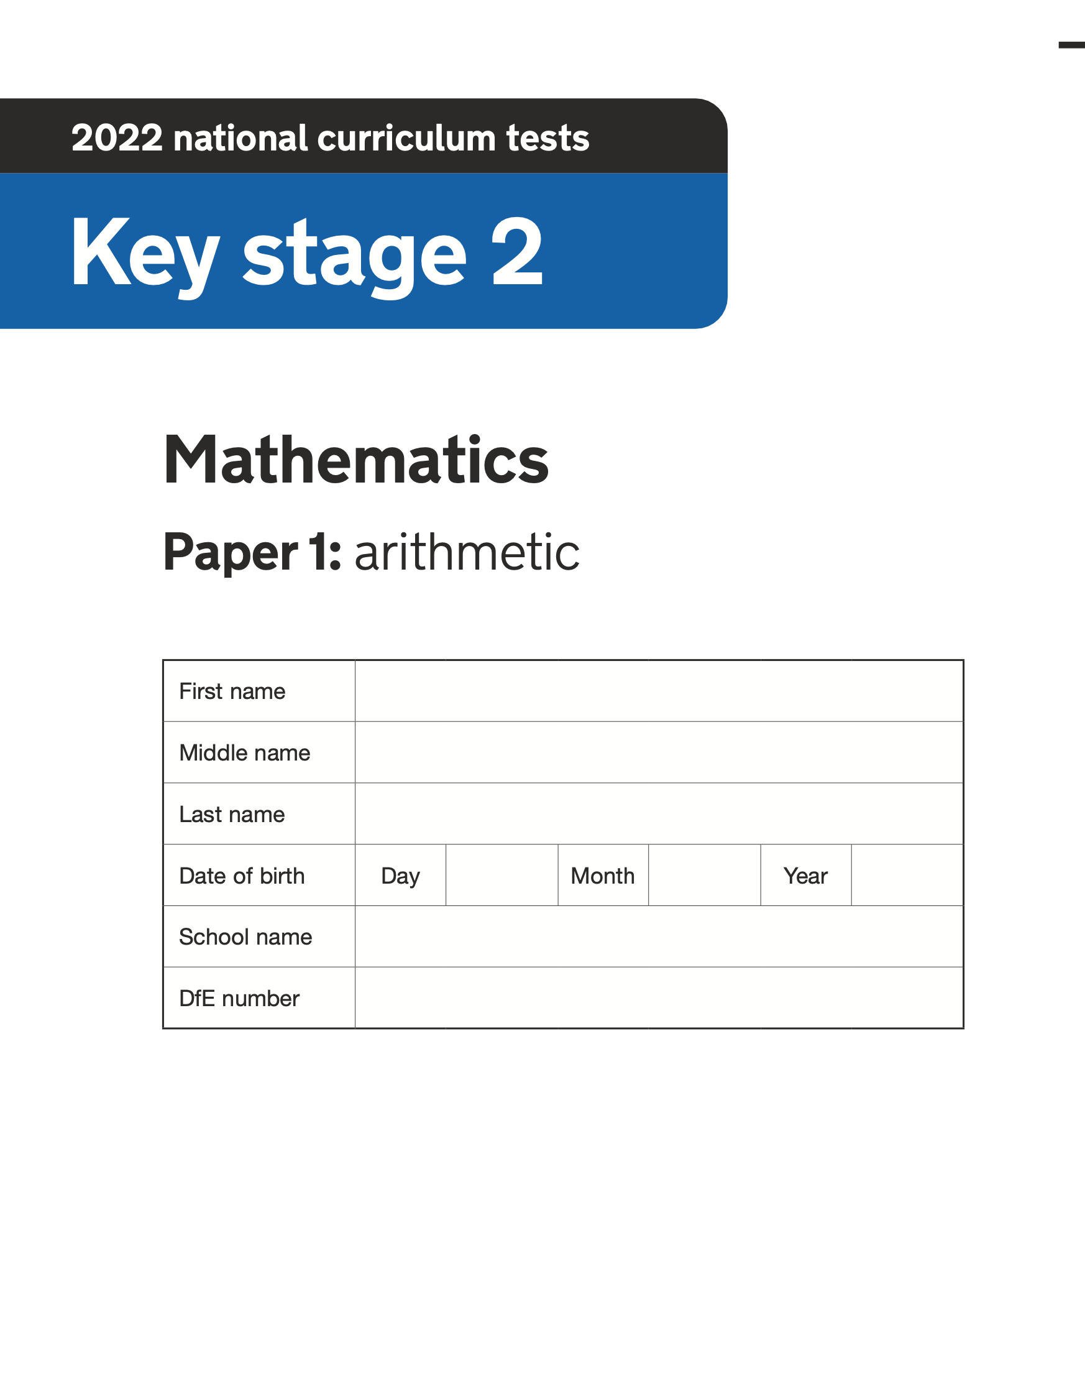
2022 Key Stage 2 SATs Mathematics
Arithmetic Paper 1
Reasoning Paper 2
Reasoning Paper 3
Pre- Key Stage 2 Standards

Slide 2
Key Stage 2 SATs papers 2022
https://www.gov.uk/government/publications/key-stage-2-tests-2022-mathematics-test-materials
Key stage 2 SATs 2019 scaled scores available in July 2022 Guidance
Scaled scores at key stage 2
Information for headteachers, teachers, governors and local authorities about scaled scores and the expected standard for the 2022 national curriculum tests.
https://www.gov.uk/guidance/scaled-scores-at-key-stage-2

Slide 3
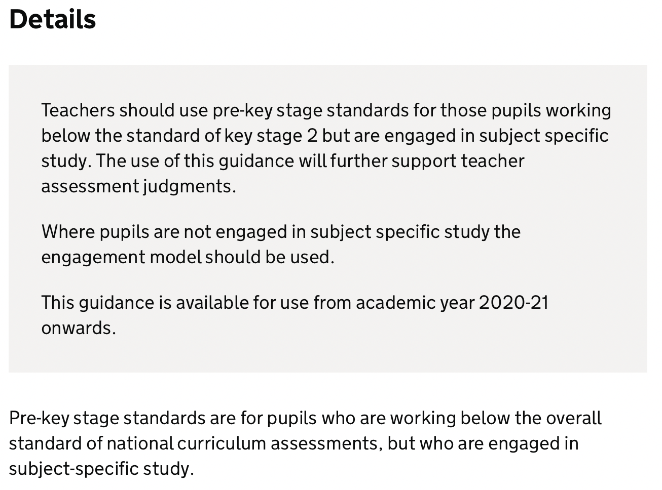
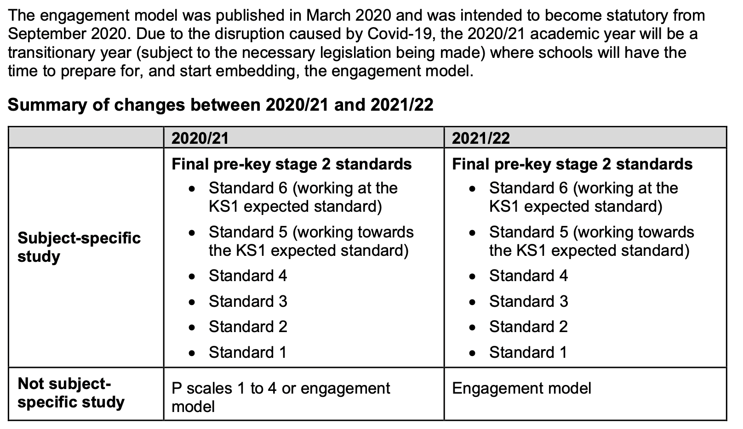
Pre-key stage 2 standards
https://www.gov.uk/government/publications/pre-key-stage-2-standards

Slide 4
Pre Key Stage 2
Using the mathematics pre-key stage standards
The six standards in this framework contain a number of ‘pupil can’ statements. To judge that a pupil is working at a standard in mathematics, teachers need to have evidence which demonstrates that the pupil meets all of the statements within that standard.
As stated on page 3, teachers should assess each individual pupil based on their own method of communication, and disregard statements which a pupil is physically unable to access.

Slide 5
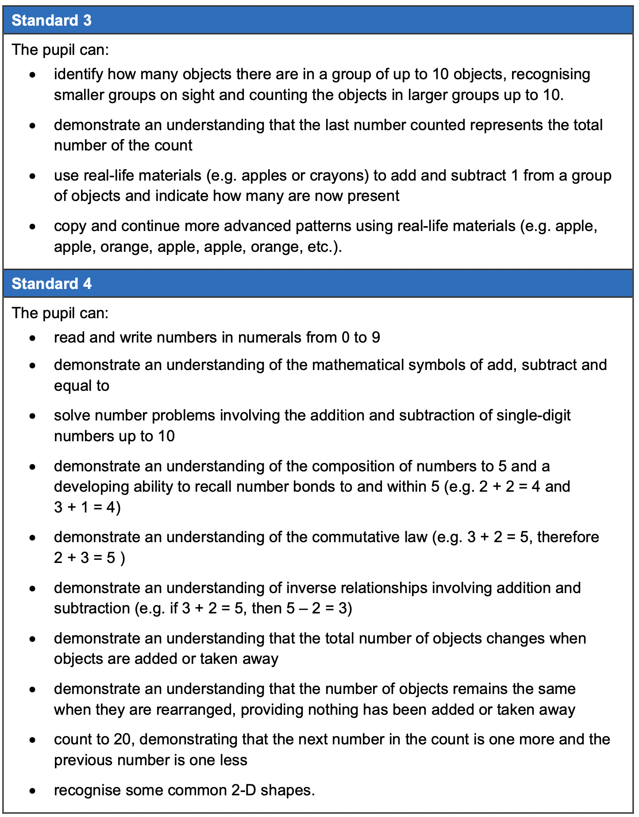
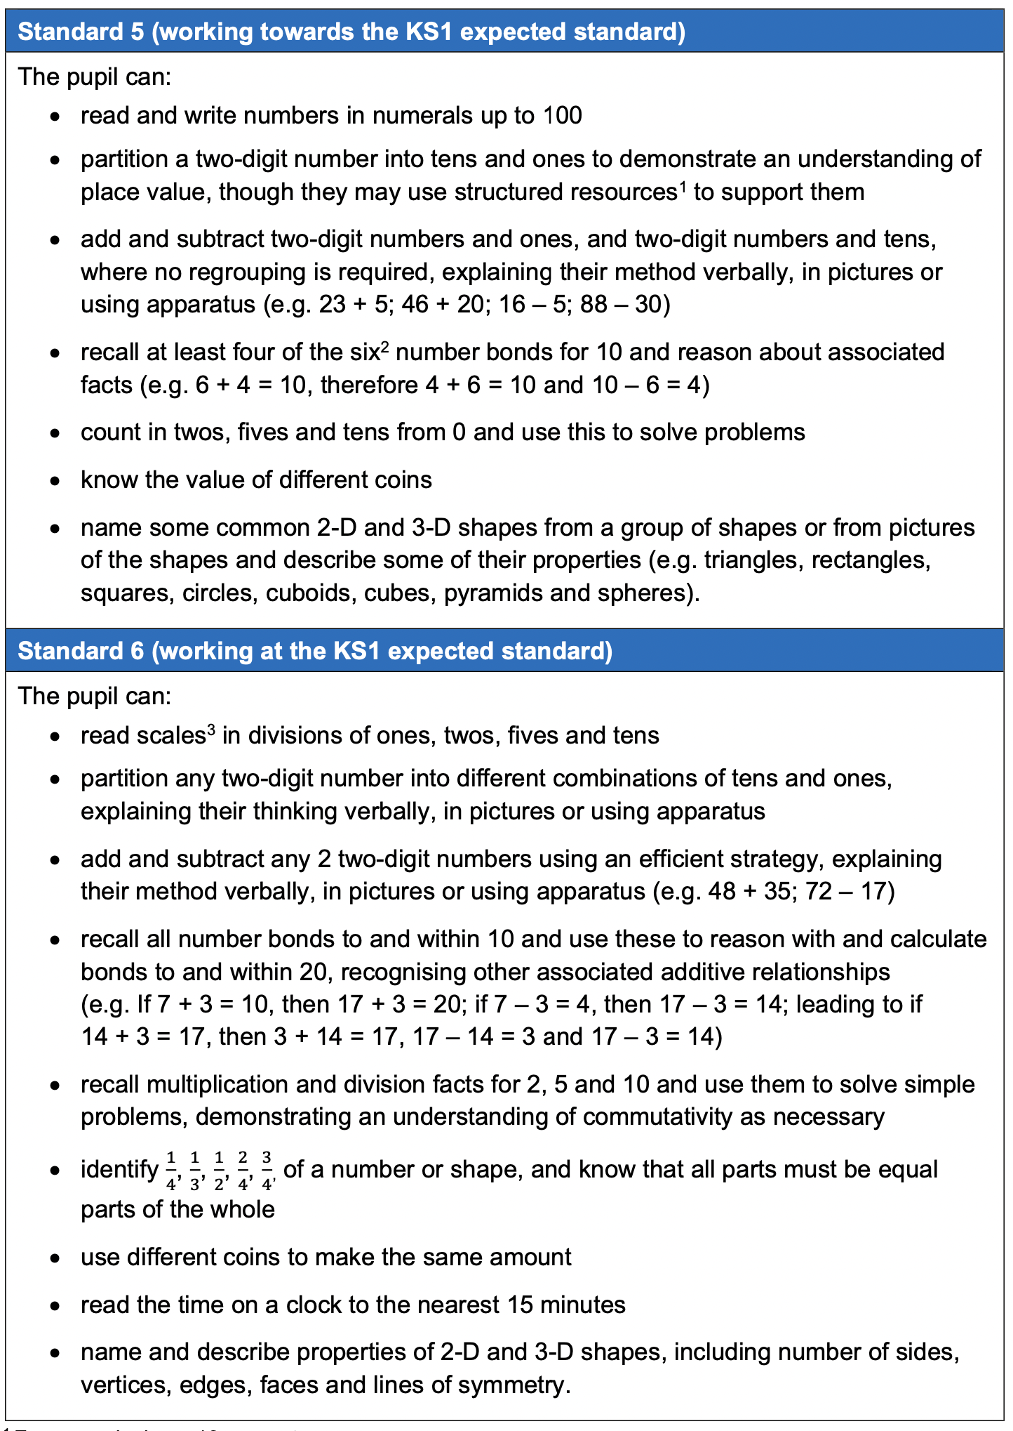

Slide 6
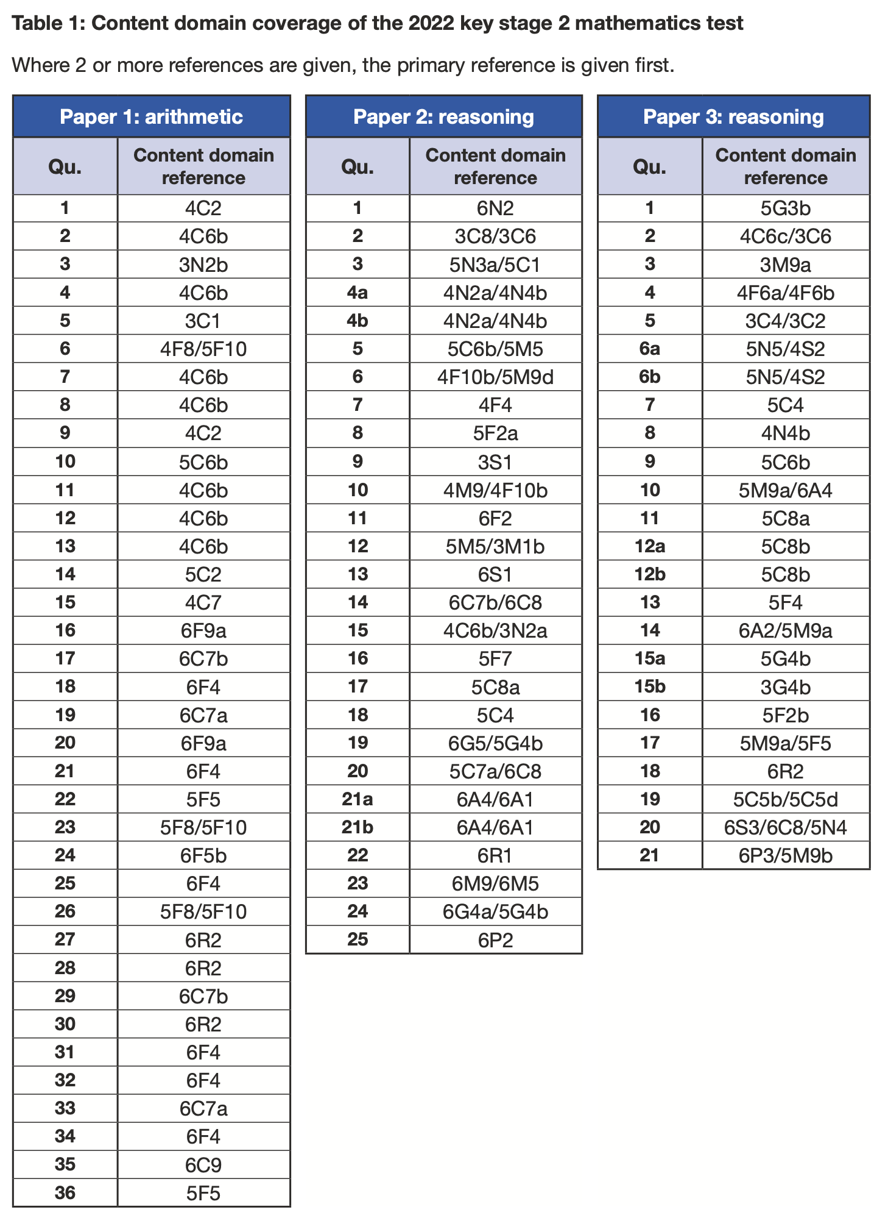
Key Stage 2 Mathematics
Mark Scheme
https://www.gov.uk/government/publications/key-stage-2-tests-2022-mathematics-test-materials

Slide 7
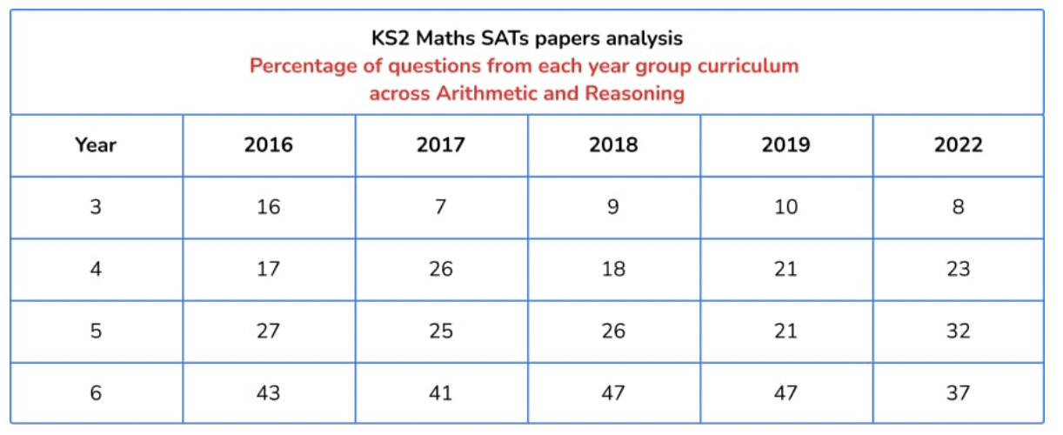
Key Stage 2 Mathematics SATs Papers comparison
https://thirdspacelearning.com/blog/ks2-sats-papers-2022-maths-question-breakdown/

Slide 8
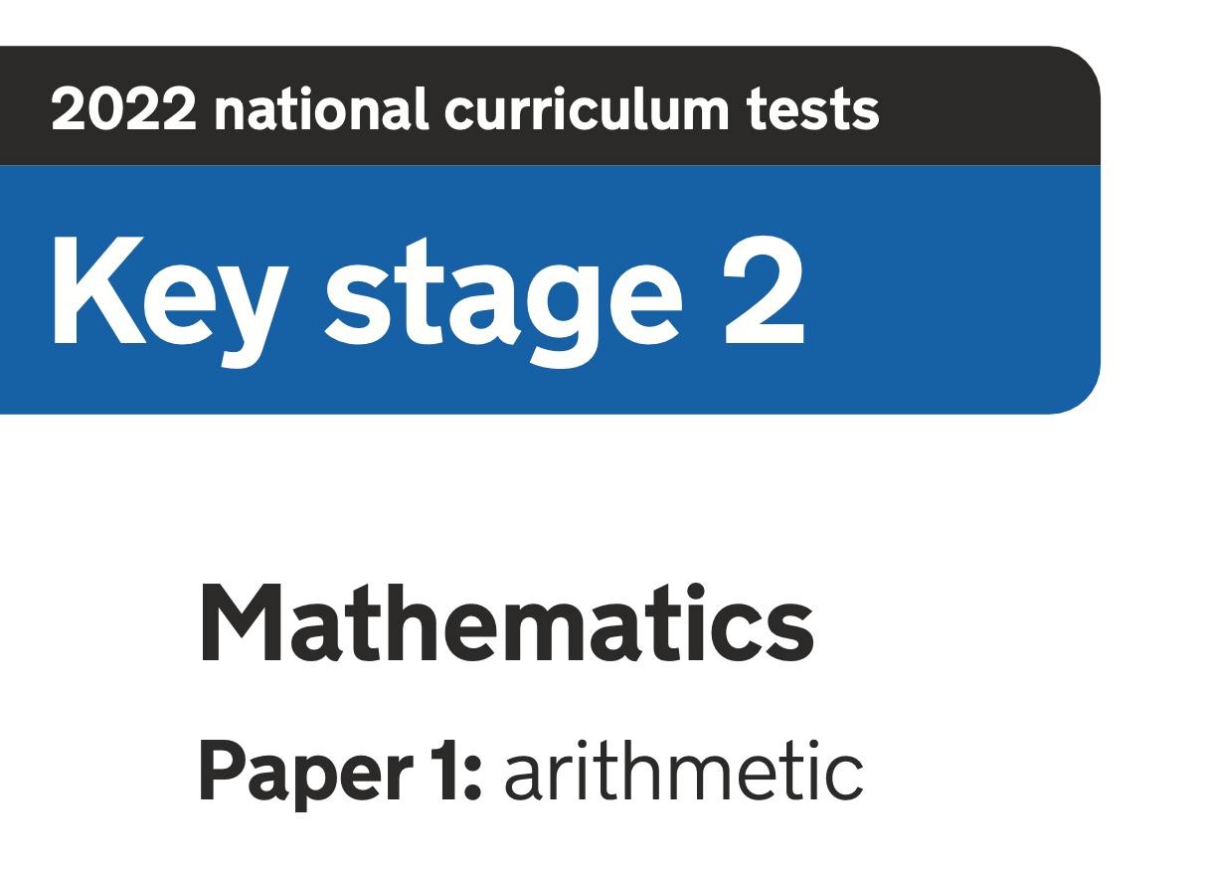
https://www.gov.uk/government/publications/key-stage-2-tests-2022-mathematics-test-materials

Slide 9
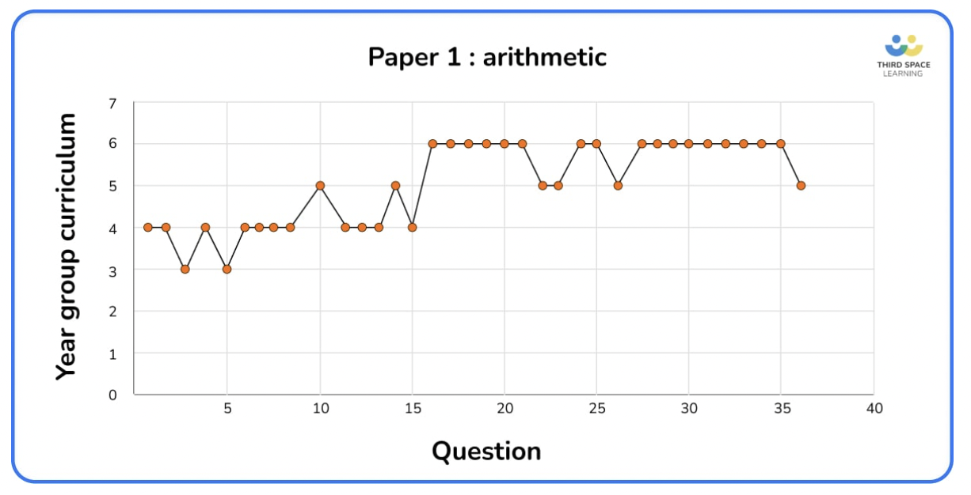
https://www.gov.uk/government/publications/key-stage-2-tests-2022-mathematics-test-materials
Arithmetic paper (36Qs)
 | 2016 | 2017 | 2018 | 2019 | 2022
Y3 | 8 | 3 | 4 | 4 | 2
Y4 | 5 | 10 | 9 | 9 | 11
Y5 | 11 | 7 | 6 | 6 | 6
Y6 | 12 | 16 | 16 | 16 | 17
https://thirdspacelearning.com/blog/ks2-sats-papers-2022-maths-question-breakdown/

Slide 10
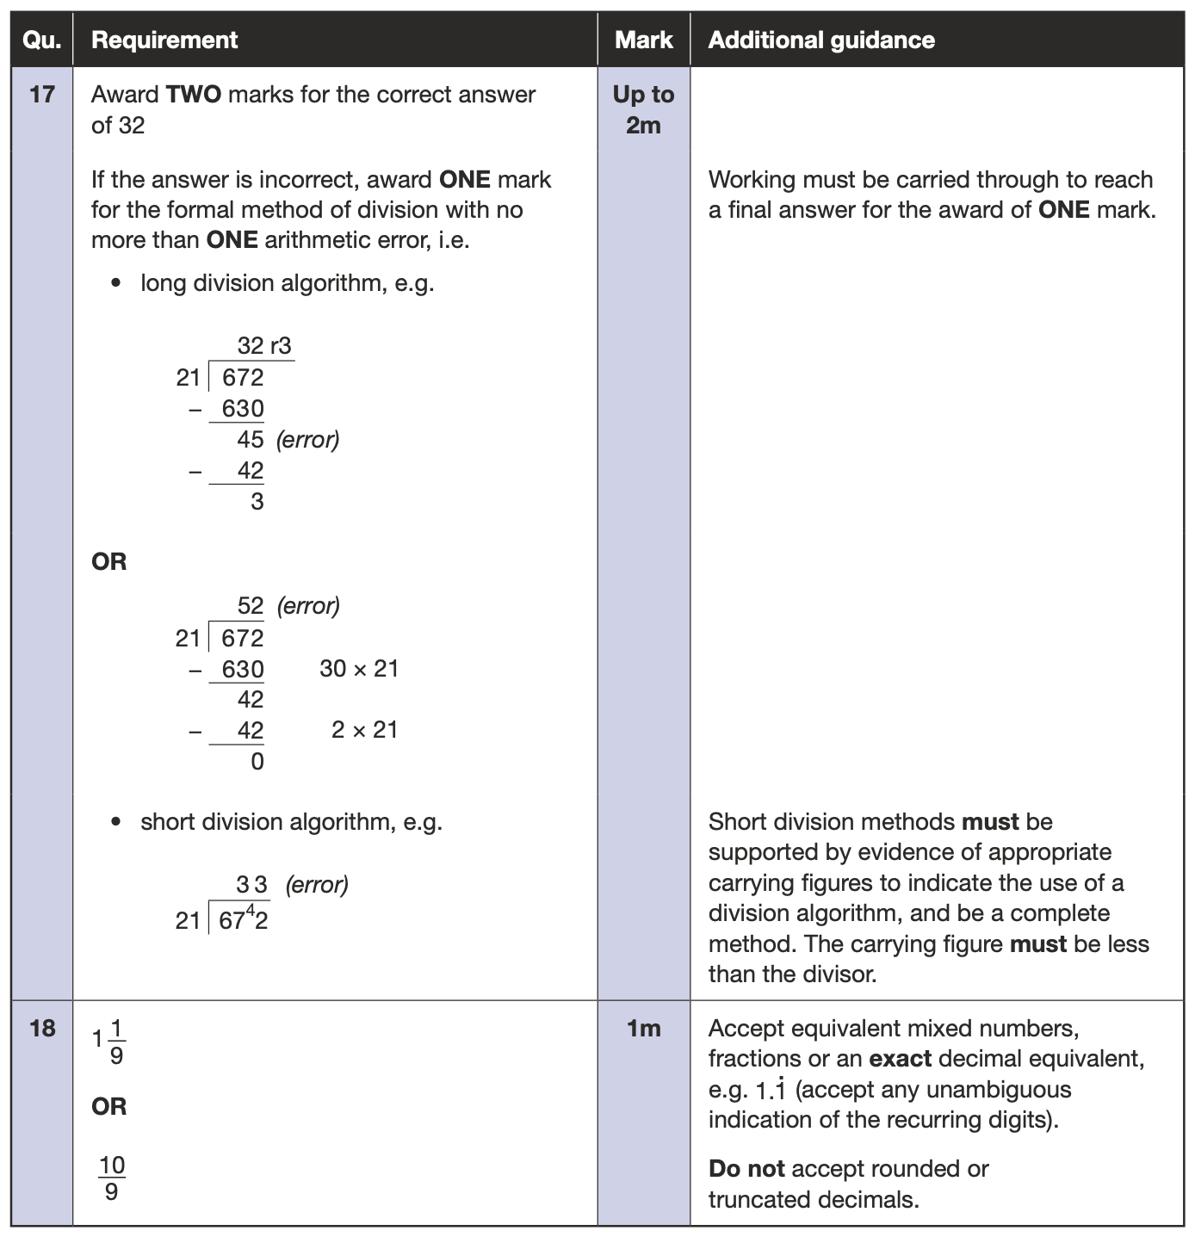
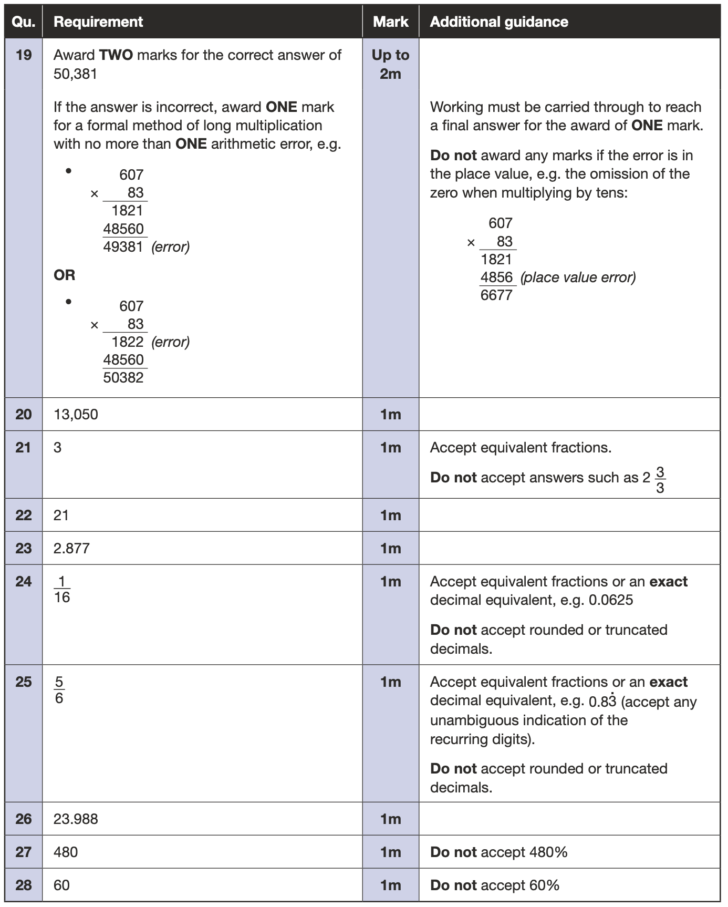
https://www.gov.uk/government/publications/key-stage-2-tests-2022-mathematics-test-materials

Slide 11
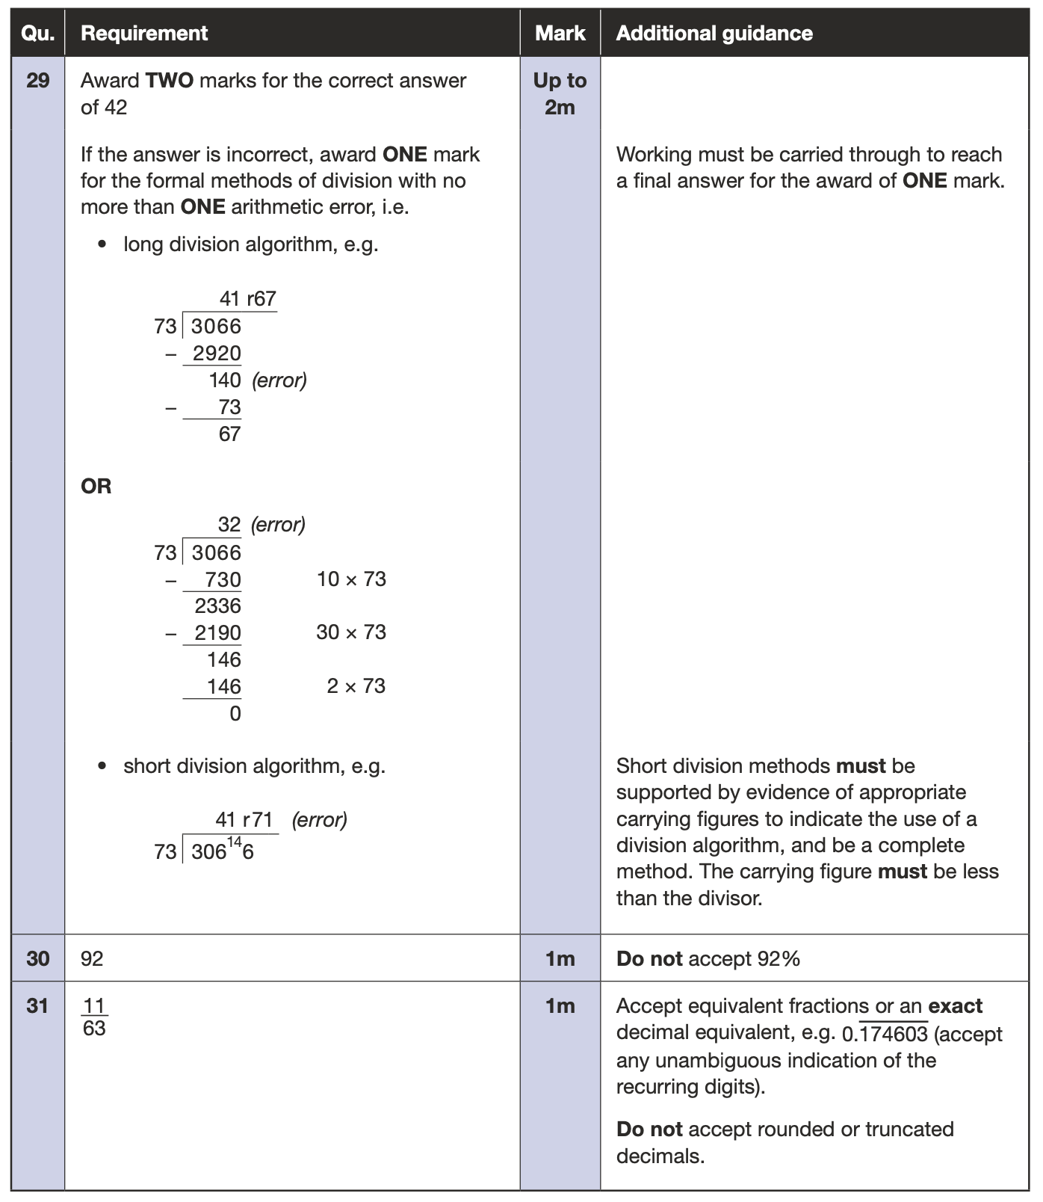
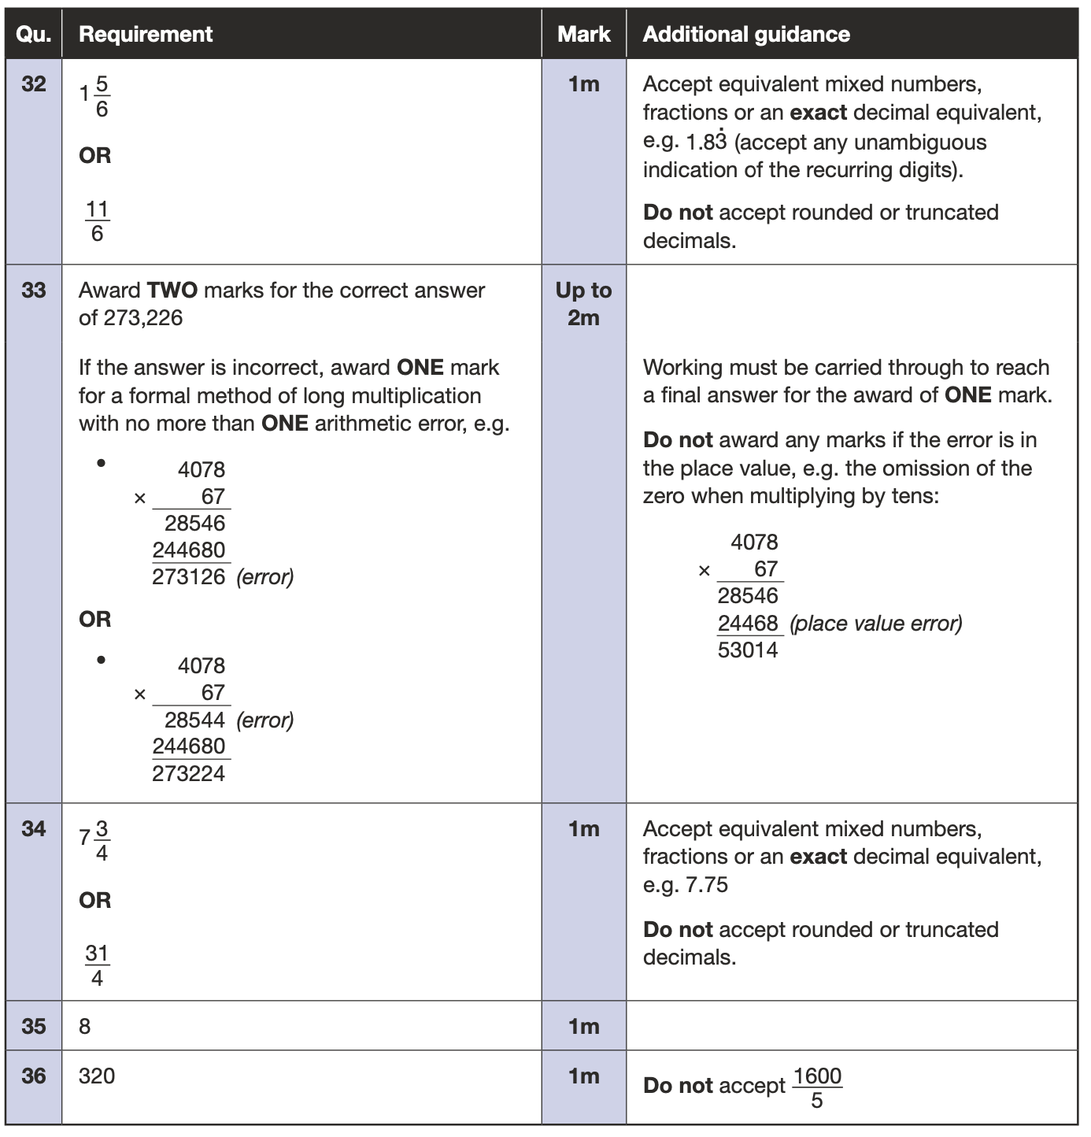
https://www.gov.uk/government/publications/key-stage-2-tests-2022-mathematics-test-materials

Slide 12
Key Stage 2 Arithmetic Paper 2022 Q1- 17
https://www.gov.uk/government/publications/key-stage-2-tests-2022-mathematics-test-materials
Notes:
Questions in order of the test top to bottom, left to right..

Slide 13
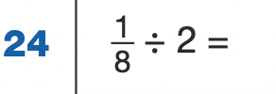
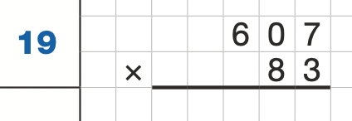
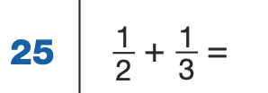
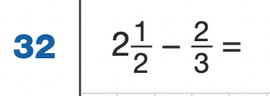
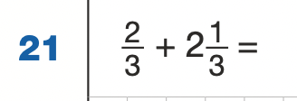
Key Stage 2 Arithmetic Paper 2022 Q18 - 32
https://www.gov.uk/government/publications/key-stage-2-tests-2022-mathematics-test-materials
Notes:
Questions in order of the test top to bottom, left to right..

Slide 14
Key Stage 2 Arithmetic Paper 2022 Q33 - 36
https://www.gov.uk/government/publications/key-stage-2-tests-2022-mathematics-test-materials
Notes:
Questions in order of the test top to bottom, left to right..

Slide 15
2022: KS2 Arithmetic Paper Addition and subtraction
https://www.gov.uk/government/publications/key-stage-2-tests-2022-mathematics-test-materials
Notes:
Questions in order of the test top to bottom, left to right..

Slide 16
2022: KS2 Arithmetic Paper Multiplication and Division
https://www.gov.uk/government/publications/key-stage-2-tests-2022-mathematics-test-materials
Notes:
Questions in order of the test top to bottom, left to right..

Slide 17
2022: KS2 Arithmetic Paper Fractions and Percentages
https://www.gov.uk/government/publications/key-stage-2-tests-2022-mathematics-test-materials
Notes:
Questions in order of the test top to bottom, left to right..

Slide 18
Year 3 and 4 questions: Arithmetic Paper 2022 Q:1, 2, 3, 4, 5, 6, 7, 8, 9, 11, 12, 13, 15
https://www.gov.uk/government/publications/key-stage-2-tests-2022-mathematics-test-materials
Notes:
Questions in order of the test top to bottom, left to right..

Slide 19
https://www.gov.uk/government/publications/key-stage-2-tests-2022-mathematics-test-materials

Slide 20
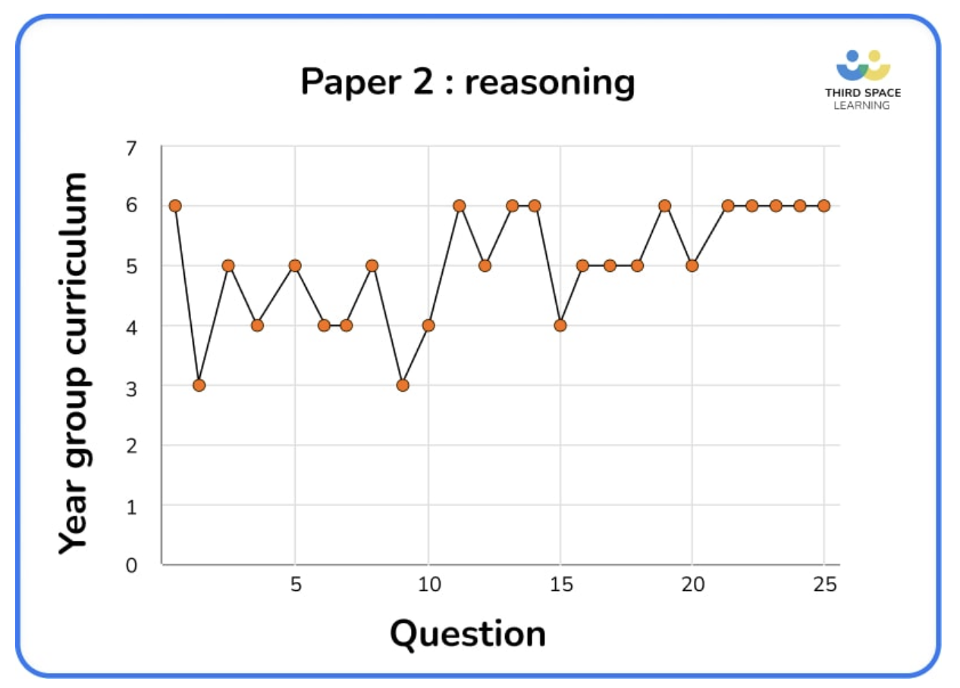
Key Stage 2 Mathematics
Paper 2: Reasoning
Paper2: Reasoning
https://www.gov.uk/government/publications/key-stage-2-tests-2022-mathematics-test-materials
 | 2016 Q20 | 2017 Q23 | 2018 Q23 | 2019 | 2022 Q25
Y3 | 5 | 0 | 3 | 3 | 2
Y4 | 2 | 6 | 3 | 4 | 5
Y5 | 6 | 7 | 6 | 7 | 8
Y6 | 13 | 8 | 10 | 12 | 10
*Some are part of a question
https://thirdspacelearning.com/blog/ks2-sats-papers-2022-maths-question-breakdown/

Slide 21
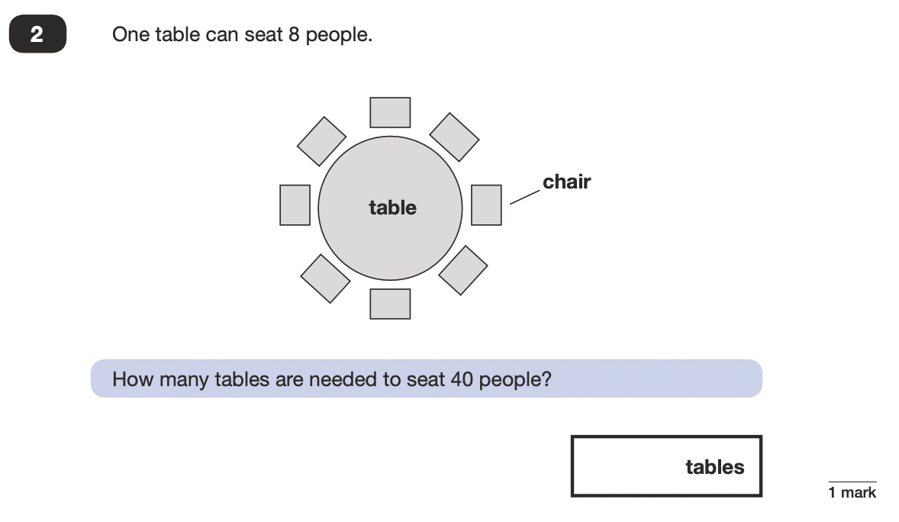
2022 Key Stage 2: Paper 2 Reasoning
https://www.gov.uk/government/publications/key-stage-2-tests-2022-mathematics-test-materials

Slide 22
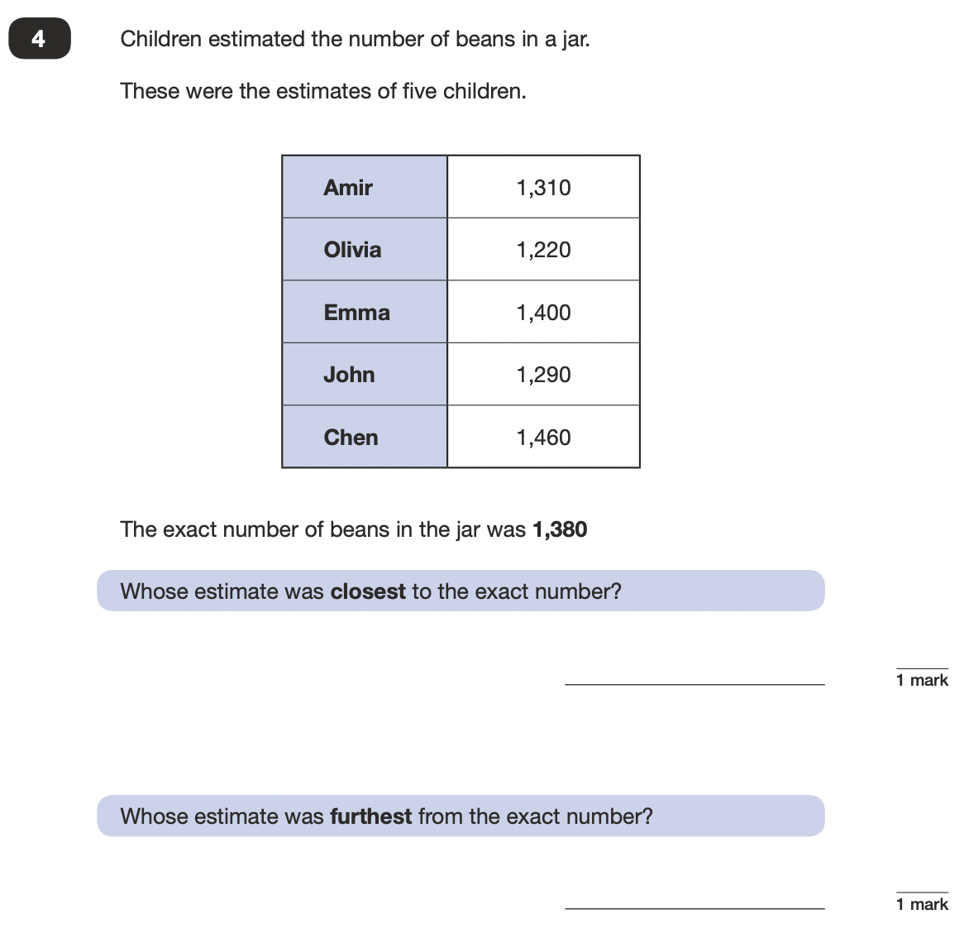
2022 Key Stage 2: Paper 2 Reasoning
https://www.gov.uk/government/publications/key-stage-2-tests-2022-mathematics-test-materials

Slide 23
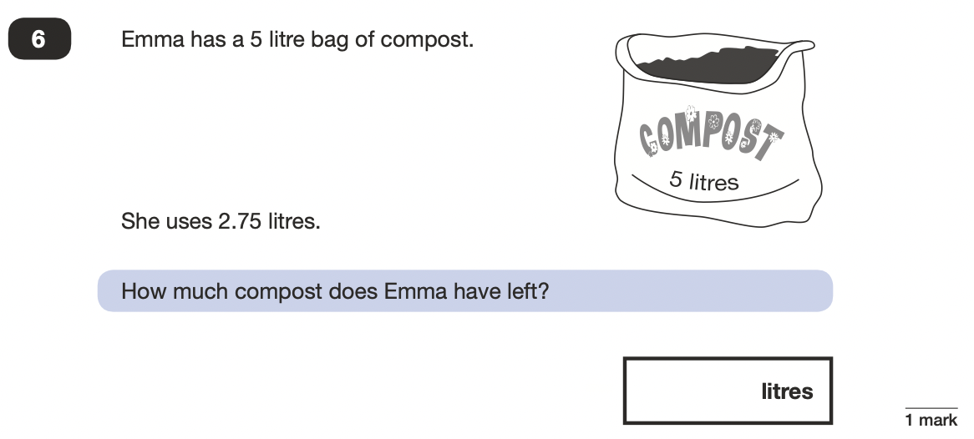
2022 Key Stage 2: Paper 2 Reasoning
https://www.gov.uk/government/publications/key-stage-2-tests-2022-mathematics-test-materials

Slide 24
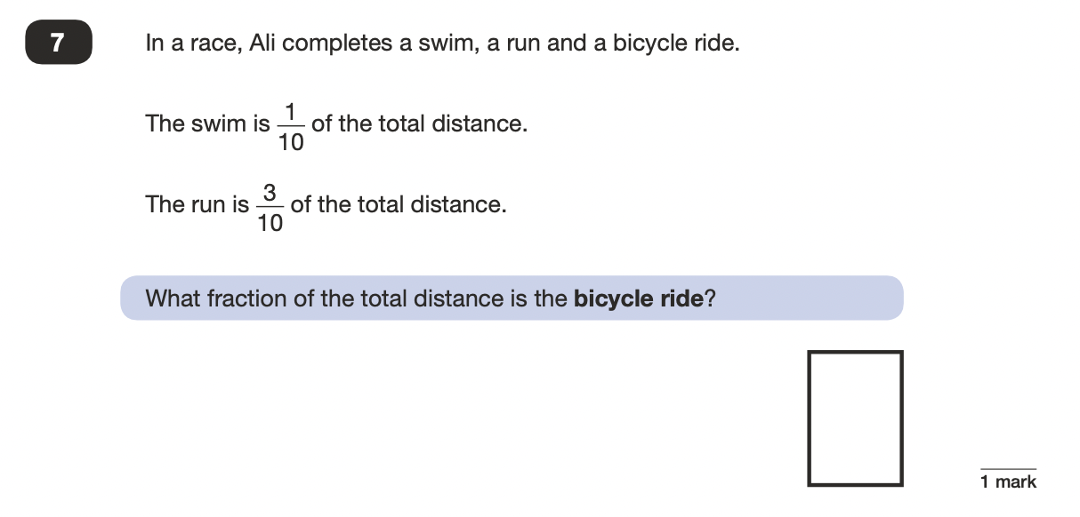
2022 Key Stage 2: Paper 2 Reasoning
https://www.gov.uk/government/publications/key-stage-2-tests-2022-mathematics-test-materials

Slide 25
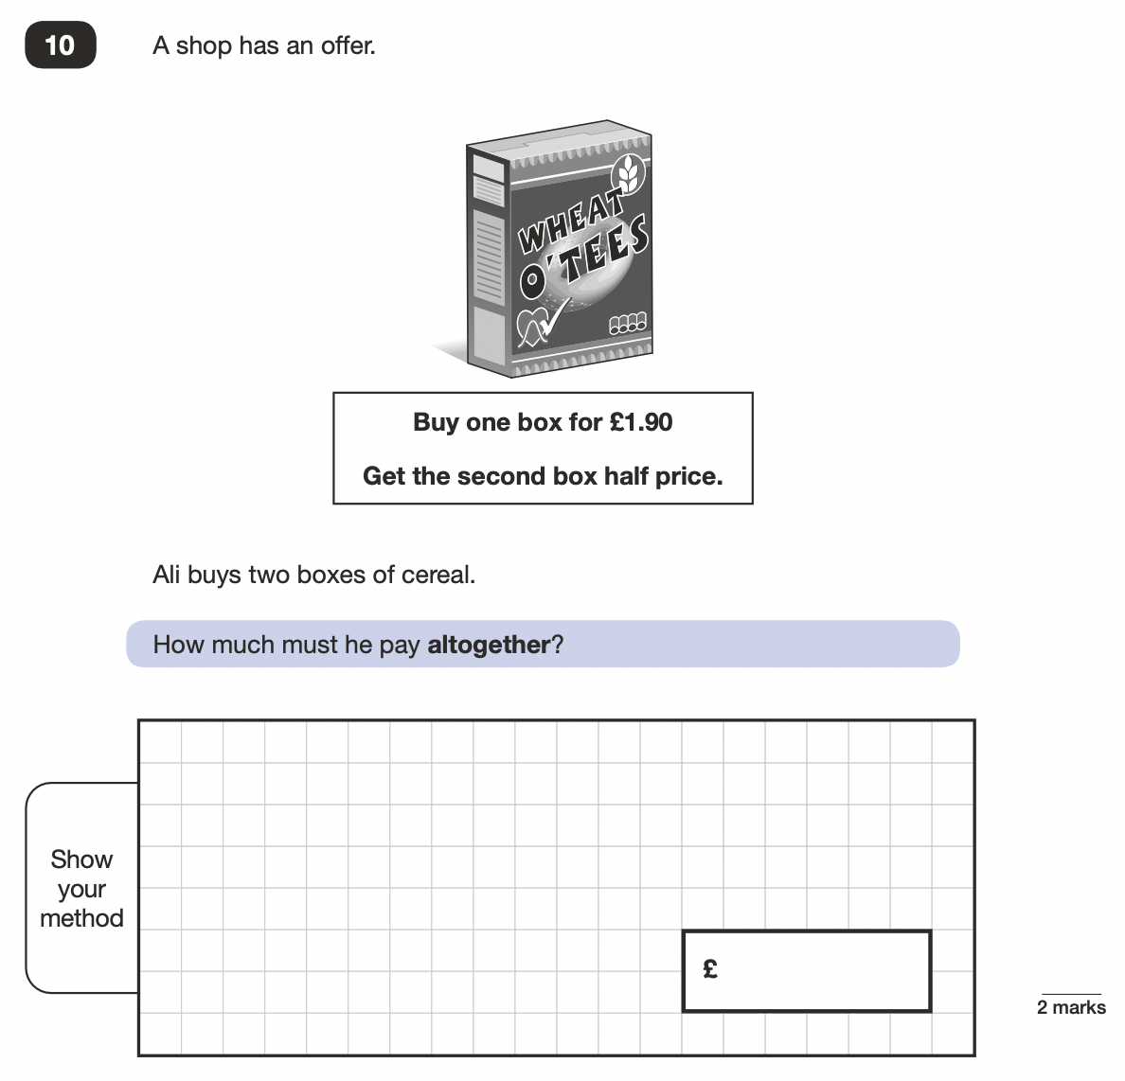
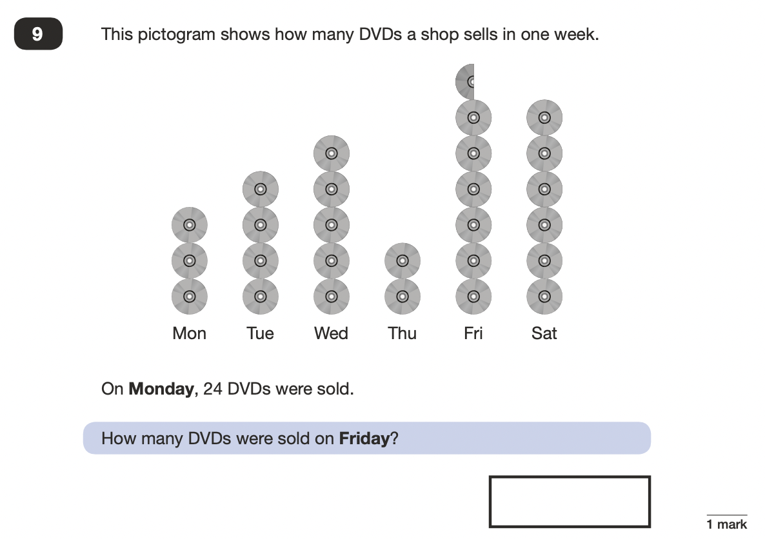
2022 Key Stage 2: Paper 2 Reasoning
https://www.gov.uk/government/publications/key-stage-2-tests-2022-mathematics-test-materials

Slide 26
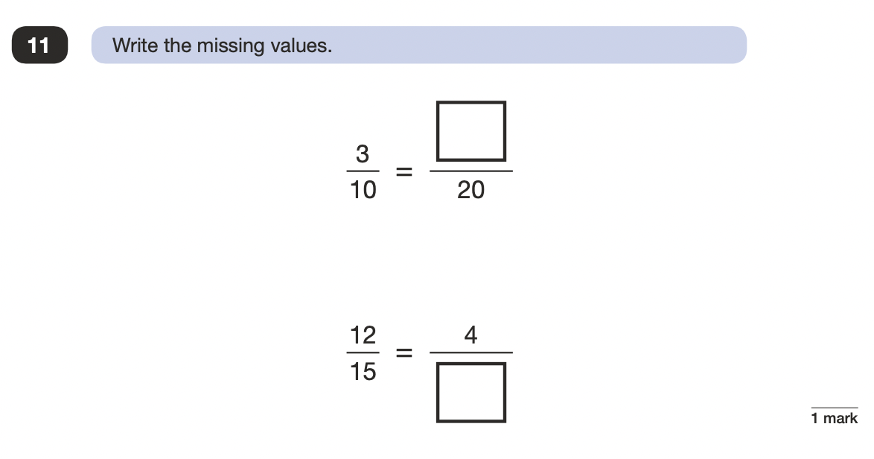
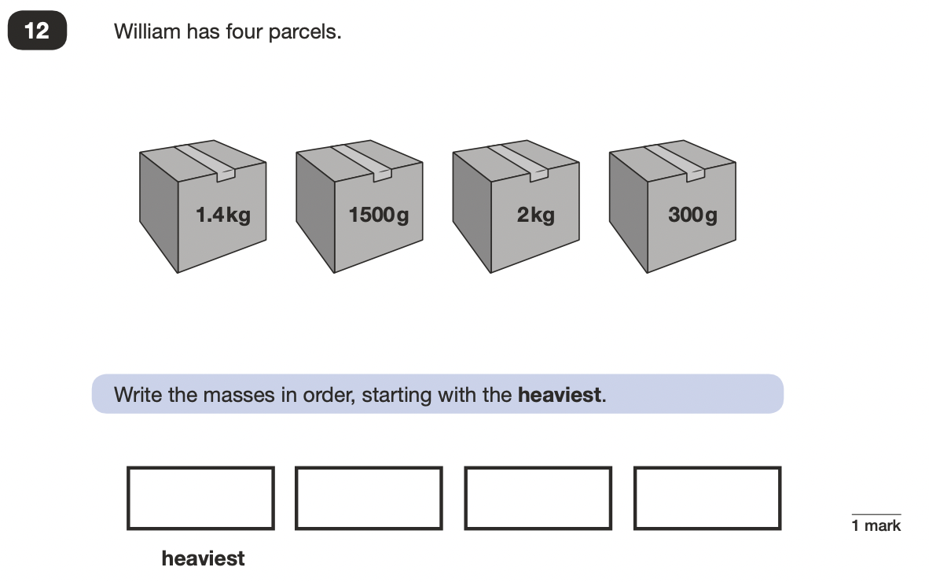
2022 Key Stage 2: Paper 2 Reasoning
https://www.gov.uk/government/publications/key-stage-2-tests-2022-mathematics-test-materials

Slide 27
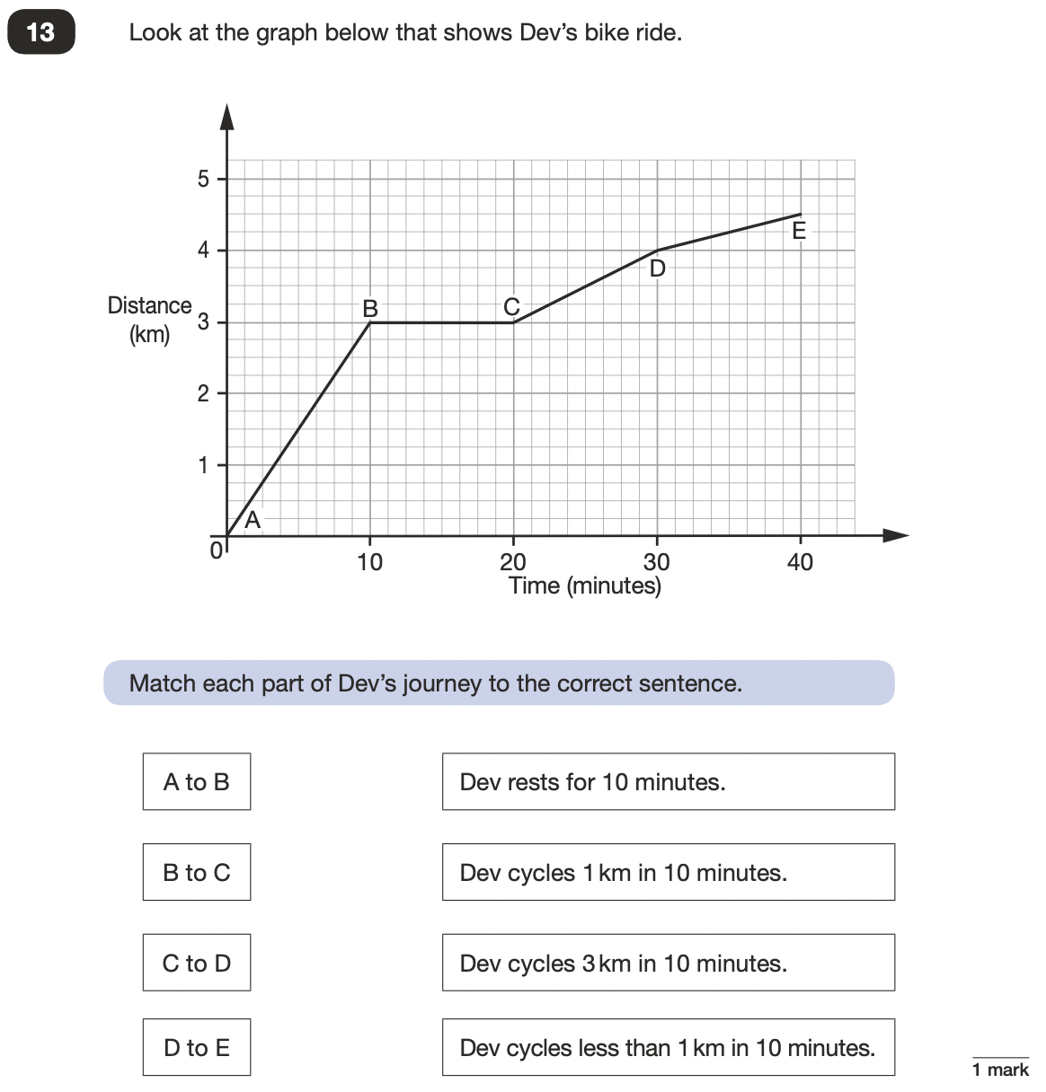
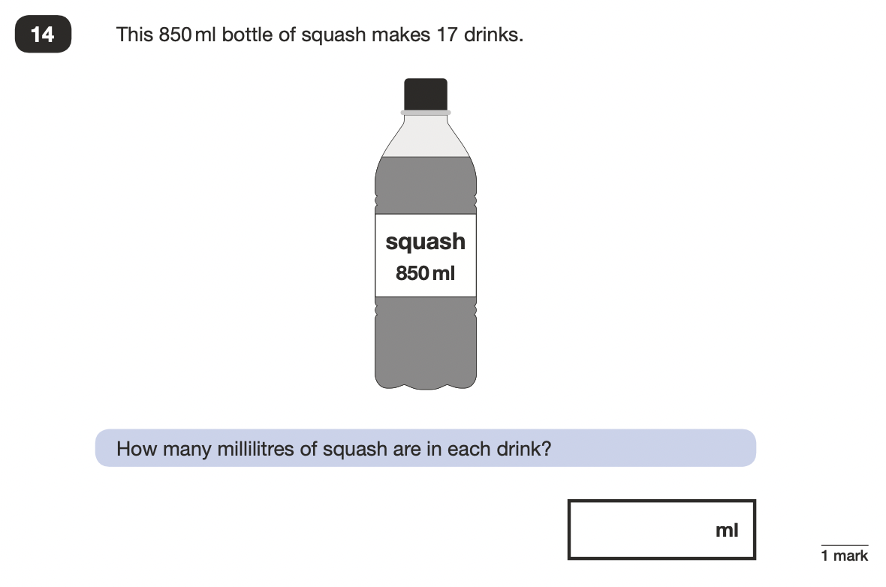
2022 Key Stage 2: Paper 2 Reasoning
https://www.gov.uk/government/publications/key-stage-2-tests-2022-mathematics-test-materials

Slide 28
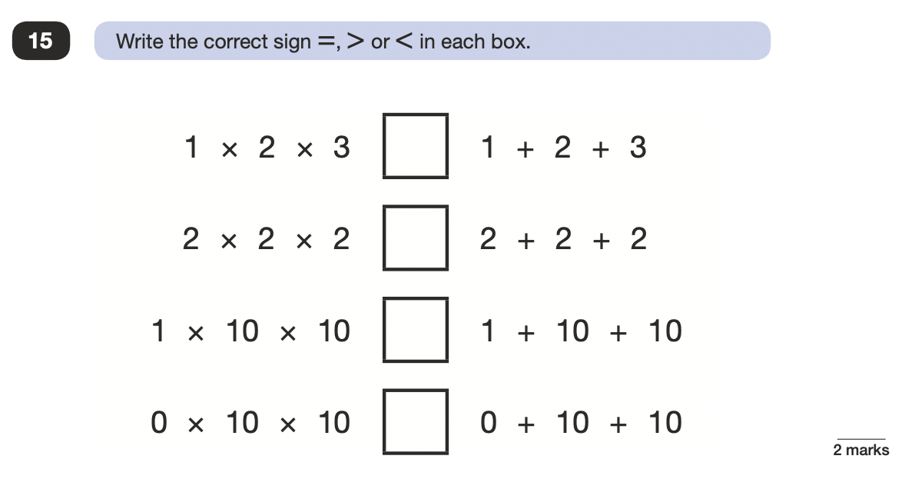
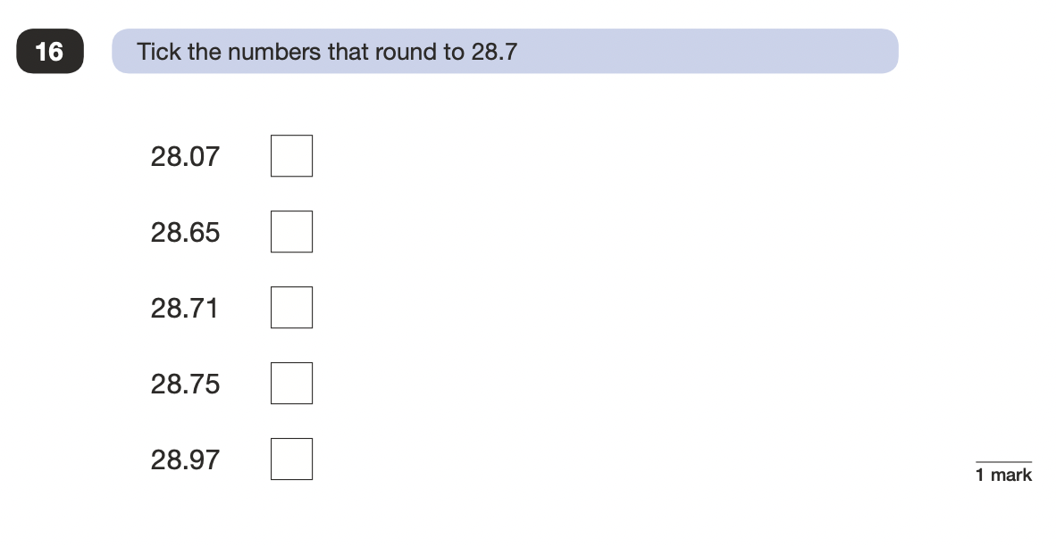
2022 Key Stage 2: Paper 2 Reasoning
https://www.gov.uk/government/publications/key-stage-2-tests-2022-mathematics-test-materials

Slide 29
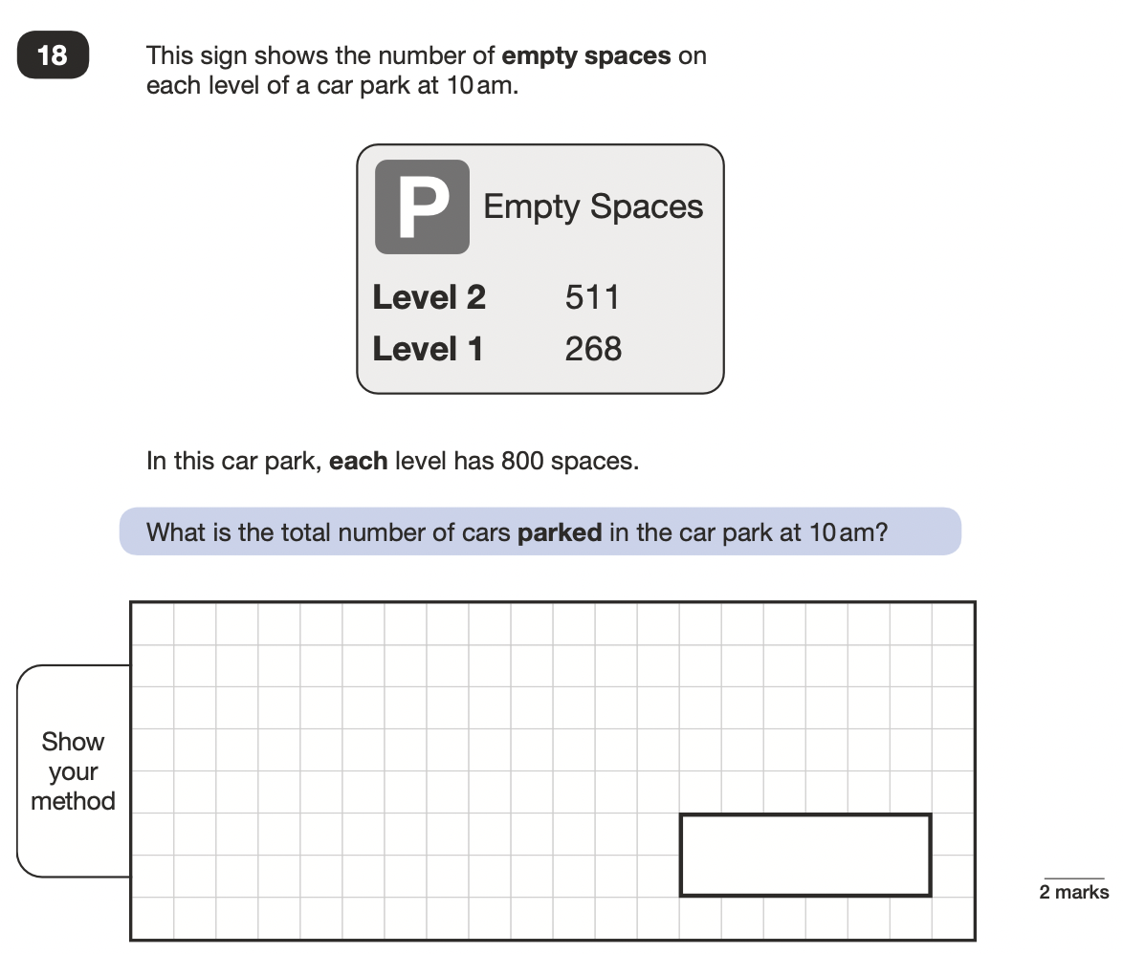
2022 Key Stage 2: Paper 2 Reasoning
https://www.gov.uk/government/publications/key-stage-2-tests-2022-mathematics-test-materials

Slide 30
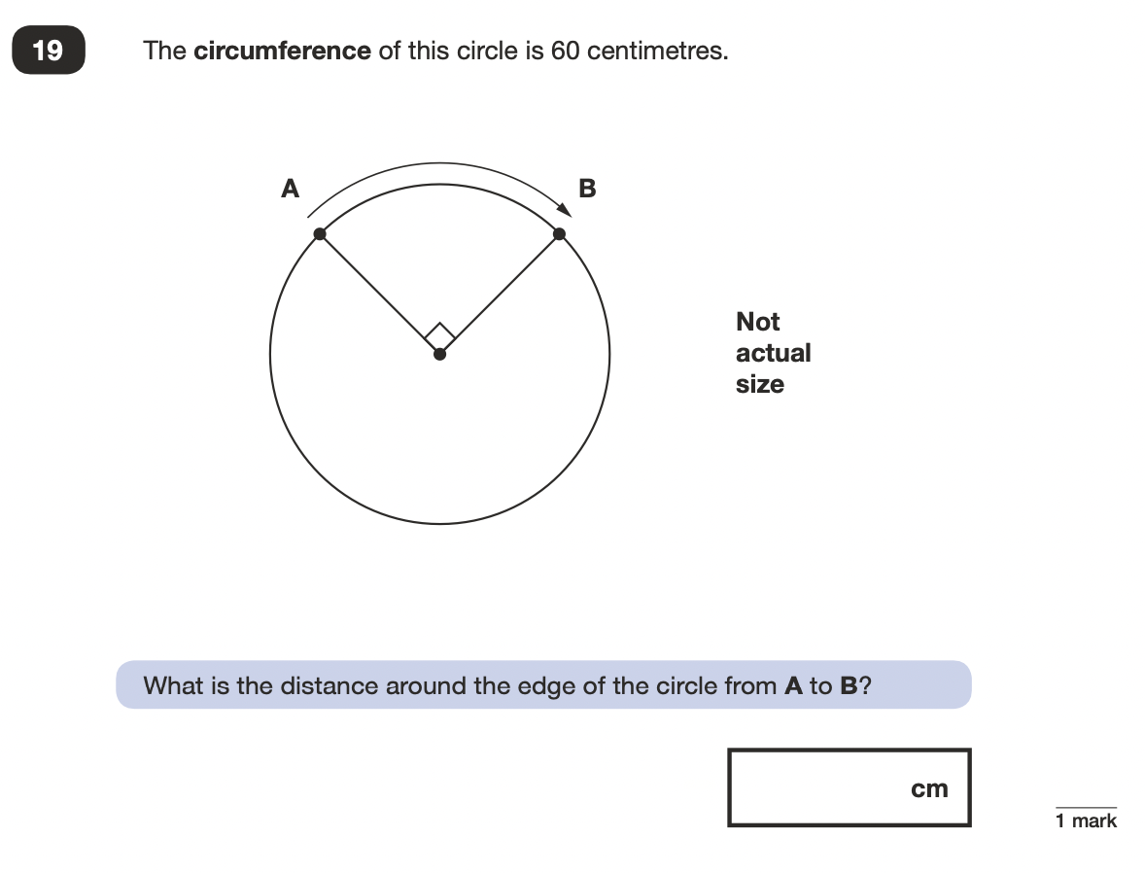
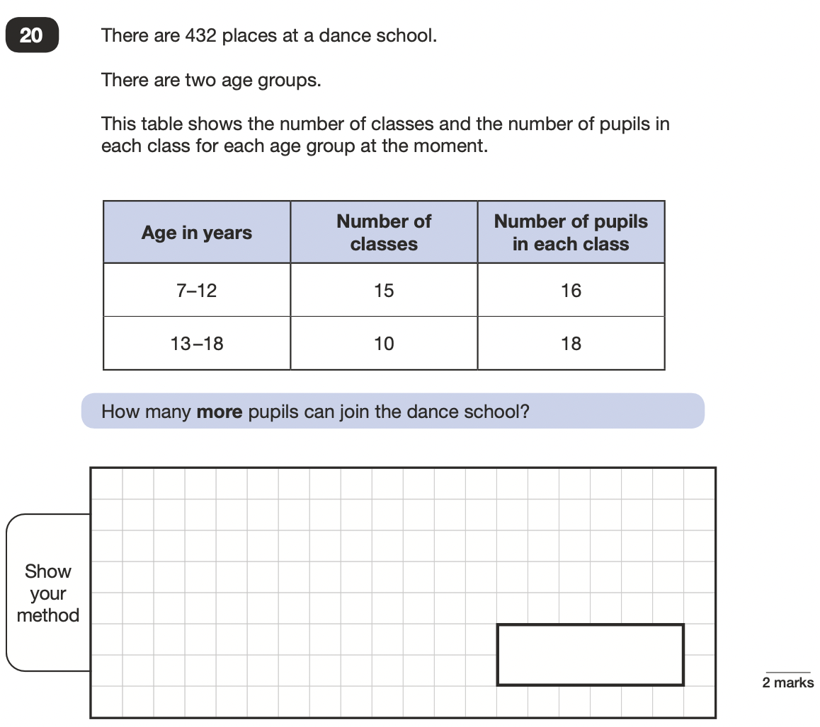
2022 Key Stage 2: Paper 2 Reasoning
https://www.gov.uk/government/publications/key-stage-2-tests-2022-mathematics-test-materials

Slide 31
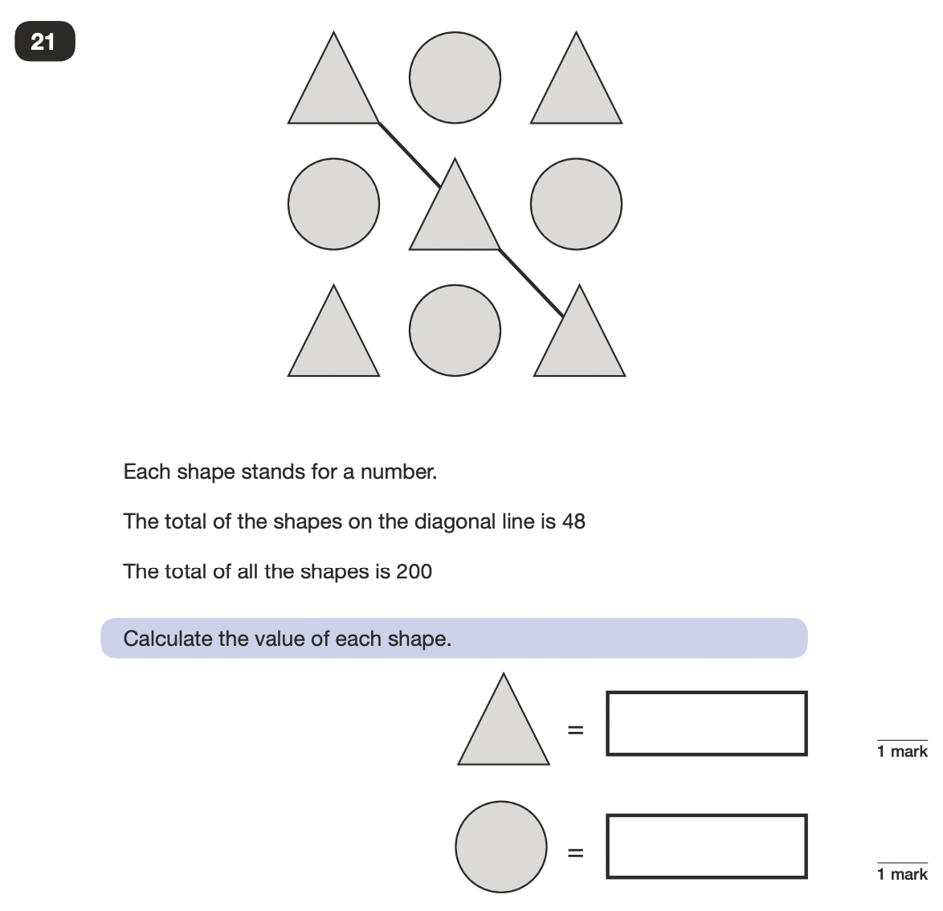
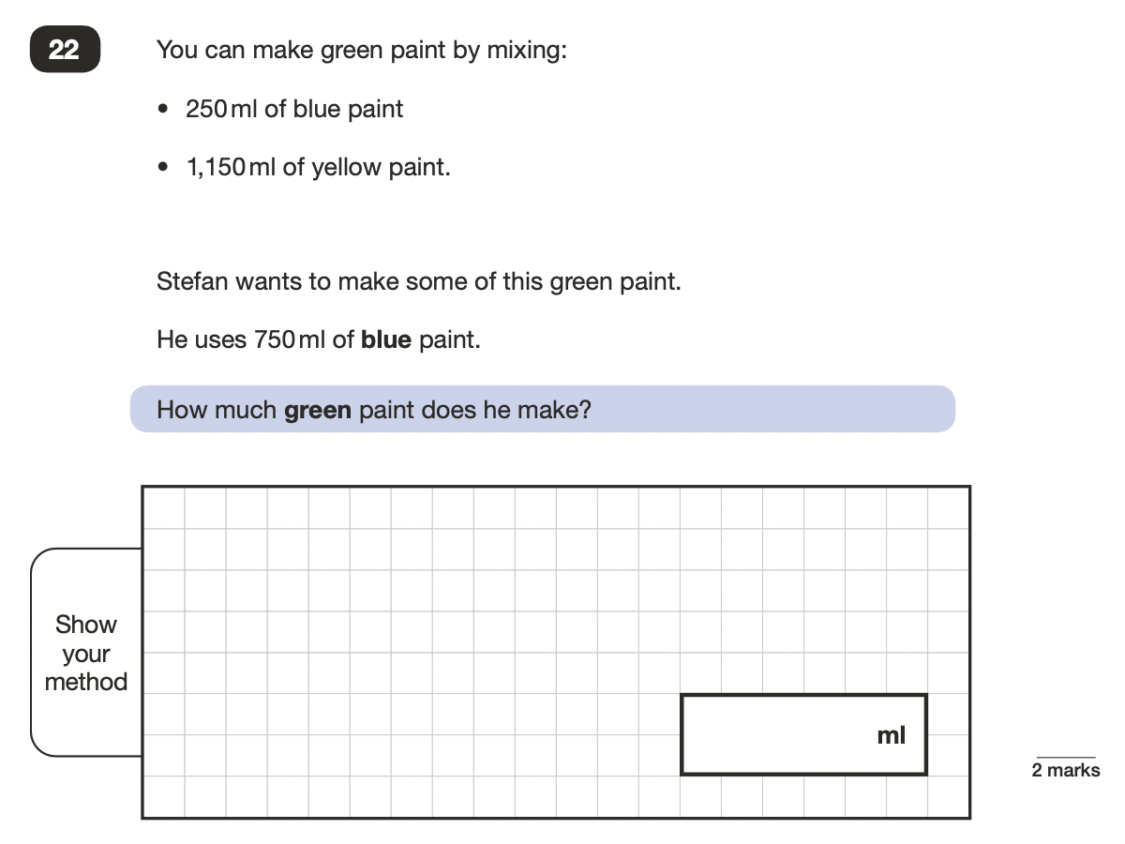
2022 Key Stage 2: Paper 2 Reasoning
https://www.gov.uk/government/publications/key-stage-2-tests-2022-mathematics-test-materials

Slide 32
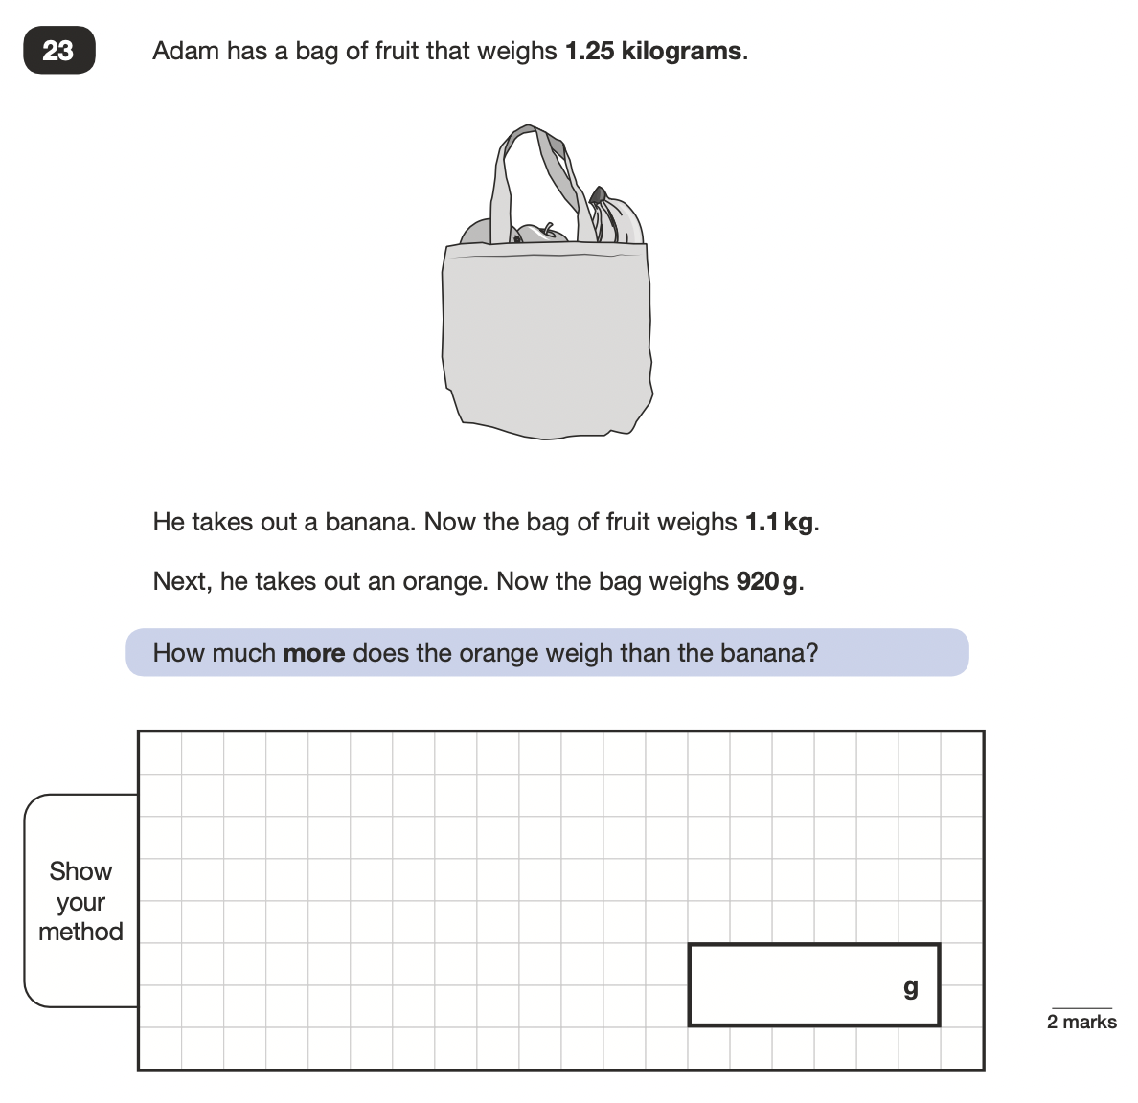
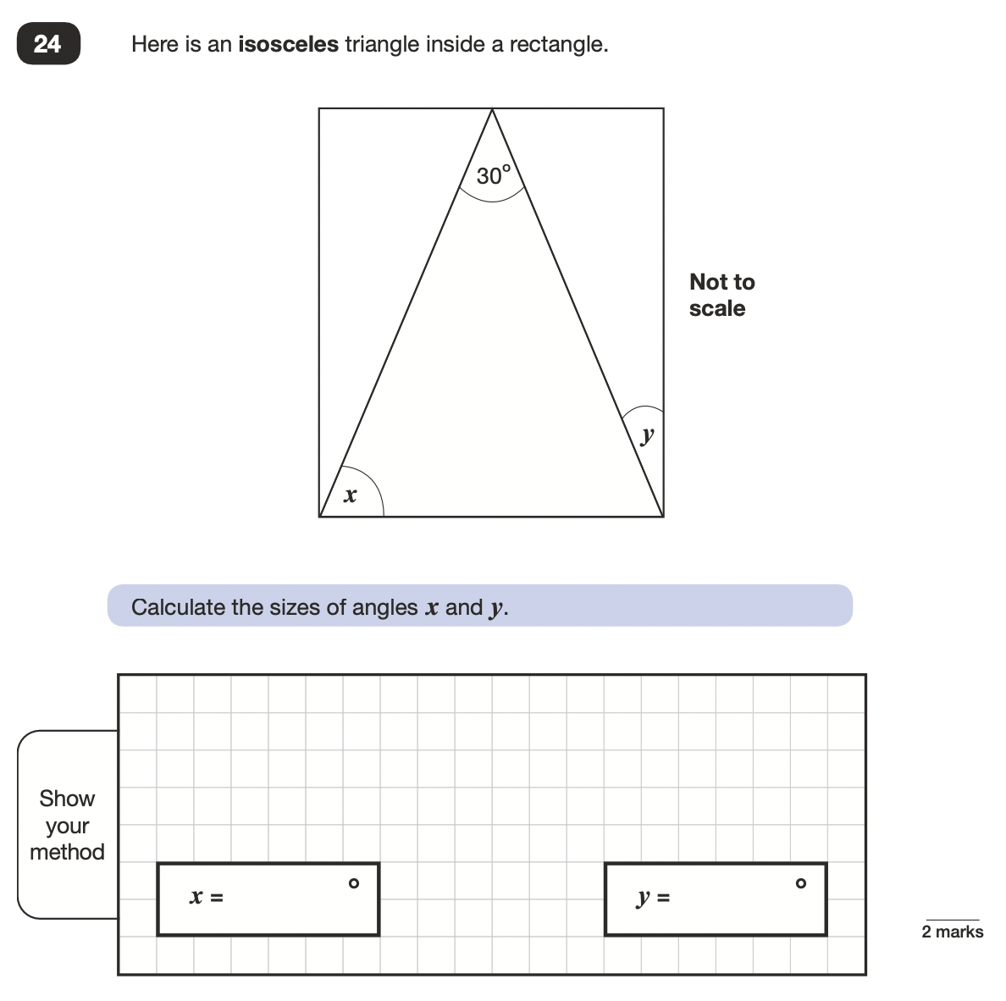
2022 Key Stage 2: Paper 2 Reasoning
https://www.gov.uk/government/publications/key-stage-2-tests-2022-mathematics-test-materials

Slide 33
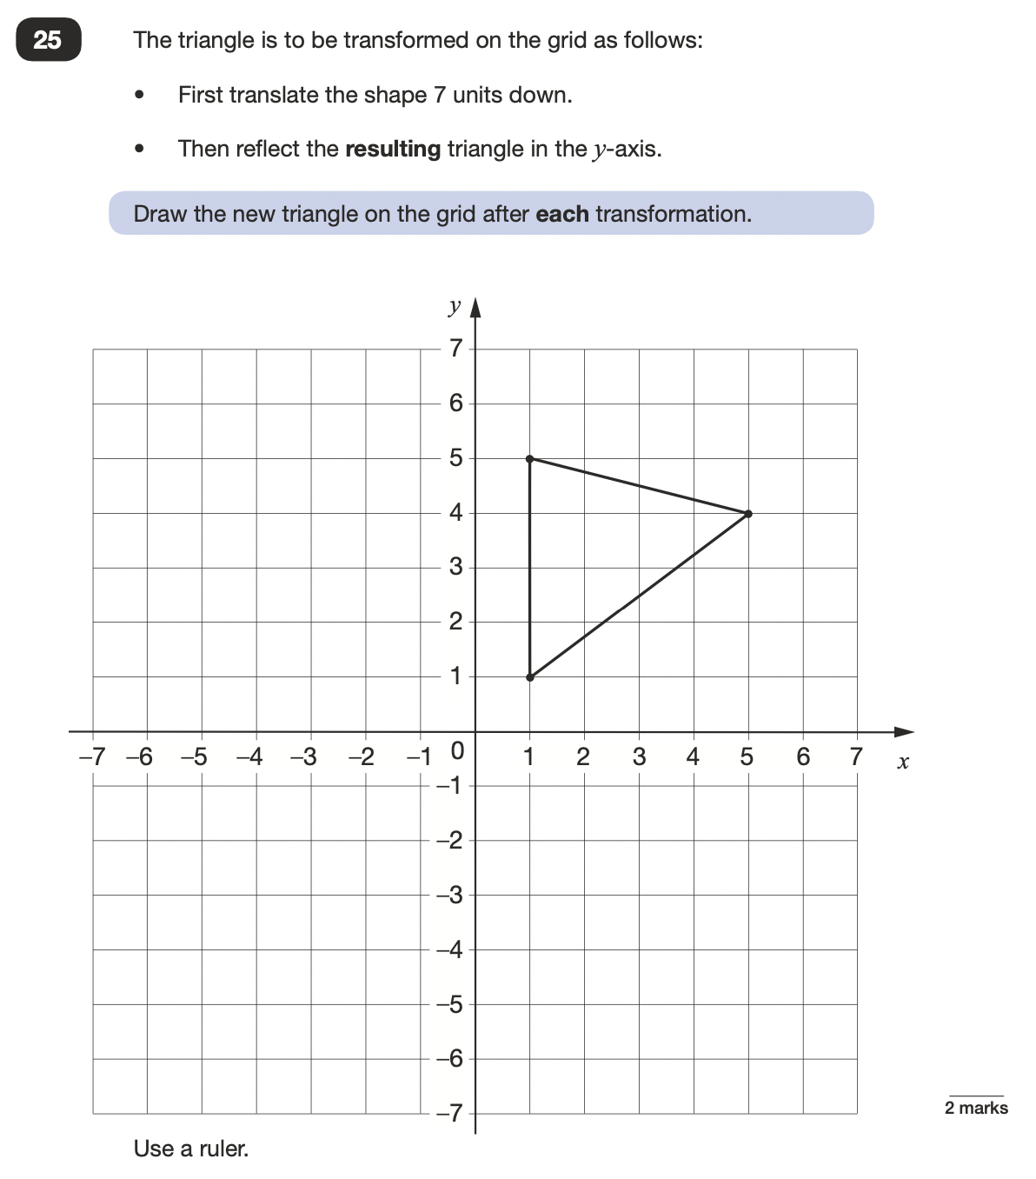
2022 Key Stage 2: Paper 2 Reasoning
https://www.gov.uk/government/publications/key-stage-2-tests-2022-mathematics-test-materials

Slide 34
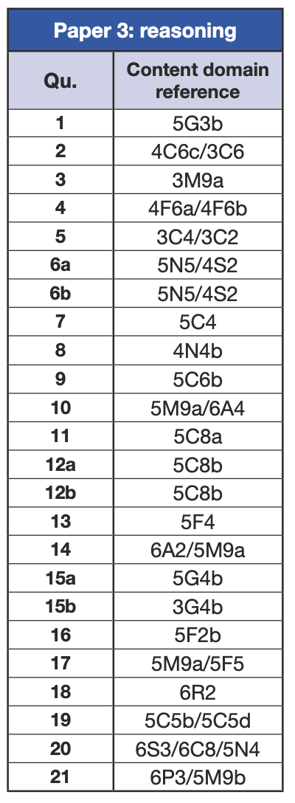
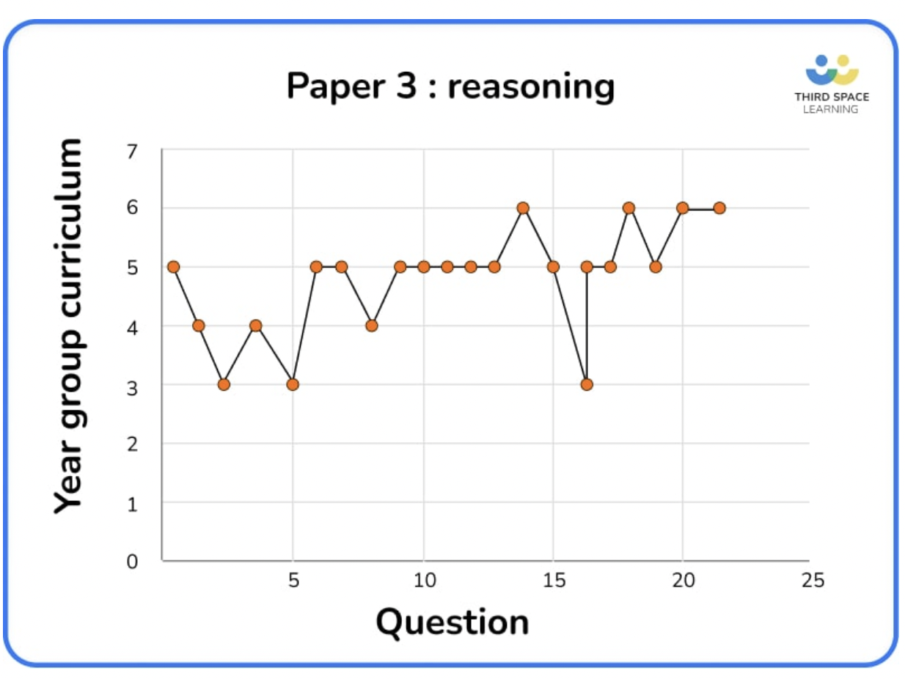
Key Stage 2 Mathematics
Paper 3: Reasoning
Paper2: Reasoning
https://www.gov.uk/government/publications/key-stage-2-tests-2022-mathematics-test-materials
 | 2016 Q21 | 2017 Q20 | 2018 Q21 | 2019 Q23 | 2022 Q21
Y3 | 1 | 2 | 1 | 5 | 3
Y4 | 5 | 4 | 3 | 6 | 3
Y5 | 7 | 5 | 10 | 6 | 12
Y6 | 13 | 9 | 12 | 11 | 4
*Some are part of a question
https://thirdspacelearning.com/blog/ks2-sats-papers-2022-maths-question-breakdown/

Slide 35
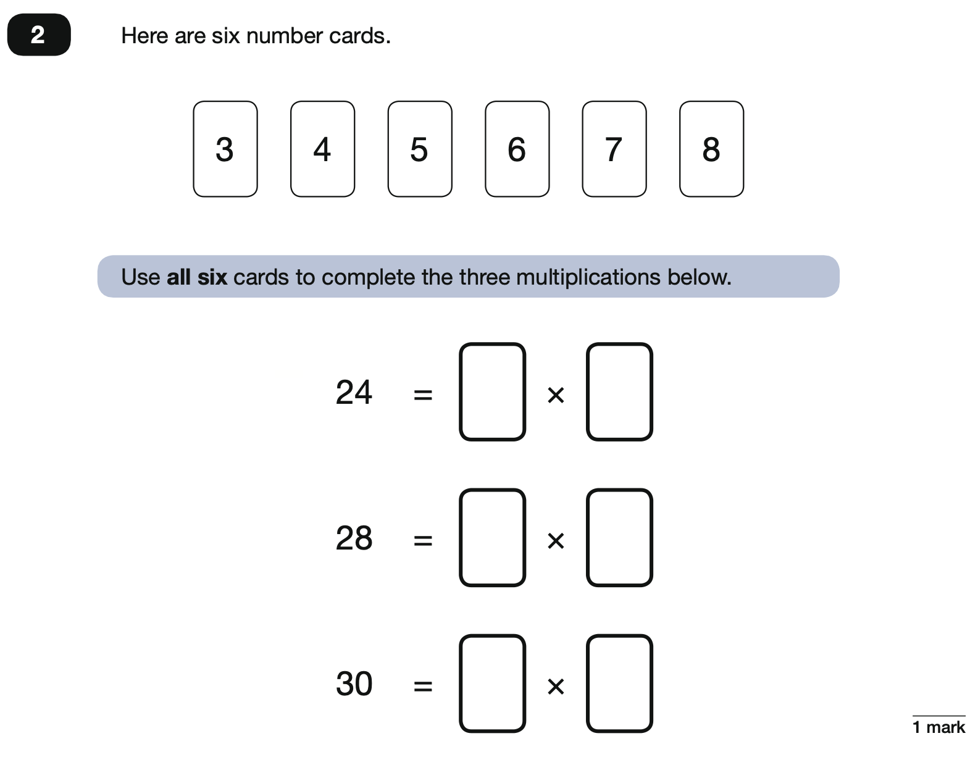
2022 Key Stage 2: Paper 3 Reasoning
https://www.gov.uk/government/publications/key-stage-2-tests-2022-mathematics-test-materials

Slide 36
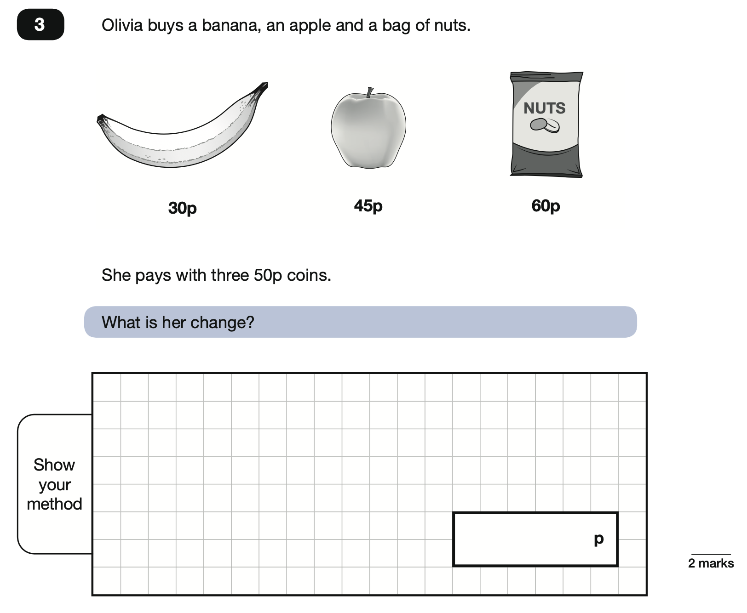
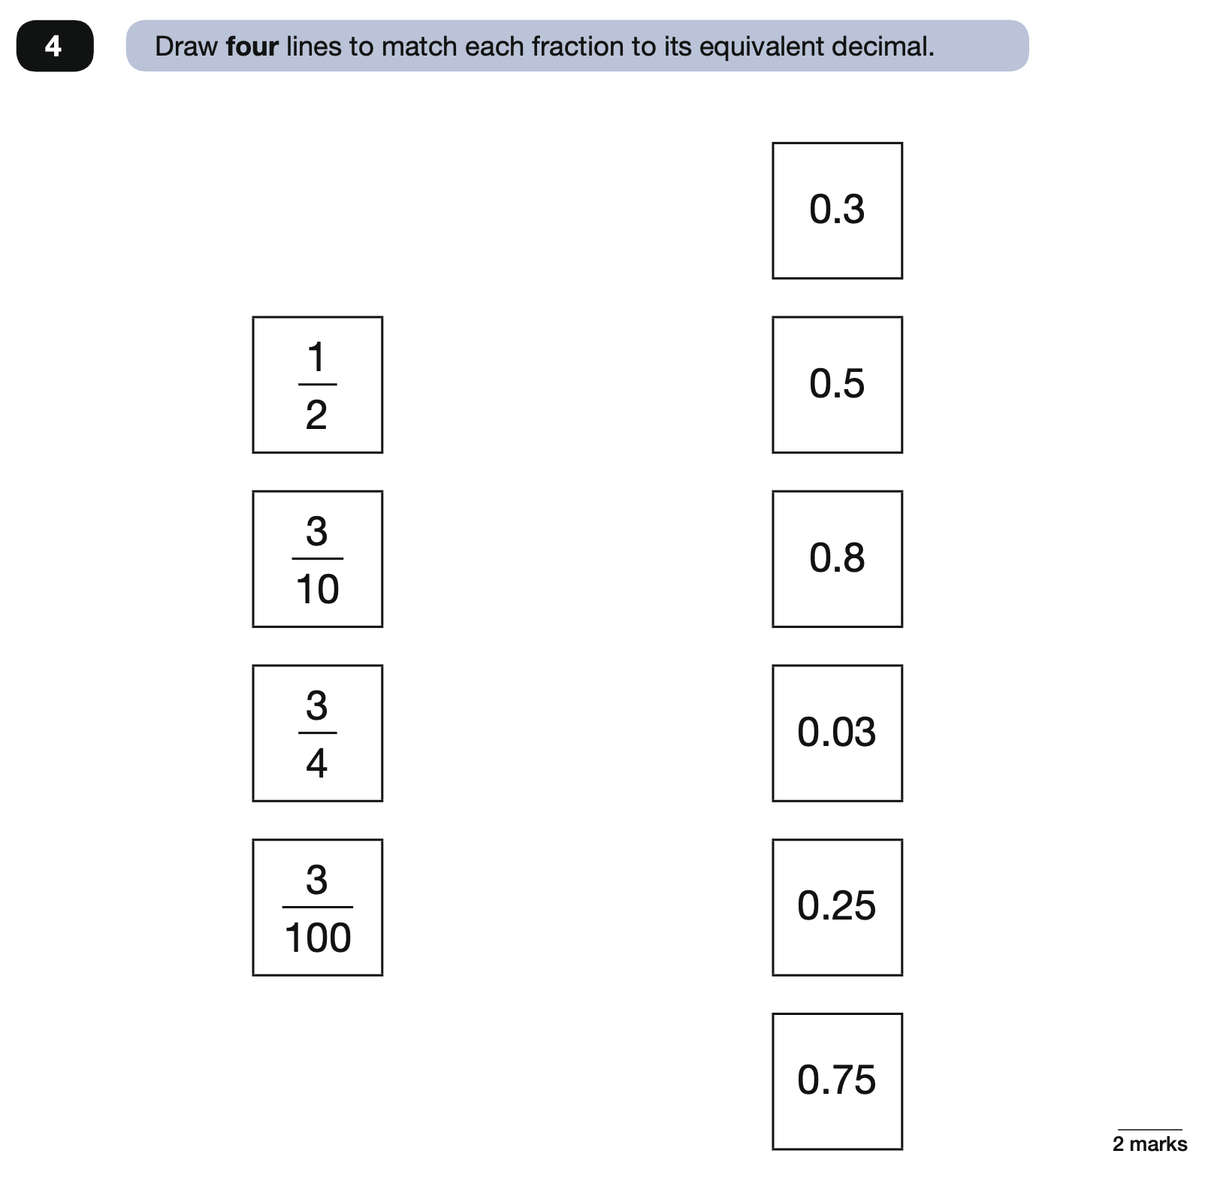
2022 Key Stage 2: Paper 3 Reasoning
https://www.gov.uk/government/publications/key-stage-2-tests-2022-mathematics-test-materials

Slide 37
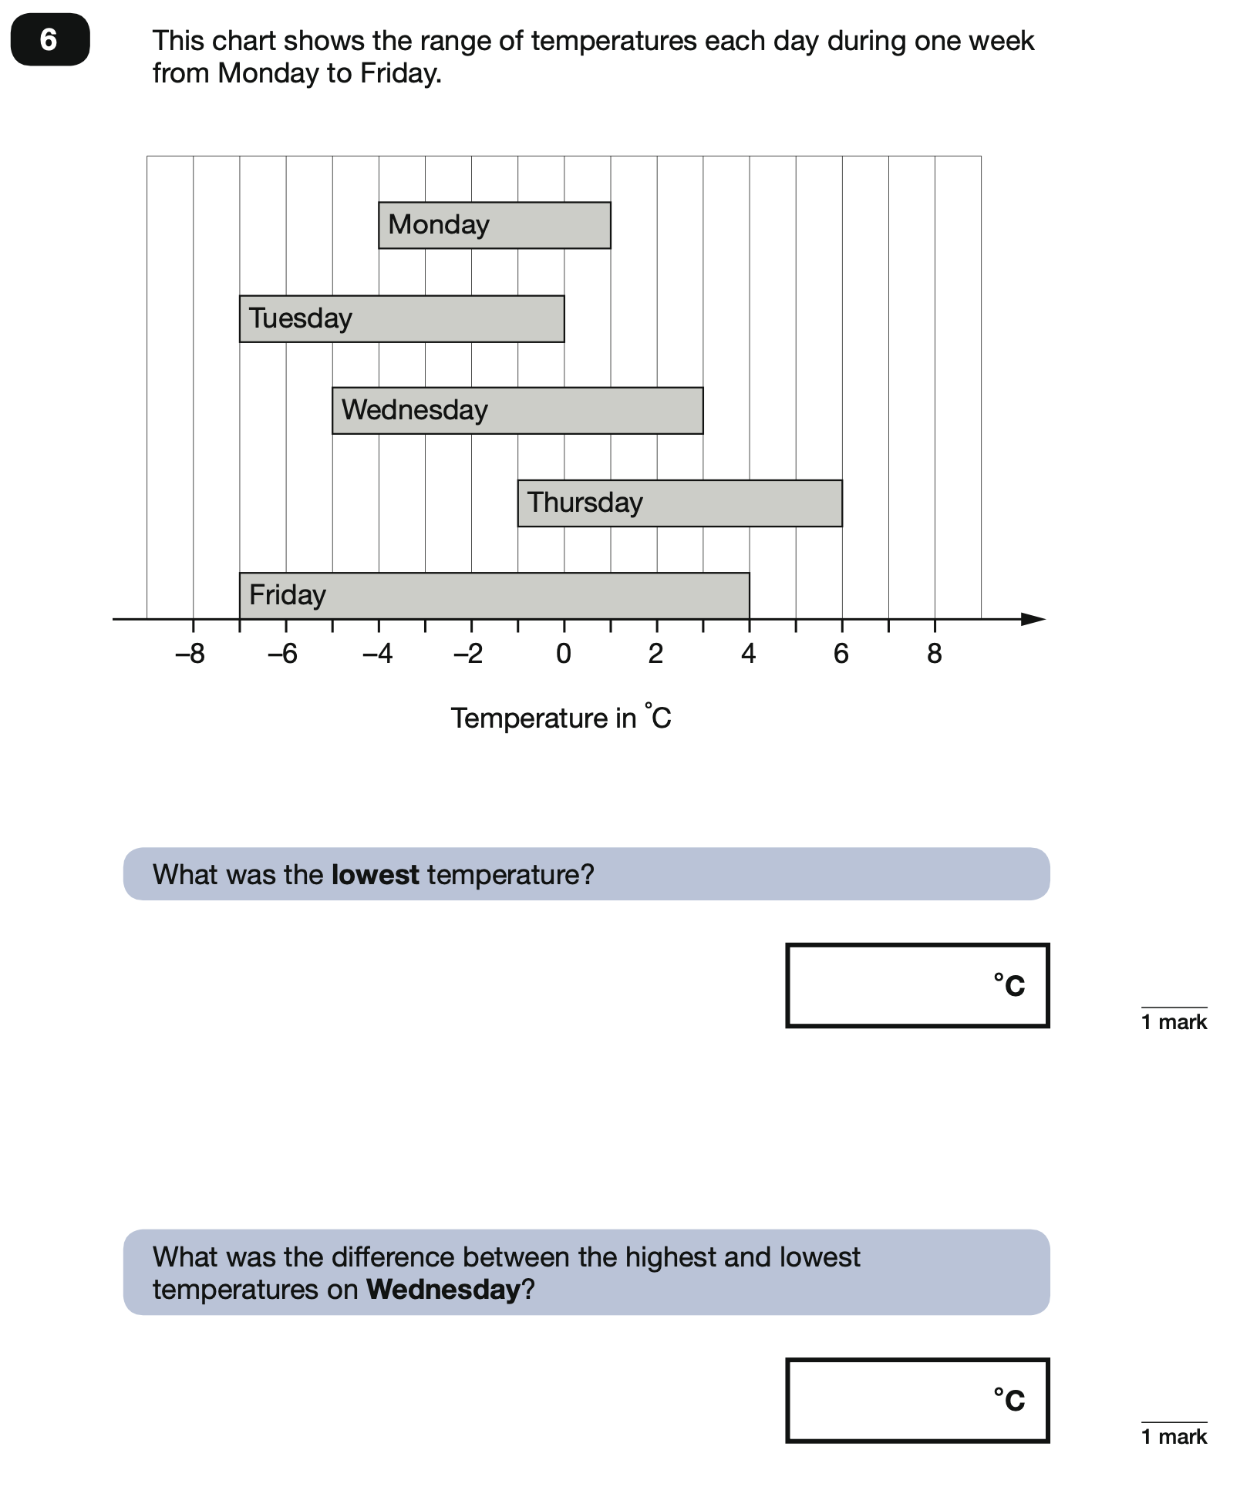
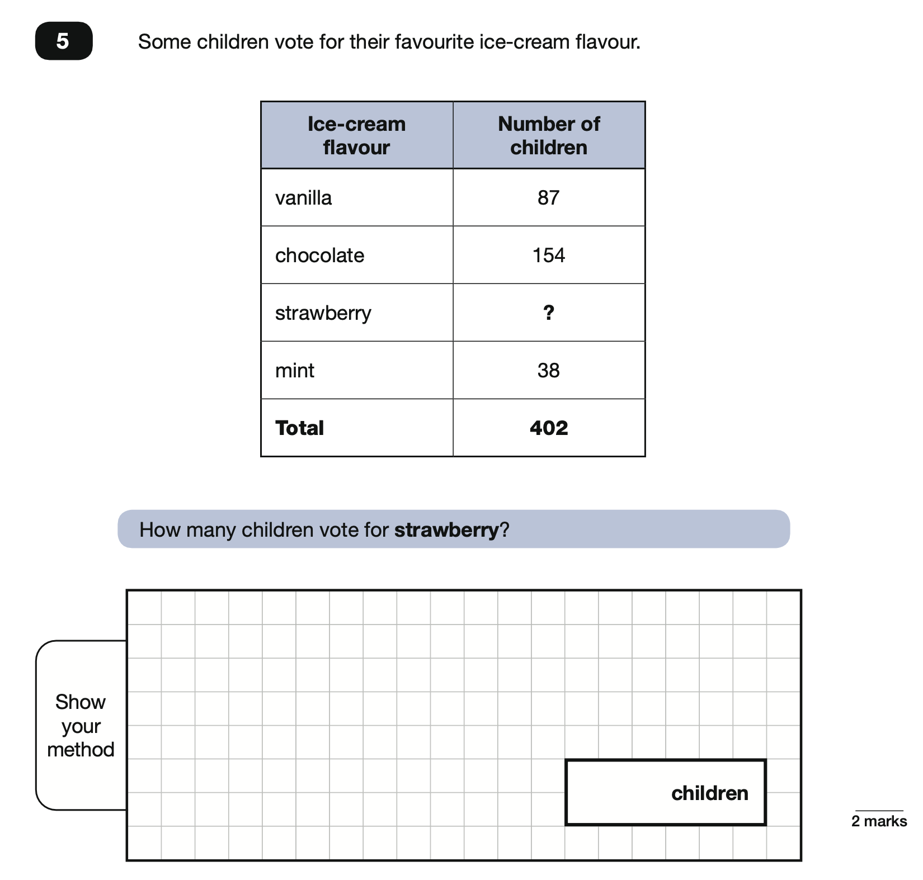
2022 Key Stage 2: Paper 3 Reasoning
https://www.gov.uk/government/publications/key-stage-2-tests-2022-mathematics-test-materials

Slide 38
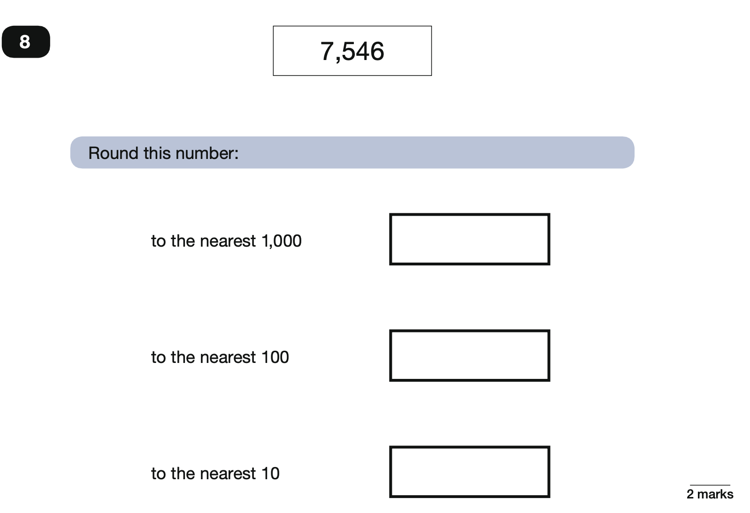
2022 Key Stage 2: Paper 3 Reasoning
https://www.gov.uk/government/publications/key-stage-2-tests-2022-mathematics-test-materials

Slide 39
2022 Key Stage 2: Paper 3 Reasoning
https://www.gov.uk/government/publications/key-stage-2-tests-2022-mathematics-test-materials

Slide 40
2022 Key Stage 2: Paper 3 Reasoning
https://www.gov.uk/government/publications/key-stage-2-tests-2022-mathematics-test-materials

Slide 41
2022 Key Stage 2: Paper 3 Reasoning
https://www.gov.uk/government/publications/key-stage-2-tests-2022-mathematics-test-materials

Slide 42
2022 Key Stage 2: Paper 3 Reasoning
https://www.gov.uk/government/publications/key-stage-2-tests-2022-mathematics-test-materials

Slide 43
2022 Key Stage 2: Paper 3 Reasoning
https://www.gov.uk/government/publications/key-stage-2-tests-2022-mathematics-test-materials

Slide 44
2022 Key Stage 2: Paper 3 Reasoning
https://www.gov.uk/government/publications/key-stage-2-tests-2022-mathematics-test-materials

Slide 45
2022 Key Stage 2: Paper 3 Reasoning
https://www.gov.uk/government/publications/key-stage-2-tests-2022-mathematics-test-materials

