Slide 1
Year 6
HIAS Blended Learning Resource
Fractions, Decimals and Percentages
HIAS maths Team
Spring 2021
Final version
© Hampshire County Council

Slide 2
HIAS Blended Learning Resource
These slides are intended to support teachers and pupils with a blended approach to learning, either in-class or online. The tasks are intended to form part of a learning journey and could be the basis of either one lesson or a short sequence of connected lessons.
The 4-step Polya model for problem solving has been used to provide a structure to support reasoning. Teachers may need to use more or fewer steps to support the range of learners in their class.
Teachers should delete, change and add slides to suit the needs of their pupils. Extra slides with personalised prompts and appropriate examples based on previous teaching may be suitable. When changing the slide-deck, teachers should consider:
Their expectations for the use of representations such as bar models, number lines, arrays and diagrams.
Which strategies and methods pupils should use and record when solving problems or identifying solutions. This could include a range of informal jottings and diagrams, the use of tables to record solutions systematically and formal or informal calculation methods.
Teachers may also wish to record a ‘voice over’ to talk pupils through the slides.

Slide 3
HIAS Blended Learning Resource
1945 George Polya published ‘How To Solve It’ 2nd ed., Princeton University Press, 1957, ISBN 0-691-08097-6.

Slide 4
Recall and use equivalences between simple fractions, decimals and percentages, including in different contexts.
HIAS Blended Learning Resource
A coat costs £40. The shop has a sale, and everything was reduced by 20% . What is the price of the coat now?
Sale now on!

Slide 5
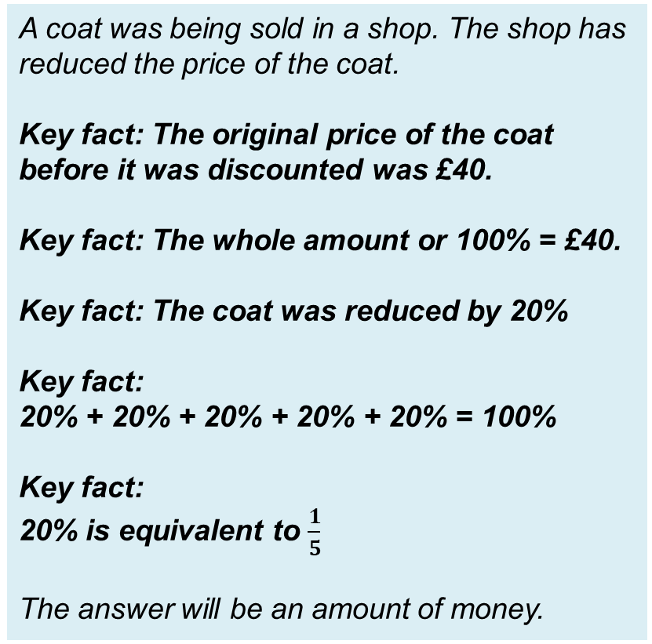
Understand the problem
HIAS Blended Learning Resource
A coat costs £40. The shop has a sale, and everything was reduced by 20% . What is the price of the coat now?
A coat was being sold in a shop. The shop has reduced the price of the coat.
Key fact: The original price of the coat before it was discounted was £40.
Key fact: The whole amount or 100% = £40.
Key fact: The coat was reduced by 20%
Key fact:
20% + 20% + 20% + 20% + 20% = 100%
Key fact:
20% is equivalent to $\frac{1}{5}$
The answer will be an amount of money.
Sale now on!

Slide 6
Make a Plan
HIAS Blended Learning Resource
Step 1:
Draw the bar model that represents the problem including the original price of the coat (whole) and the percentage discount
Step 2:
Label the bar model showing that £40 is equal to 100%
Step 3:
Work out what 20% of £40 is.
Step 4:
Take 20% away from £40 to find the cost of the coat now that it has been reduced.
A coat costs £40. The shop has a sale, and everything was reduced by 20% . What is the price of the coat now?
Sale now on!

Slide 7
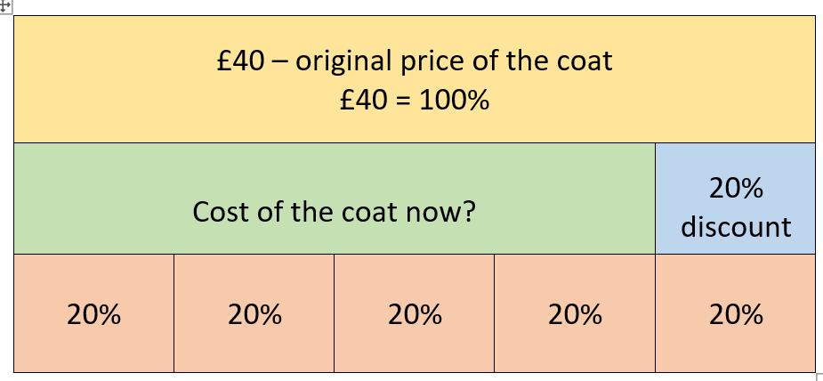

Slide 8
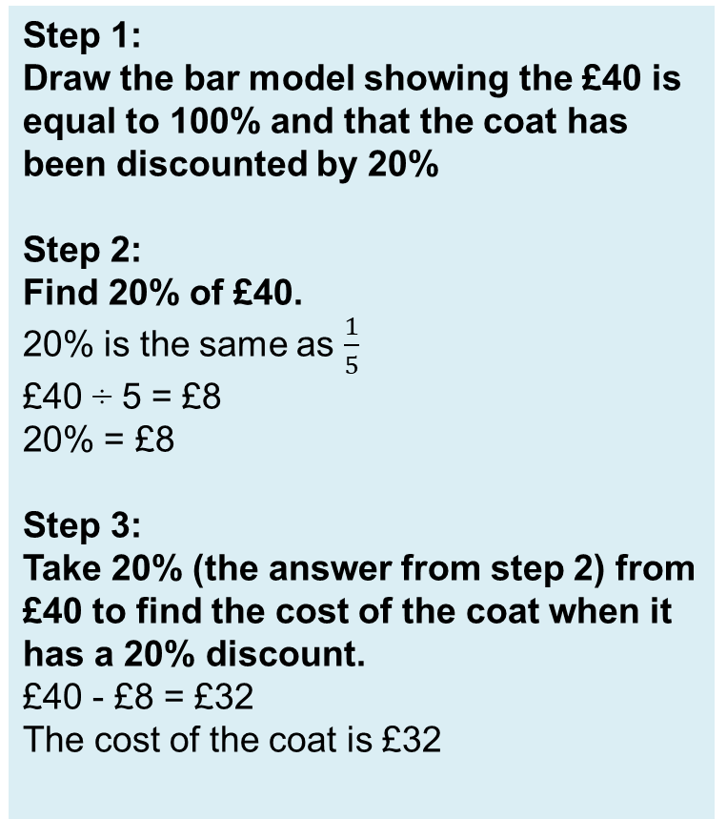
Carry out your plan: show your reasoning
HIAS Blended Learning Resource
Step 1:
Draw the bar model showing the £40 is equal to 100% and that the coat has been discounted by 20%
Step 2:
Find 20% of £40.
20% is the same as $\frac{1}{5}$
£40 ÷ 5 = £8
20% = £8
Step 3:
Take 20% (the answer from step 2) from £40 to find the cost of the coat when it has a 20% discount.
£40 - £8 = £32
The cost of the coat is £32
A coat costs £40. The shop has a sale, and everything was reduced by 20% . What is the price of the coat now?
Sale now on!

Slide 9
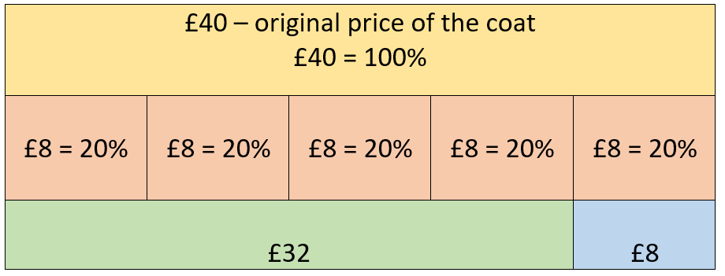
Divide £40 by 5 to find out what 20% is as 20% is the same as $\frac{1}{5}$
Take 20% (£8) away from £40 to find out how much the coat costs now?

Slide 10
Review your solution: does it seem reasonable? Which steps/ parts did you find easy and which harder?
HIAS Blended Learning Resource
How could you check?
Go through the steps you took and check for errors
Remember the question is about is about how much money the coat is now. Even though you have done lots of thinking about percentages, the answer is the cost of the coat.
Is the answer you have now less than £40?
Try to solve the calculation a different way and see if you get the same answer
A coat costs £40. The shop has a sale, and everything was reduced by 20% . What is the price of the coat now?
Sale now on!

Slide 11
Now try this one
HIAS Blended Learning Resource
Understand the problem
Make a plan
Carry out your plan: show your reasoning
Review your solution: does it seem reasonable?
Think about your learning: which parts of the problem did you find easy and which parts did you find harder?
A coat costs £40. The shop has a sale, and everything was reduced by 40% . What is the price of the coat now?
Sale now on!

Slide 12
HIAS Maths team
HIAS Blended Learning Resource
The HIAS maths team offer a wide range of high-quality services to support schools in improving outcomes for learners, including courses, bespoke consultancy and in-house training.
For further details referring to maths, please contact either of the team leads:
Jacqui Clifft : Jacqui.clifft@hants.gov.uk
Jo Lees: Jo.Lees@hants.gov.uk
For further details on the full range of services available please contact us using the following details:
Tel: 01962 874820 or email: hias.enquiries@hants.gov.uk
For further details on the full range of services available please contact us using the following details:
Tel: 01962 874820 or email: hias.enquiries@hants.gov.uk

