Slide 1
Analysis of Questions KS2 SATs 2016

Slide 2
Analysis of Questions in KS2 SATs 2017 (2016)
Arithmetic Paper 36 (36) Qs | Reasoning Paper 2 23 (20) Qs | Reasoning Paper 3 24(21)Qs
Y3= 3 (8) Y4= 10 (5) Y5= 7 (11) Y6= 16 (12) (from Q14(19)) | Y3= 0 (5) answers Y4= 6 (2) answers Y5= 7 (6) answers* Y6= 8 (13) answers (from Q11 (7) | Y3= 2 (1) answer Y4= 4 (5) answers* Y5= 5 (7) answers* Y6= 9 (13) answers* (from Q 4(2)
Denotes a ‘part answer’ also
Notes:
Y456 curriculum focus….really in 2016, reinforced further in 2017 for arithmetic. Slight reduction in Y5/ Y6 questions in reasoning papers particularly Paper 3
Y6 questions start a bit later in the sequnce this year compared to last year

Slide 3
End of KS1: SATs Arithmetic Paper 2016
Q: 1,2,3,4,5, 6, 7, 8,9,10,11,13, 15,16,19,23

Slide 4
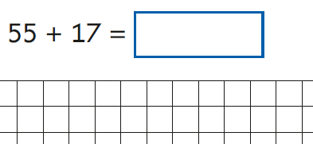
End of KS1: SATs Arithmetic Paper 2016 Q12, 13, 14,15,16,17,18,19

Slide 5
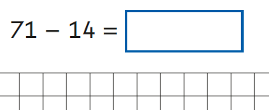
End of KS1: SATs Arithmetic Paper 2016 Q 20,21,22,23,24,25

Slide 6
Key stage 1 Arithmetic Paper 2017 Q1-20
Notes:
Organised vertically in order.

Slide 7
Key stage 1 Arithmetic Paper 2017 Q21-25

Slide 8
KS2 Arithmetic paper 2016: Q:1, 2,3,4,5,6,7,8,9,10,11,12,13,14,15
More questions than minutes…
Notes:
Pink: Y3
Green: Y4
Blue: Y5

Slide 9
KS2 Arithmetic Paper 2016 Q:16, 17,18,19,20,21,22,23,24,25,26,27,28,29,31,32,33,34
More questions than minutes…
Notes:
Green: Y4
Blue: Y5
Mauve: Y6

Slide 10
KS2 Arithmetic Paper 2017 Q1,2,3,4,5,6,7,8,9,10,11,12,13,14,15,16,17,18
40 + 1,000 =
707 + 1,818 =
4/6 + 3/6 =
505 ÷ 1 =
345 − 60 =
2.7 + 3.014 =
Notes:
Q in order vertically…
Year 4 green; Year 3 orange; year 5 lilac; year 6 pink

Slide 11
KS2 Arithmetic Paper 2017 Q19,20,21,22,23,24,25,26,27,28,29,30,31,32,33,34,35,36
Notes:
Q in order vertically
Year 4 green; year 5 lilac; year 6 pink

Slide 12
KS2 Arithmetic Paper 2017 Q:3,12,15, 23, 26,27 28,30,32, 35
4/6 + 3/6 =
Notes:
6 calculations involving fractions in 2016
10 calculations involving fractions in 2017: year 4 (2); year 5 (2); year 6 (6)

Slide 13
KS2 Arithmetic Paper 2017 Q: 4,9, 17,18,20,27,28,36
2016
505 ÷ 1 =
Notes:
2016: There were 8 division calculations (rh side column) Pink Y3 (2), Green Y4 (1), Blue Y5 (1), Mauve Y6 (4)
8 division in 2017: 2 from Year 4; 1 from year 5; 5 from year 6

Slide 14
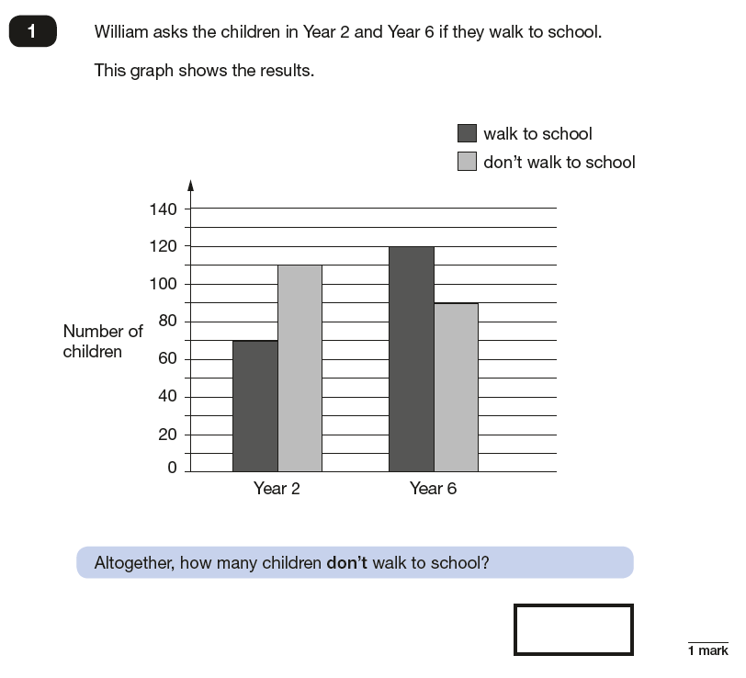
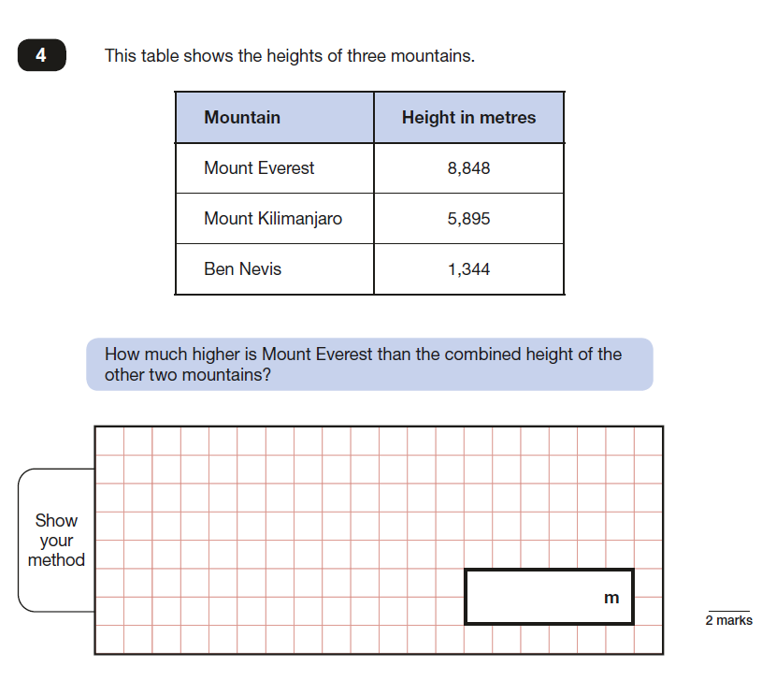
2017 KS2 Paper 2: Reasoning

Slide 15
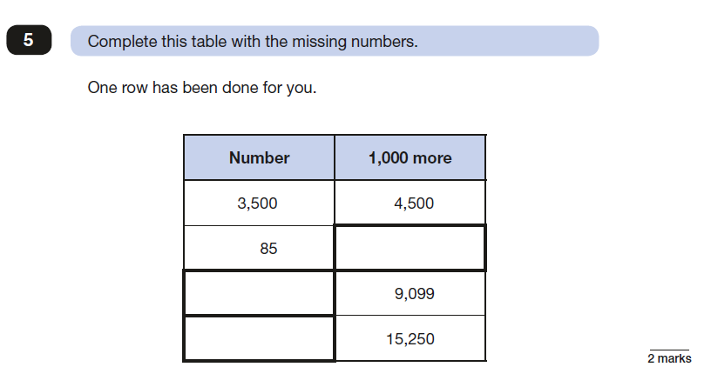
2017 KS2 Paper 2: Reasoning

Slide 16
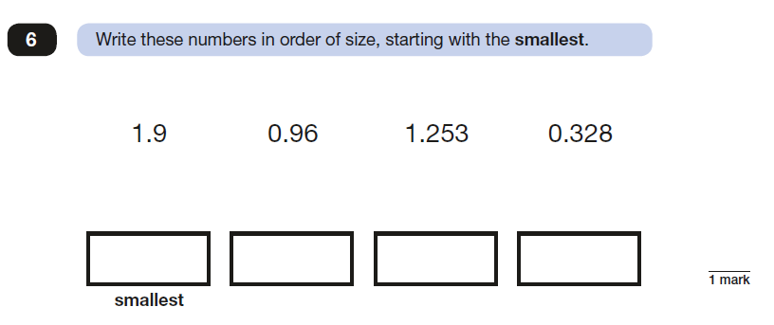
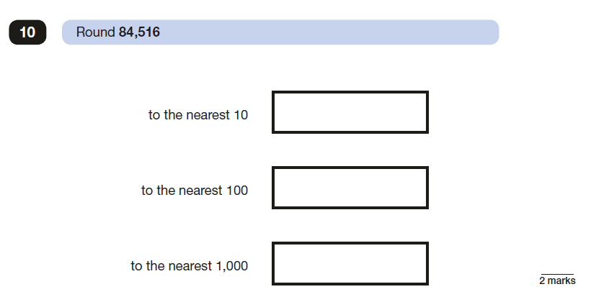
2017 KS2 Paper 2: Reasoning

Slide 17
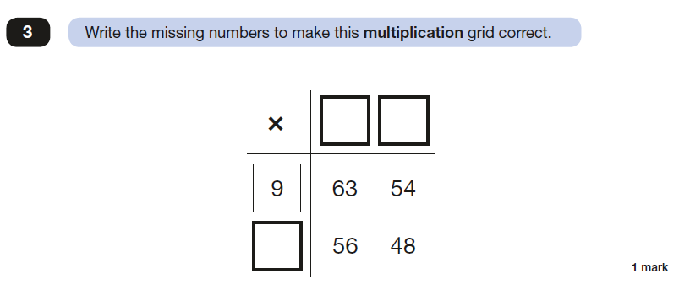
2017 KS2 Paper 2: Reasoning

Slide 18
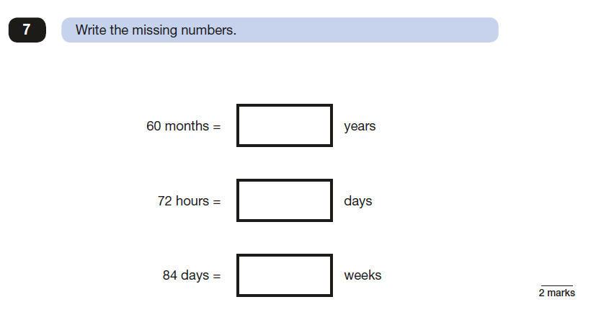
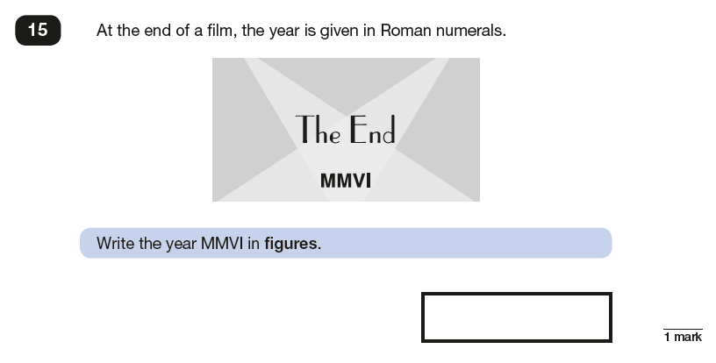
2017 KS2 Paper 2: Reasoning

Slide 19
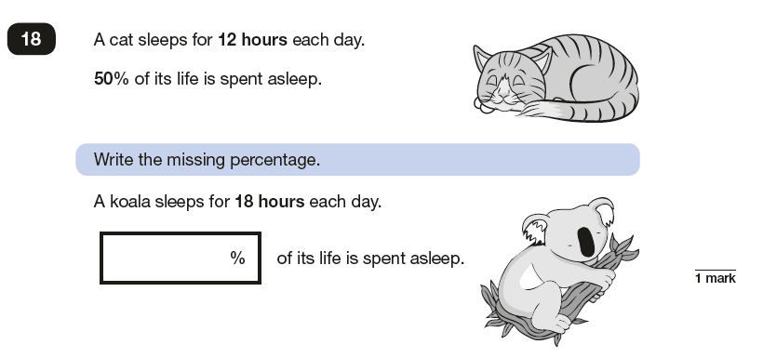
2017 KS2 Paper 2: Reasoning

Slide 20
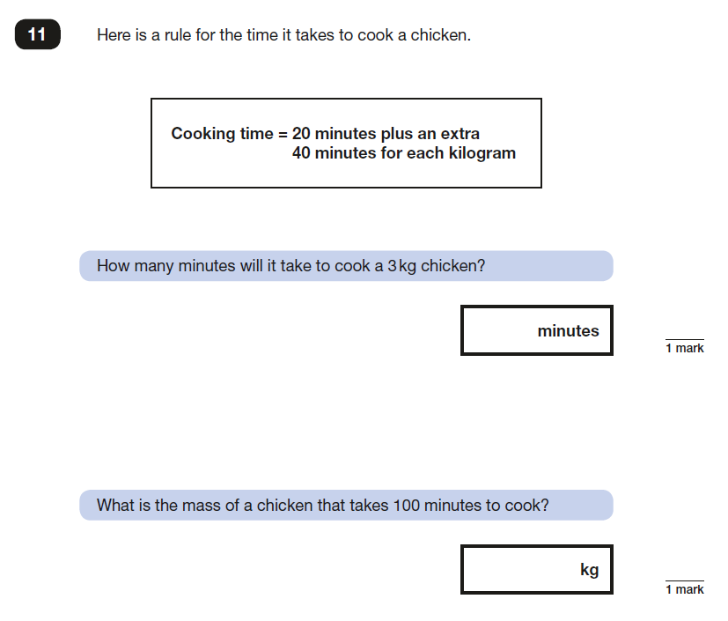
2017 KS2 Paper 2: Reasoning

Slide 21
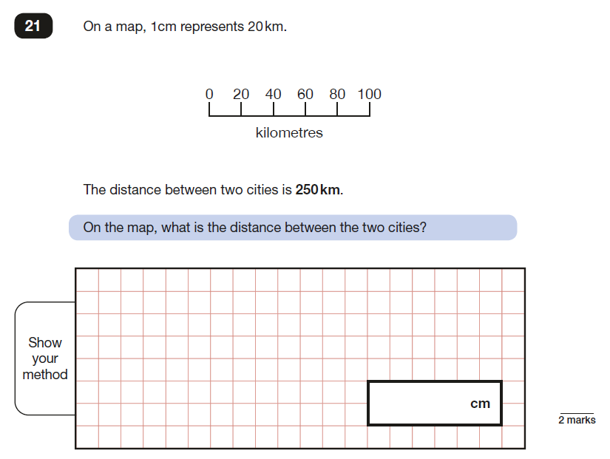
2017 KS2 Paper 2: Reasoning

Slide 22
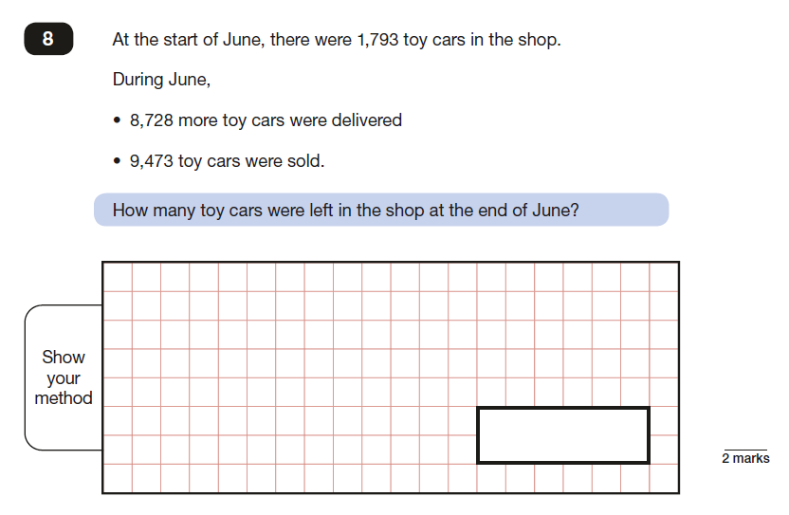
2017 KS2 Paper 2: Reasoning

Slide 23
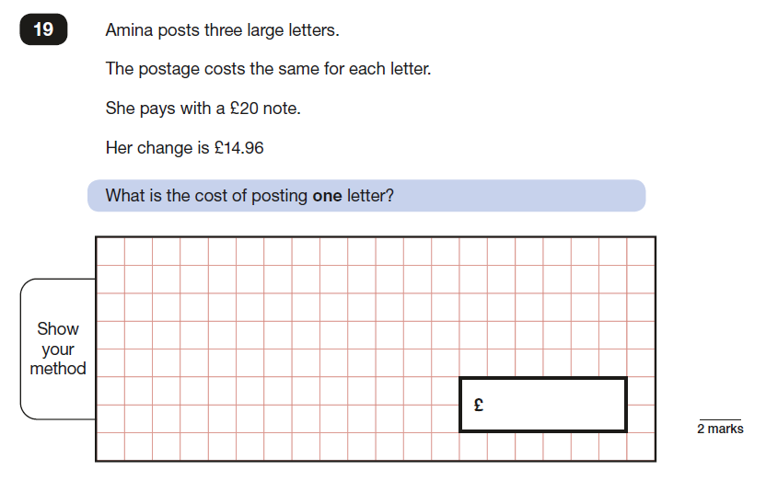
2017 KS2 Paper 2: Reasoning

Slide 24
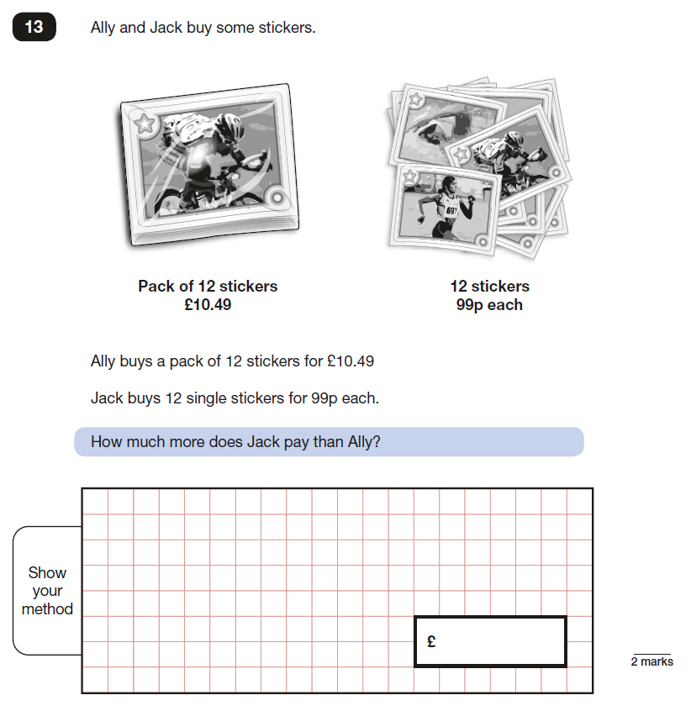
2017 KS2 Paper 2: Reasoning

Slide 25
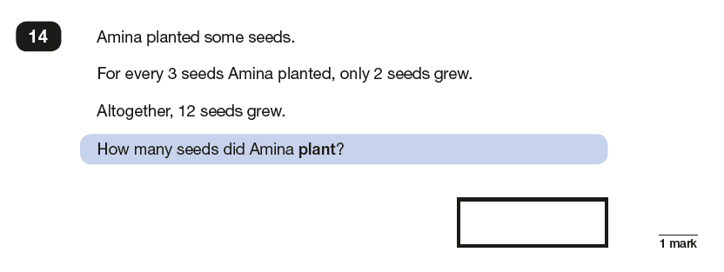
2017 KS2 Paper 2: Reasoning

Slide 26
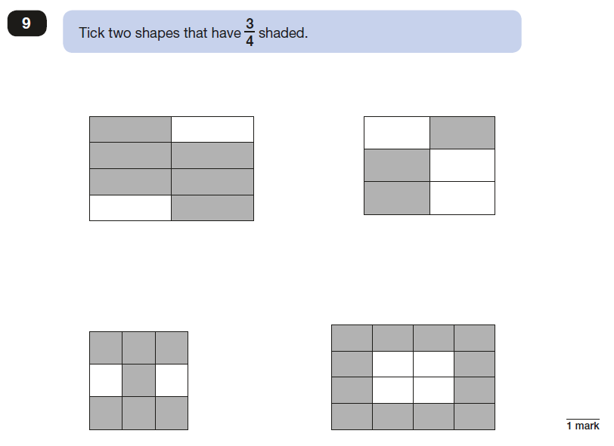
2017 KS2 Paper 2: Reasoning

Slide 27
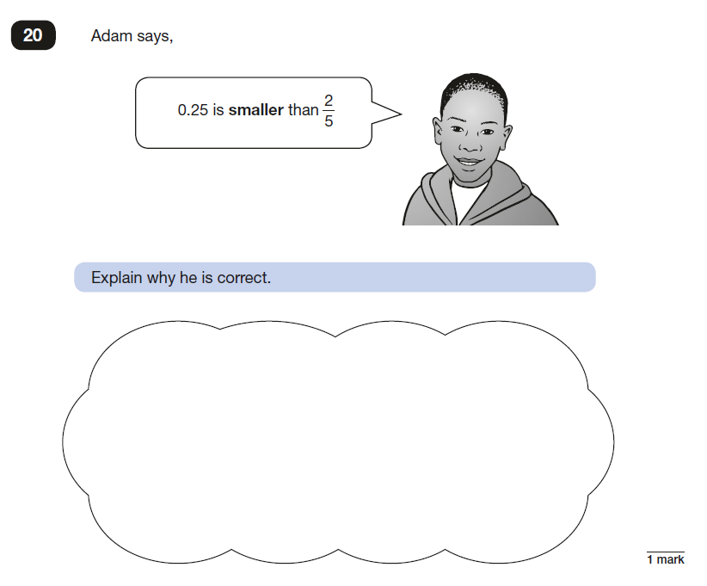
2017 KS2 Paper 2: Reasoning

Slide 28
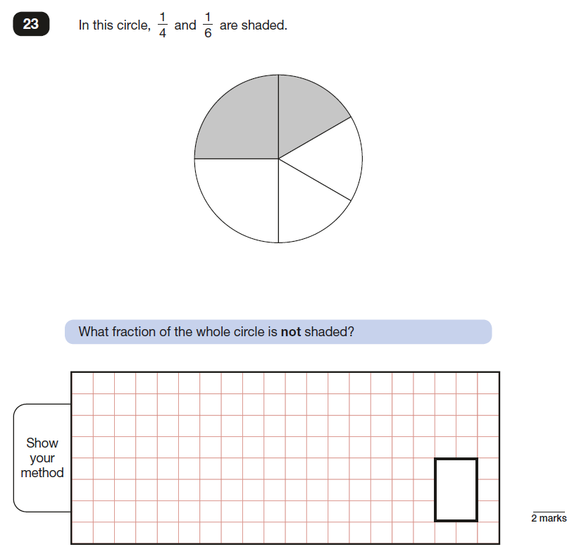
2017 KS2 Paper 2: Reasoning

Slide 29
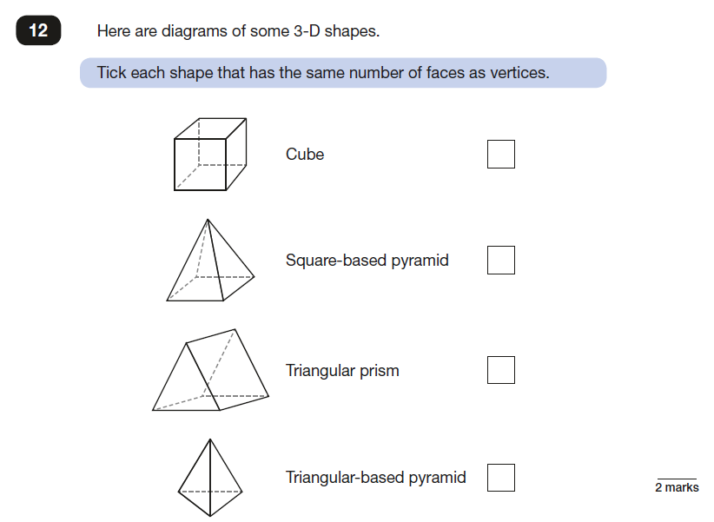
2017 KS2 Paper 2: Reasoning

Slide 30
2017 KS2 Paper 2: Reasoning

Slide 31
2017 KS2 Paper 2: Reasoning

Slide 32
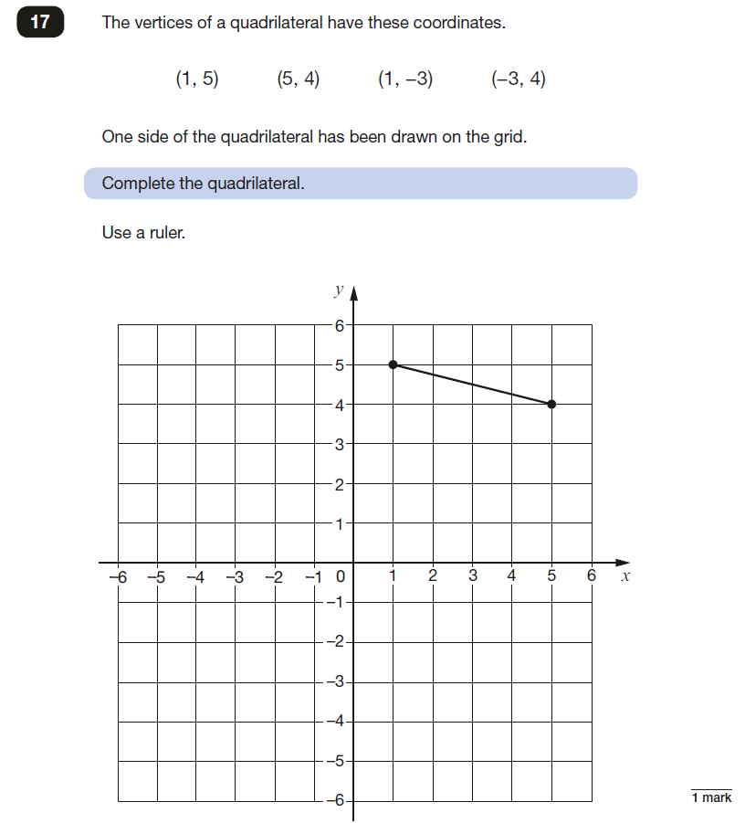
2017 KS2 Paper 2: Reasoning

Slide 33
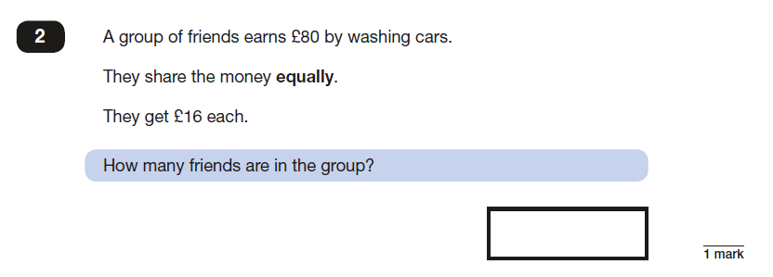
2017 KS2 Paper 3: Reasoning

Slide 34
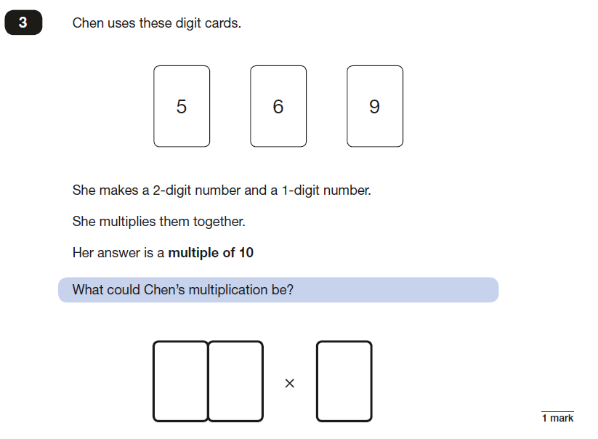
2017 KS2 Paper 3: Reasoning

Slide 35
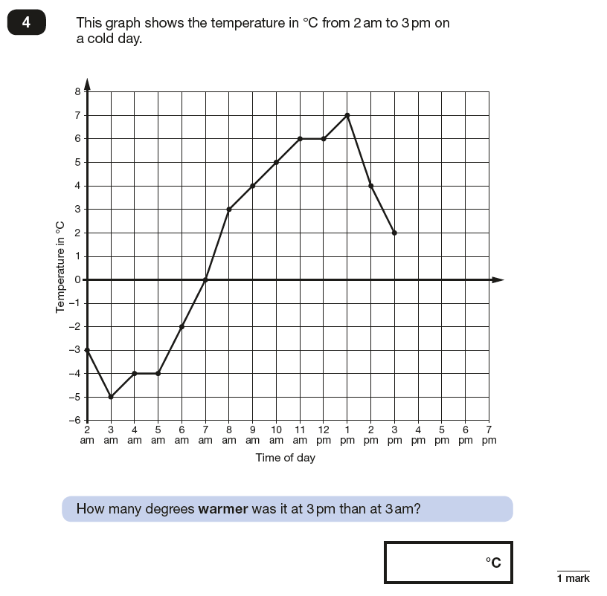
2017 KS2 Paper 3: Reasoning

Slide 36
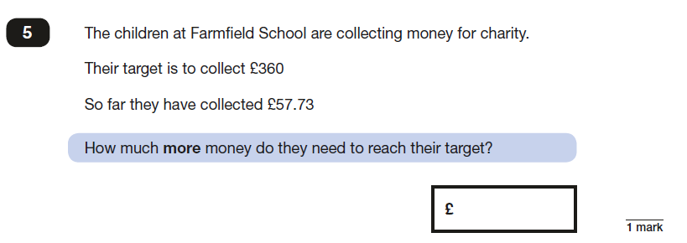
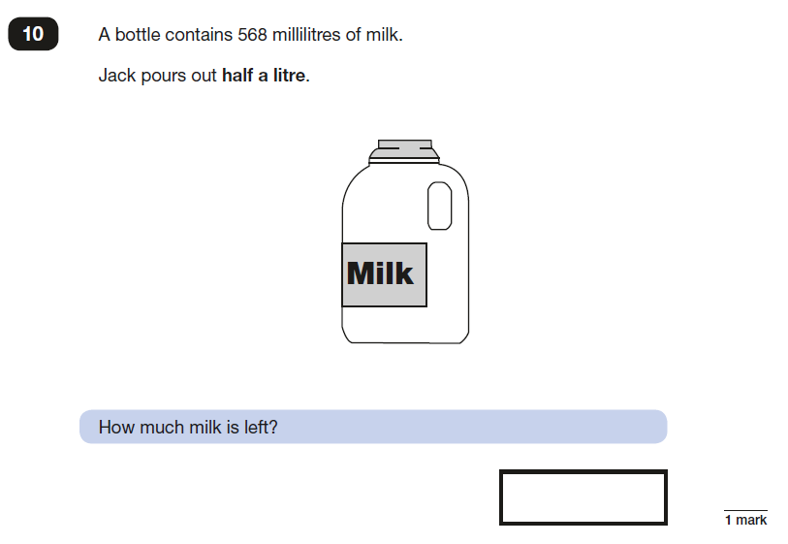
2017 KS2 Paper 3: Reasoning

Slide 37
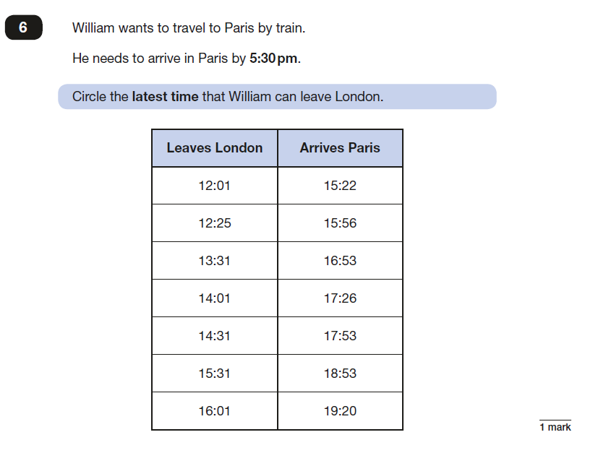
2017 KS2 Paper 3: Reasoning

Slide 38
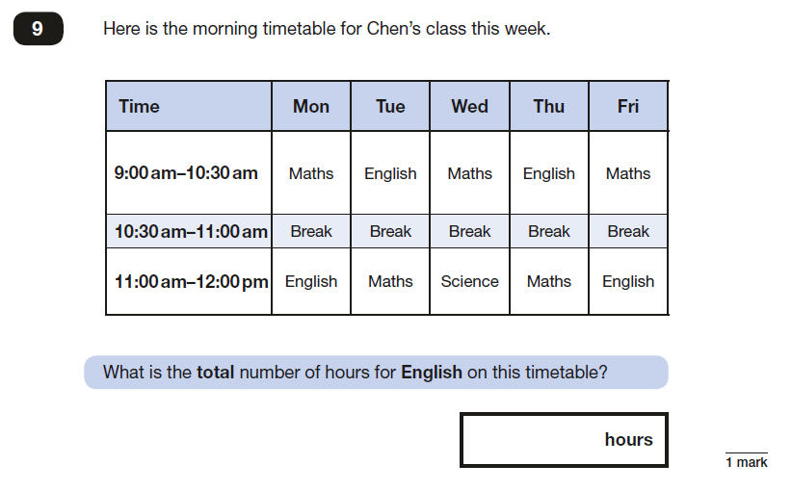
2017 KS2 Paper 3: Reasoning

Slide 39
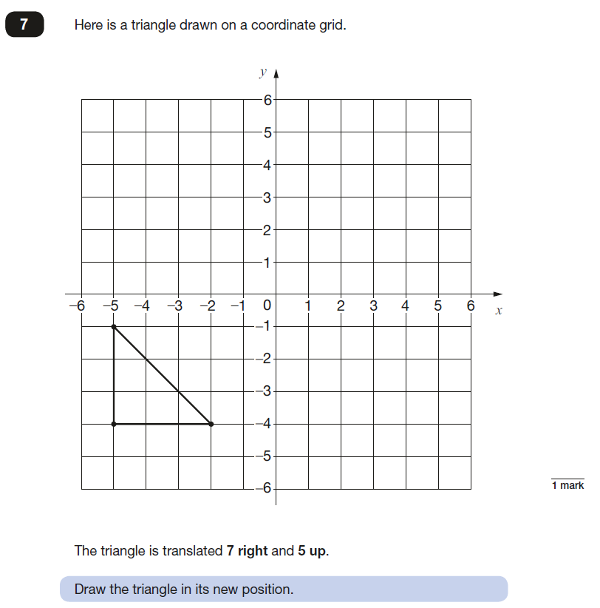
2017 KS2 Paper 3: Reasoning

Slide 40
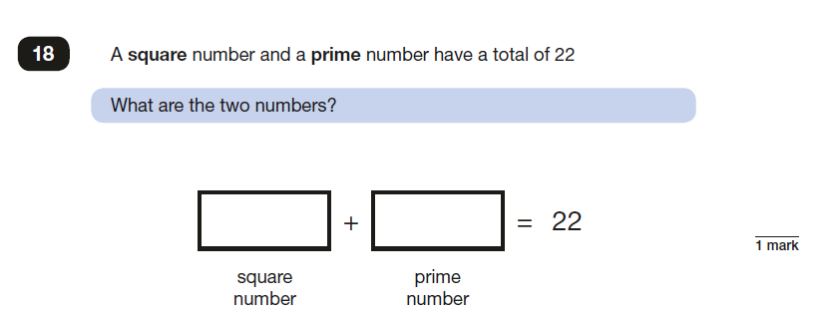
2017 KS2 Paper 3: Reasoning

Slide 41
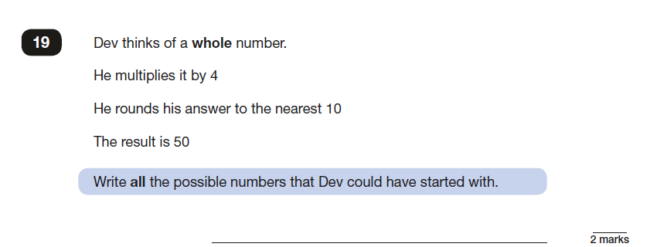
2017 KS2 Paper 3: Reasoning

Slide 42
2017 KS2 Paper 3: Reasoning

Slide 43
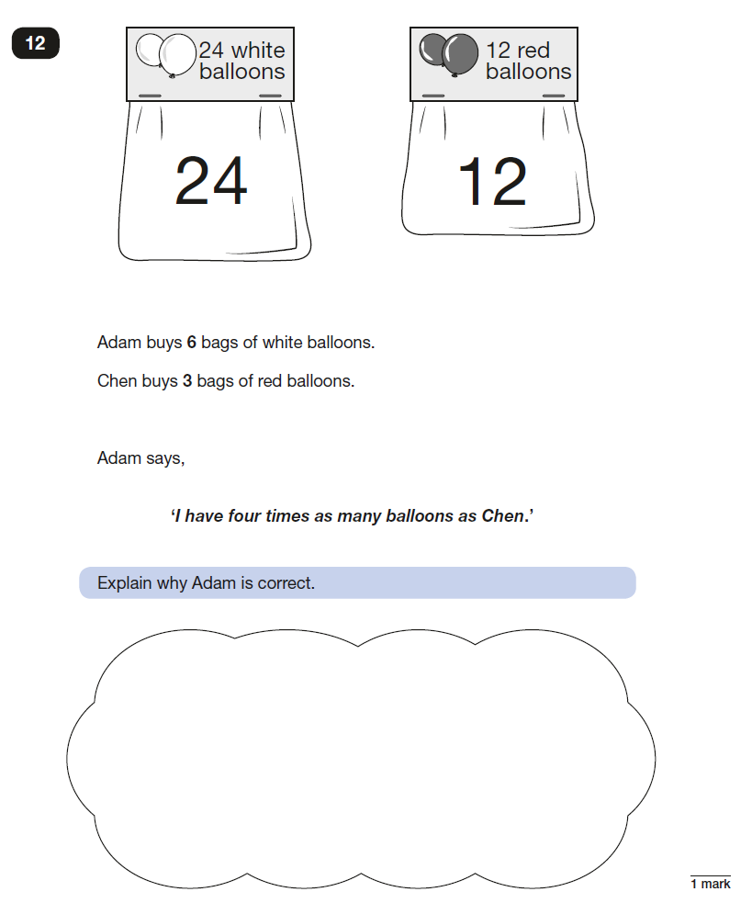
2017 KS2 Paper 3: Reasoning

Slide 44
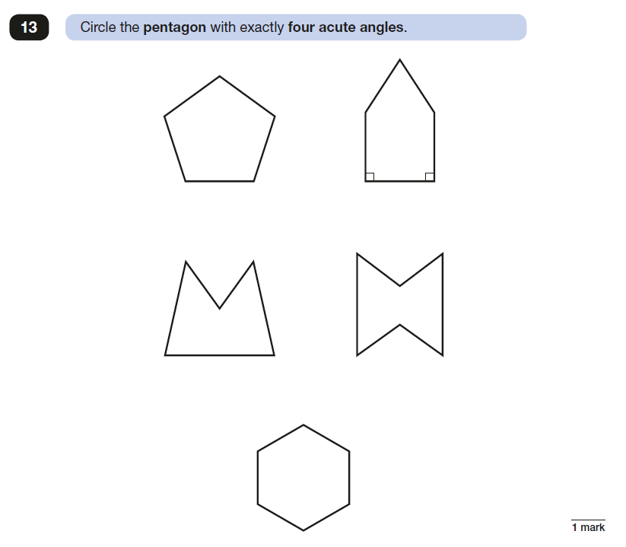
2017 KS2 Paper 3: Reasoning

Slide 45
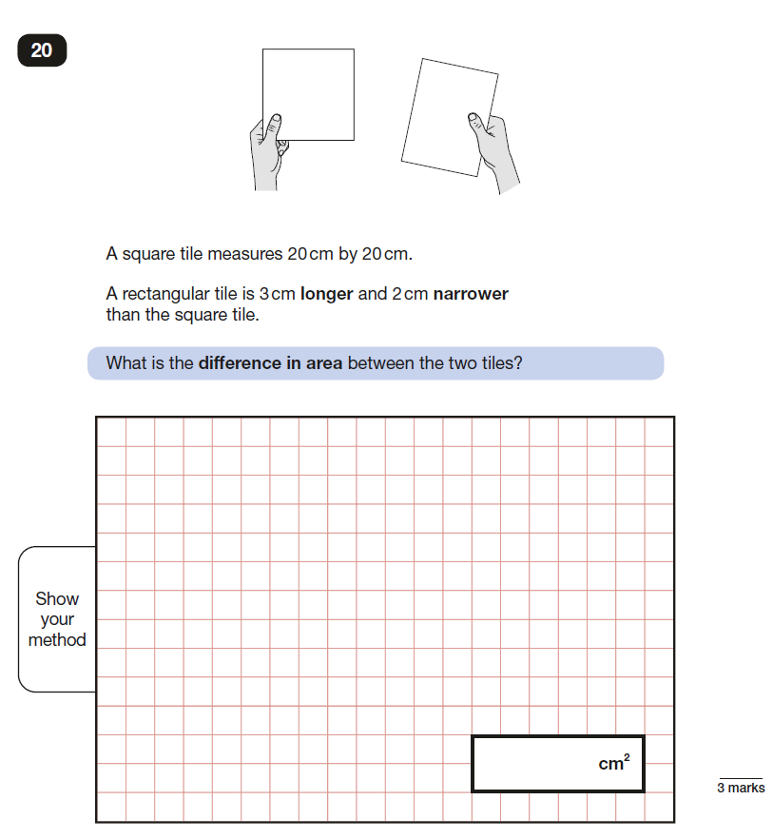
2017 KS2 Paper 3: Reasoning

Slide 46
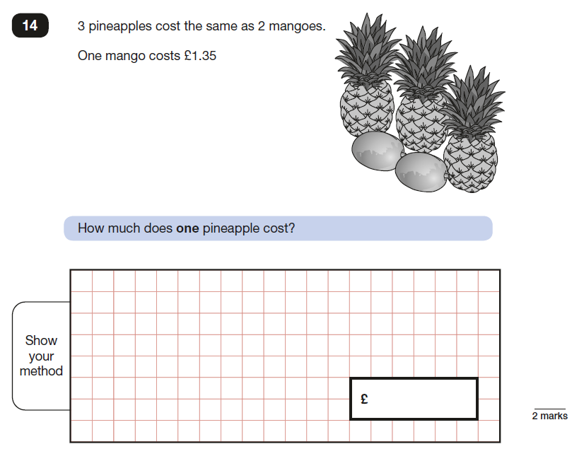
2017 KS2 Paper 3: Reasoning

Slide 47
2017 KS2 Paper 3: Reasoning

Slide 48
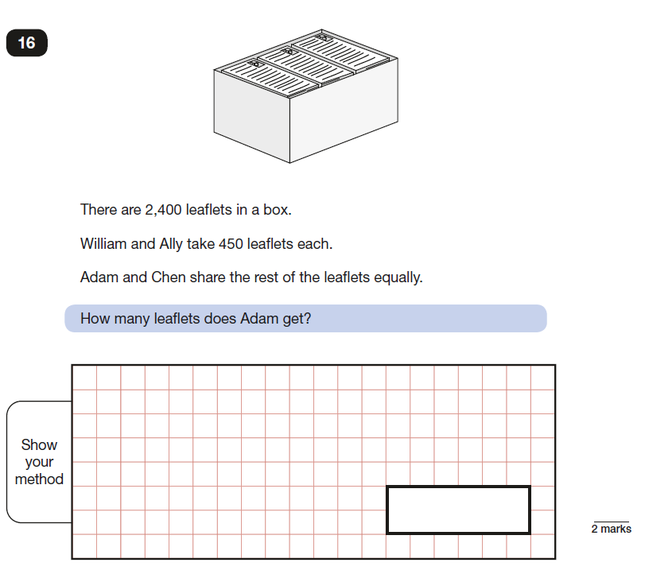
2017 KS2 Paper 3: Reasoning

Slide 49
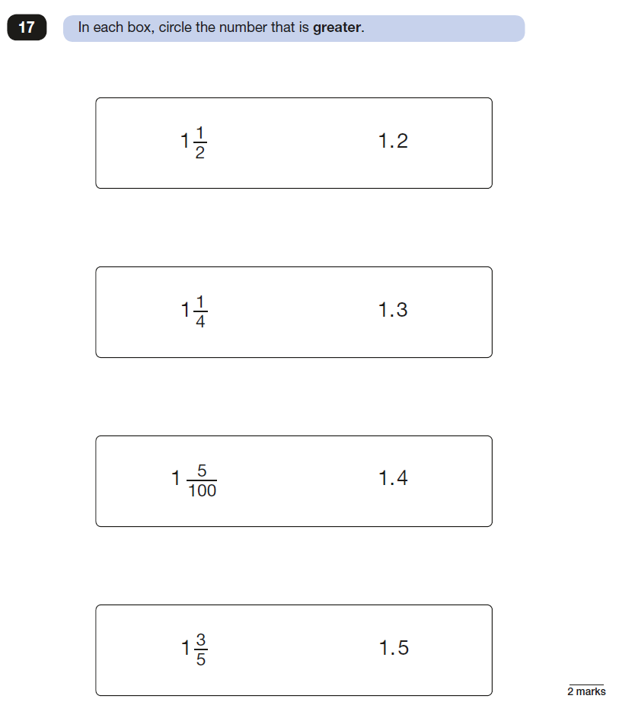
2017 KS2 Paper 3: Reasoning

Slide 50
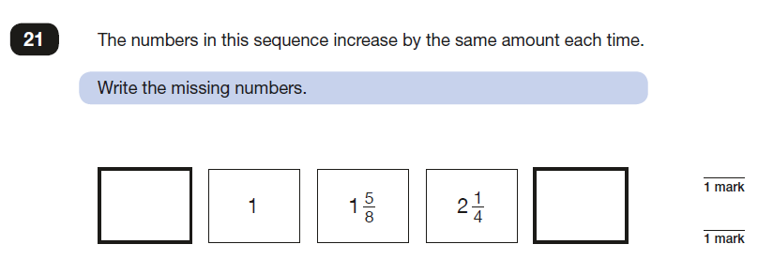
2017 KS2 Paper 3: Reasoning

Slide 51
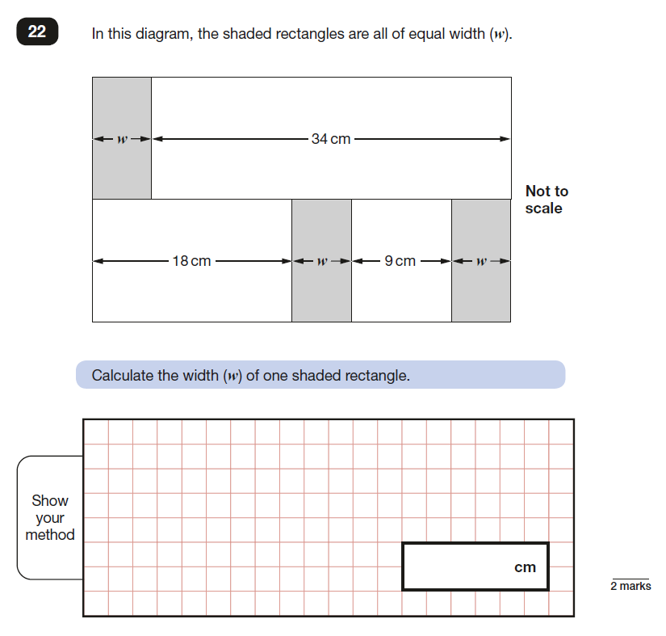
2017 KS2 Paper 3: Reasoning

Slide 52
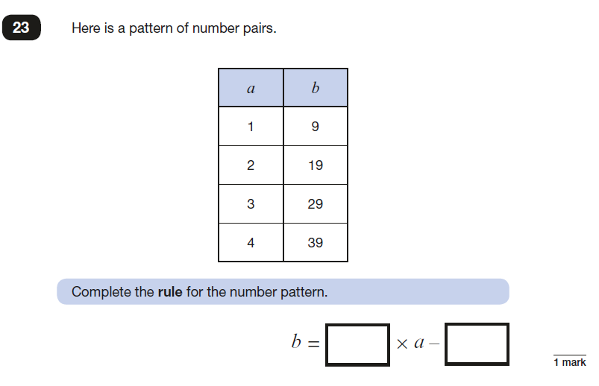
2017 KS2 Paper 3: Reasoning

Slide 53
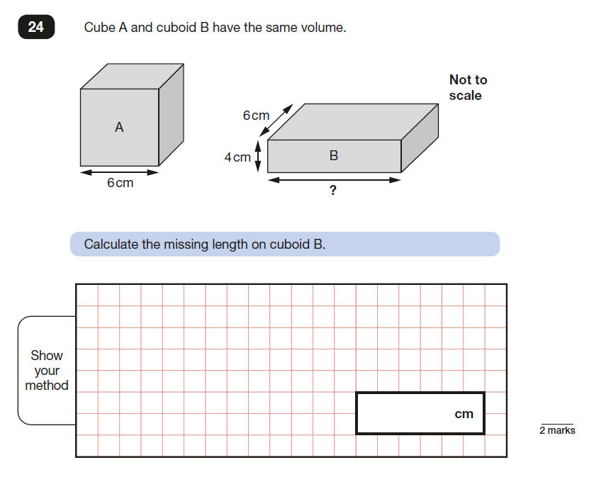
2017 KS2 Paper 3: Reasoning

