Slide 1
Year 5
HIAS Blended Learning Resource
Subtraction and Addition (whole numbers)
Solve addition and subtraction multi-step problems in contexts, deciding which operations and methods to use and why
Use rounding to check answers to calculations and determine, in the context of a problem, levels of accuracy
HIAS maths Team
Spring 2021
Final version
© Hampshire County Council

Slide 2
HIAS Blended Learning Resource
These slides are intended to support teachers and pupils with a blended approach to learning, either in-class or online. The tasks are intended to form part of a learning journey and could be the basis of either one lesson or a short sequence of connected lessons.
The 4-step Polya model for problem solving has been used to provide a structure to support reasoning. Teachers may need to use more or fewer steps to support the range of learners in their class.
Teachers should delete, change and add slides to suit the needs of their pupils. Extra slides with personalised prompts and appropriate examples based on previous teaching may be suitable. When changing the slide-deck, teachers should consider:
Their expectations for the use of representations such as bar models, number lines, arrays and diagrams.
Which strategies and methods pupils should use and record when solving problems or identifying solutions. This could include a range of informal jottings and diagrams, the use of tables to record solutions systematically and formal or informal calculation methods.
Teachers may also wish to record a ‘voice over’ to talk pupils through the slides.

Slide 3
HIAS Blended Learning Resource
1945 George Polya published ‘How To Solve It’ 2nd ed., Princeton University Press, 1957, ISBN 0-691-08097-6.

Slide 4
Solving addition and subtraction multi-step problems in context
HIAS Blended Learning Resource
Kirsty is playing a game. She has 3,407 points. Then she scores another 588 points.
Kirsty’s target is 5000 points.
How many more points does Kirsty need to reach her target?

Slide 5
Understand the problem
HIAS Blended Learning Resource
Key fact: Kirsty is playing a game and she already has 3,407 points
Key fact: Kirsty scores another 588 points
Key fact: Kirsty’s target is 5000 points.
We need to find out how many points Kirsty has altogether and how many more she needs to reach her target of 5000.
Kirsty is playing a game. She has 3,407 points. Then she scores another 588 points.
Kirsty’s target is 5000 points.
How many more points does Kirsty need to reach her target?

Slide 6
Make a Plan
HIAS Blended Learning Resource
Step 1: We need to visualise this problem so we can be sure we understand it fully. Representing the problem with bar models should help us.
Step 2: : We need to make sure our calculations are correct. Estimating these first will help us.
Step 3: We need to carry out our calculations and check these against our estimates.
Step 4:
We must provide the answer to the problem by stating how many more points Kirsty needs to reach her target.
Kirsty is playing a game. She has 3,407 points. Then she scores another 588 points.
Kirsty’s target is 5000 points.
How many more points does Kirsty need to reach her target?

Slide 7
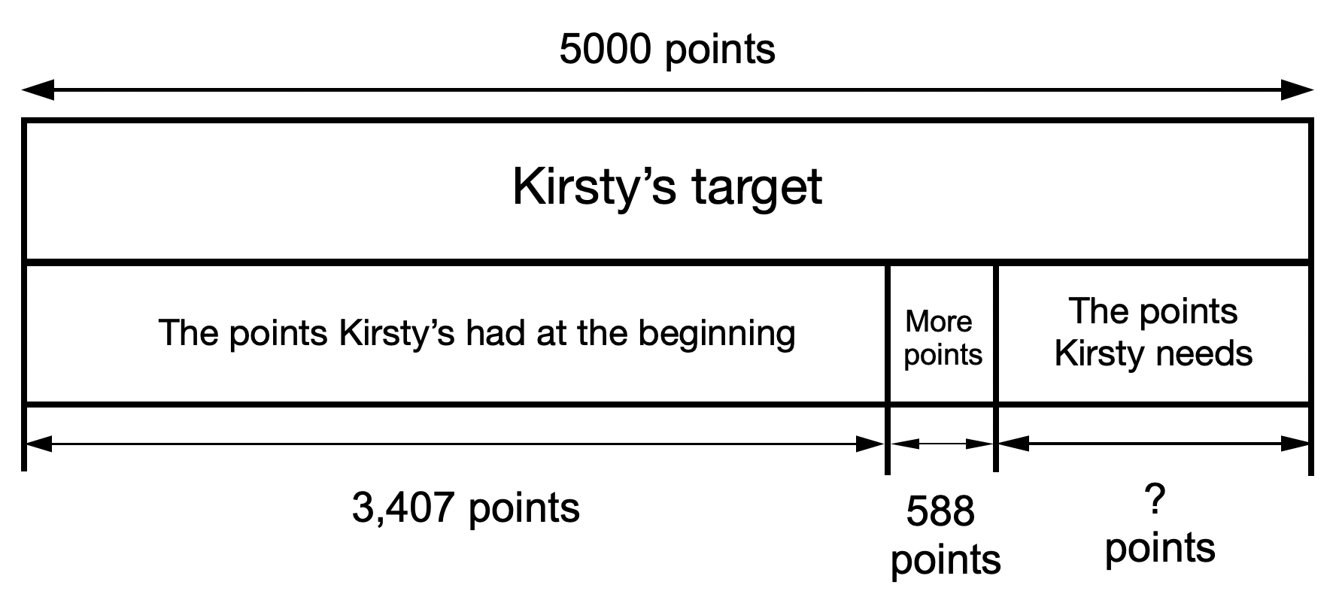

Slide 8
Carry out your plan: show your reasoning
HIAS Blended Learning Resource
Step 1: Draw the bar models and label them so we are clear in our understanding of the problem.
We can see now that we need to add the 3,407 points Kirsty had at the beginning to the 588 more she scored. If we subtract this total from the 5000 points she needs altogether, we will find out how many more she needs.
Step 2: We need to estimate the answers to our calculations.
Rounding 3,407 and 588 each to the nearest 100 should help:
3,407 → 3,400
588 → 600
3,400 + 600 = 4,000
5000 - 4000 = 1000
Our answer will be approximately 1000
Step 3: We need to carry out the calculations: and check these against our estimates:
3,407 + 588 = 3,995
5000 - 3,995 = 1,005
This answer is very close to the estimate of 1000
Step 4:
We can now answer the problem:
Kirsty needs 1,005 points to reach her target.
Kirsty is playing a game. She has 3,407 points. Then she scores another 588 points.
Kirsty’s target is 5000 points.
How many more points does Kirsty need to reach her target?

Slide 9
Review your solution: does it seem reasonable? Which steps/ parts did you find easy and which harder?
HIAS Blended Learning Resource
How could you check?
Go through the steps you took and check for errors
Remember to use the estimate.
You could use a different method to check your calculations (mental, jottings or formal written methods).
Kirsty is playing a game. She has 3,407 points. Then she scores another 588 points.
Kirsty’s target is 5000 points.
How many more points does Kirsty need to reach her target?

Slide 10
Now try this one
HIAS Blended Learning Resource
Understand the problem
Make a plan
Carry out your plan: show your reasoning
Review your solution: does it seem reasonable?
Think about your learning: which parts of the problem did you find easy and which parts did you find harder?
Kirsty is playing a game. She has 1,334 points. Then she scores another 1,872 points.
Kirsty’s target is 4000 points.
How many more points does Kirsty need to reach her target?

Slide 11
HIAS Maths team
HIAS Blended Learning Resource
The HIAS maths team offer a wide range of high-quality services to support schools in improving outcomes for learners, including courses, bespoke consultancy and in-house training.
For further details referring to maths, please contact either of the team leads:
Jacqui Clifft : Jacqui.clifft@hants.gov.uk
Jo Lees: Jo.Lees@hants.gov.uk
For further details on the full range of services available please contact us using the following details:
Tel: 01962 874820 or email: hias.enquiries@hants.gov.uk
For further details on the full range of services available please contact us using the following details:
Tel: 01962 874820 or email: hias.enquiries@hants.gov.uk

