Slide 1
Year 9
HIAS Blended Learning Resource
Construction (unit 9.10)
Derive and use the standard ruler and compass constructions: perpendicular bisector of a line segment; constructing a perpendicular to a given line from/ at a given point; bisecting a given angle.
HIAS maths Team
Spring 2021
Final version
© Hampshire County Council

Slide 2
HIAS Blended Learning Resource
These slides are intended to support teachers and students with a blended approach to learning, either in-class or online. The tasks are intended to form part of a learning journey and could be the basis of either one lesson or a short sequence of connected lessons.
Teachers should delete, change and add slides to suit the needs of their students. Extra slides with personalised prompts and appropriate examples based on previous teaching may be suitable. When changing the slide-deck, teachers should consider:
Their expectations for the use of representations such as bar models, number lines, arrays and geometric diagrams.
Which strategies and methods students should use and record when solving problems or identifying solutions. This could include a range of informal jottings and diagrams, the use of tables to record solutions systematically and formal or informal calculation methods.
Teachers may also wish to record a ‘voice over’ to talk students through the slides.

Slide 3
HIAS Blended Learning Resource
YEAR 9: SPRING TERM OVERVIEW
Week | HIAS Unit | Topic
1 | Unit 9.6 | Probability: Sets and Venn diagrams
2 | Unit 9.7 | Statistics: Bivariate data
3 | Unit 9.8 | Proportion: Direct
4 |  | Proportion: Indirect
5 |  | Powers and roots
 | Half term
6 | Unit 9.9 | Approximation
7 |  | Compound units
8 | Unit 9.10 | Geometry: Pythagoras and trigonometry
9 |  | Geometry: Constructions
10 | Unit 9.11 | Algebra: Functions

Slide 4
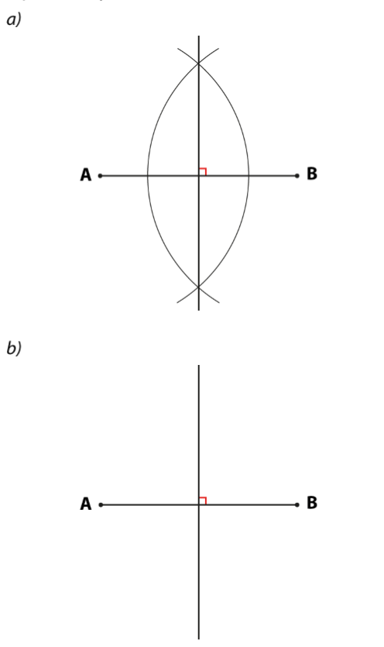
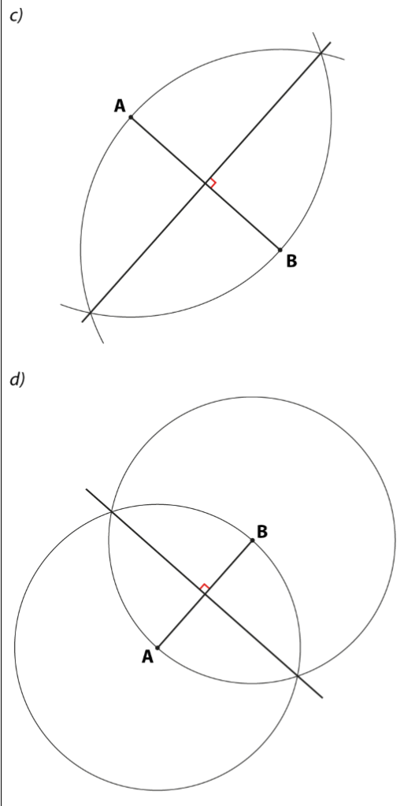
HIAS Blended Learning Resource
Which of these diagrams show an accurate construction of the perpendicular bisector of the line segment AB? Explain how you know.
Adapted from NCETM
Notes:
a) b) and c) use arcs of different lengths but show the intersecting arcs for a perpendicular bisector

Slide 5
HIAS Blended Learning Resource
The line segment AB is 8cm long.
Which of these methods could be used to construct the perpendicular bisector of AB?
Constructing arcs which are 3cm from both A and B
Constructing arcs which are 4cm from both A and B
Constructing arcs which are 5cm from both A and B
Constructing arcs which are 8cm from both A and B
b) Which is the best method and why? Explain you reasoning.
Adapted from NCETM
Notes:
(iii) and (iv) could be used
Would not intersect
Would only bisect the line segment at the midpoint
This is the best as it is over the half way point but would not create an unnecessarily large arc
This could work but would have an unnecessarily large arc

Slide 6
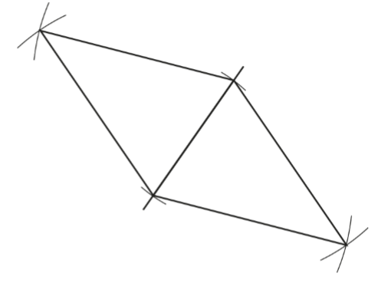
HIAS Blended Learning Resource
Tom has constructed two identical isosceles triangles:
What shape has he made?
Sketch the diagram and draw in the longest diagonal that you can.
Write down as many properties as you can.
Adapted from NCETM
Notes:
Answers are on the next slide

Slide 7
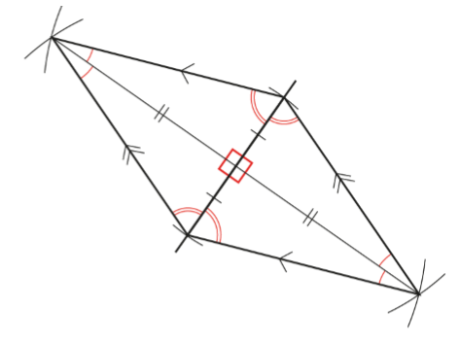
HIAS Blended Learning Resource
Answer to previous slide
Tom has constructed a rhombus with sets of equal angles, angles that have been bisected, two sets of pairs of parallel lines and a perpendicular bisector (the lines bisect each other at right angles):
Adapted from NCETM

Slide 8
HIAS Maths team
HIAS Blended Learning Resource
The HIAS maths team offer a wide range of high-quality services to support schools in improving outcomes for learners, including courses, bespoke consultancy and in-house training.
For further details, please contact any member of the secondary maths team:
Jo Lees: Jo.Lees@hants.gov.uk
Jenny Burn: Jenny.Burn@hants.gov.uk
Tessa Ingrey: Tessa.Ingrey@hants.gov.uk
For further details on the full range of services available please contact us using the following details:
Tel: 01962 874820 or email: hias.enquiries@hants.gov.uk
For further details on the full range of services available please contact us using the following details:
Tel: 01962 874820 or email: hias.enquiries@hants.gov.uk

