Slide 1
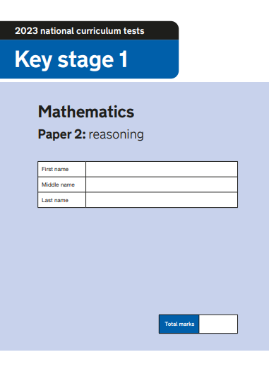
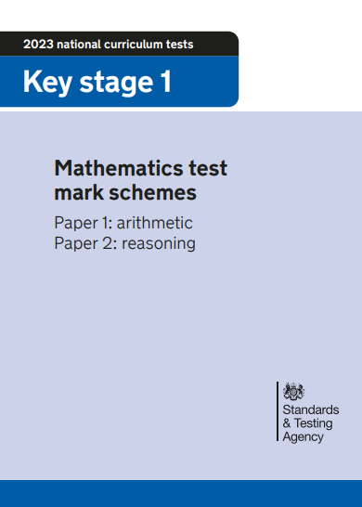
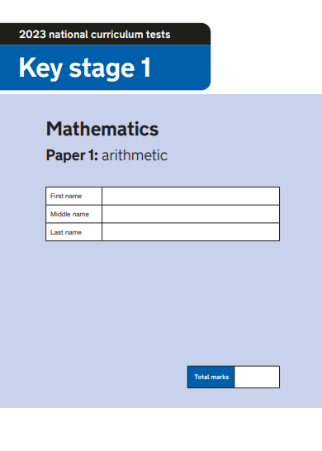
2023 Key Stage 1 SATs Mathematics
Arithmetic Paper 1
Reasoning Paper 2
Pre- Key Stage 1 Standards

Slide 2
Key Stage 1 SATs papers 2023
Key stage 1 tests: 2023 mathematics test materials - GOV.UK (www.gov.uk)
Key stage 1 SATs 2023 scaled scores
Details
A scaled score between 100 and 115 shows the pupil has met the expected standard in the test.
The lowest scaled score that can be awarded on a key stage 1 test is 85. The highest score is 115. Pupils need to have a raw score of at least 3 marks to be awarded the minimum scaled score.
2023 scaled scores at key stage 1 - GOV.UK (www.gov.uk)
Understanding scaled scores at key stage 1
https://www.gov.uk/guidance/understanding-scaled-scores-at-key-stage-1

Slide 3
Understanding scaled scores at key stage 1 https://www.gov.uk/guidance/understanding-scaled-scores-at-key-stage-1
What is a scaled score?
Tests are developed to the same specification each year, however, because the questions must be different, the difficulty of tests may vary slightly each year. This means we need to convert the total number of marks a pupil gets in a test (their ‘raw’ score) into a scaled score, to ensure we can make accurate comparisons of pupil performance over time.
Pupils scoring at least 100 will always have met the expected standard on the test. However, given that the difficulty of the tests may vary each year, the number of raw score marks needed to achieve a scaled score of 100 may also change. For example, if the overall difficulty of a test decreases compared with previous years, the raw score required to meet the expected standard will increase. Similarly, if the test is more difficult, the raw score required to meet the expected standard will decrease.
In 2016, panels of teachers set the raw score required to meet the expected standard. We have used data from trialling to maintain that standard for the tests from 2017 onwards.

Slide 4
https://www.gov.uk/guidance/understanding-scaled-scores-at-key-stage-1

Slide 5
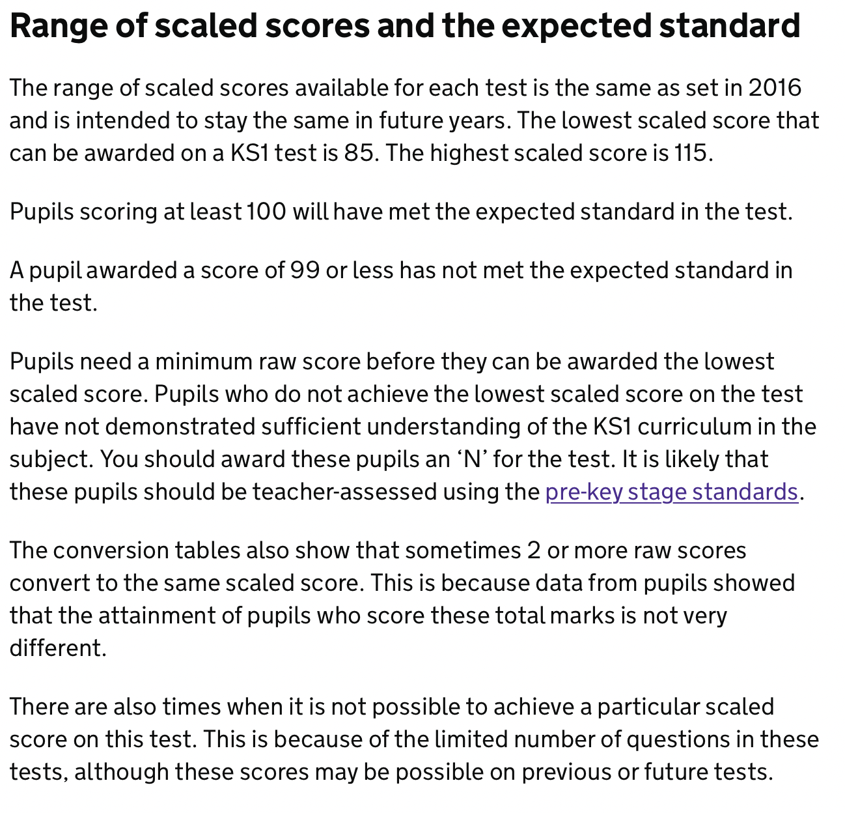
Range of scaled scores and the expected standard
https://www.gov.uk/guidance/understanding-scaled-scores-at-key-stage-1

Slide 6
Using and interpreting test outcomes
You should use evidence from the English reading and mathematics tests to inform your teacher assessment judgement for each pupil. You can also use the optional KS1 English grammar, punctuation and spelling test to inform your teacher assessment judgement in English writing.
The tests can provide evidence that a pupil has met certain ‘pupil can’ statements, as well as evidence to support the judgement overall. Tests and teacher assessment are different forms of assessment, so it is not necessary for the outcomes to be the same.
The national curriculum tests are compensatory – as pupils can score marks from any parts of the tests, pupils with the same total score may achieve their marks in different ways. The teacher assessment frameworks are different and ask teachers to assess pupils against certain aspects of the national curriculum, based on a range of evidence from the classroom.
It is possible for a pupil to have met the expected standard in the test, but not for teacher assessment, because of gaps in their knowledge or understanding. It is also possible for pupils to have demonstrated their attainment of the ‘pupil can’ statements through their classwork, but not to have achieved the mark for a related question on the test. If a pupil gets a question wrong in the test on an area of the curriculum that they have demonstrated in their classwork, the teacher will want to take this into consideration when making their teacher assessment judgement.
Together, the tests and teacher assessment provide a broader picture of pupil attainment
https://www.gov.uk/guidance/understanding-scaled-scores-at-key-stage-1

Slide 7
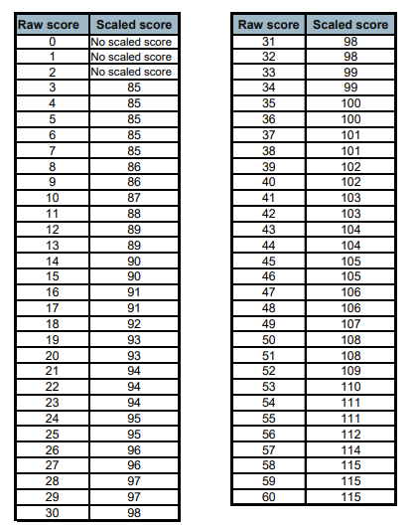
2023 Key Stage 1 Scaled scores: mathematics
2023 scaled scores at key stage 1 - GOV.UK (www.gov.uk)

Slide 8
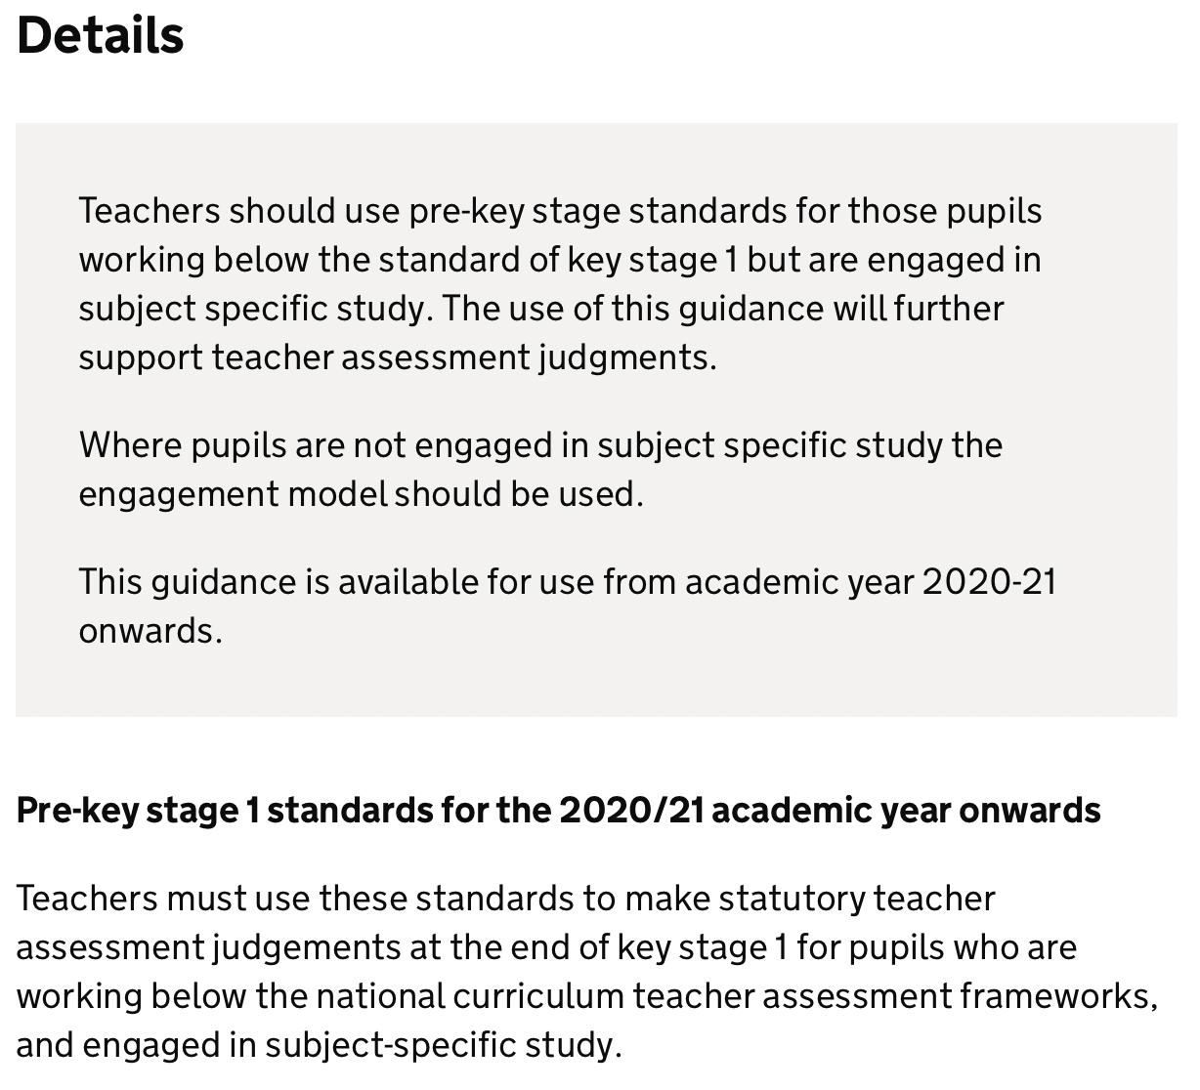
Statutory guidance
Pre-key stage 1 standards
For teachers to report assessment outcomes for pupils working below the standard of national curriculum assessments (commonly called SATs) at the end of KS1.
https://www.gov.uk/government/publications/pre-key-stage-1-standards

Slide 9
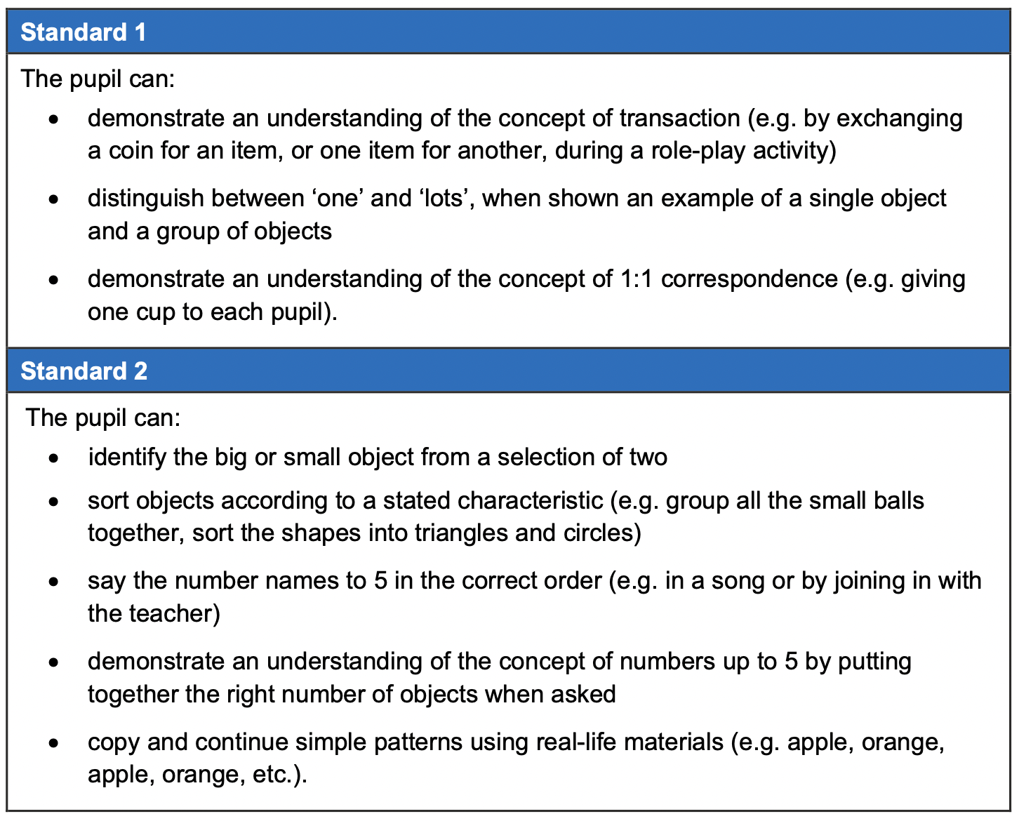
Pre Key Stage 1

Slide 10
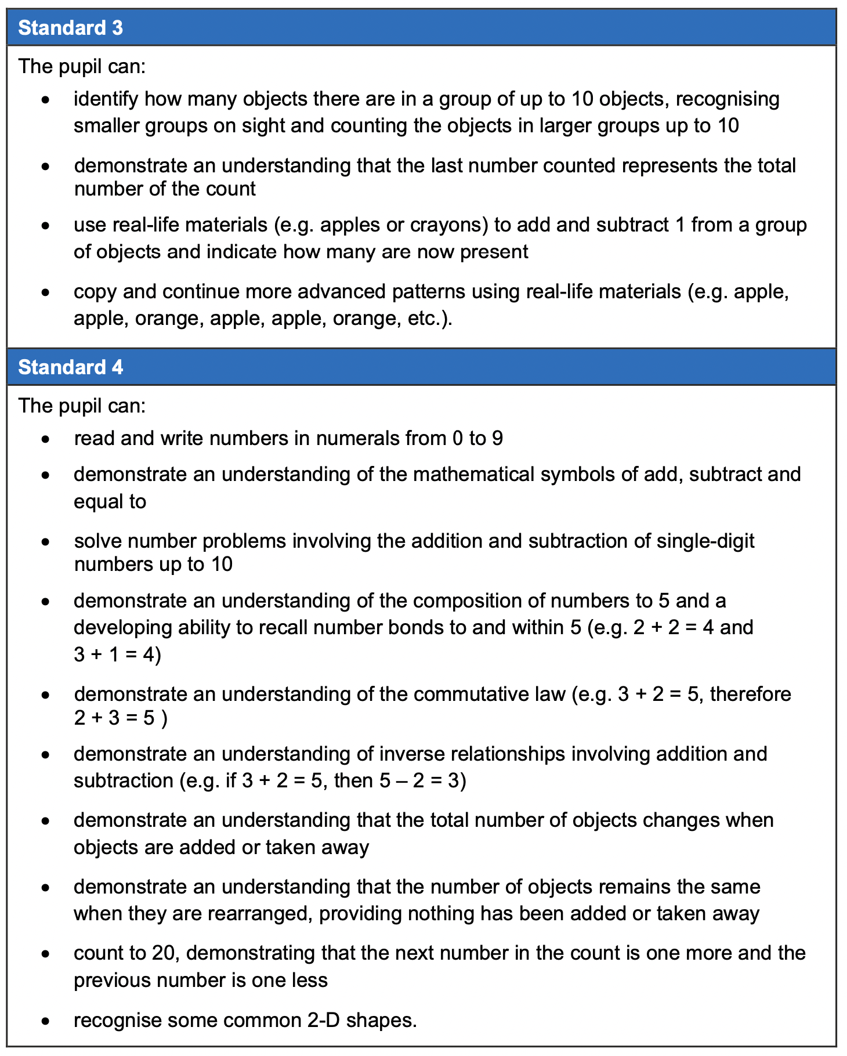
Pre Key Stage 1

Slide 11
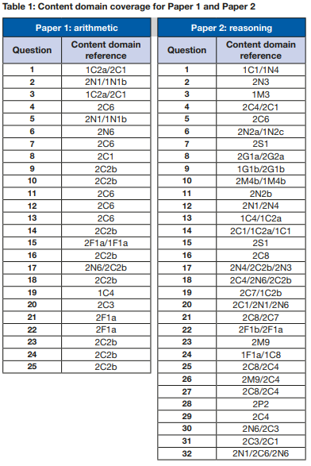
Key Stage 1 Mathematics
Mark Scheme
2023 key stage 1 mathematics mark schemes (publishing.service.gov.uk)

Slide 12
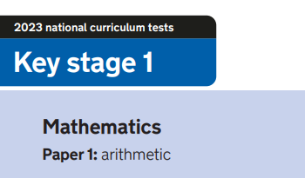
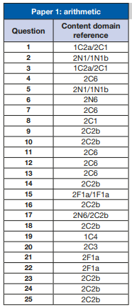
https://www.gov.uk/government/publications/key-stage-1-tests-2022-mathematics-test-materials

Slide 13
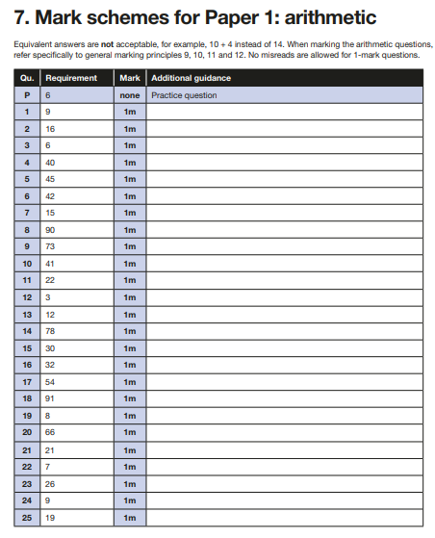
2023 key stage 1 mathematics mark schemes (publishing.service.gov.uk)

Slide 14
Key Stage 1 Arithmetic Paper 2023
2023 key stage 1 mathematics Paper 1 arithmetic (publishing.service.gov.uk)
Notes:
Questions in order of the test top to bottom, left to right..

Slide 15
2023: KS1 Arithmetic Paper Addition and subtraction
2023 key stage 1 mathematics Paper 1 arithmetic (publishing.service.gov.uk)
Notes:
Questions in order of the test top to bottom, left to right..

Slide 16
2023: KS1 Arithmetic Paper Multiplication and Division
2023 key stage 1 mathematics Paper 1 arithmetic (publishing.service.gov.uk)
Notes:
Questions in order of the test top to bottom, left to right..

Slide 17
2023: KS1 Arithmetic Paper Fractions
2023 key stage 1 mathematics Paper 1 arithmetic (publishing.service.gov.uk)
Notes:
Questions in order of the test top to bottom, left to right..

Slide 18
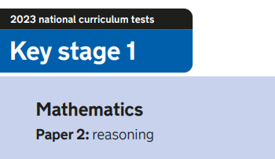
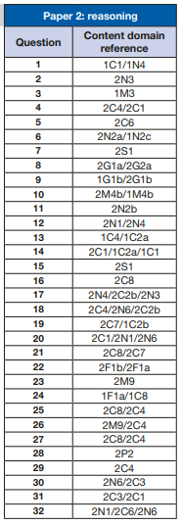
2023 key stage 1 mathematics Paper 2 reasoning (publishing.service.gov.uk)

Slide 19
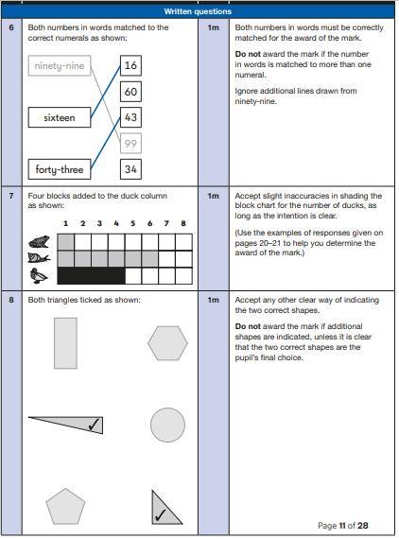
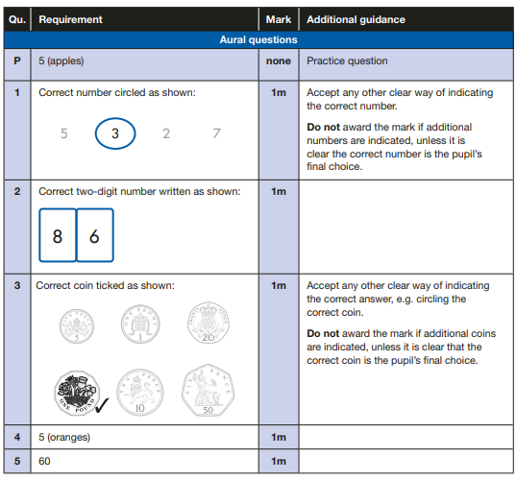
Key Stage 1 Mathematics
Mark Scheme
2023 key stage 1 mathematics mark schemes (publishing.service.gov.uk)

Slide 20
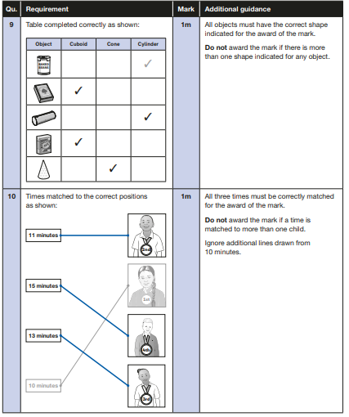
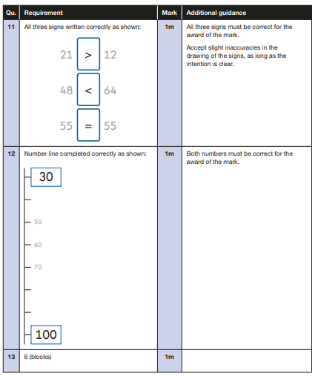
Key Stage 1 Mathematics
Mark Scheme
2023 key stage 1 mathematics mark schemes (publishing.service.gov.uk)

Slide 21
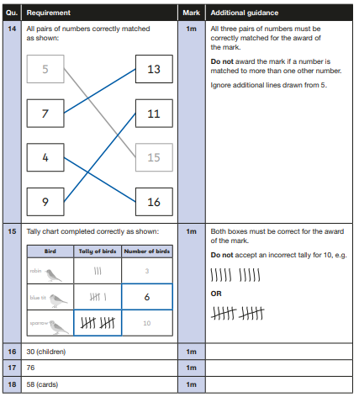
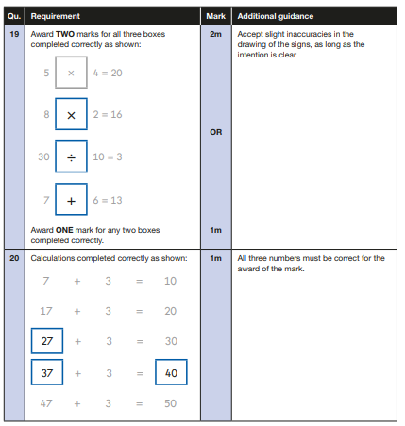
Key Stage 1 Mathematics
Mark Scheme
2023 key stage 1 mathematics mark schemes (publishing.service.gov.uk)

Slide 22
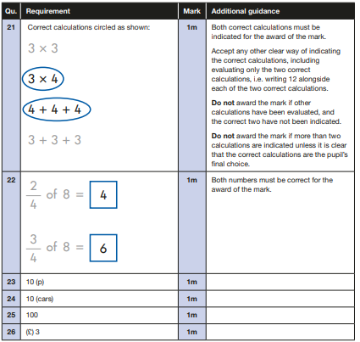
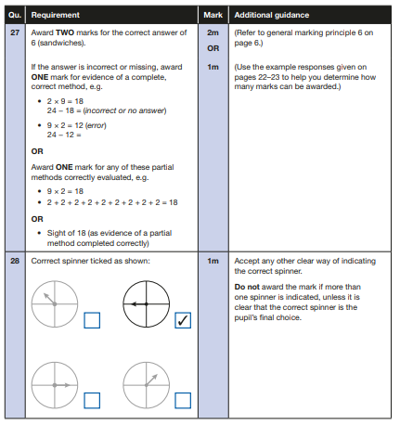
Key Stage 1 Mathematics
Mark Scheme
2023 key stage 1 mathematics mark schemes (publishing.service.gov.uk)

Slide 23
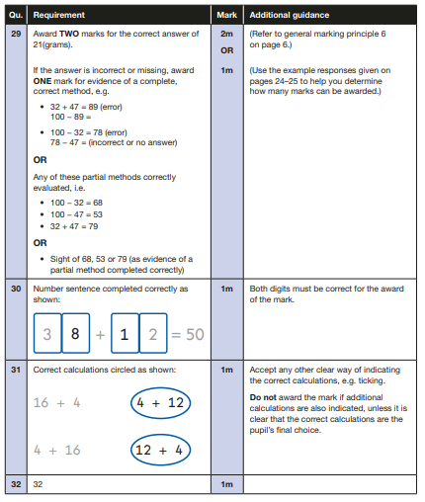
Key Stage 1 Mathematics
Mark Scheme
2023 key stage 1 mathematics mark schemes (publishing.service.gov.uk)

Slide 24
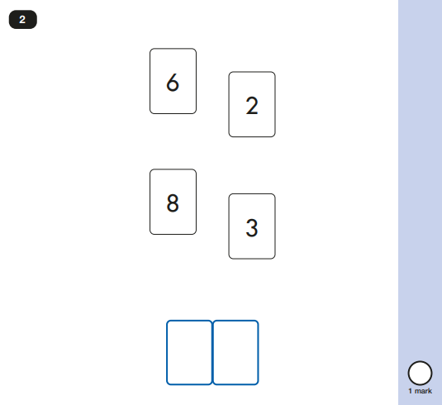
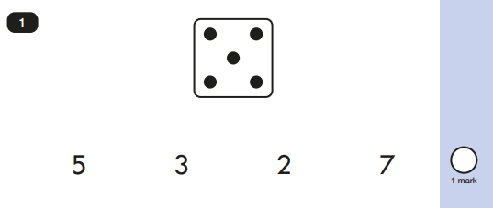
2023 Key Stage 1: Paper 2 Reasoning
2023 key stage 1 mathematics Paper 2 reasoning (publishing.service.gov.uk)

Slide 25
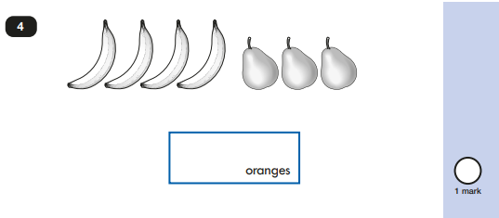
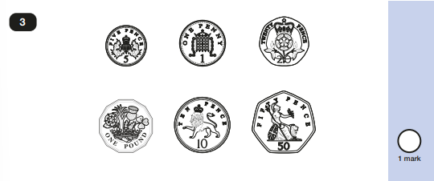
2023 Key Stage 1: Paper 2 Reasoning
2023 key stage 1 mathematics Paper 2 reasoning (publishing.service.gov.uk)

Slide 26
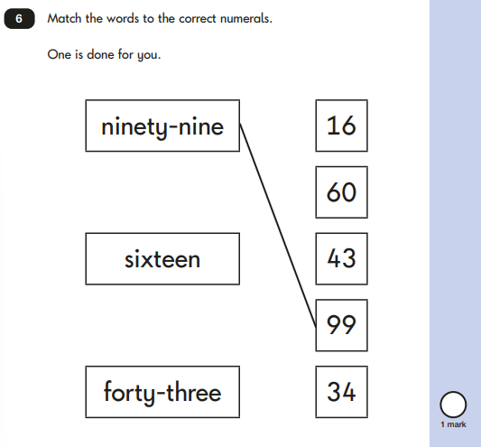
2023 Key Stage 1: Paper 2 Reasoning
2023 key stage 1 mathematics Paper 2 reasoning (publishing.service.gov.uk)

Slide 27
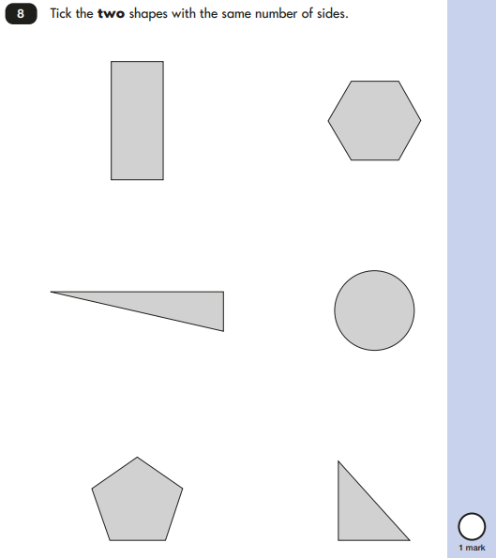
2023 Key Stage 1: Paper 2 Reasoning
2023 key stage 1 mathematics Paper 2 reasoning (publishing.service.gov.uk)

Slide 28
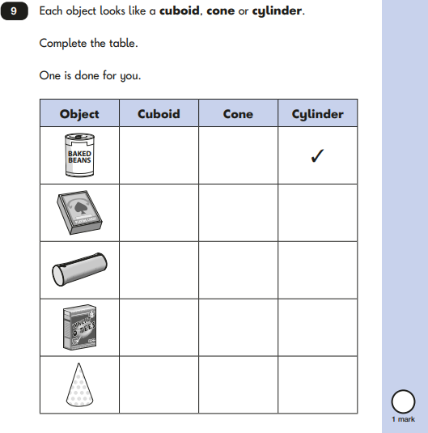
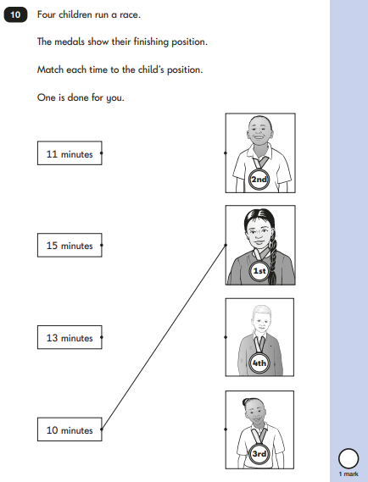
2023 Key Stage 1: Paper 2 Reasoning
2023 key stage 1 mathematics Paper 2 reasoning (publishing.service.gov.uk)

Slide 29
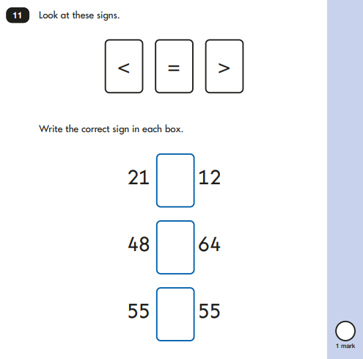
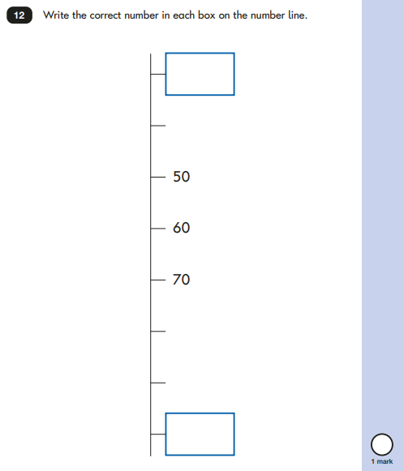
2023 Key Stage 1: Paper 2 Reasoning
2023 key stage 1 mathematics Paper 2 reasoning (publishing.service.gov.uk)

Slide 30
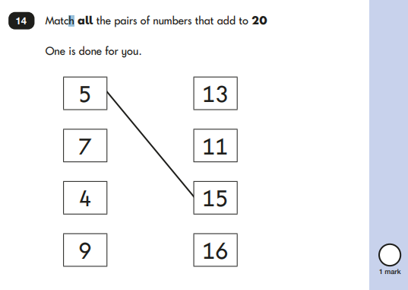
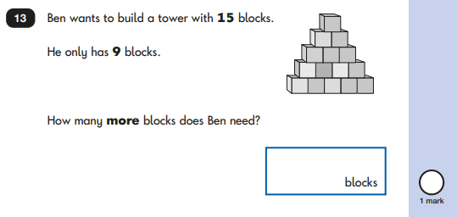
2023 Key Stage 1: Paper 2 Reasoning
2023 key stage 1 mathematics Paper 2 reasoning (publishing.service.gov.uk)

Slide 31
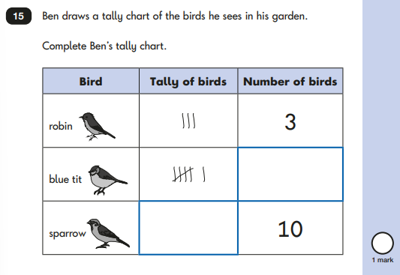
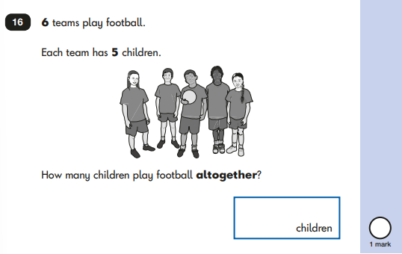
2023 Key Stage 1: Paper 2 Reasoning
2023 key stage 1 mathematics Paper 2 reasoning (publishing.service.gov.uk)

Slide 32
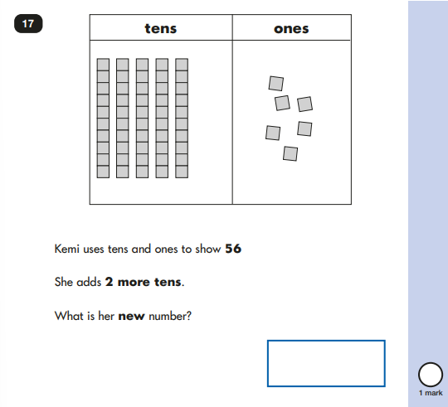
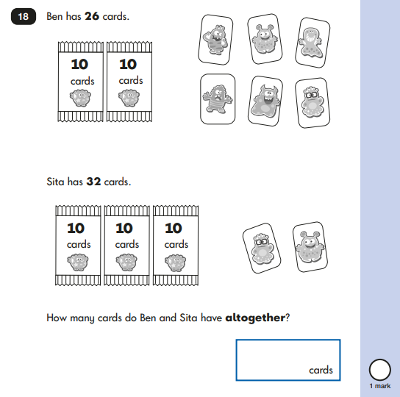
2023 Key Stage 1: Paper 2 Reasoning
2023 key stage 1 mathematics Paper 2 reasoning (publishing.service.gov.uk)

Slide 33
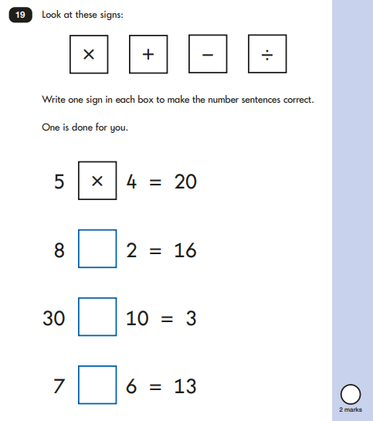
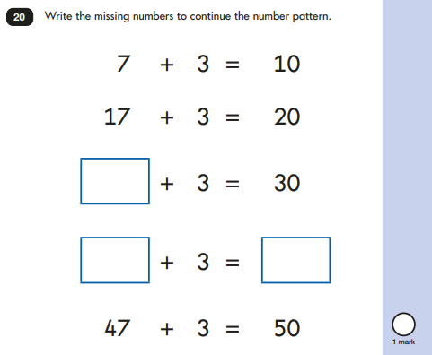
2023 Key Stage 1: Paper 2 Reasoning
2023 key stage 1 mathematics Paper 2 reasoning (publishing.service.gov.uk)

Slide 34
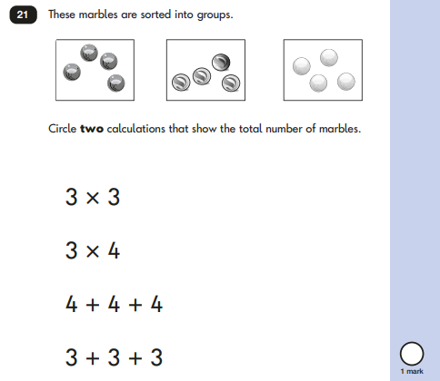
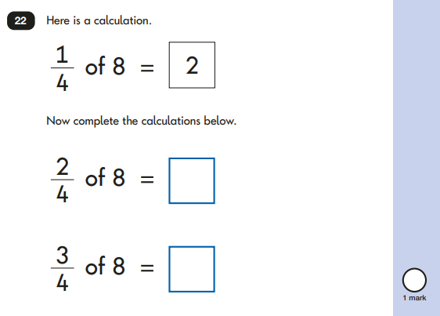
2023 Key Stage 1: Paper 2 Reasoning
2023 key stage 1 mathematics Paper 2 reasoning (publishing.service.gov.uk)

Slide 35
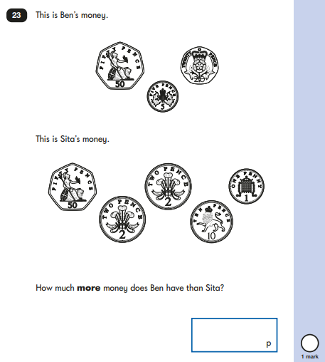
2023 Key Stage 1: Paper 2 Reasoning
2023 key stage 1 mathematics Paper 2 reasoning (publishing.service.gov.uk)

Slide 36
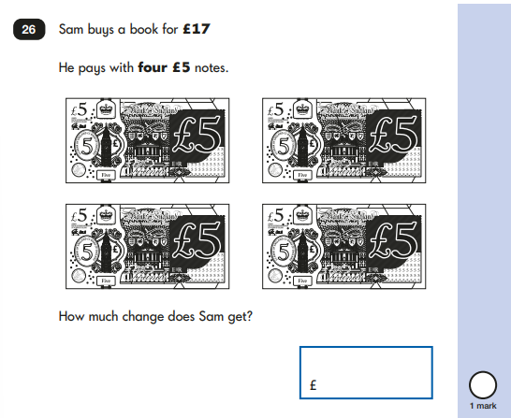
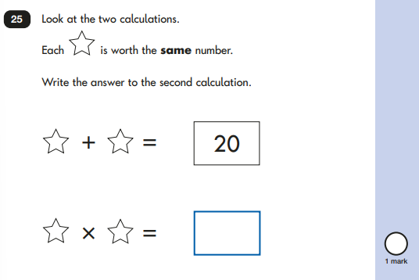
2023 Key Stage 1: Paper 2 Reasoning
2023 key stage 1 mathematics Paper 2 reasoning (publishing.service.gov.uk)

Slide 37
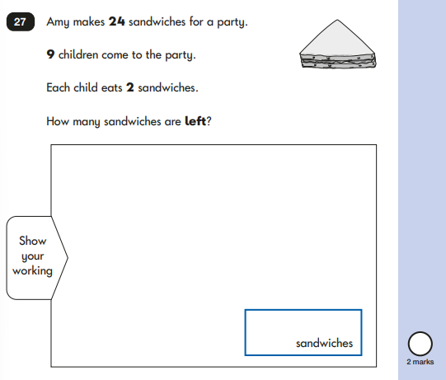
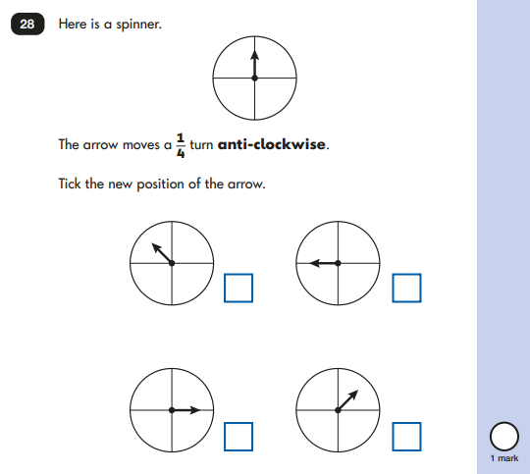
2023 Key Stage 1: Paper 2 Reasoning
2023 key stage 1 mathematics Paper 2 reasoning (publishing.service.gov.uk)

Slide 38
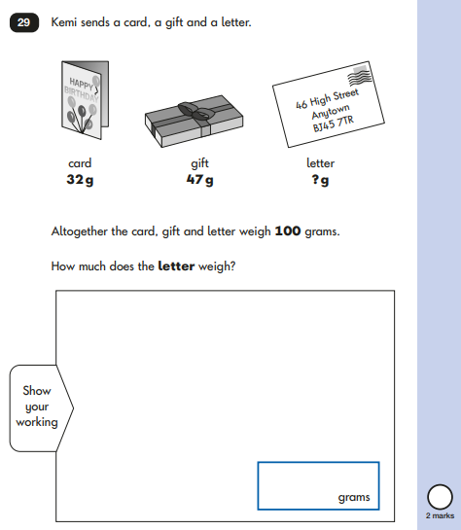
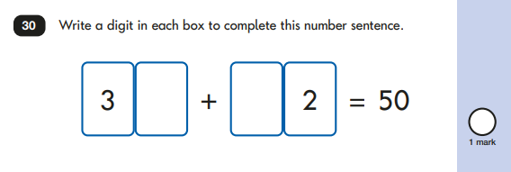
2023 Key Stage 1: Paper 2 Reasoning
2023 key stage 1 mathematics Paper 2 reasoning (publishing.service.gov.uk)

Slide 39
2023 Key Stage 1: Paper 2 Reasoning
2023 key stage 1 mathematics Paper 2 reasoning (publishing.service.gov.uk)

