Slide 1
Year 3
HIAS Blended Learning Resource
Fractions
Add and subtract fractions with the same denominator within one whole
HIAS maths Team
Spring 2021
Final version
© Hampshire County Council

Slide 2
HIAS Blended Learning Resource
These slides are intended to support teachers and pupils with a blended approach to learning, either in-class or online. The tasks are intended to form part of a learning journey and could be the basis of either one lesson or a short sequence of connected lessons.
The 4-step Polya model for problem solving has been used to provide a structure to support reasoning. Teachers may need to use more or fewer steps to support the range of learners in their class.
Teachers should delete, change and add slides to suit the needs of their pupils. Extra slides with personalised prompts and appropriate examples based on previous teaching may be suitable. When changing the slide-deck, teachers should consider:
Their expectations for the use of representations such as bar models, number lines, arrays and diagrams.
Which strategies and methods pupils should use and record when solving problems or identifying solutions. This could include a range of informal jottings and diagrams, the use of tables to record solutions systematically and formal or informal calculation methods.
Teachers may also wish to record a ‘voice over’ to talk pupils through the slides.

Slide 3
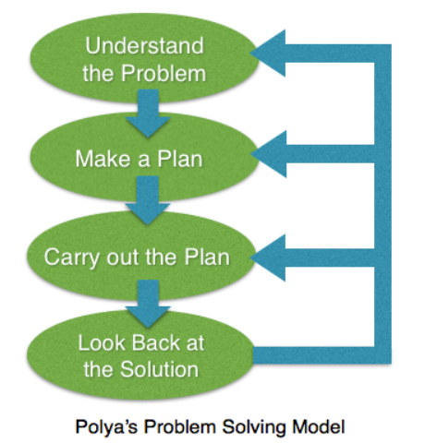
HIAS Blended Learning Resource
1945 George Polya published ‘How To Solve It’ 2nd ed., Princeton University Press, 1957, ISBN 0-691-08097-6.

Slide 4
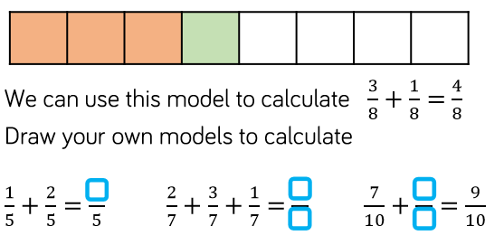
Adding fractions with the same denominator within one whole
HIAS Blended Learning Resource
Use the same model to calculate

Slide 5
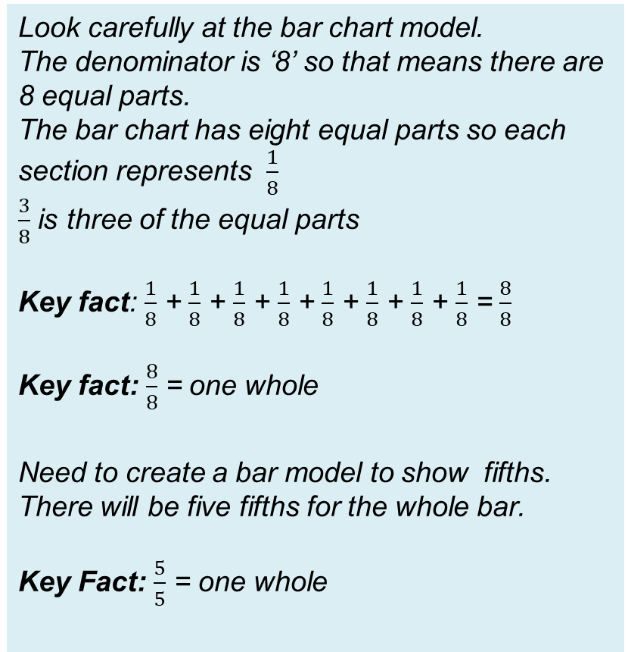
Understand the problem
HIAS Blended Learning Resource
Look carefully at the bar chart model.
The denominator is ‘8’ so that means there are 8 equal parts.
The bar chart has eight equal parts so each section represents $\frac{1}{8}$
$\frac{3}{8}$ is three of the equal parts
Key fact: $\frac{1}{8}$ + $\frac{1}{8}$ + $\frac{1}{8}$ + $\frac{1}{8}$ + $\frac{1}{8}$ + $\frac{1}{8}$ + $\frac{1}{8}$ + $\frac{1}{8}$ = $\frac{8}{8}$
Key fact: $\frac{8}{8}$ = one whole
Need to create a bar model to show fifths. There will be five fifths for the whole bar.
Key Fact: $\frac{5}{5}$ = one whole

Slide 6
Make a Plan
HIAS Blended Learning Resource
Step 1:
Draw a bar model to show fifths
Remember there are 5 equal parts
Step 2:
Colour the bar model to show each fraction
Step 3:
Complete the calculation to show how many fifths altogether

Slide 8
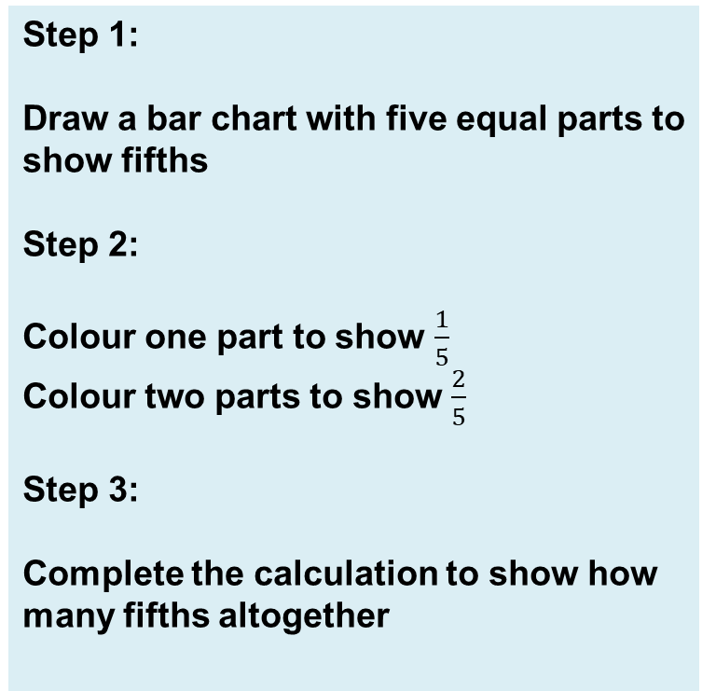
Carry out your plan: show your reasoning
HIAS Blended Learning Resource
Step 1:
Draw a bar chart with five equal parts to show fifths
Step 2:
Colour one part to show $\frac{1}{5}$
Colour two parts to show $\frac{2}{5}$
Step 3:
Complete the calculation to show how many fifths altogether

Slide 9
Step 1: Draw a bar chart with five equal parts to show fifths
Step 2:
Colour one part to show $\frac{1}{5}$
Colour two parts to show $\frac{2}{5}$
Step 3:
Complete the calculation to show how many fifths altogether
$\frac{1}{5}$ + $\frac{2 }{5}$ = $\frac{3}{5}$

Slide 10
Review your solution: does it seem reasonable? Which steps/ parts did you find easy and which harder?
HIAS Blended Learning Resource
How could you check?
Go through the steps you took and check for errors
Remember to check the denominator is the same
Try to solve the calculation a different way and see if you get the same answer

Slide 11
Now try these ones
HIAS Blended Learning Resource
Understand the problem
Make a plan
Carry out your plan: show your reasoning
Review your solution: does it seem reasonable?
Think about your learning: which parts of the problem did you find easy and which parts did you find harder?
Use the same model to calculate

Slide 12
HIAS Maths team
HIAS Blended Learning Resource
The HIAS maths team offer a wide range of high-quality services to support schools in improving outcomes for learners, including courses, bespoke consultancy and in-house training.
For further details referring to maths, please contact either of the team leads:
Jacqui Clifft : Jacqui.clifft@hants.gov.uk
Jo Lees: Jo.Lees@hants.gov.uk
For further details on the full range of services available please contact us using the following details:
Tel: 01962 874820 or email: hias.enquiries@hants.gov.uk
For further details on the full range of services available please contact us using the following details:
Tel: 01962 874820 or email: hias.enquiries@hants.gov.uk

