Slide 1
2017 Key Stage 1 SATs
Mark scheme in ‘notes’ view

Slide 2
End of KS1: SATs Arithmetic Paper 2016
Q: 1,2,3,4,5, 6, 7, 8,9,10,11,13, 15,16,19,23

Slide 3
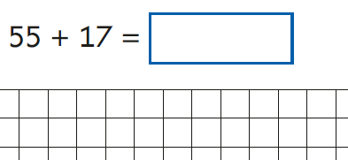
End of KS1: SATs Arithmetic Paper 2016 Q12, 13, 14,15,16,17,18,19

Slide 4
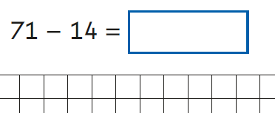
End of KS1: SATs Arithmetic Paper 2016 Q 20,21,22,23,24,25

Slide 5
Key stage 1 Arithmetic Paper 2017 Q1-20
Notes:
Organised vertically in order.

Slide 6
Key stage 1 Arithmetic Paper 2017 Q21-25

Slide 7
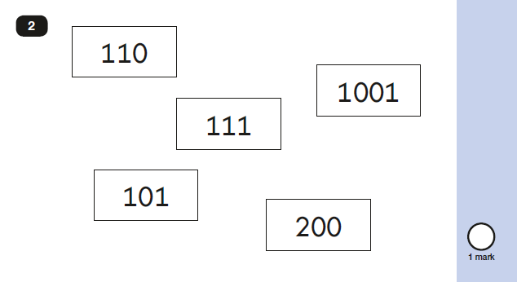
2017 Key Stage 1: Paper 2
Aural question: one hundred and one

Slide 8
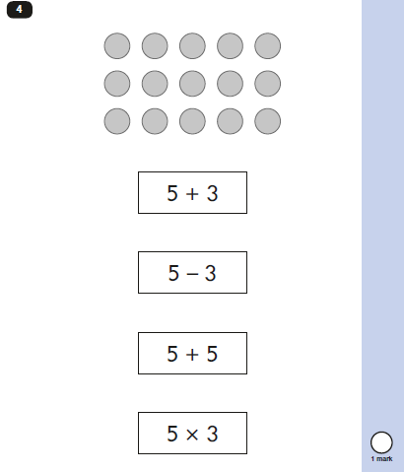
2017 Key Stage 1: Paper 2
Aural question

Slide 9
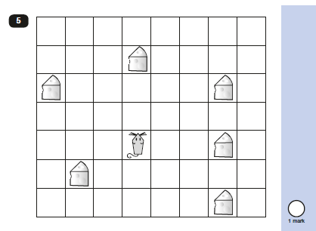
2017 Key Stage 1: paper 2
Aural question

Slide 10
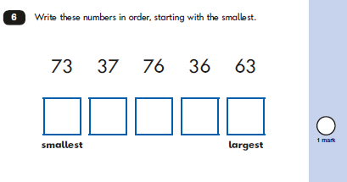
2017 Key Stage 1: Paper 2

Slide 11
2017 Key Stage 1: Paper 2

Slide 12
2017 Key Stage 1: Paper 2

Slide 13
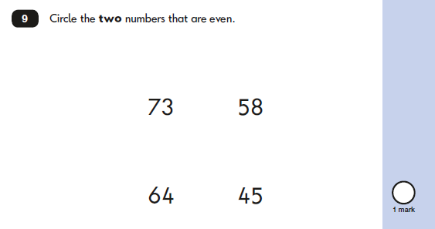
2017 Key Stage 1: Paper 2

Slide 14
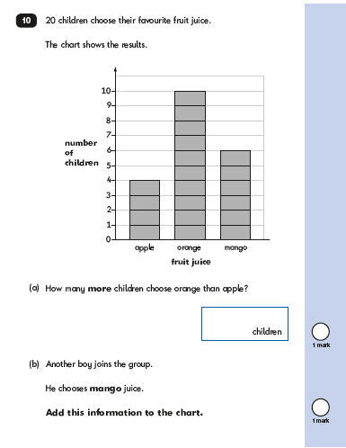
2017 Key Stage 1: Paper 2
4 examples of responses in mark scheme

Slide 15
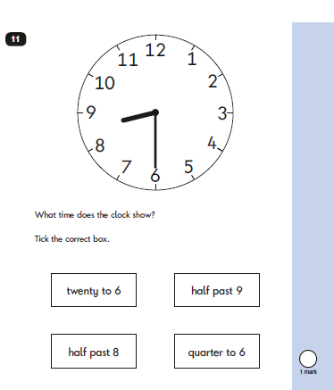
2017 Key Stage 1: Paper 2

Slide 16
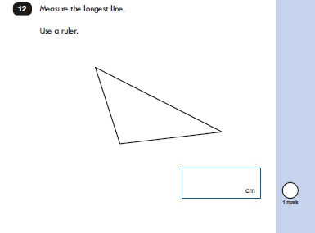
2017 Key Stage 1: Paper 2

Slide 17
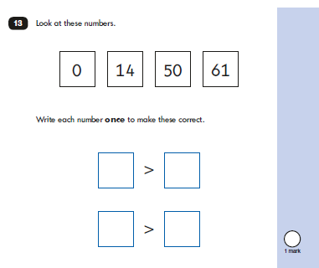
2017 Key Stage 1: Paper 2

Slide 18
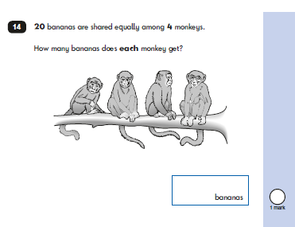
2017 Key Stage 1: Paper 2

Slide 19
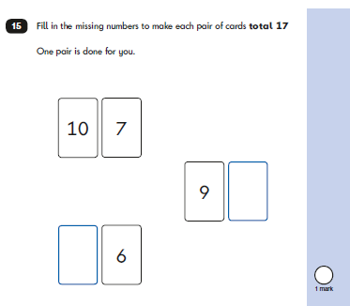
2017 Key Stage 1: Paper 2

Slide 20
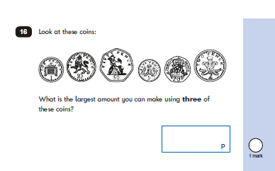
2017 Key Stage 1: Paper 2

Slide 21
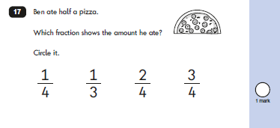
2017 Key Stage 1: Paper 2

Slide 22
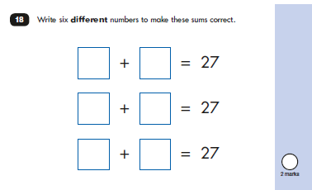
2017 Key Stage 1: Paper 2

Slide 23
2017 Key Stage 1: Paper 2

Slide 24
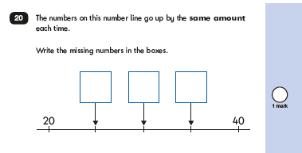
2017 Key Stage 1: Paper 2

Slide 25
2017 Key Stage 1: Paper 2

Slide 26
2017 Key Stage 1: Paper 2

Slide 27
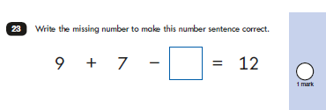
2017 Key Stage 1: Paper 2

Slide 28
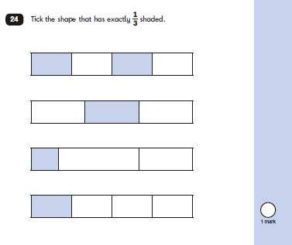
2017 Key Stage 1: Paper 2

Slide 29
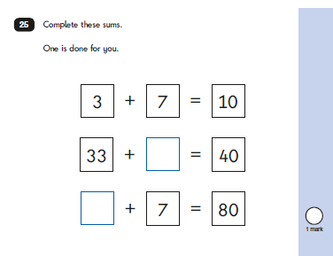
2017 Key Stage 1: Paper 2

Slide 30
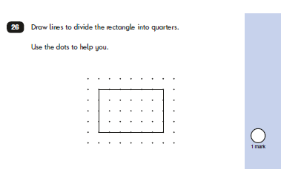
2017 Key Stage 1: Paper 2

Slide 31
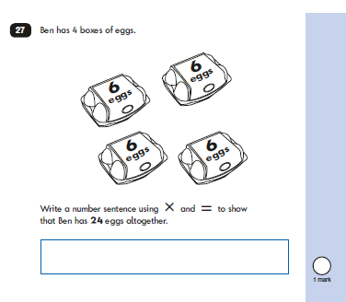
2017 Key Stage 1: Paper 2

Slide 32
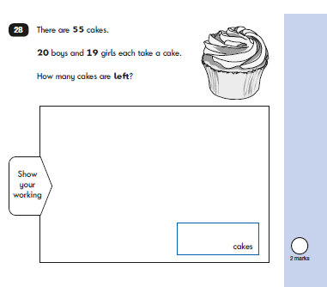
2017 Key Stage 1: Paper 2
10 examples of responses in mark scheme

Slide 33
2017 Key Stage 1: Paper 2

Slide 34
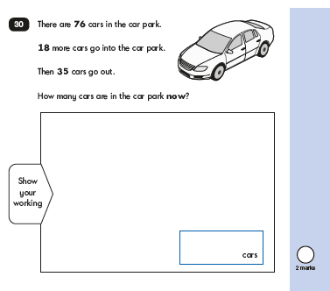
2017 Key Stage 1: Paper 2
8 examples of responses in mark scheme

Slide 35
2017 Key Stage 1: Paper 2

