Slide 1
Year 1
HIAS Blended Learning Resource
1.5 Telling the time
HIAS maths Team
Spring 2021
Final version
© Hampshire County Council

Slide 2
HIAS Blended Learning Resource
These slides are intended to support teachers and pupils with a blended approach to learning, either in-class or online. The tasks are intended to form part of a learning journey and could be the basis of either one lesson or a short sequence of connected lessons.
The 4-step Polya model for problem solving has been used to provide a structure to support reasoning. Teachers may need to use more or fewer steps to support the range of learners in their class.
Teachers should delete, change and add slides to suit the needs of their pupils. Extra slides with personalised prompts and appropriate examples based on previous teaching may be suitable. When changing the slide-deck, teachers should consider:
Their expectations for the use of representations such as bar models, number lines, arrays and diagrams.
Which strategies and methods pupils should use and record when solving problems or identifying solutions. This could include a range of informal jottings and diagrams, the use of tables to record solutions systematically and formal or informal calculation methods.
Teachers may also wish to record a ‘voice over’ to talk pupils through the slides.

Slide 3
HIAS Blended Learning Resource
1945 George Polya published ‘How To Solve It’ 2nd ed., Princeton University Press, 1957, ISBN 0-691-08097-6.

Slide 4
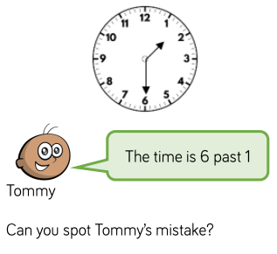
Maths focus: Telling the time
HIAS Blended Learning Resource

Slide 5
Understand the problem
HIAS Blended Learning Resource
There are 60 minutes in an hour.
Between each of the numbers around the clock is 5 minutes.
The longer hand is the minutes.
The shorter hand is the hour.
Minutes are shown in “minutes past” or “minutes to”
We use halves and quarters to show the distance around the clock too.
30 minutes = half past
Common Problems
Muddling up the hand.
Reading the numbers on the clock-face as minutes.

Slide 6
Make a Plan
HIAS Blended Learning Resource
Step 1: Start at 12 and count round the clock until you reach the minute (longer) hand to show how many minutes.
Step 2: Look at the hour hand to see which numbers it is on or between.
Put the times shown by the hands together to tell the time.
Step 3: Explain whether Tommy is right or wrong. Give examples of how to tell the time or what common mistakes they may have made.
Tommy is right because…..
Tommy is not right because…….

Slide 7
Step 1: Start at 12 and count round the clock until you reach the minute (longer) hand to show how many minutes.
5 minutes past
10 minutes past
The Minute hand shows
Half past_____
15 past (or quarter)
20 minutes past
25 minutes past
30 minutes past or half past

Slide 8
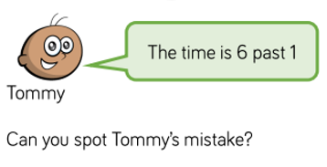
Step 2: Look at the position of the hour hand.
The hour hand is between 1 and 2. This means it is between 1 o’clock and 2’o clock.
It is half past one
Step 3: Explain Tommy’s mistake.
I think Tommy thinks each number on the clock is worth 1 minute.

Slide 9
Carry out your plan: show your reasoning
HIAS Blended Learning Resource
Step 1: The minute hand shows half past the hour. Count in 5s (minutes) at each number.
“5, 10, 15, 20, 25, 30”
Step 2: Look at the position of the hour hand.
Step 3: Explain Tommy’s mistake. Tommy is right because…..
Tommy is not right because…….
I think Tommy thinks each number on the clock is worth 1 minute.

Slide 10
Review your solution: does it seem reasonable? Which steps/ parts did you find easy and which harder?
HIAS Blended Learning Resource
How could you check?
Go through the steps you took and check for errors
Check you have counted in 5s correctly.
Have you given reasons and explained why you think Tommy is right/wrong?

Slide 11
Now try this one
HIAS Blended Learning Resource
Understand the problem
Make a plan
Carry out your plan: show your reasoning
Review your solution: does it seem reasonable?
Think about your learning: which parts of the problem did you find easy and which parts did you find harder?
TASK variation
2 minutes past 6

Slide 12
HIAS Maths team
HIAS Blended Learning Resource
The HIAS maths team offer a wide range of high-quality services to support schools in improving outcomes for learners, including courses, bespoke consultancy and in-house training.
For further details referring to maths, please contact either of the team leads:
Jacqui Clifft : Jacqui.clifft@hants.gov.uk
Jo Lees: Jo.Lees@hants.gov.uk
For further details on the full range of services available please contact us using the following details:
Tel: 01962 874820 or email: hias.enquiries@hants.gov.uk
For further details on the full range of services available please contact us using the following details:
Tel: 01962 874820 or email: hias.enquiries@hants.gov.uk

