Slide 1
Year 4
HIAS Blended Learning Resource
Multiplication and Division
Solve problems involving multiplication and division 2
HIAS maths Team
Spring 2021
Final version
© Hampshire County Council

Slide 2
HIAS Blended Learning Resource
These slides are intended to support teachers and pupils with a blended approach to learning, either in-class or online. The tasks are intended to form part of a learning journey and could be the basis of either one lesson or a short sequence of connected lessons.
The 4-step Polya model for problem solving has been used to provide a structure to support reasoning. Teachers may need to use more or fewer steps to support the range of learners in their class.
Teachers should delete, change and add slides to suit the needs of their pupils. Extra slides with personalised prompts and appropriate examples based on previous teaching may be suitable. When changing the slide-deck, teachers should consider:
Their expectations for the use of representations such as bar models, number lines, arrays and diagrams.
Which strategies and methods pupils should use and record when solving problems or identifying solutions. This could include a range of informal jottings and diagrams, the use of tables to record solutions systematically and formal or informal calculation methods.
Teachers may also wish to record a ‘voice over’ to talk pupils through the slides.

Slide 3
HIAS Blended Learning Resource
1945 George Polya published ‘How To Solve It’ 2nd ed., Princeton University Press, 1957, ISBN 0-691-08097-6.

Slide 4
Solve problems involving multiplication and division
HIAS Blended Learning Resource
A class of 36 children are travelling to an ‘outdoor’ pursuit centre together.
They travel by mini bus. Each mini bus will hold 8 passengers.
6 adults will be accompanying the children.
How many minibuses are needed?
How many spare seats will there be?
Adapted from ‘Dip and Pick

Slide 5
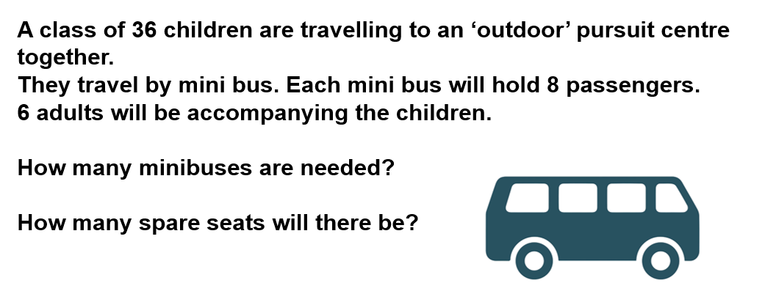
Understand the problem
HIAS Blended Learning Resource
Some children and adults are travelling by mini bus to an ‘outdoor’ pursuit centre.
Key fact: a minibus holds 8 passengers
We need to work out how many mini buses are needed to take everyone. We can’t leave anyone behind.
We have to calculate in groups of 8 seats. We may have some empty seats in one mini bus.
TASK

Slide 6
Make a Plan
HIAS Blended Learning Resource
Step 1:
Work out how many people (children and adults ) need to travel to the ’outdoor’ pursuit centre.
Step 2:
Work out how many groups of 8 this is. Each group of 8 people will fill a mini bus.
Step 3:
Work out how many spare seats there will be.
TASK

Slide 7
There are 42 people
This is not a multiple of 8
There are ? full mini buses
? people left to go in another mini bus
+8
+8
0
?
?
?
?
?
?
1 bus = 8 people
2 buses = 16 people
3 buses = 24 people …
8 x 1 = 8
8 x 2= 16
8 x 3 = 24 …

Slide 8
Carry out your plan: show your reasoning
HIAS Blended Learning Resource
Step 1:
Work out how many people (children and adults ) need to travel to the ’outdoor’ pursuit centre.
36 children + 6 adults = 42 people
Step 2:
Work out how many groups of 8 this is. Each group of 8 people will fill a mini bus.
42 is not a multiple of 8.
40 ÷ 8 = 5 full mini buses
42 ÷ 8 = 5 full mini buses and 2 people left behind
We will need an extra mini bus with 2 people in it.
Step 3:
Work out how many spare seats there will be.
There will be 6 spare seats
TASK

Slide 9
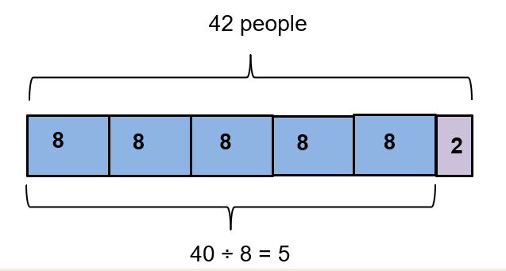
There are 42 people
This is not a multiple of 8
There are five full mini buses (8x5 =40)
Two people left to go in another mini bus
42 ÷ 8 = 5 full buses remainder 2 people
42 ÷ 8 = 5 r 2
Need 6 minibuses
+8
+8
+8
+8
+8
+2
0
8
16
24
32
40
42
only 2 people in this bus
6 spare seats
6 mini buses are needed.
There will be 6 spare seats.
40 people divided into groups of 8 is 5 groups of 8 people.
40 ÷ 8 = 5
42 people divided into groups of 8 is 5 groups of 8 people and 2 people left over.
42÷ 8 = 5 r 2

Slide 10
Review your solution: does it seem reasonable? Which steps/ parts did you find easy and which harder?
HIAS Blended Learning Resource
How could you check?
Go through the steps you took and check for errors
Remember the question is about how many
minibuses are needed and how many spare
seats
2.Try to solve the calculation a different way and see if you get the same answer
TASK

Slide 11
Now try this one
HIAS Blended Learning Resource
Understand the problem
Make a plan
Carry out your plan: show your reasoning
Review your solution: does it seem reasonable?
Think about your learning: which parts of the problem did you find easy and which parts did you find harder?
TASK variation
A class of 30 children are travelling to an ‘outdoor’ pursuit centre together.
They travel by mini bus. Each mini bus will hold 8 passengers.
5 adults will be accompanying the children.
How many minibuses are needed?
How many spare seats will there be?

Slide 12
HIAS Maths team
HIAS Blended Learning Resource
The HIAS maths team offer a wide range of high-quality services to support schools in improving outcomes for learners, including courses, bespoke consultancy and in-house training.
For further details referring to maths, please contact either of the team leads:
Jacqui Clifft : Jacqui.clifft@hants.gov.uk
Jo Lees: Jo.Lees@hants.gov.uk
For further details on the full range of services available please contact us using the following details:
Tel: 01962 874820 or email: hias.enquiries@hants.gov.uk
For further details on the full range of services available please contact us using the following details:
Tel: 01962 874820 or email: hias.enquiries@hants.gov.uk

