Slide 1
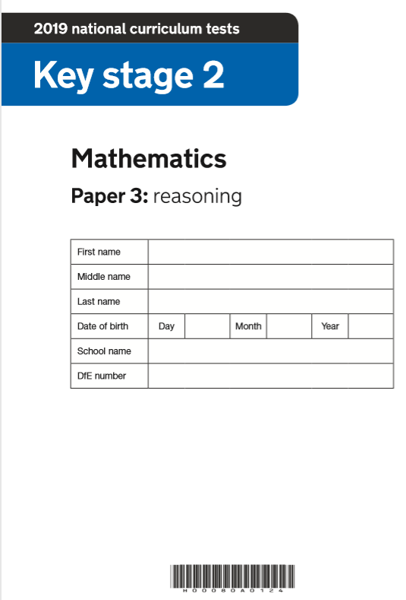
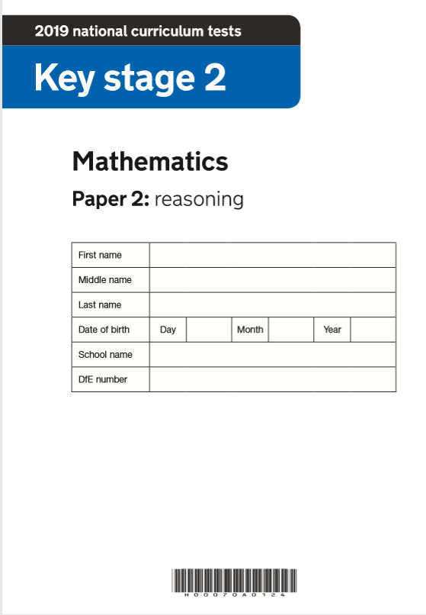
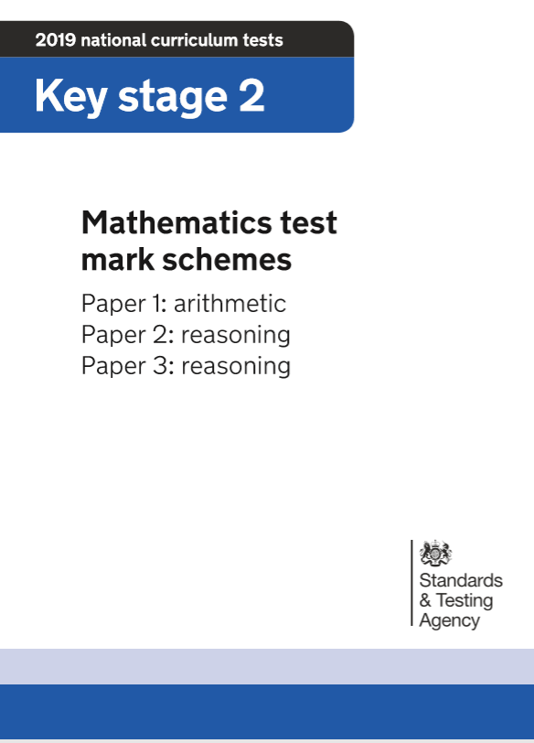
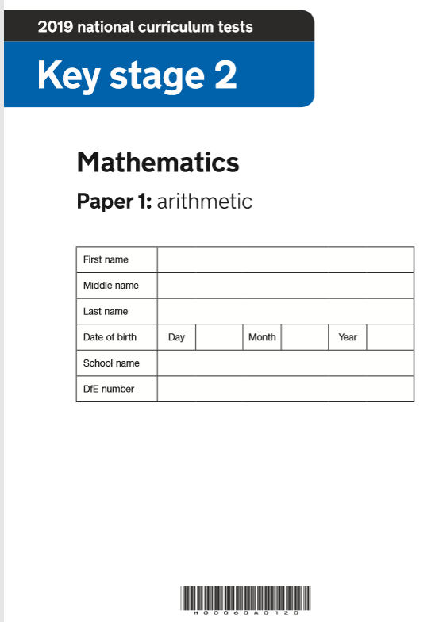
2019 Key Stage 2 SATs Mathematics
Arithmetic Paper 1
Reasoning Paper 2
Reasoning Paper 3
Pre- Key Stage 2 Standards

Slide 2
Key Stage 2 SATs papers 2019
https://www.gov.uk/government/publications/key-stage-2-tests-2019-mathematics-test-materials
Key stage 2 SATs 2019 scaled scores available in July 2019
Guidance
Scaled scores at key stage 2
Information for headteachers, teachers, governors and local authorities about scaled scores and the expected standard for the 2018 national curriculum tests.
https://www.gov.uk/guidance/scaled-scores-at-key-stage-2

Slide 3
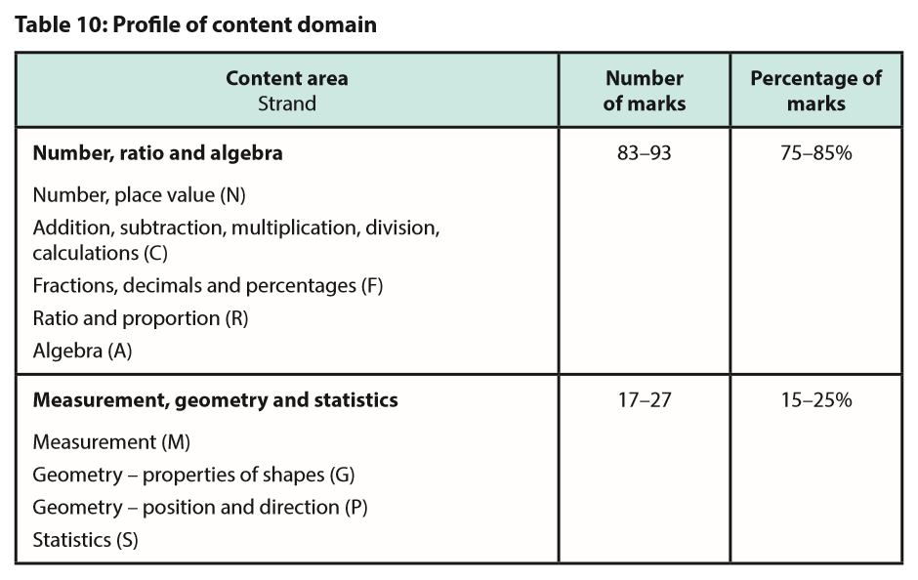
Guidance for test developers on the purpose, format, content, cognitive demand and specification for the key stage 2 mathematics test.
https://www.gov.uk/government/publications/key-stage-2-mathematics-test-framework

Slide 4
Statutory guidance
Pre-key stage 2 standards
For teachers to report assessment outcomes for pupils working below the standard of national curriculum assessments (commonly called SATs) at the end of KS2.
Details
Pre-key stage standards are for pupils who are working below the overall standard of national curriculum assessments, but who are engaged in subject-specific study.
2018 to 2019 Pre-key stage 2 standards
Teachers must use these standards to make statutory teacher assessment judgements at the end of key stage 2 for pupils who are working below the national curriculum tests and teacher assessment frameworks, and above P scale 4. If a pupil is working below these standards, teachers should report their outcomes using P scales 1 to 4.
These are for use from the 2018 to 2019 academic year onwards. They are the same documents that we originally published in May 2018 to give teachers advance notice of the final standards.
https://www.gov.uk/government/publications/pre-key-stage-2-standards

Slide 5
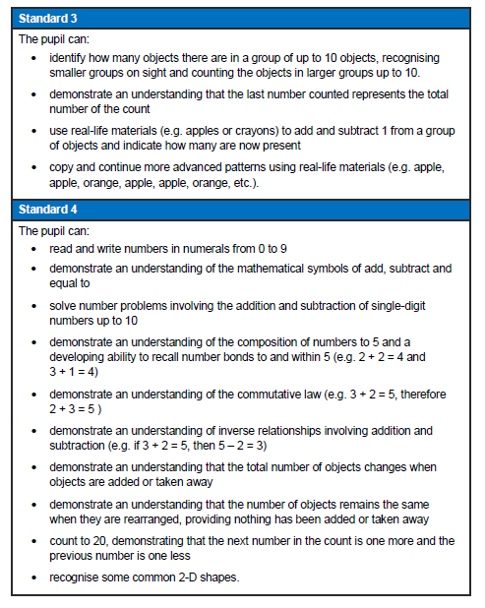
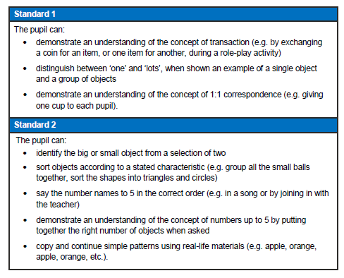
Pre Key Stage 2
…teachers need to have evidence which demonstrates that the pupil meets all of the statements within that standard.’
‘Assess each individual pupil based on their own method of communication, and disregard statements which a pupil is physically unable to access.’

Slide 6
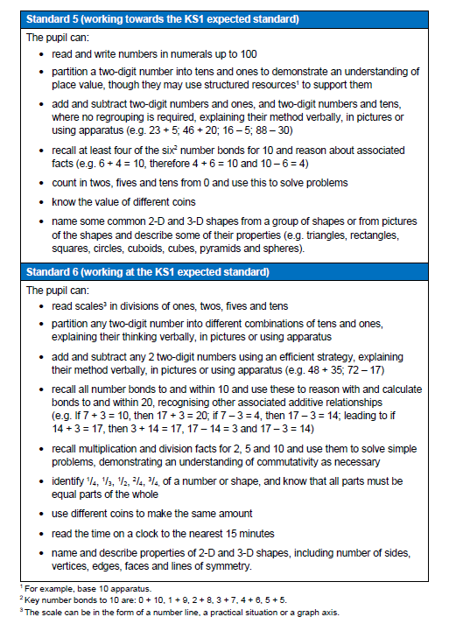
Pre Key Stage 2
Standard 5 and 6
Same wording as KS1 Teacher Assessment Frameworks 2018/19

Slide 7
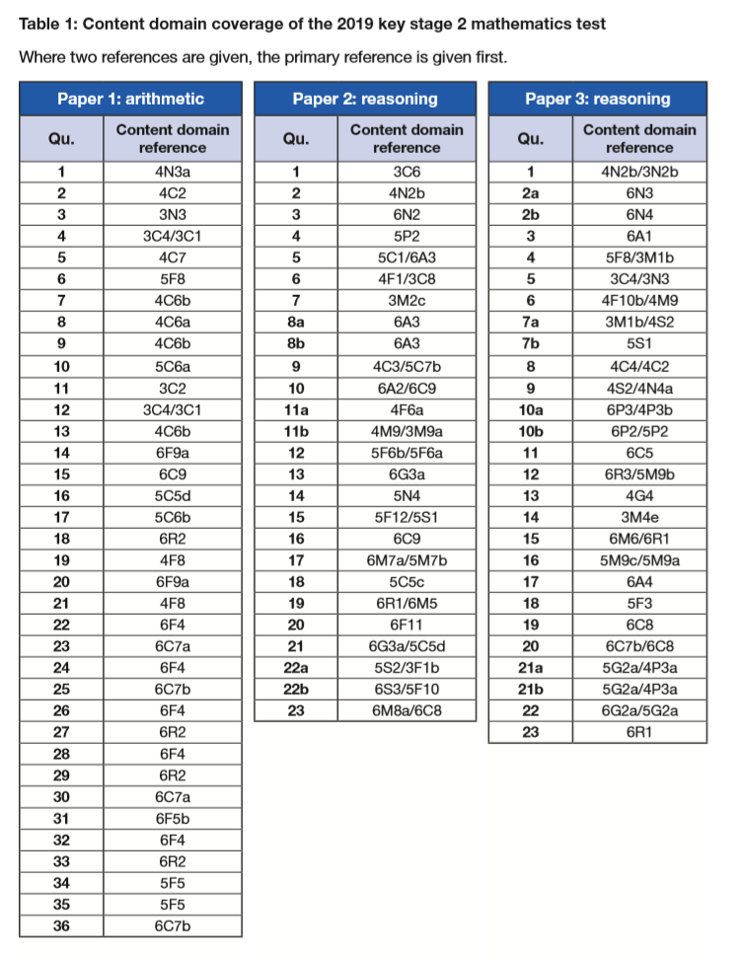
Key Stage 2 Mathematics
Mark Scheme
https://www.gov.uk/government/publications/key-stage-2-tests-2019-mathematics-test-materials

Slide 8
https://www.gov.uk/government/publications/key-stage-2-tests-2019-mathematics-test-materials

Slide 9
https://www.gov.uk/government/publications/key-stage-2-tests-2019-mathematics-test-materials
Key Stage 2 SATs: Arithmetic Paper 1
Year 3: Q3, 4, 11,12
Year 4: Q1, 2, 5, 7, 8, 9,13,19, 21
Year 5: Q6, 10,16,17, 34, 35
Year 6: Q14, 15, 18, 20, 22-33, 36
13 questions from Lower KS 2
2018, 2017 (2016)
Arithmetic Paper 36, 36 (36) Qs
Y3= 4, 3 (8) Y4= 9, 10 (5) Y5= 6, 7 (11) Y6= 16,16 (12) (from Q 18,14(19))
Number of questions involving:
Add/sub: 14
Multiplication: 9
Division: 8
%: 4
Fractions: 8

Slide 10
Analysis of Questions in KS2 SATs 2018, 2017 (2016)
Arithmetic Paper 36,36 (36) Qs | Reasoning Paper 2 23, 23 (20) Qs | Reasoning Paper 3 21, 24(21)Qs
Y3= 4, 3 (8) Y4= 9, 10 (5) Y5= 6, 7 (11) Y6= 16,16 (12) (from Q 18,14(19)) | Y3= 3, 0 (5) answers Y4= 3, 6 (2) answers Y5= 6, 7 (6) answers* Y6= 10, 8 (13) answers (from Q 5,11 (7) | Y3= 1, 2 (1) answer Y4= 3, 4 (5) answers* Y5= 10, 5 (7) answers* Y6= 12, 9 (13) answers* (from Q 2,4(2)
Denotes a ‘part answer’ also

Slide 11
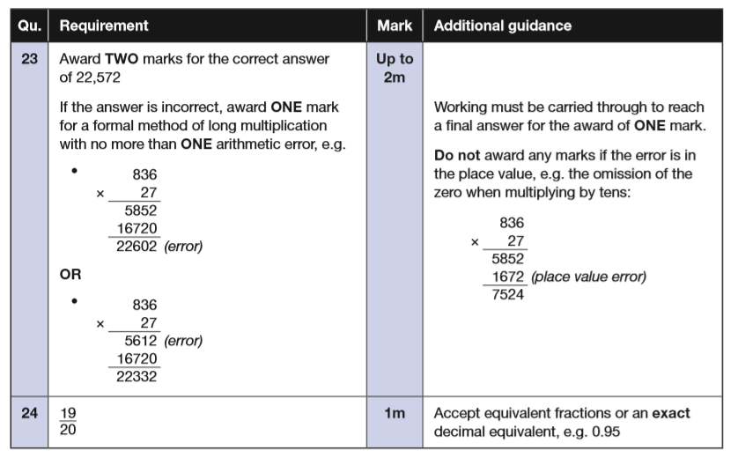
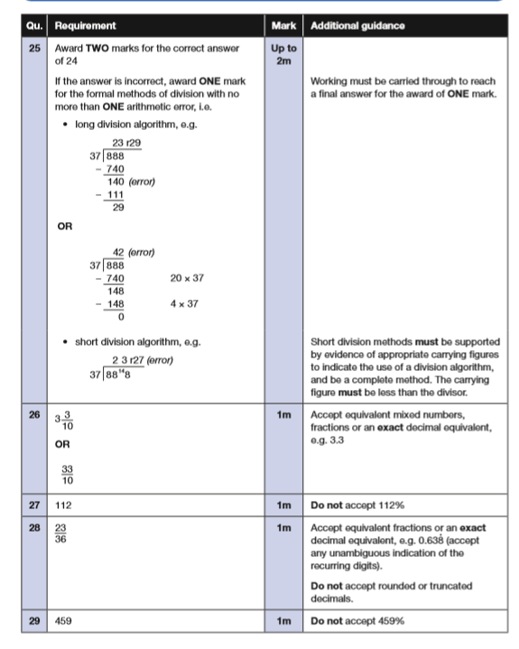
https://www.gov.uk/government/publications/key-stage-2-tests-2019-mathematics-test-materials

Slide 12
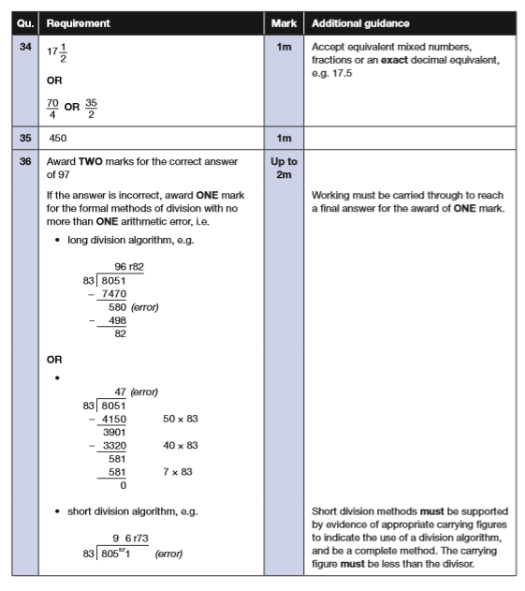
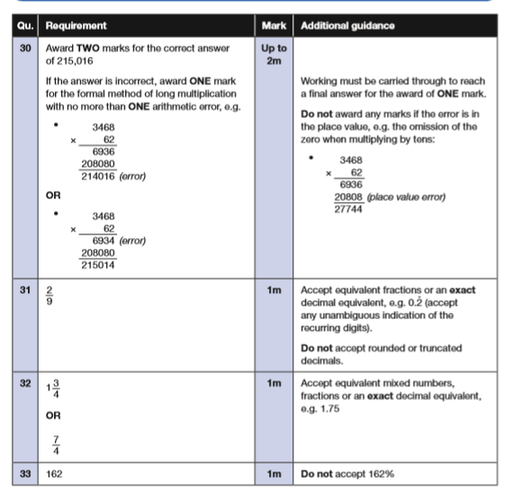
https://www.gov.uk/government/publications/key-stage-2-tests-2019-mathematics-test-materials

Slide 13
Key Stage 2 Arithmetic Paper 2019 Q1- 15
https://www.gov.uk/government/publications/key-stage-2-tests-2019-mathematics-test-materials
Notes:
Questions in order of the test top to bottom, left to right..

Slide 14
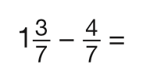
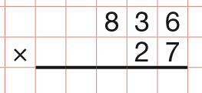
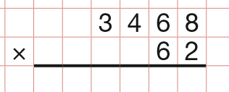
Key Stage 2 Arithmetic Paper 2019 Q16-30
https://www.gov.uk/government/publications/key-stage-2-tests-2019-mathematics-test-materials
Notes:
Questions in order of the test top to bottom, left to right..

Slide 15
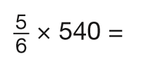
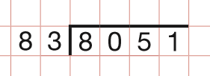
Key Stage 2 Arithmetic Paper 2019 Q31- 36
https://www.gov.uk/government/publications/key-stage-2-tests-2019-mathematics-test-materials
Notes:
Questions in order of the test top to bottom, left to right..

Slide 16
2019: KS2 Arithmetic Paper Addition and subtraction
Notes:
Questions in order of the test top to bottom, left to right..

Slide 17
2019: KS2 Arithmetic Paper Multiplication and Division
Notes:
Questions in order of the test top to bottom, left to right..

Slide 18
2019: KS2 Arithmetic Paper Fractions
Notes:
Questions in order of the test top to bottom, left to right..

Slide 19
2019: KS2 Arithmetic Paper Percentages
2018: Key Stage 2

Slide 20
Year 3 /4 questions: Arithmetic Paper 2019 Q:1, 2, 3, 4, 5, 7, 8, 9,11,12,13,19, 21
https://www.gov.uk/government/publications/key-stage-2-tests-2019-mathematics-test-materials
Notes:
Questions in order of the test top to bottom, left to right..

Slide 21
https://www.gov.uk/government/publications/key-stage-2-tests-2019-mathematics-test-materials

Slide 22
Key Stage 2 Mathematics
Mark Scheme
https://www.gov.uk/government/publications/key-stage-2-tests-2019-mathematics-test-materials

Slide 23
https://www.gov.uk/government/publications/key-stage-2-tests-2019-mathematics-test-materials
Key Stage 2 SATs: Reasoning Paper 2
Year 3: Q1, 6, 7
Year 4: Q2, 6, 9, 11
Year 5: Q4, 5, 12,14,15, 18, 22a
Year 6: Q3, 5, 8, 10,13,16,17,19, 20, 21, 22, 23
7 questions from Lower KS 2
7 questions Y5
12 questions Y6
2018, 2017 (2016)
Reasoning Paper 2 23, 23 (20) Qs
Y3= 3, 0 (5) answers Y4= 3, 6 (2) answers Y5= 6, 7 (6) answers* Y6= 10, 8 (13) answers (from Q 5,11 (7)

Slide 24
2019 Key Stage 2: Paper 2 Reasoning

Slide 25
2019 Key Stage 2: Paper 2 Reasoning

Slide 26
2019 Key Stage 2: Paper 2 Reasoning

Slide 27
2019 Key Stage 2: Paper 2 Reasoning

Slide 28
2019 Key Stage 2: Paper 2 Reasoning

Slide 29
2019 Key Stage 2: Paper 2 Reasoning

Slide 30
2019 Key Stage 2: Paper 2 Reasoning

Slide 31
2019 Key Stage 2: Paper 2 Reasoning

Slide 32
2019 Key Stage 2:Paper 2 Reasoning

Slide 33
2019 Key Stage 2:Paper 2 Reasoning

Slide 34
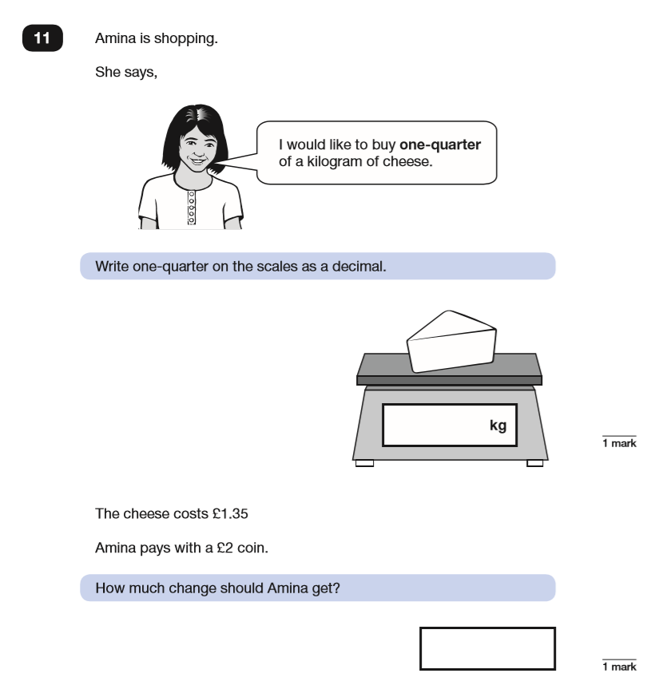
2019 Key Stage 2:Paper 2 Reasoning

Slide 35
2019 Key Stage 2: Paper 2 Reasoning

Slide 36
2019 Key Stage 2: Paper 2 Reasoning

Slide 37
2019 Key Stage 2: Paper 2 Reasoning

Slide 38
2019 Key Stage 2: Paper 2 Reasoning

Slide 39
2019 Key Stage 2:Paper 2 Reasoning

Slide 40
2019 Key Stage 2:Paper 2 Reasoning

Slide 41
2019 Key Stage 2: Paper 2 Reasoning

Slide 42
2019 Key Stage 2: Paper 2 Reasoning

Slide 43
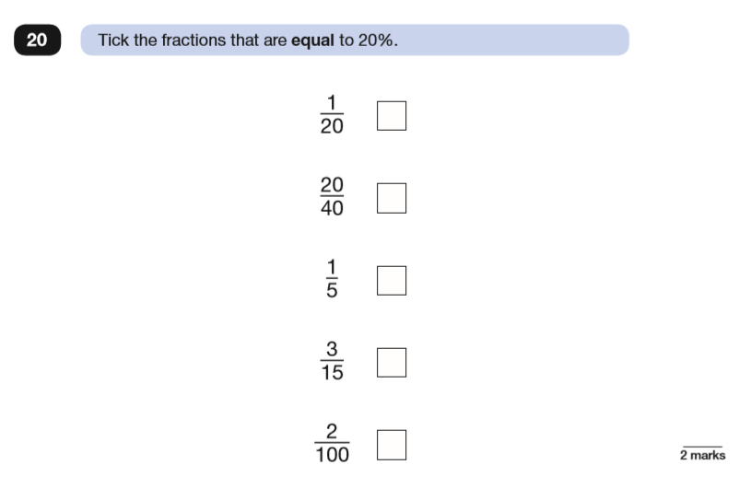
2019 Key Stage 2: Paper 2 Reasoning Paper 2 Reasoning

Slide 44
2019 Key Stage 2: Paper 2 Reasoning

Slide 45
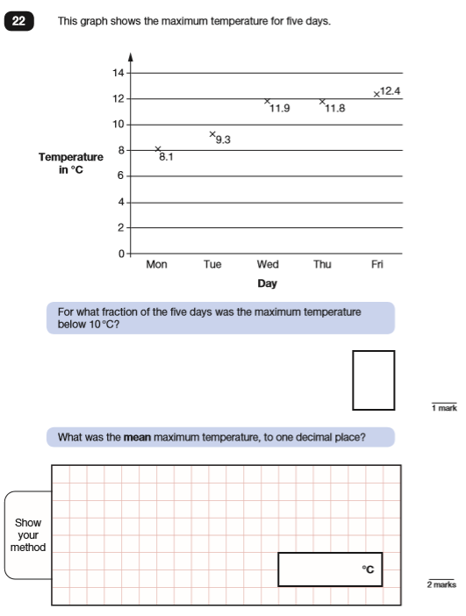
2019 Key Stage 2: Paper 2 Reasoning

Slide 46
2019 Key Stage 2:Paper 2 Reasoning

Slide 47
https://www.gov.uk/government/publications/key-stage-2-tests-2019-mathematics-test-materials

Slide 48
Key Stage 2 Mathematics
Mark Scheme
https://www.gov.uk/government/publications/key-stage-2-tests-2019-mathematics-test-materials

Slide 49
https://www.gov.uk/government/publications/key-stage-2-tests-2019-mathematics-test-materials
Key Stage 2 SATs: Reasoning Paper 3
Year 3: Q1, 4, 5, 7a,14
Year 4: Q1, 6, 8, 9,10a,13
Year 5: Q1, 7b,16, 18, 21, 22
Year 6: Q2, 3,10,11,12,15,17,19, 20, 22, 23
8 questions from Lower KS 2
6 questions Y5
11 questions Y6
2018, 2017 (2016)
Reasoning Paper 3 21, 24(21)Qs
Y3= 1, 2 (1) answer Y4= 3, 4 (5) answers* Y5= 10, 5 (7) answers* Y6= 12, 9 (13) answers* (from Q 2,4(2)

Slide 50
2019 Key Stage 2: Paper 3 Reasoning

Slide 51
2019 Key Stage 2: Paper 3 Reasoning

Slide 52
2019 Key Stage 2: Paper 3 Reasoning

Slide 53
2019 Key Stage 2: Paper 3 Reasoning

Slide 54
2019 Key Stage 2: Paper 3 Reasoning

Slide 55
2019 Key Stage 2: Paper 3 Reasoning

Slide 56
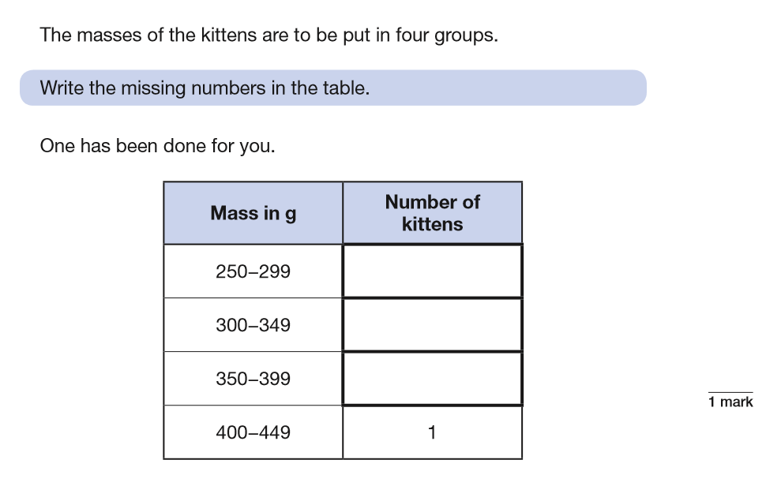
2019 Key Stage 2: Paper 3 Reasoning

Slide 57
2019 Key Stage 2: Paper 3 Reasoning

Slide 58
2019 Key Stage 2: Paper 3 Reasoning

Slide 59
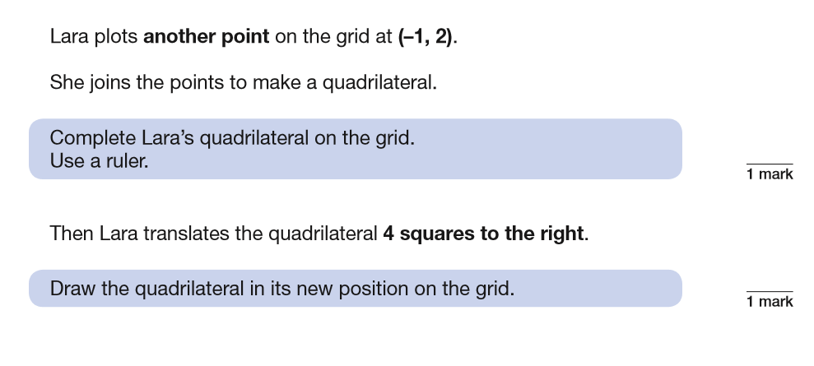
2019 Key Stage 2: Paper 3 Reasoning

Slide 60
2019 Key Stage 2: Paper 3 Reasoning

Slide 61
2019 Key Stage 2: Paper 3 Reasoning

Slide 62
2019 Key Stage 2: Paper 3 Reasoning

Slide 63
2019 Key Stage 2: Paper 3 Reasoning

Slide 64
2019 Key Stage 2: Paper 3 Reasoning

Slide 65
2019 Key Stage 2: Paper 3 Reasoning

Slide 66
2019 Key Stage 2: Paper 3 Reasoning

Slide 67
2019 Key Stage 2: Paper 3 Reasoning

Slide 68
2019 Key Stage 2: Paper 3 Reasoning

Slide 69
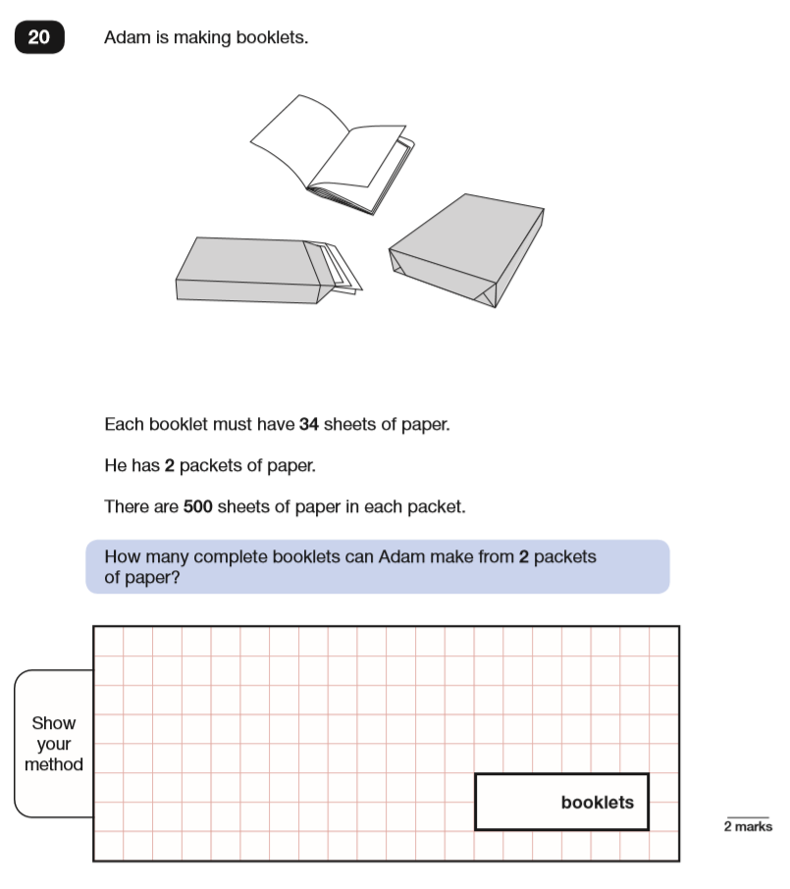
2019 Key Stage 2: Paper 3 Reasoning

Slide 70
2019 Key Stage 2: Paper 3 Reasoning

Slide 71
2019 Key Stage 2: Paper 3 Reasoning

Slide 72
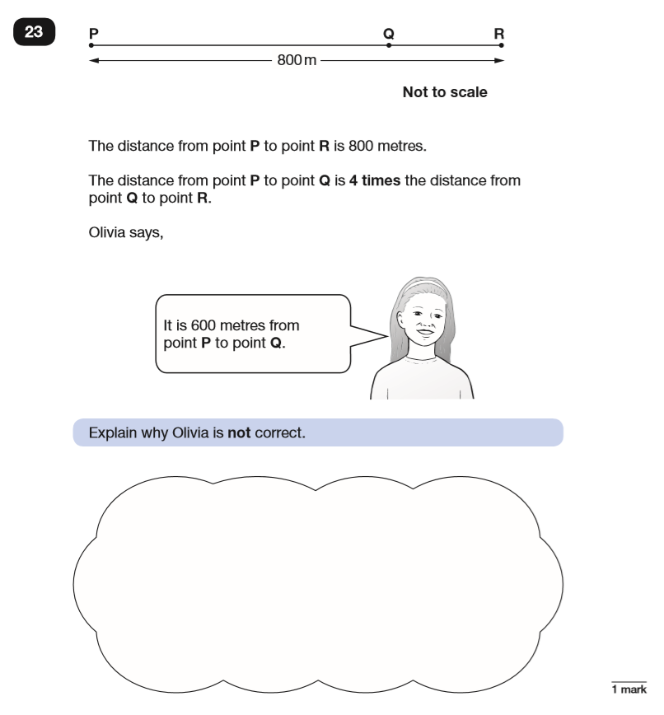
2019 Key Stage 2: Paper 3 Reasoning

