Slide 1
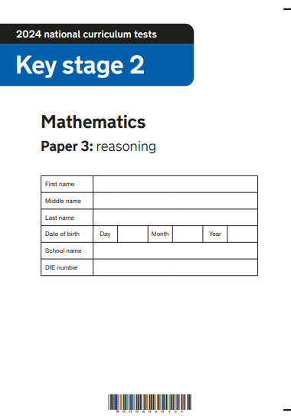
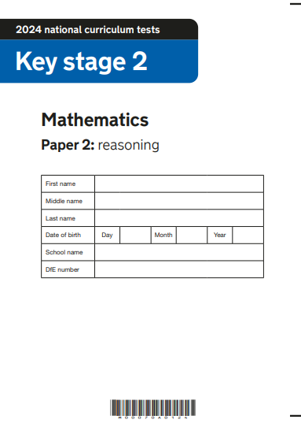
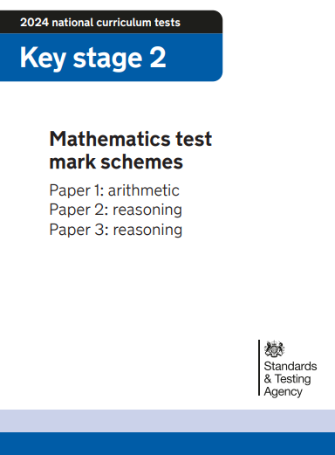
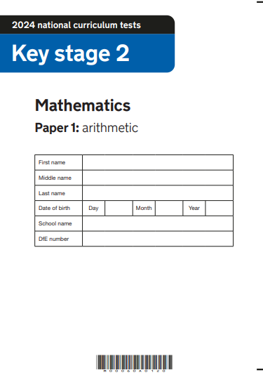
2024 Key Stage 2 SATs
Arithmetic Paper 1
Reasoning Paper 2
Reasoning Paper 3
Pre- Key Stage 2 Standards

Slide 2
Key Stage 2 SATs papers 2024
Key stage 2 tests: 2024 mathematics test materials - GOV.UK (www.gov.uk)
Key stage 2 SATs 2024 scaled scores published in July 2024 Guidance
Scaled scores at key stage 2
Information for headteachers, teachers, governors and local authorities about scaled scores and the expected standard for the 2023 national curriculum tests.
Understanding scaled scores at key stage 2 - GOV.UK (www.gov.uk)

Slide 3
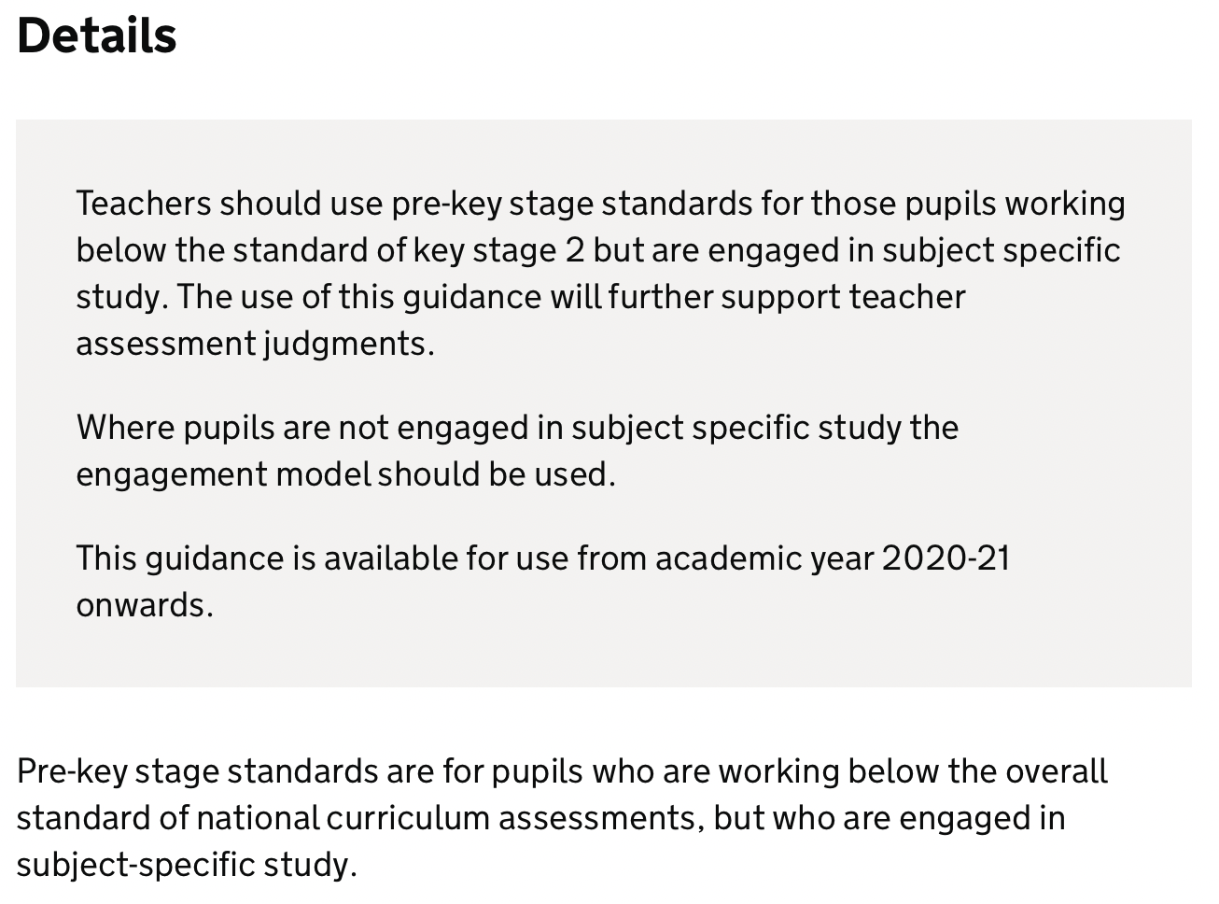
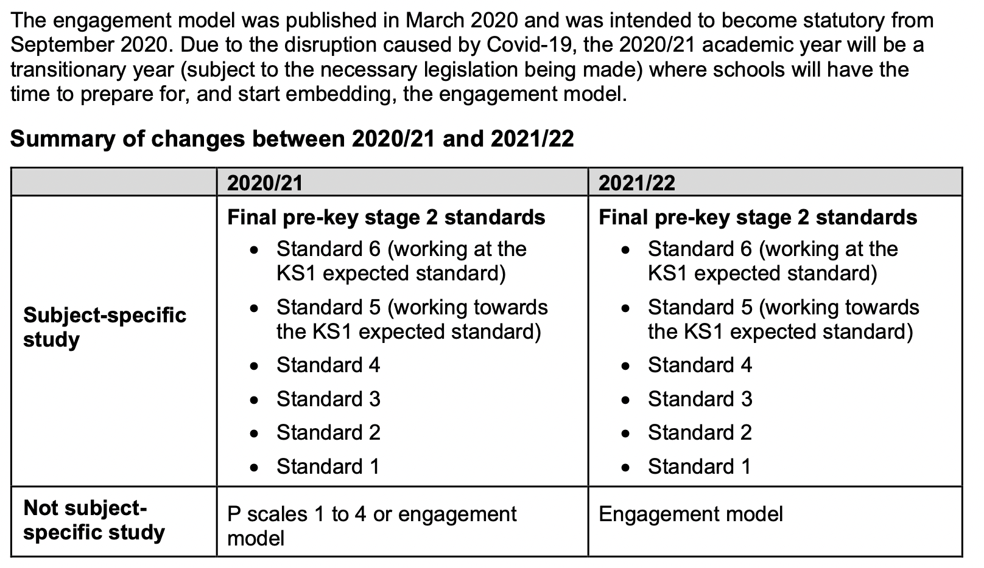
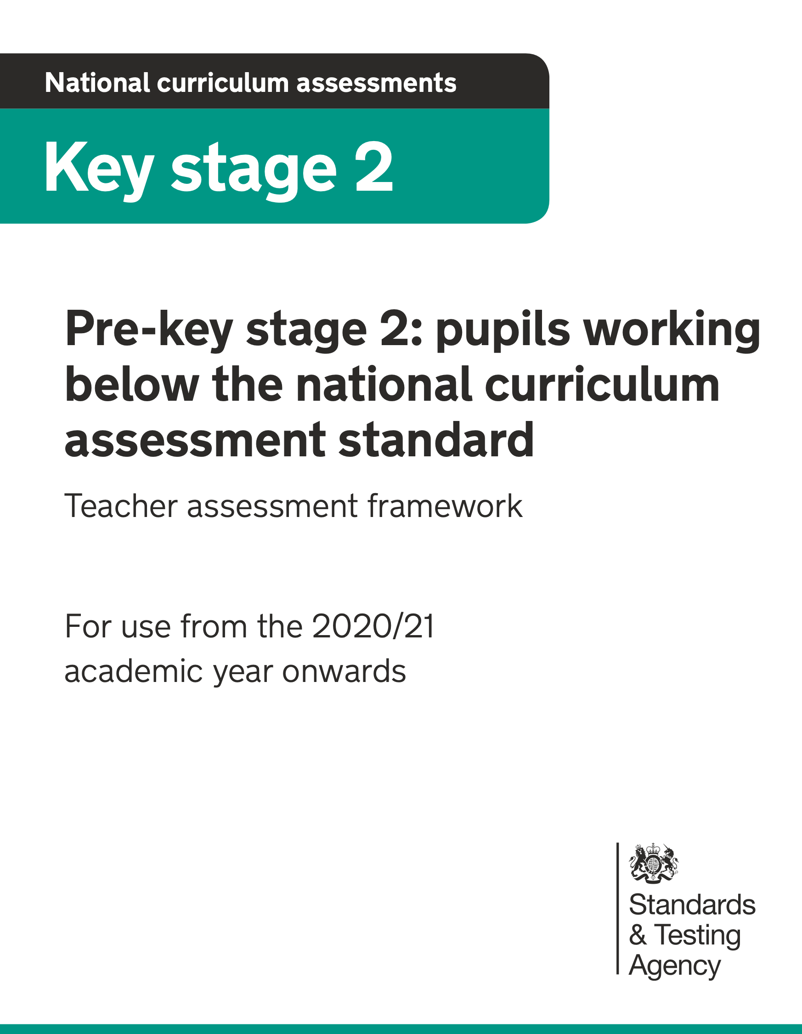
Pre-key stage 2 standards
https://www.gov.uk/government/publications/pre-key-stage-2-standards

Slide 4
Pre-key stage 2
Using the mathematics pre-key stage standards
The six standards in this framework contain a number of ‘pupil can’ statements. To judge that a pupil is working at a standard in mathematics, teachers need to have evidence which demonstrates that the pupil meets all of the statements within that standard.
As stated on page 3, teachers should assess each individual pupil based on their own method of communication, and disregard statements which a pupil is physically unable to access.

Slide 5
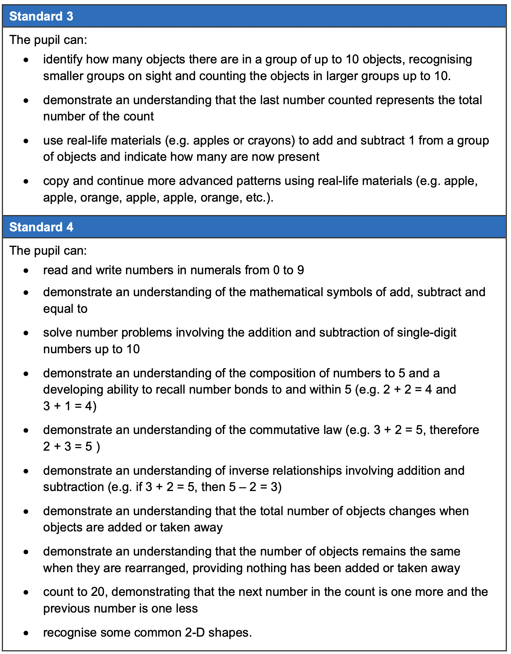
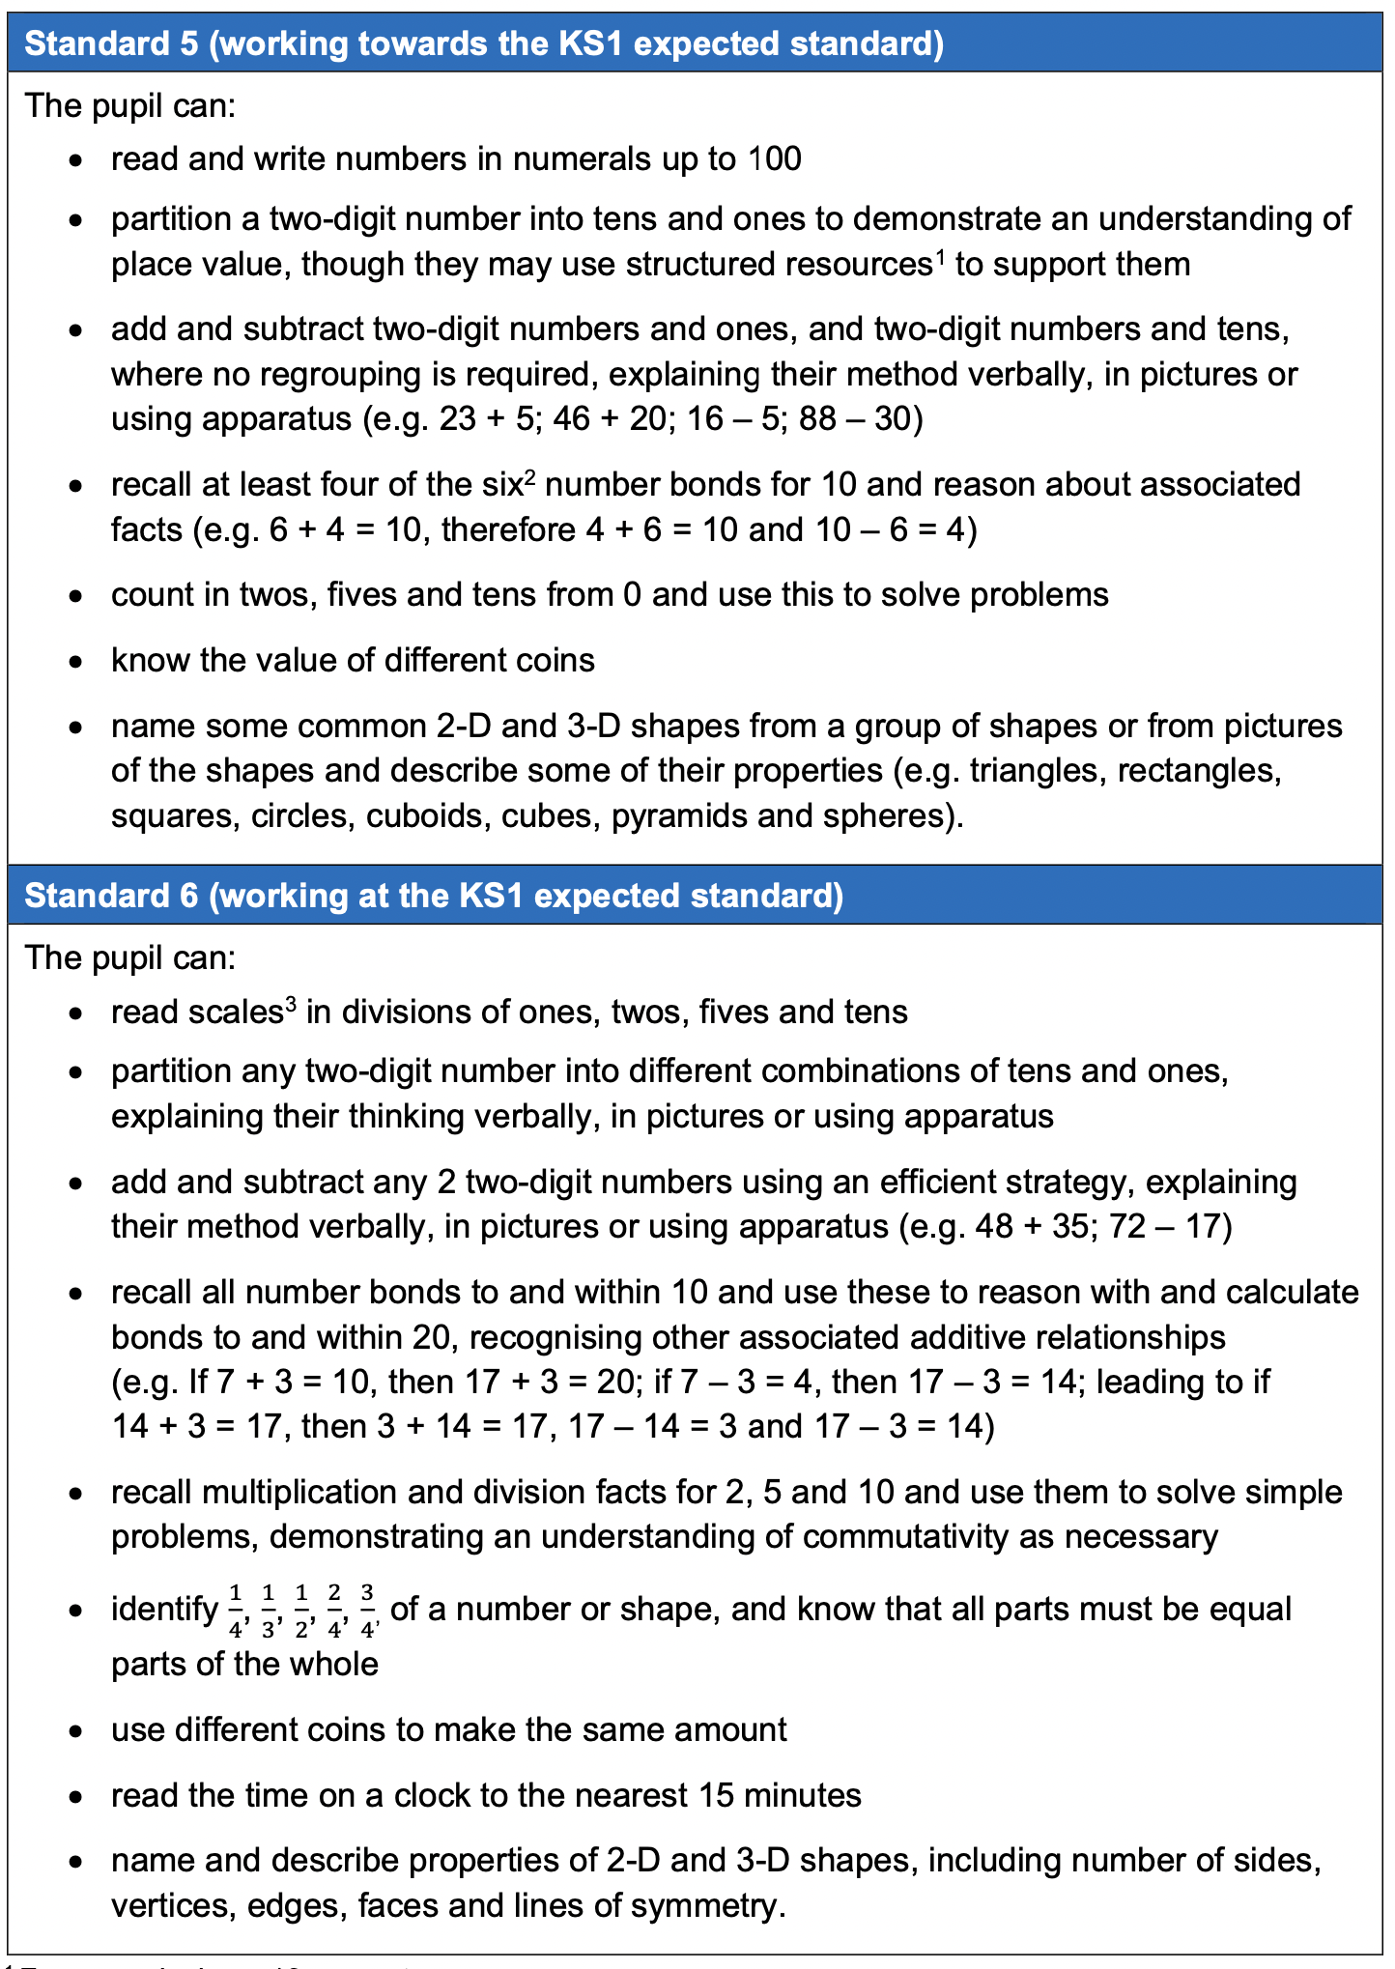

Slide 6
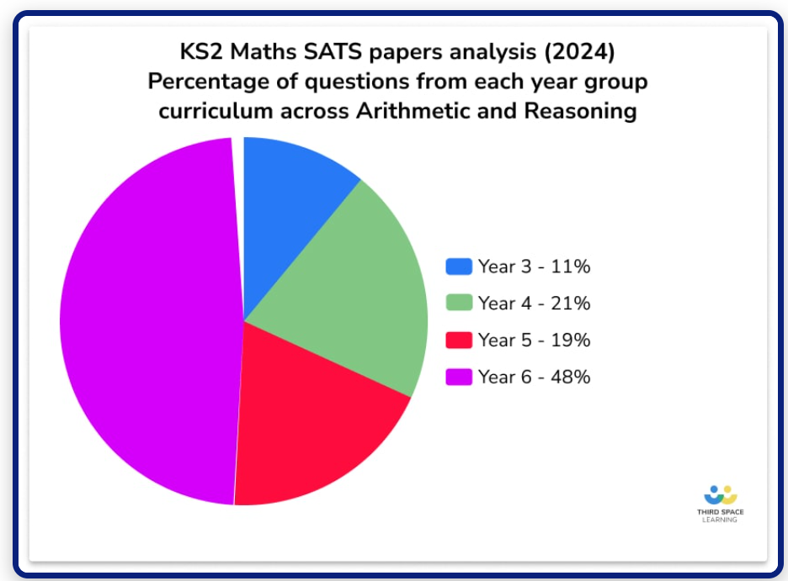
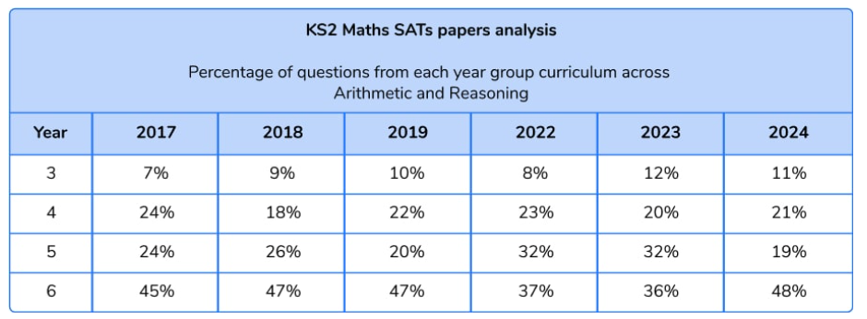
KS2 SATs Analysis
KS2 SATs 2024: Maths Papers Question Breakdown (thirdspacelearning.com)

Slide 7
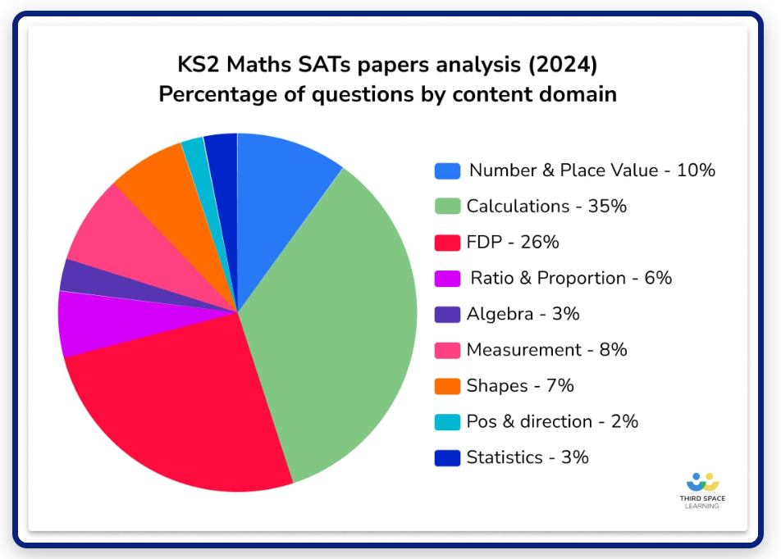
Notes:
Same domain weighting as before – hasn’t changed.

Slide 8
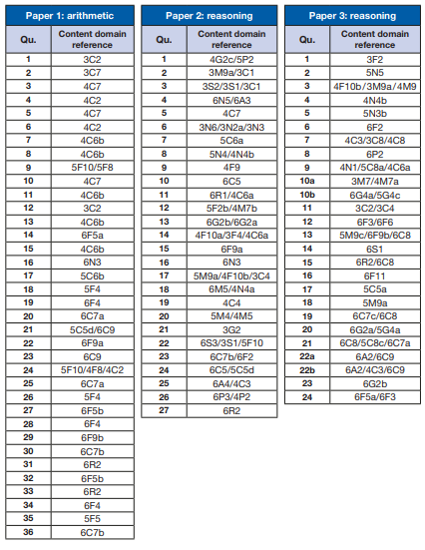
Key Stage 2 Mathematics
Mark Scheme
Content domain coverage
The 2024 test meets the specification in the test framework.
Table 1 sets out the areas of the content domain that are assessed in Papers 1, 2 and 3.
The references are taken from the test framework. A question assessing 4C7, for example, sets out to ‘multiply two-digit and three-digit numbers by a one-digit number using a formal written layout’ and is taken from the year 4 programme of study.
2016 key stage 2 mathematics test framework (publishing.service.gov.uk)
Key stage 2 tests: 2024 mathematics test materials

Slide 9
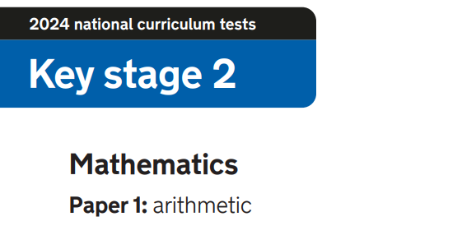
2024 key stage 2 mathematics Paper 1: arithmetic (publishing.service.gov.uk)

Slide 10
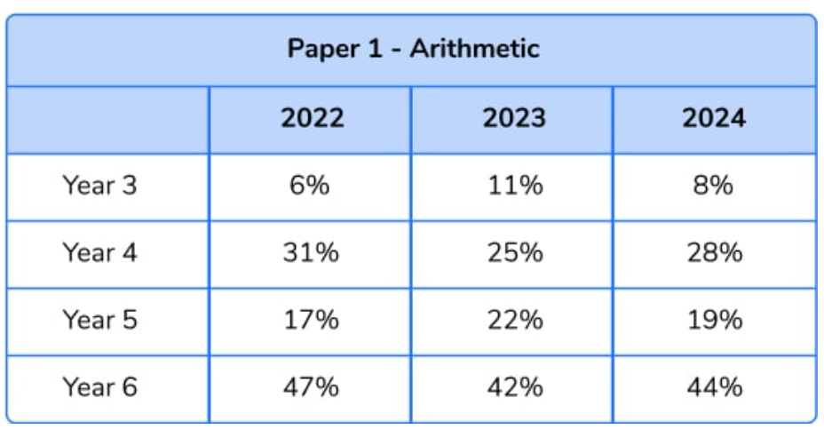
Arithmetic paper (36Qs)
KS2 SATs 2024: Maths Papers Question Breakdown (thirdspacelearning.com)

Slide 11
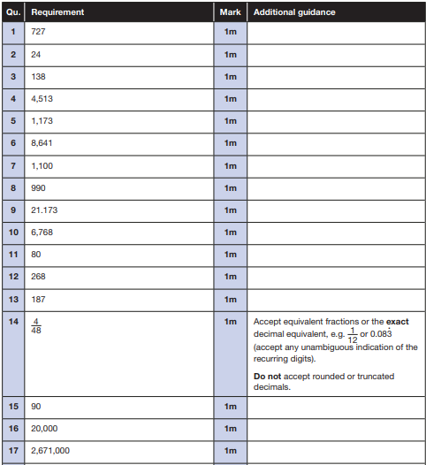
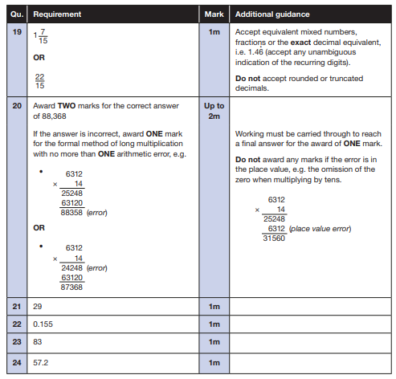

Slide 12
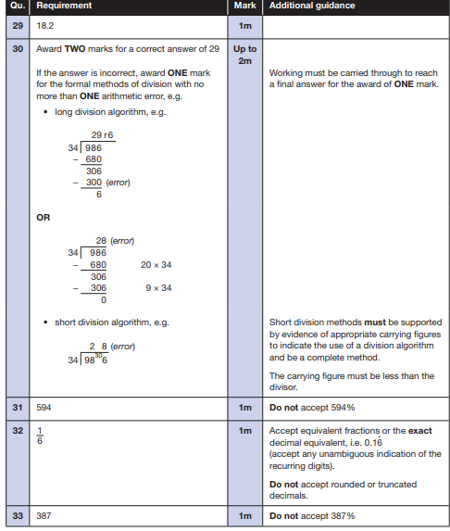
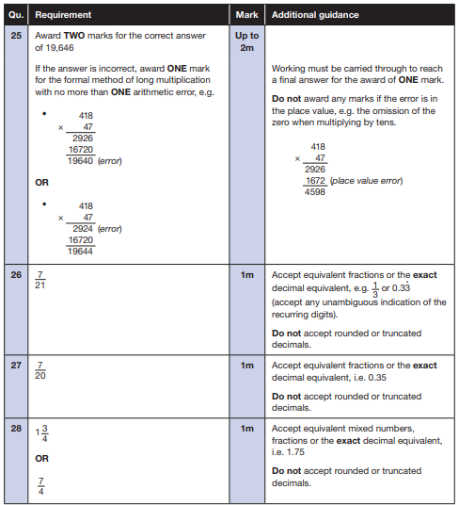

Slide 13
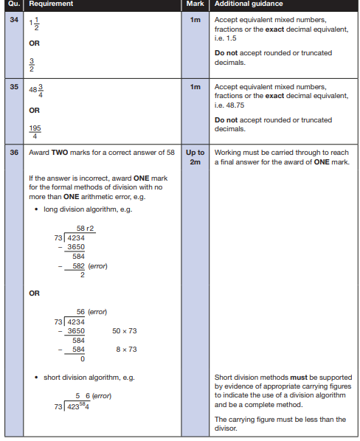

Slide 14
Key Stage 2 Arithmetic Paper 2024 Q1- 18
2024 key stage 2 mathematics Paper 1: arithmetic (publishing.service.gov.uk)

Slide 15
Key Stage 2 Arithmetic Paper 2024 Q19- 36
2024 key stage 2 mathematics Paper 1: arithmetic (publishing.service.gov.uk)

Slide 16
Key Stage 2 Arithmetic Paper 2024 Addition and Subtraction
2024 key stage 2 mathematics Paper 1: arithmetic (publishing.service.gov.uk)

Slide 17
Key Stage 2 Arithmetic Paper 2024 Multiplication and Division
2024 key stage 2 mathematics Paper 1: arithmetic (publishing.service.gov.uk)

Slide 18
Key Stage 2 Arithmetic Paper 2024 Fractions, Decimals and Percentages
2024 key stage 2 mathematics Paper 1: arithmetic (publishing.service.gov.uk)

Slide 19
Key Stage 2 Arithmetic Paper 2024 Year 3 and Year 4 Questions
2024 key stage 2 mathematics Paper 1: arithmetic (publishing.service.gov.uk)

Slide 20
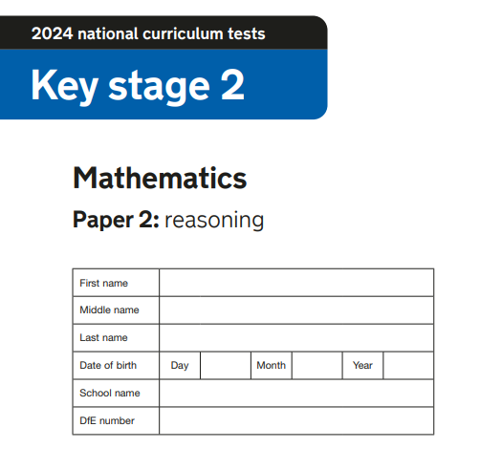
2024 key stage 2 mathematics Paper 2: reasoning (publishing.service.gov.uk)

Slide 21
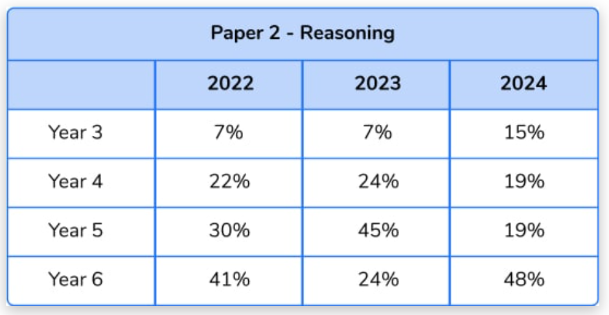
KS2 SATs 2024: Maths Papers Question Breakdown (thirdspacelearning.com)
2024 key stage 2 mathematics test mark schemes Paper 1: arithmetic, Paper 2: reasoning and Paper 3: reasoning (publishing.service.gov.uk)

Slide 22
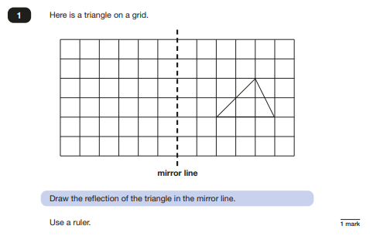
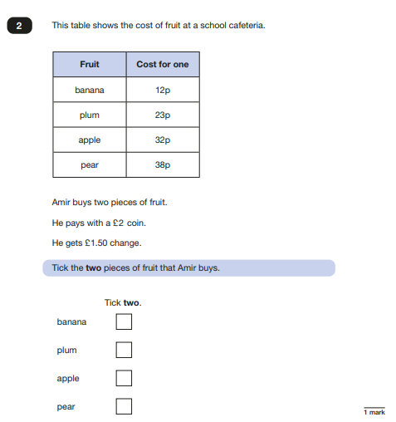
2024 Key Stage 2: Paper 2 Reasoning

Slide 23
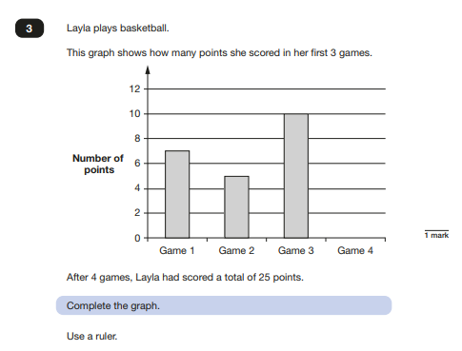
2024 Key Stage 2: Paper 2 Reasoning

Slide 24
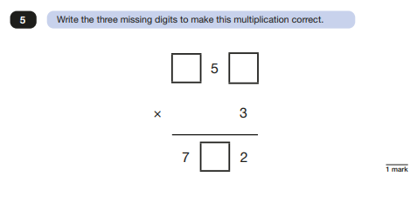
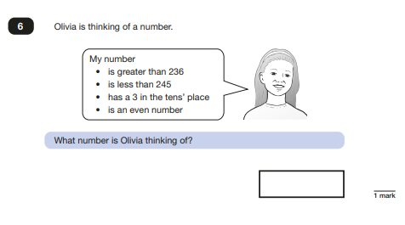
2024 Key Stage 2: Paper 2 Reasoning

Slide 25
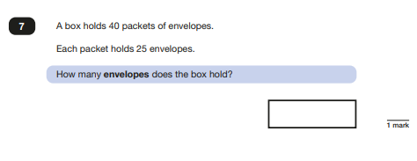
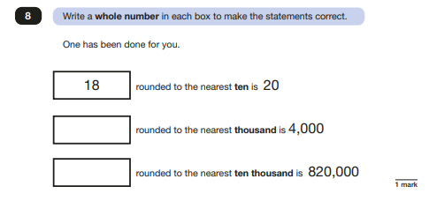
2024 Key Stage 2: Paper 2 Reasoning

Slide 26
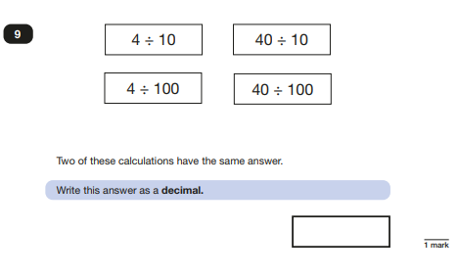
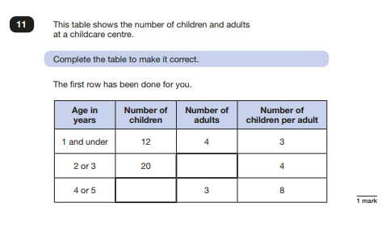
2024 Key Stage 2: Paper 2 Reasoning

Slide 27
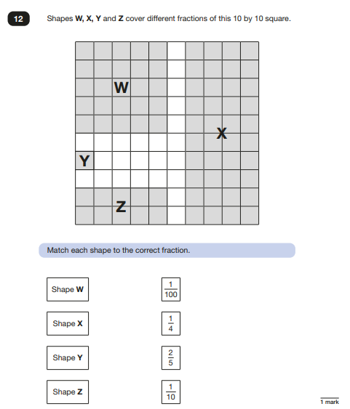
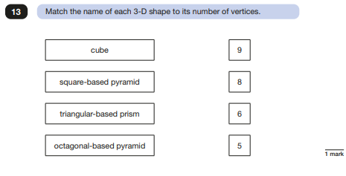
2024 Key Stage 2: Paper 2 Reasoning

Slide 28
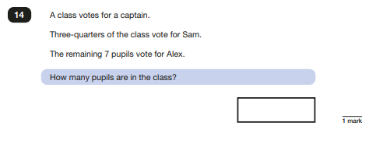
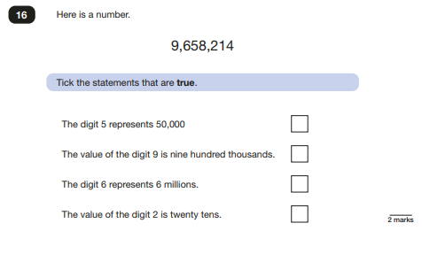
2024 Key Stage 2: Paper 2 Reasoning

Slide 29
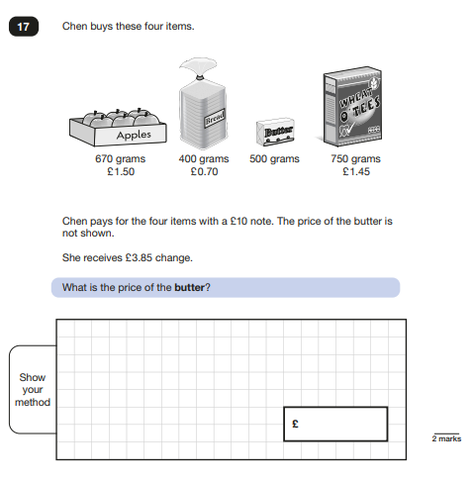
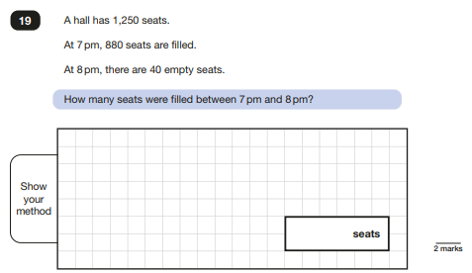
2024 Key Stage 2: Paper 2 Reasoning

Slide 30
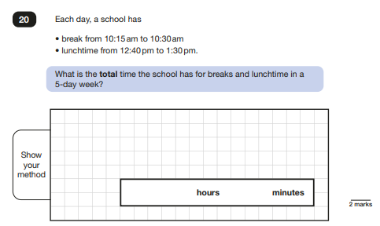
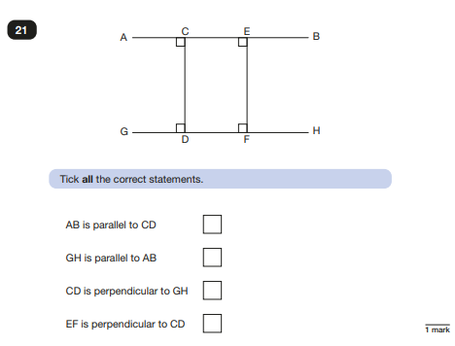
2024 Key Stage 2: Paper 2 Reasoning

Slide 31
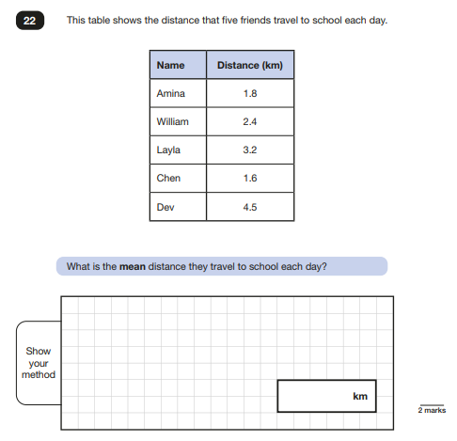
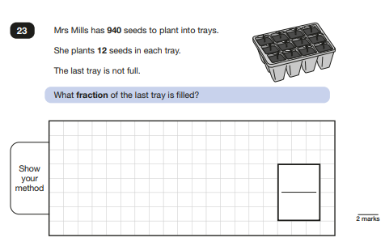
2024 Key Stage 2: Paper 2 Reasoning

Slide 32
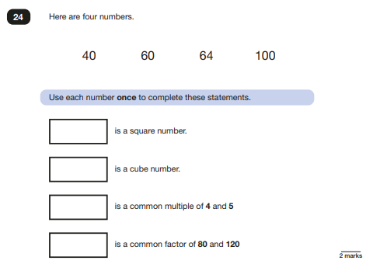
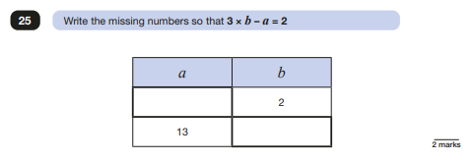
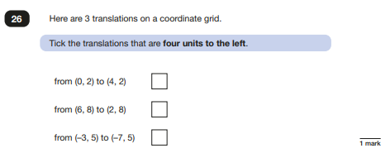
2024 Key Stage 2: Paper 2 Reasoning

Slide 33
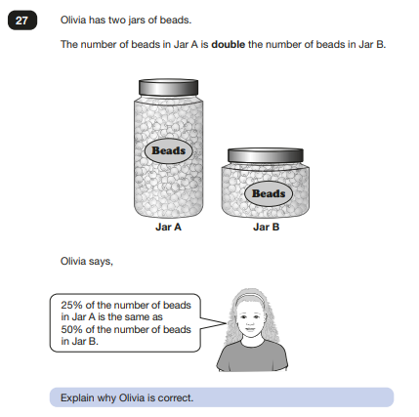
2024 Key Stage 2: Paper 2 Reasoning

Slide 34
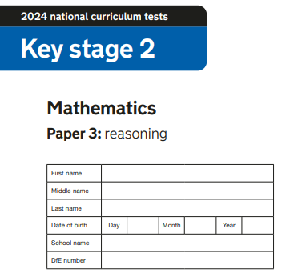
2024 key stage 2 mathematics Paper 3: reasoning (publishing.service.gov.uk)

Slide 35
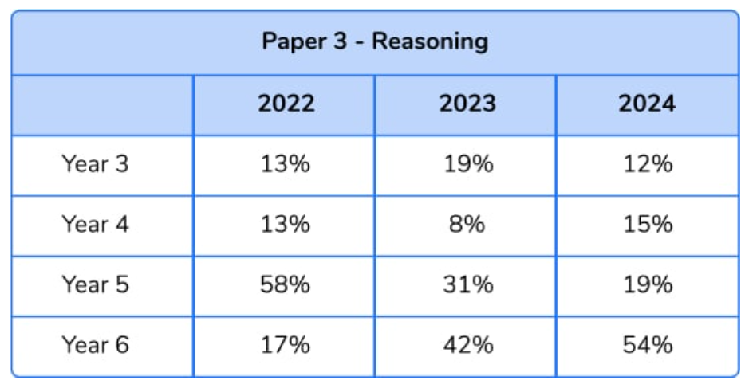
KS2 SATs 2024: Maths Papers Question Breakdown (thirdspacelearning.com)
2024 key stage 2 mathematics test mark schemes Paper 1: arithmetic, Paper 2: reasoning and Paper 3: reasoning (publishing.service.gov.uk)

Slide 36
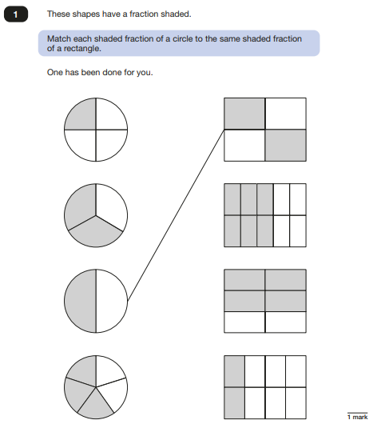
2024 Key Stage 2: Paper 3 Reasoning

Slide 37
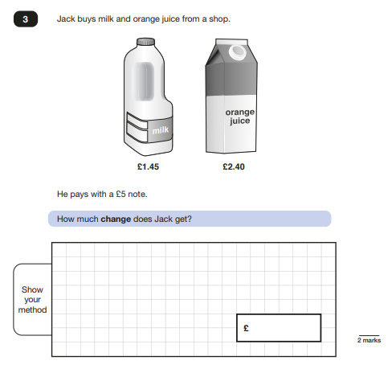
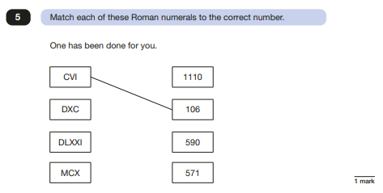
2024 Key Stage 2: Paper 3 Reasoning

Slide 38
2024 Key Stage 2: Paper 3 Reasoning

Slide 39
2024 Key Stage 2: Paper 3 Reasoning

Slide 40
2024 Key Stage 2: Paper 3 Reasoning

Slide 41
2024 Key Stage 2: Paper 3 Reasoning

Slide 42
2024 Key Stage 2: Paper 3 Reasoning

Slide 43
2024 Key Stage 2: Paper 3 Reasoning

Slide 44
2024 Key Stage 2: Paper 3 Reasoning

Slide 45
2024 Key Stage 2: Paper 3 Reasoning

Slide 46
2024 Key Stage 2: Paper 3 Reasoning

